Slide 1



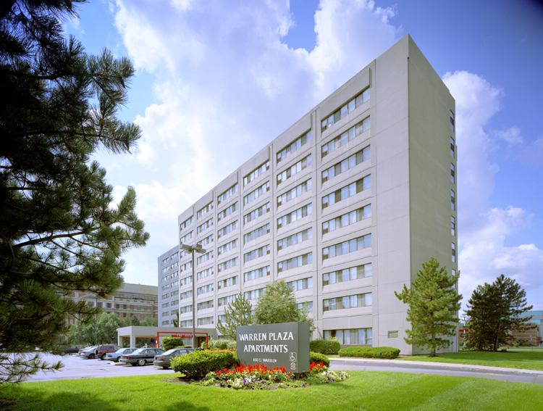
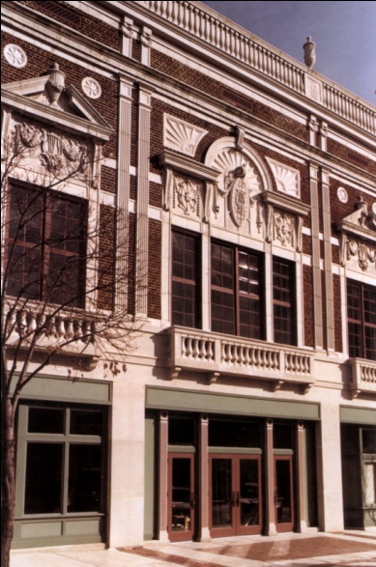
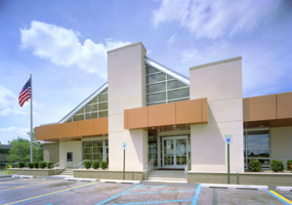
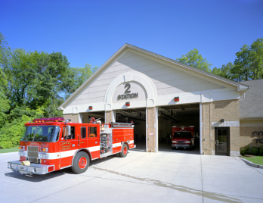
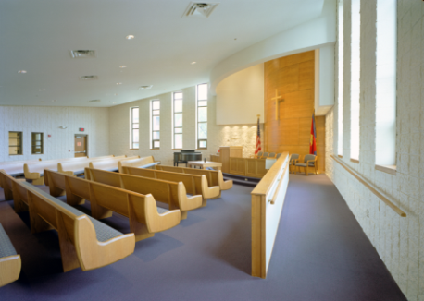
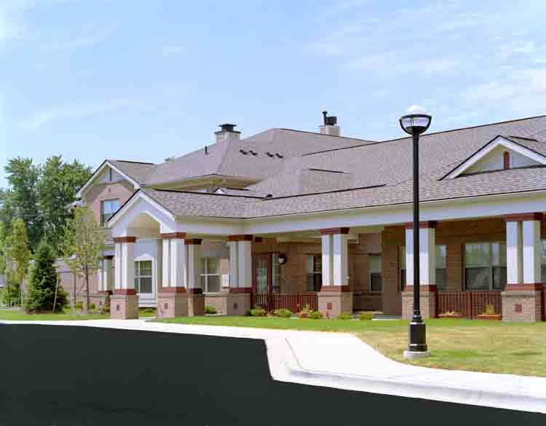
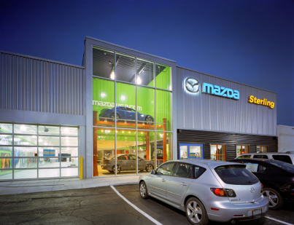
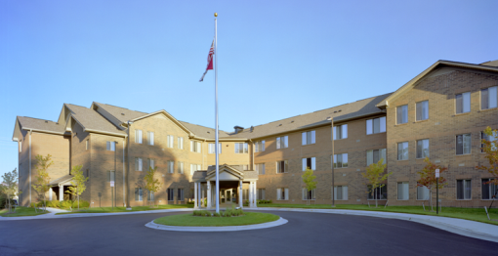
Great Lakes Capital Fund

Slide 2

Agenda
Fun Stuff
Energy Efficiency Case Studies
Energy Conservation – Is it Free?
Attendee Participation
Funding Sources

Slide 3
Fun Stuff
True or False
Building envelope refers to large FedEx mailing pouch
Fluorescent lights are all about the same cost
If natural gas prices are low, is it wise to have the most energy efficient available?

Slide 4
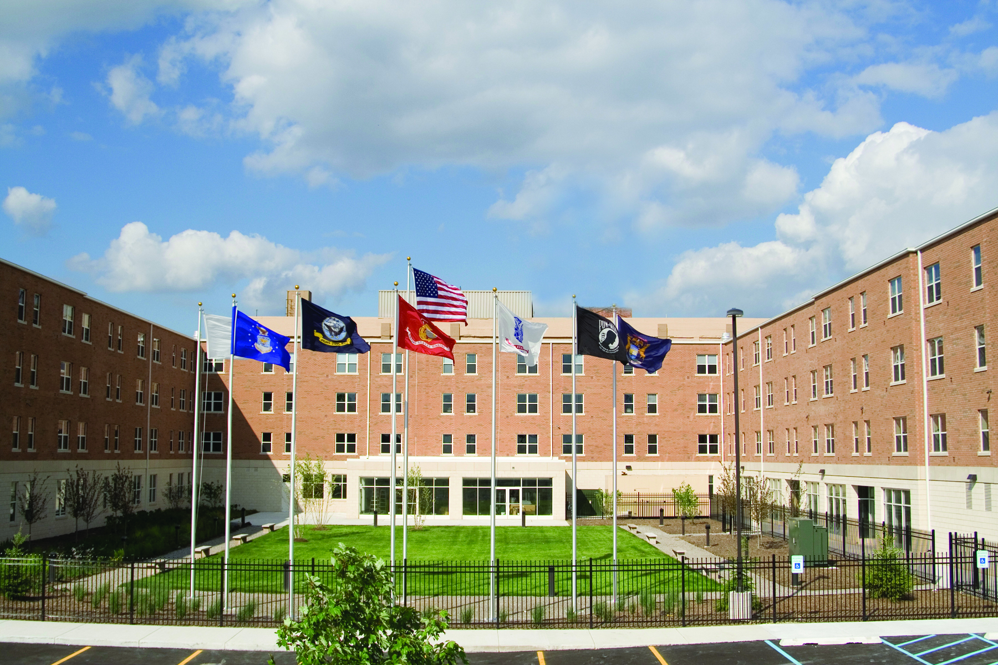
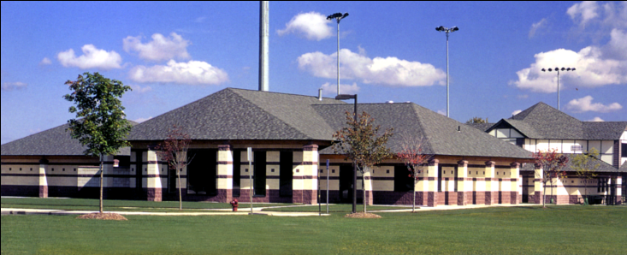
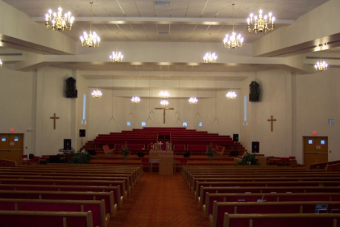
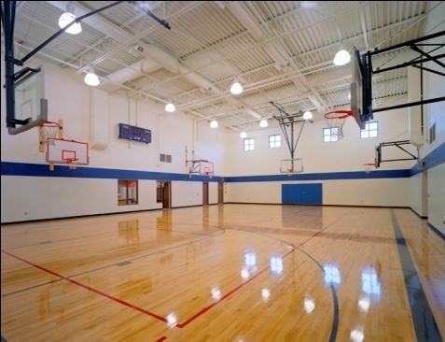
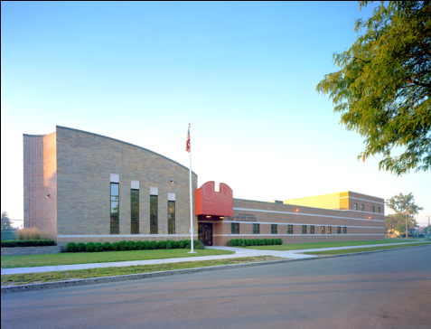
EXPERIENCE VARIOUS PROJECTS
Piquette Square VA
- Architect: John H. Donolan
Drake Park Community Center
- Architect: Fusco, Shaffer & Pappas, Inc.
Salvation Army Temple Corps Bldg.
- Architect: Ehresman Associates, Inc.
Antioch Baptist Church, Phase I
- Architect: Micuda Associates, Inc.
Antioch Baptist Church, Phase II
- Architect: Fusco, Shaffer & Pappas, Inc.

Slide 5
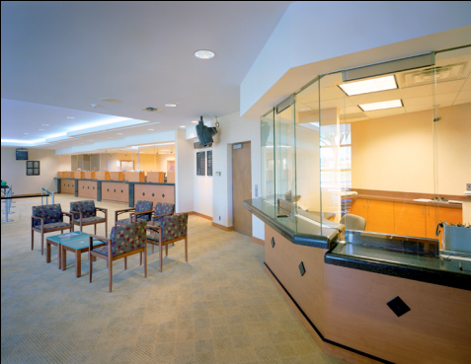
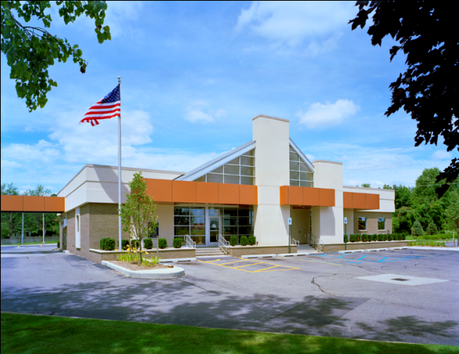
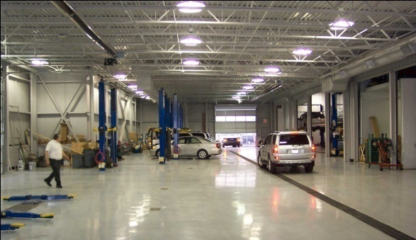
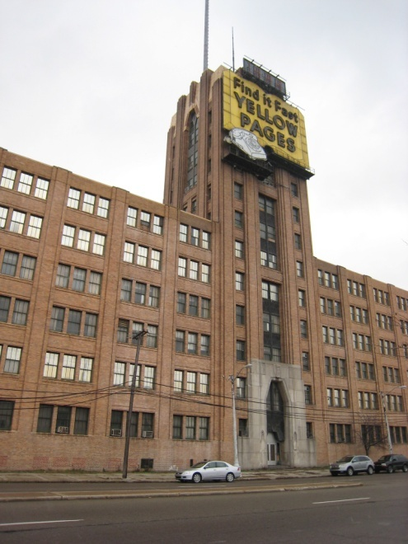
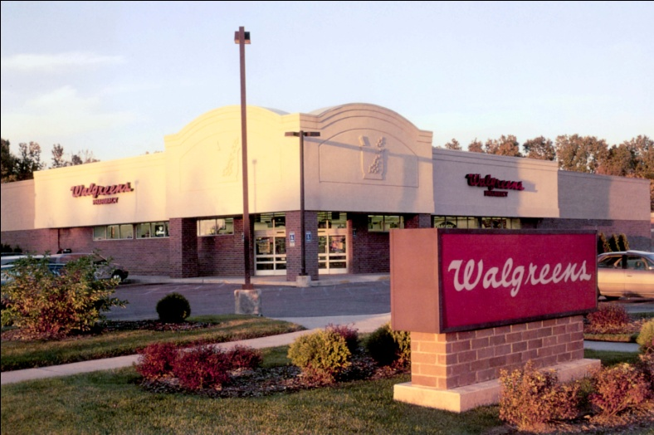
EXPERIENCE VARIOUS PROJECTS
Oakland University Credit Union
- Architect: Fusco, Shaffer & Pappas, Inc.
Michigan Bell Building
- Architect: Fusco, Shaffer & Pappas, Inc
Red Holman GMC
- Architect: L & A Architects, Inc.
Walgreens
- Architect: Seigfreid, Edwards & Asso.

Slide 6
Energy Efficiency and conservation

Slide 7


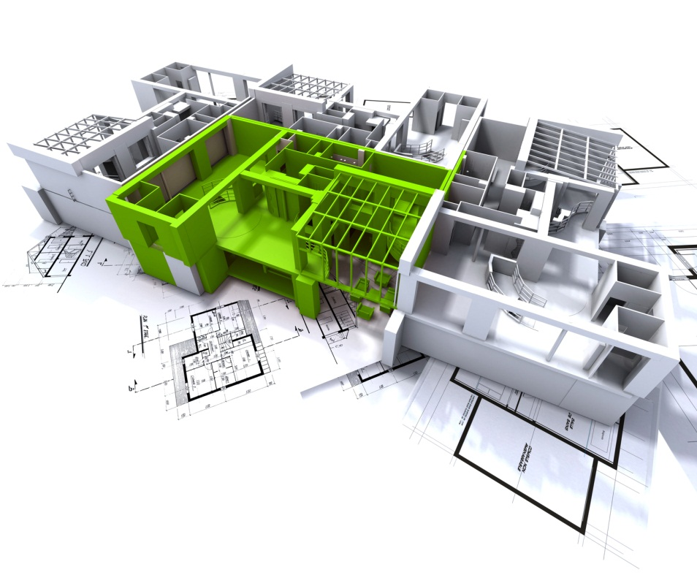
Saving Energy
O’Brien Energy Solutions
Comfort for People
Maintenance and Energy Cost Reductions
Go Green! Save Green$

Slide 8

Return on Investment
National average internal rate of return on energy efficiency products is 21.2%
Two to Three Year Project Payback on Lighting Projects
Renewable energy technologies also return, but at lower levels
How much energy and money would you like to save?
Combine fast payback projects with ones of longer duration

Slide 9
($98,268 Cost - $27,491 DTE Incentive)

Slide 10
O’Brien Construction Headquarters
Energy Efficiency Systems and features
Geothermal Heating and Cooling
Water Cooled Variable Refrigerant Volume (VRV) System
Energy Recovery Units
Dual use Hot Water Heater
Skylights
Wall floor and roof insulation and building sealers
LED interior and exterior lighting
Windows - thermally broken aluminum frames
Window glass is low-E argon filled.
Recycled 95% of the construction debris
500 gallon underground storage tank
Polished concrete floors
Low flow water devices
Motion sensors to control lighting
Temperature control by zone
Balanced construction costs versus energy efficiency. We obtained excellent value for our energy dollars.
Recharging Station for electric vehicles

Slide 11
Corporate Energy Goals
Reduce energy costs while maintaining a good environment for employees
Minimize effect on maintenance costs
Utilize alternative energy power sources
Use energy as a learning tool
Leadership in Energy and Environmental Design (LEED)
Decide what fits best with the overall mission of the organization.
Facilities energy usage should dovetail with the other departments functions.

Slide 12
Energy Management Strategy
Utility Rates and Monitoring Bills
Commissioning Maintenance Training
Top Management Support
Strategic Plan Implementation
Purchasing
Finance
Technology
People

Slide 13
SELECTING O’BRIEN CONSTRUCTION and Energy solutions
Finding Money to Fund Your Projects
Great Lakes Capital Fund
Utility Company Incentives about 25%
Michigan Saves Loans
Tax Deductions
Positive Cash Flow

Slide 14
O’BRIEN CONSTRUCTION Company and O’Brien Energy solutions
WE WANT TO BE YOUR PARTNER IN BUILDING THIS COMMUNITY!
O’Brien Energy Solutions - your strategic energy partner
Energy management is more than just a passing fad
It takes continuing effort to maintain energy savings
A sustainable facilities plan reduces overall facilities costs

Slide 15
Q & A Discussion
Thank you for Participating

Slide 16
Extra Slides

Slide 17
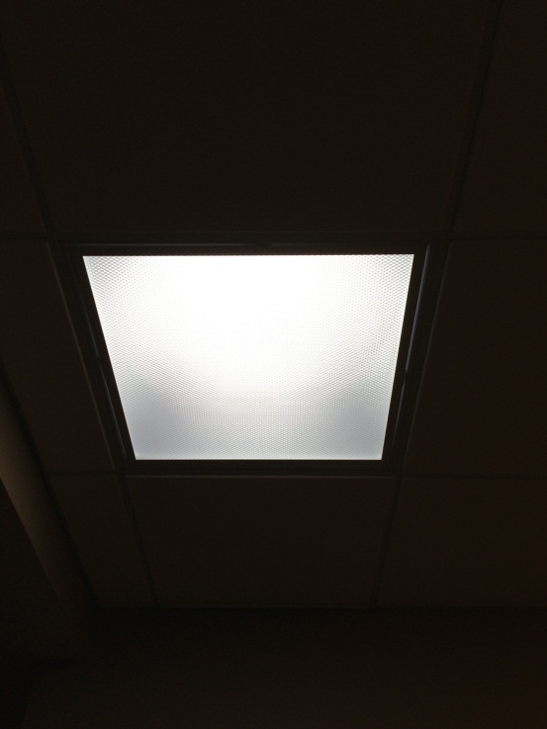
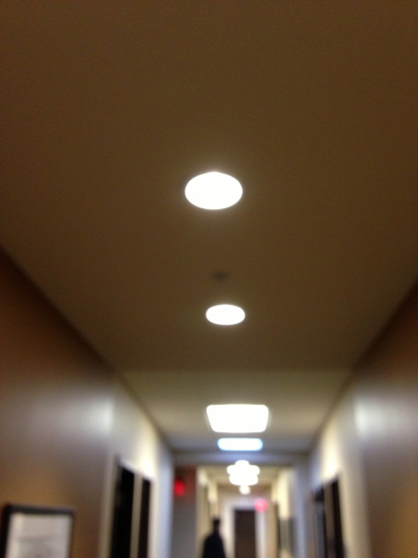
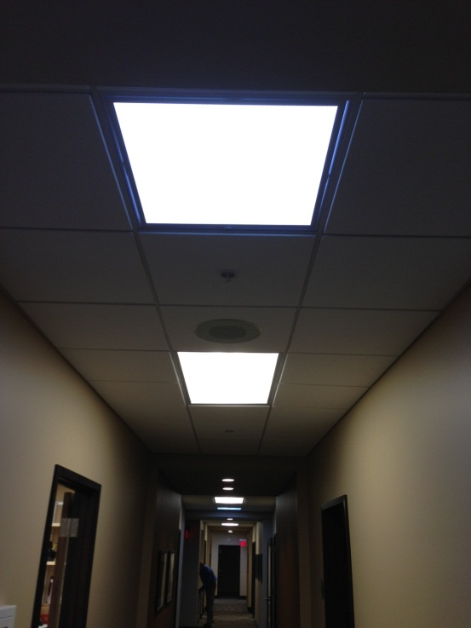
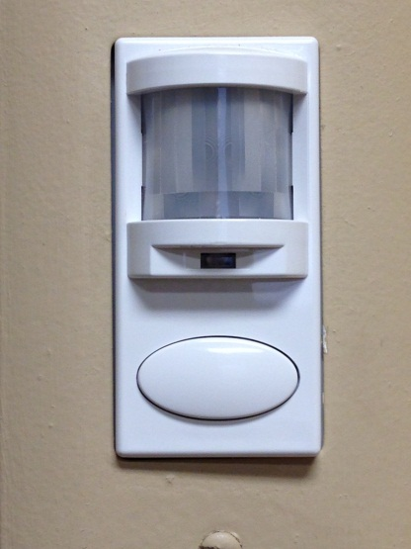
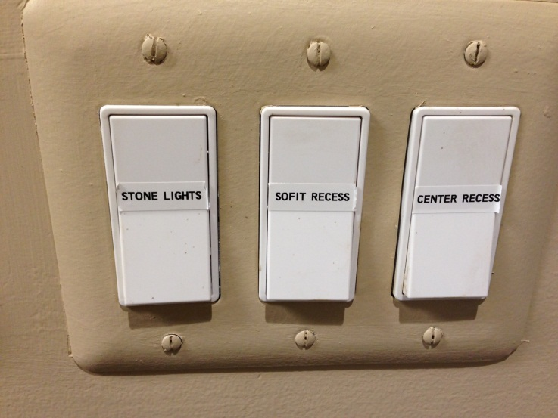
Skylight
2x2 Skylight
2x4 Fluorescent Fixture
LED Corridor Lighting
Light Switch Labels
Occupancy Sensor

Slide 18
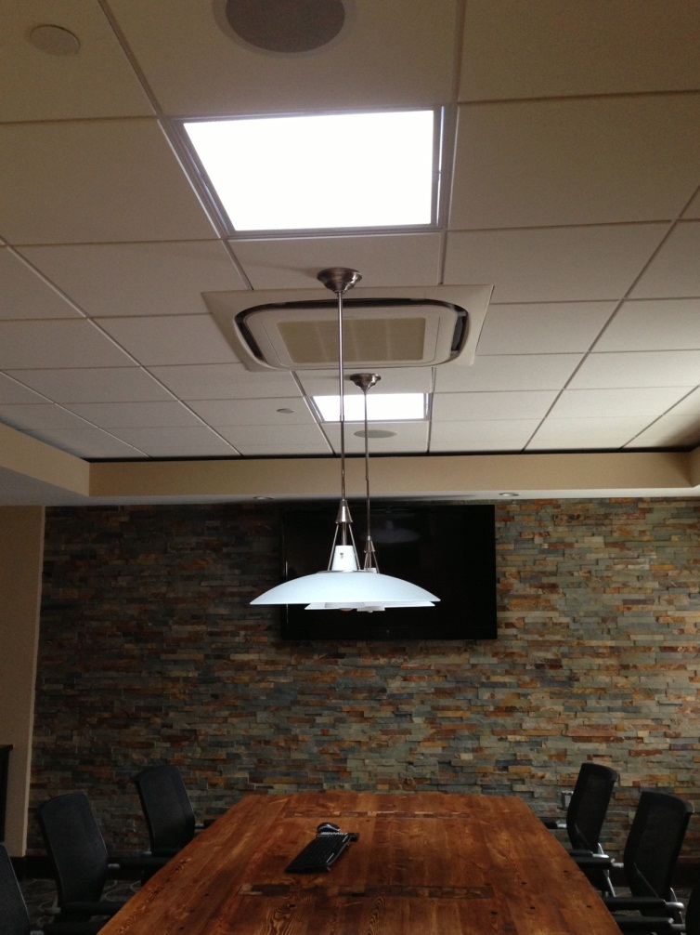
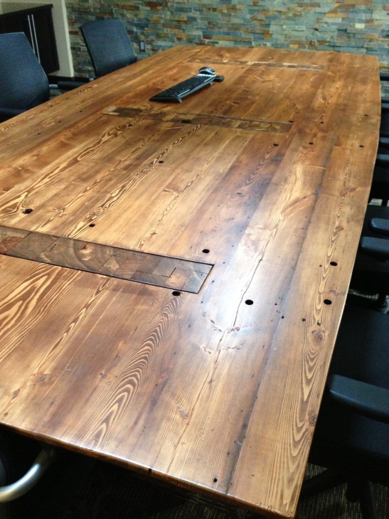
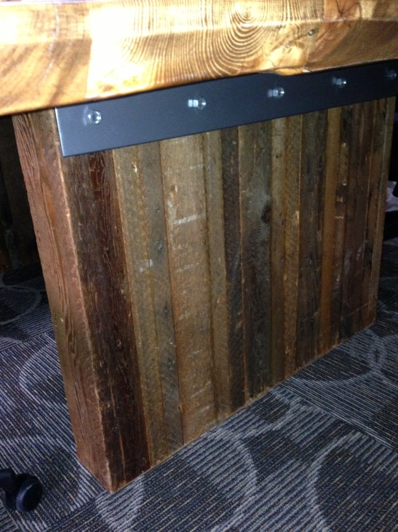
O’Brien Construction Company Conference Room
Skylights, LED Chandelier,
Recycled Wood Table
Recycled Wood Top
Recycled Wood Legs

Slide 19
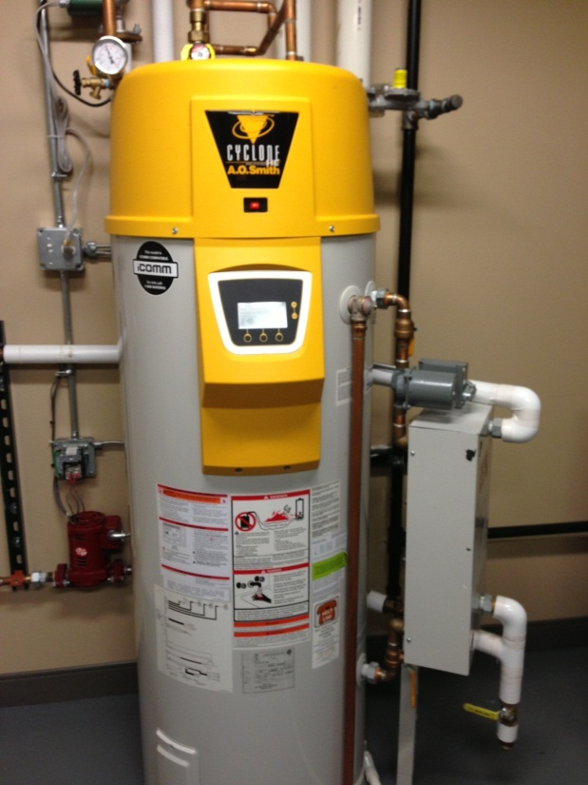
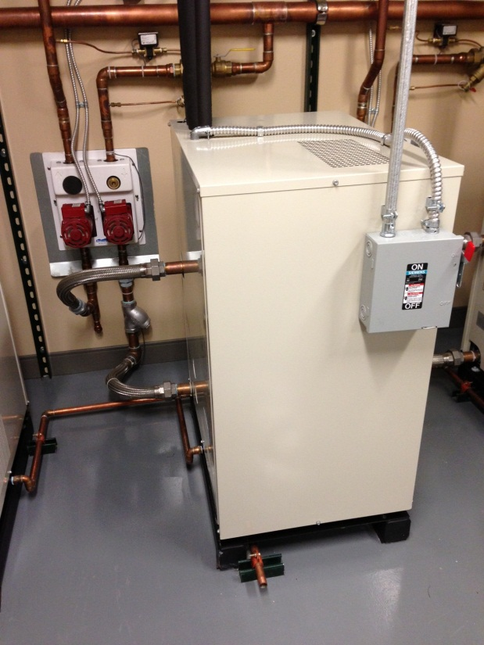
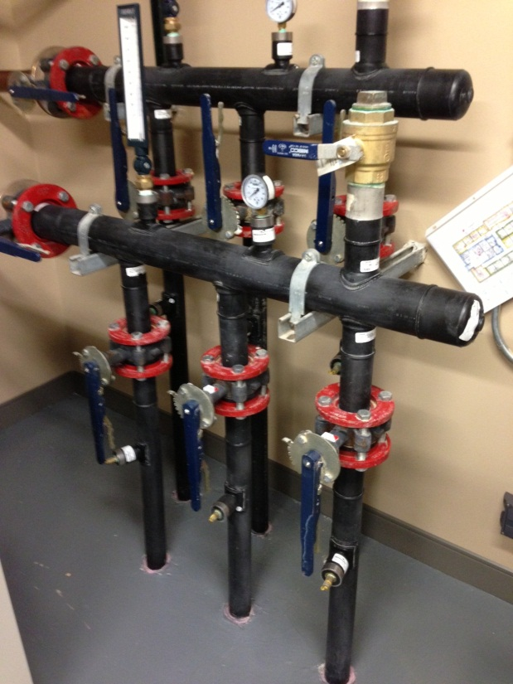
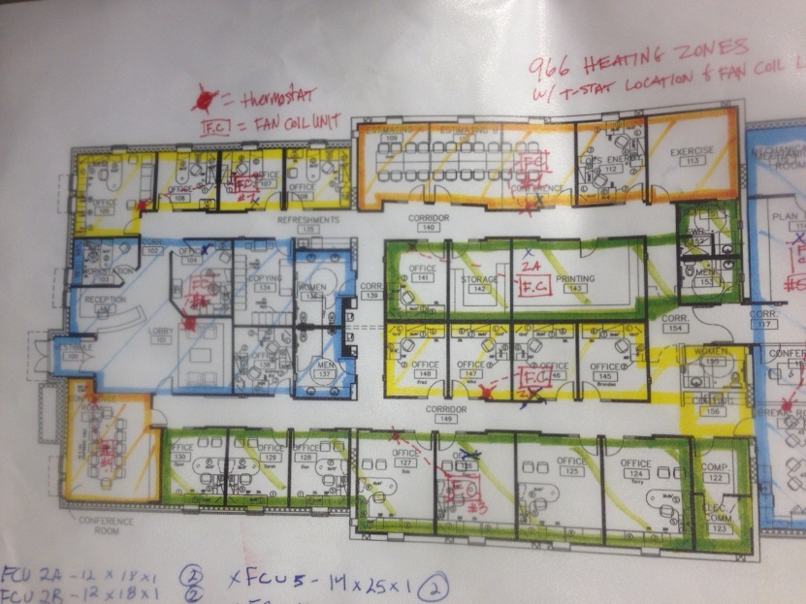
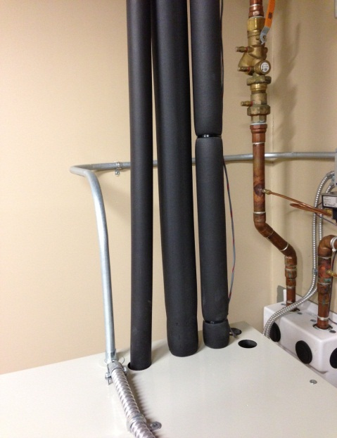
Dual Purpose Water Heater
Domestic and Aux Bldg Heat
Geothermal Heat Pump
Geothermal Lines to Wells
Variable Refrigerant
Volume HVAC
HVAC Zone Layout

Slide 20
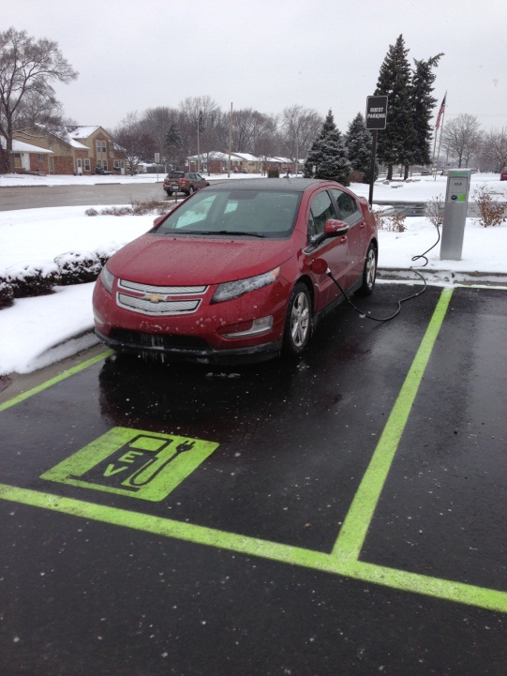
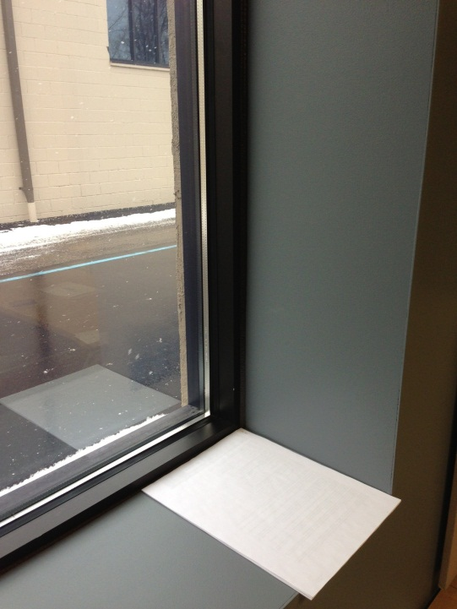
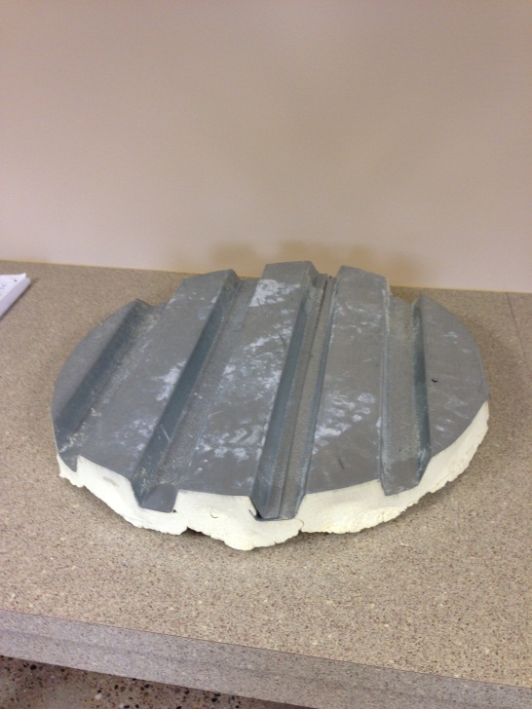
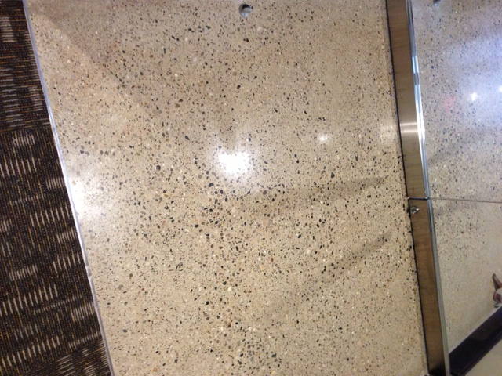
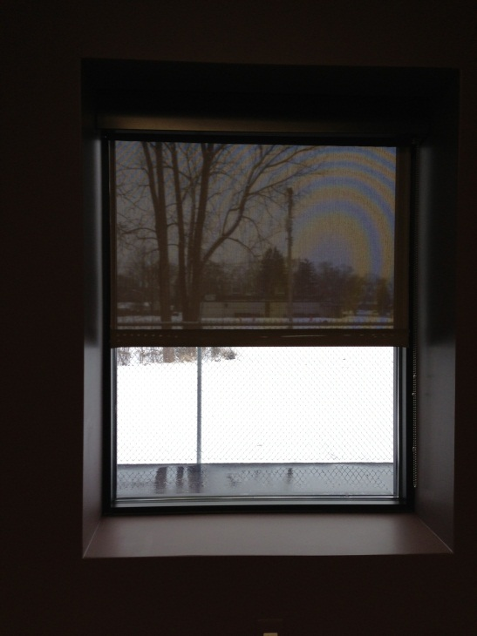
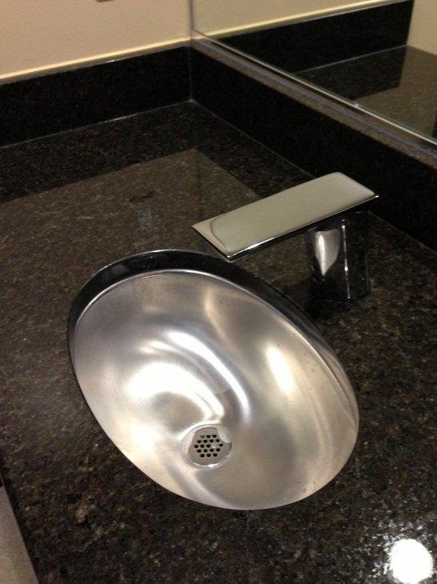
Electric Vehicle Charging
Extra Insulation
Roof Deck Foam Insulation
Small Sink and
Auto Control Faucet
Polished Concrete Floor
Window Shade

Slide 21
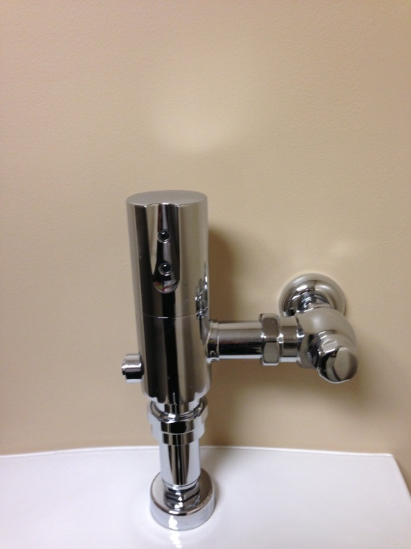
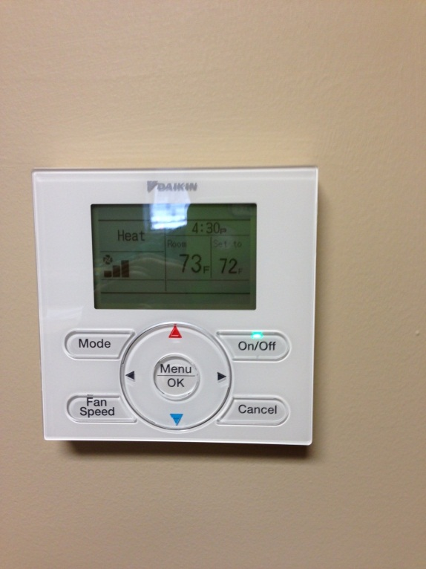
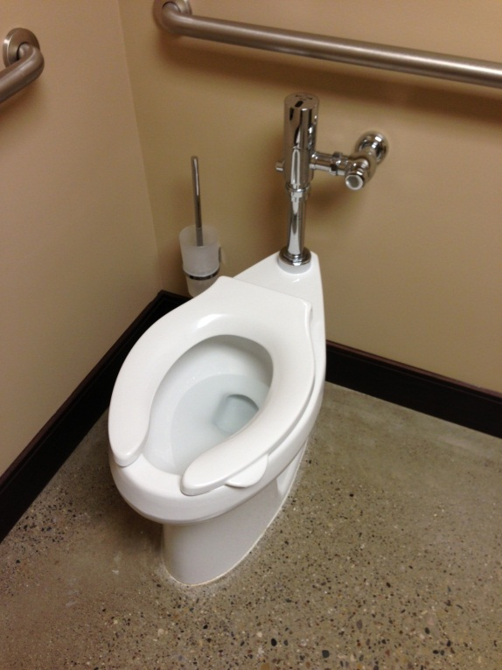
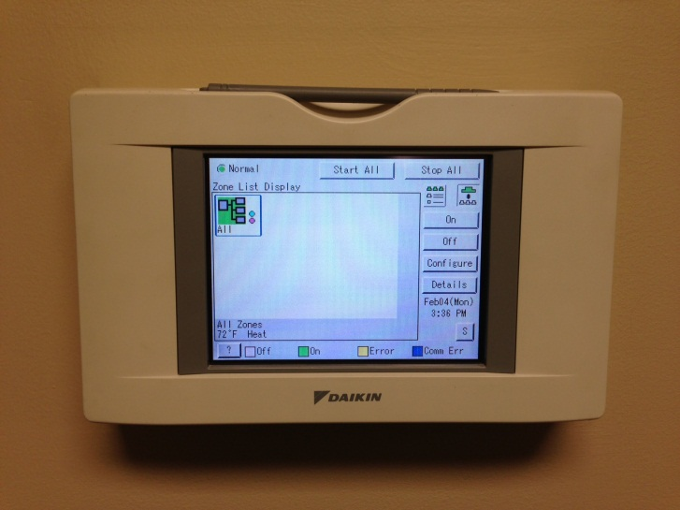
Autoflush Toilet
Note Cleaning Brush
Auto Flush Valve
Office HVAC Control
HVAC Master Control Panel

Slide 22
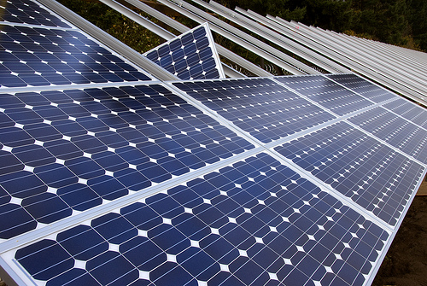
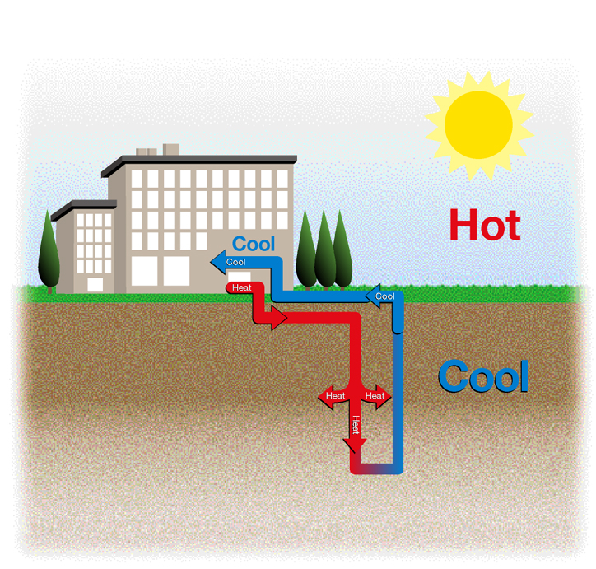
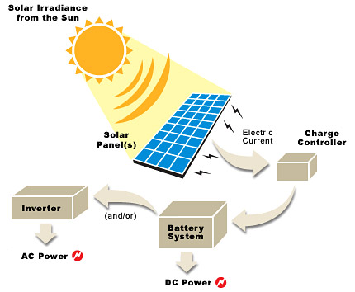
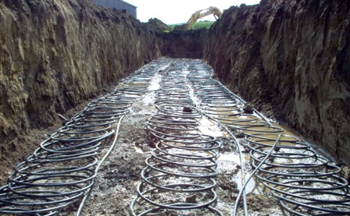

Slide 23
Managing Energy After Initial Projects are Complete
Track utility usage and costs monthly
Identify grants, subsidies, incentives for efficiency and renewable deployment
Institute Sustainable Building Strategy
Review of automated building functions quarterly
Ensure HVAC and lighting system commissioning is complete and perform additional training for managers, maintenance staff and building occupants
Engage people using the offices , classrooms and residential halls to save energy

Slide 24

Building Automation System
Control Functions
HVAC Controls and Remote Programming
Lighting Controls
Security System Integration
Energy usage monitoring

Slide 25
Energy Audit Summary
Decision matrix for Building Manager
Comprehensive Energy Analysis
Systems are interrelated
Sustainable site and operations
Capital Budget
Consider water, transportation and landscaping

Slide 26
About O’Brien Construction
O’Brien Construction’s and Energy Solutions Mission Statement
The Mission of O’Brien Construction and Energy Solutions is to develop lasting relationships based on mutual trust and respect. The initiatives we use in creating our relationships will be guided by the following principles.
♦ Our Clients Are The Focus Of Everything We Do.
♦ Employee Involvement Is Our Way Of Life.
♦ Continuous Quality Improvement Is Essential To Our Success.
♦ Subcontractors And Suppliers Are Our Partners.
♦ Integrity Is Never Compromised.

