Slide 1
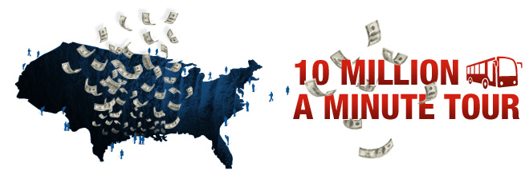
TBD TITLE SLIDE
The Economy, Jobs, and Fiscal Responsibility
From Main Street to Wall Street to Washington
September 7th – October 9th

Slide 2

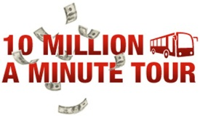
The Federal Government
has Grown Dramatically
1912
Federal Spending
$16 Billion in 2012 Dollars
Source: Historical Statistics of the United States, Millennial Edition On Line, Cambridge 2006; Congressional Budget Office, Long-Term Budget Outlook, June 2012. Compiled by TCAII

Slide 3
We’ve Lost Control of the Budget
Source: Historical Statistics of the United States, Millennial Edition On Line, Table Ea636–643 Federal government expenditure, by major function: 1789–1970. Congressional Budget Office, Historical Tables. Compiled by TCAII.
Notes:
2133% increase in mandatory control of budget. Our budget is out of control.

Slide 4
Where the Money Goes
Notes:
Explanation of how our government spends its money.

Slide 5
Federal Spending
and Revenue Trends

Slide 6
Federal Debt Levels

Slide 7
Federal Financial Sink Hole

Slide 8
Comparative Government
Debt Burdens

Slide 9
The Federal Public Debt

Slide 10
Our Fiscal Future

Slide 11
Social Insurance Cash Flows

Slide 12
Social Insurance
Payments vs. Benefits

Slide 13
Comparative Health Care Costs

Slide 14
Relative Defense Spending
Source: SIPRI Military Expenditure Database, Military Expenditure by Country, In Constant (2010) US$ millions. Compiled by TCAII.

Slide 15
Comparative Tax Burden 2012

Slide 16
Select Individual Tax Expenditures
(2010-2014)

Slide 17
Effective Federal Income Tax Rates

Slide 18
The Year End Fiscal Cliff
 | 2013 | 2013-2022
2001/2003/2010 Tax Cuts | $110 Billion | $2.8 Trillion
Alternative Minimum Tax Patches | $125 Billion | $1.7 Trillion
Jobs Measures | $115 Billion | $150 Billion
Medicare Physician Payments | $10 Billion | $150 Billion
Budget Control Act Sequester | $65 Billion | $980 Billion
"Tax Extenders" | $30 Billion | $455 Billion
Health Care Reform Taxes | $25 Billion | $420 Billion
Net Interest | N/A | $1.2 Trillion
Total (Without Jobs Measures) | ~$400 Billion | $7.9 Trillion
Total (With Jobs Measures) | ~$500 Billion | $8.1 Trillion

Slide 19

Taxpayer’s Burden by State 2010
(Thousands of Dollars)
Alaska
Wyoming
North Dakota
Utah
Nebraska
South Dakota
Montana
Iowa
Oregon
Tennessee
Arkansas
Idaho
Minnesota
Colorado
Florida
Arizona
Virginia
$21.2
$20.2
$9.5
$2.6
$2.4
$1.4
$0.3
$0.5
$0.9
$1.1
$1.7
$2.6
$2.6
$2.9
$2.9
$3.3
$3.6
Nevada
Missouri
Georgia
Indiana
Kansas
Texas
Wisconsin
Ohio
New Hampshire
Vermont
Washington
Pennsylvania
South Carolina
New Mexico
Oklahoma
Alabama
Louisiana
$3.7
$3.8
$3.9
$3.9
$4.6
$5.5
$5.7
$6.0
$8.2
$9.1
$9.8
$10.3
$10.5
$11.8
$12.6
$14.3
$14.7
North Carolina
Maine
Mississippi
Delaware
New York
Maryland
Rhode Island
West Virginia
Michigan
California
Massachusetts
Kentucky
Illinois
Hawaii
New Jersey
Connecticut
$14.8
$15.0
$15.7
$16.3
$17.2
$17.3
$18.8
$20.5
$20.8
$21.4
$23.2
$23.5
$31.6
$32.7
$35.8
$49.0
Source: 2010, Institute for Truth in Accounting. All information from State CAFRs
Numbers in red denote burden per taxpayer, Numbers in black denote a surplus per taxpayer

Slide 20

Protecting Their Future
1912

Slide 21
6 Key Principles for Reform
Pro Growth
Socially Equitable
Culturally Acceptable
Mathematically Accurate
Politically Feasible
Bipartisan Support

Slide 22
Areas of Reforms
Budgeting
Social Security
Health Care
Medicare & Medicaid
Defense
Taxes
Other
Political

Slide 23
Budgeting
No Budget, No Pay
Recapture Control over the Budget
Reform Federal Budget Controls
(Pay-Go Rules, Debt to GDP Targets)

Slide 24
Social Security
Raise The Taxable Wage Base Cap
Gradually Raise the Retirement Eligibility Ages
Revise Benefit Structure Based on Income
Supplemental Retirement Savings Account

Slide 25
Health Care
Basic Level of Health Coverage for all Citizens
Revise Payment Practices to be Evidence Based
Phase Out the Tax Exclusion for Employer Provided Health Insurance

Slide 26
Medicare & Medicaid
Impose an Annual Budget for Medicare & Medicaid Spending
Make Medicare Premiums Subsidies More
Needs Based
Rationalize Medicaid Minimum Standard

Slide 27
Defense
Require Cost Consideration in Defense Planning
Right-Size our Bases and Force Structure
Modernize Purchasing and Compensation Practices

Slide 28
Taxes
Reform Individual Federal Income Tax
Reform Corporate Federal Income Tax
Determine Income Level Where No Income Tax is Paid

Slide 29
Other
Develop a Strategic Framework for the Federal Government
Create Government Transformation Task Force

Slide 30
Political
Redistricting Reform
Integrated & Open Primaries
Campaign Finance Reform
Term Limits

Slide 31
Partner Organizations
Committee for a Responsible Federal Budget-www.crfb.org (www.FixtheDebt.org)
Committee for Economic Development - www.ced.org
Common Sense Coalition - www.thecommonsensecoalition.com
Concord Coalition - www.concordcoalition.org
No Labels - www.nolabels.org
Rebellious Truths - www.rebellioustruths.org
The Can Kicks Back - www.thecankicksback.org

Slide 32
What You Can Do
Educate yourself and others on the facts, tough choices and solutions (Participate in Live Online Town Hall on September 15 at www.KeepingAmericaGreat.org)
Use the “Serious 7: Serious Questions for Serious Candidates”
Make these issues the top priority on election day
Hold our elected officials accountable

