Slide 1


THETFORD GARDEN CENTRE LTD
IMPACT REPORT 2024

Slide 2
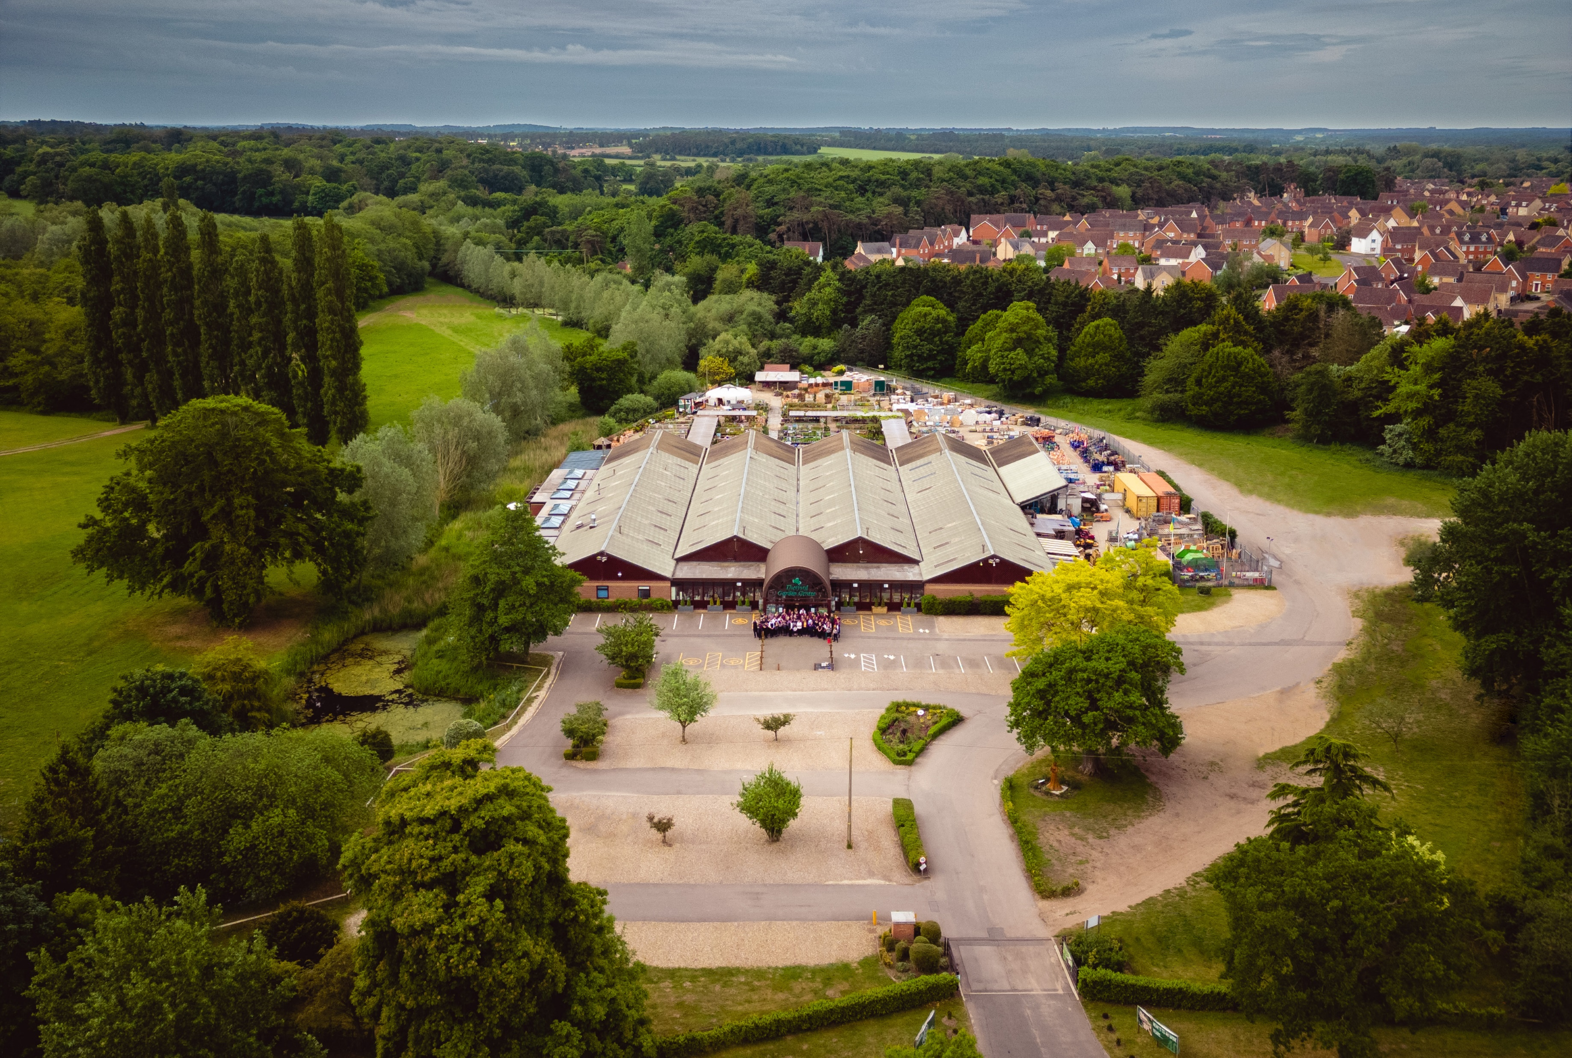
Add full page pic of Garden Centre

Slide 3
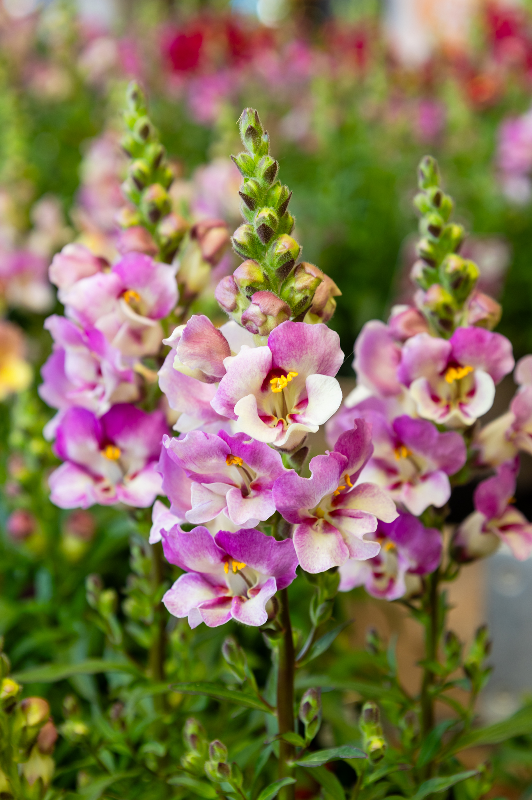
Contents
4. Our Mission
5. B Corp – What’s It All About?
6. Governance
7. Workers
8. Community
9. Environment
10. Customers
11. Our Business Carbon Footprint
12. The Future

Slide 4
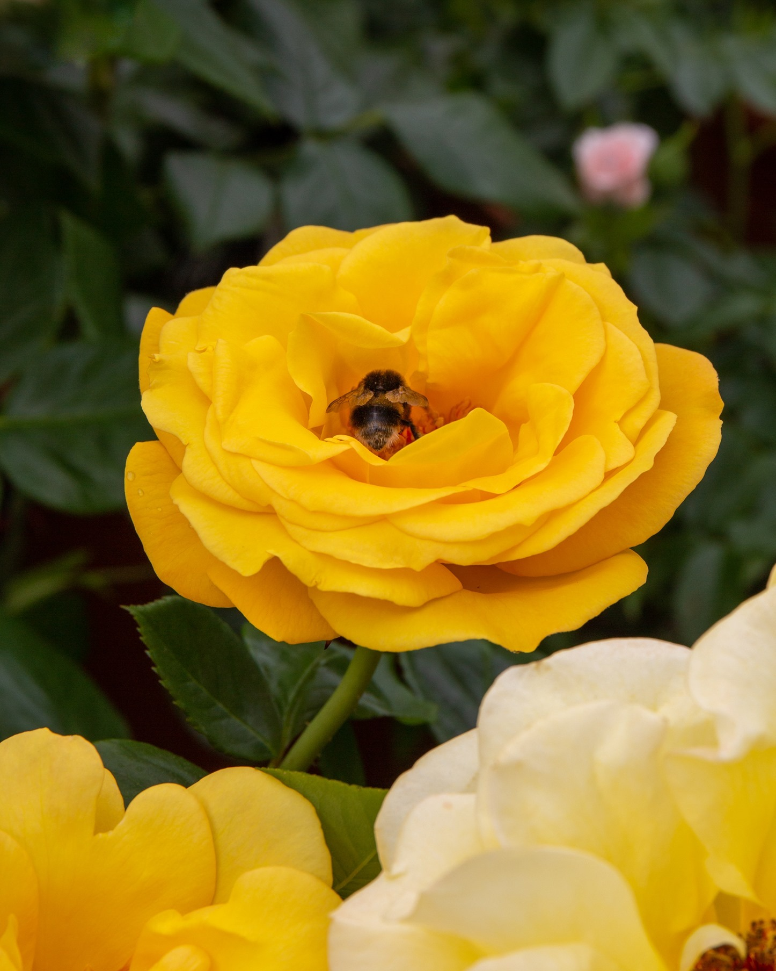
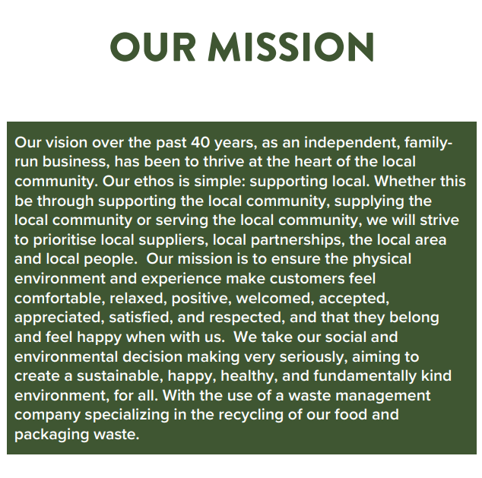

Slide 5

B Corp - What’s It All About?
Certified B Corporations, or B corps, are companies verified to meet high standards of social and environmental performance, transparency, and accountability.
From 2023-24, we, at Thetford Garden Centre worked hard on proving that we are a worthy company to display the B Corp logo with pride and join the other companies who are part of this amazing collective.
It wasn’t an easy ride. We proved that we are a part of the B Corp movement in making our store a better, safer and more sustainable place for our customers to shop, eat and spend time in.
Showing our B Corp Accreditation also means that we must continue to strive and improve each and every year to ensure a better place for people and planet.
Overall Score for 2024: 80.5

Slide 6

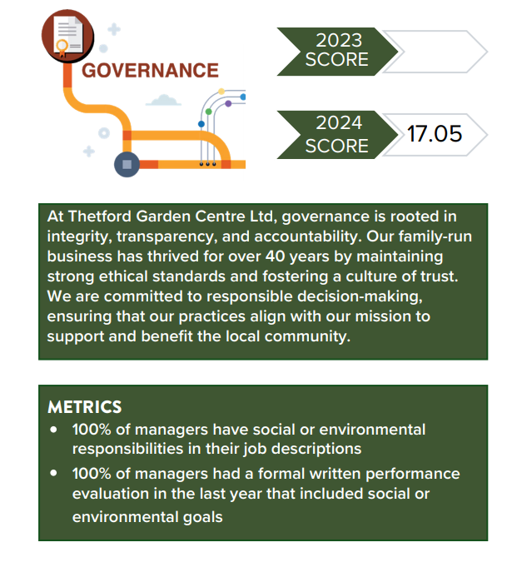
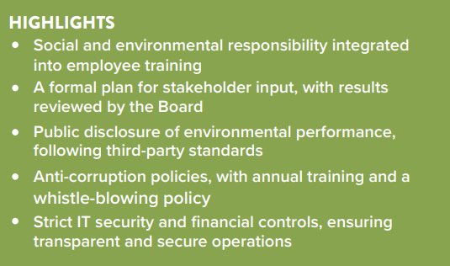
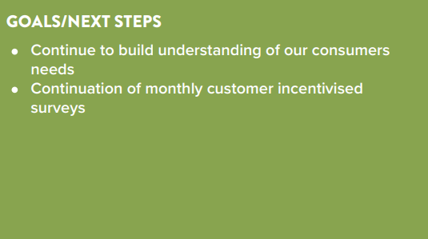
GOVERNANCE
17.0

Slide 7
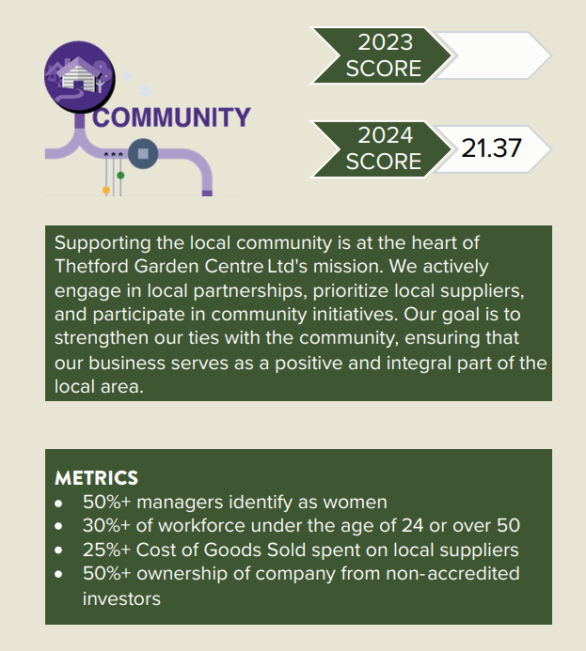
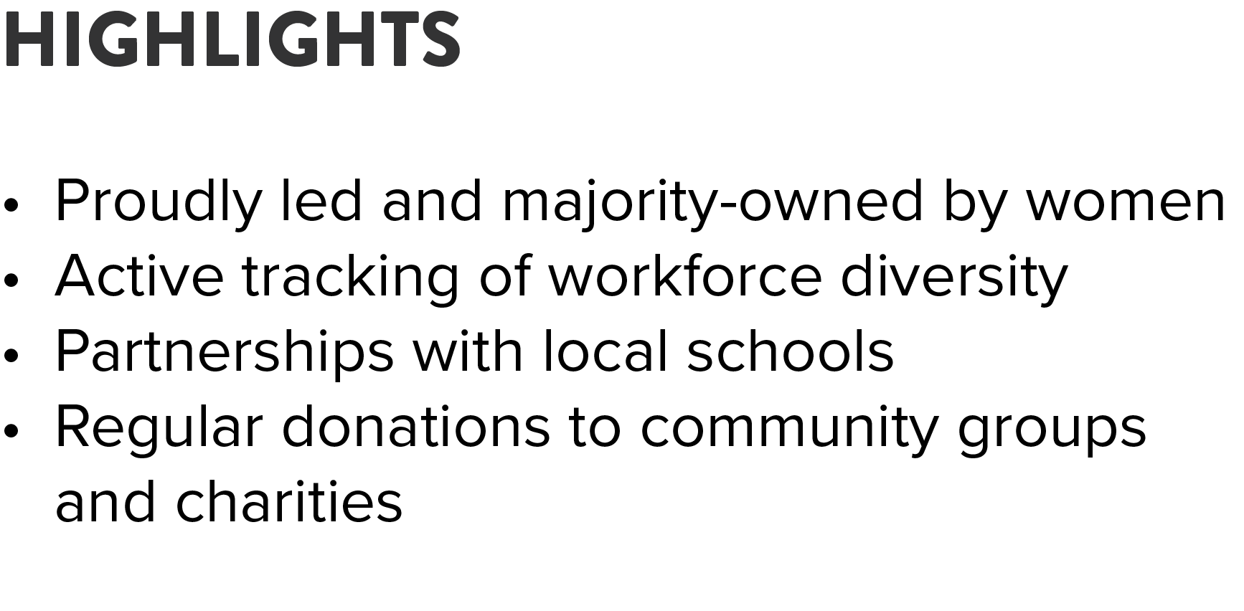
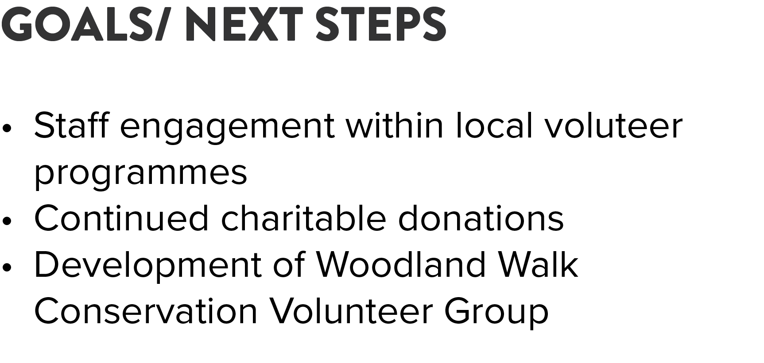
COMMUNITY
20.8

Slide 8
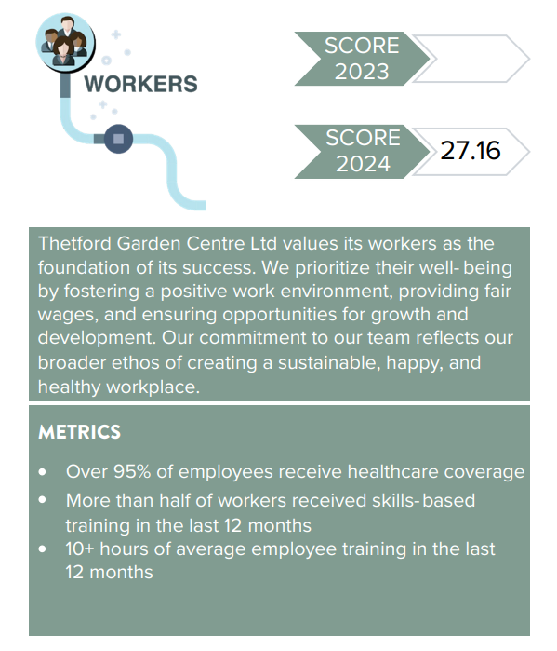


WORKERS
24.0
All team members received skills-based training in the last 12 months
10+ hours of average employee training in the last 12 months

Slide 9
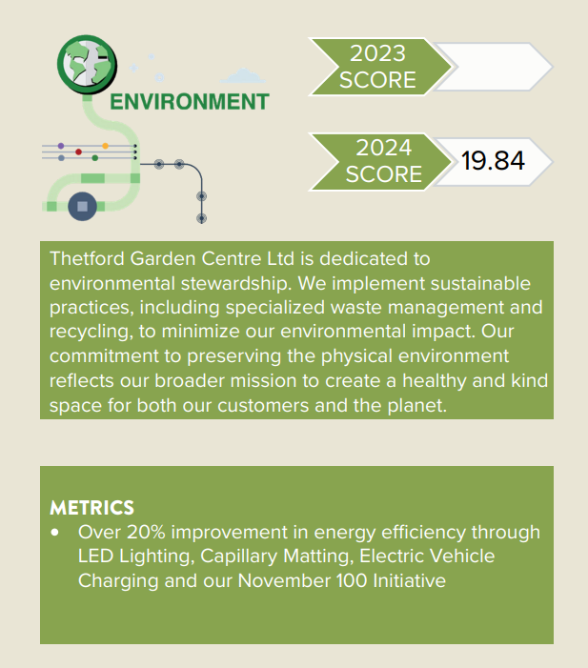
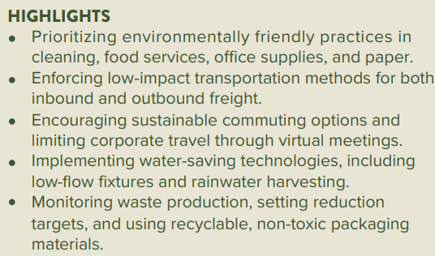
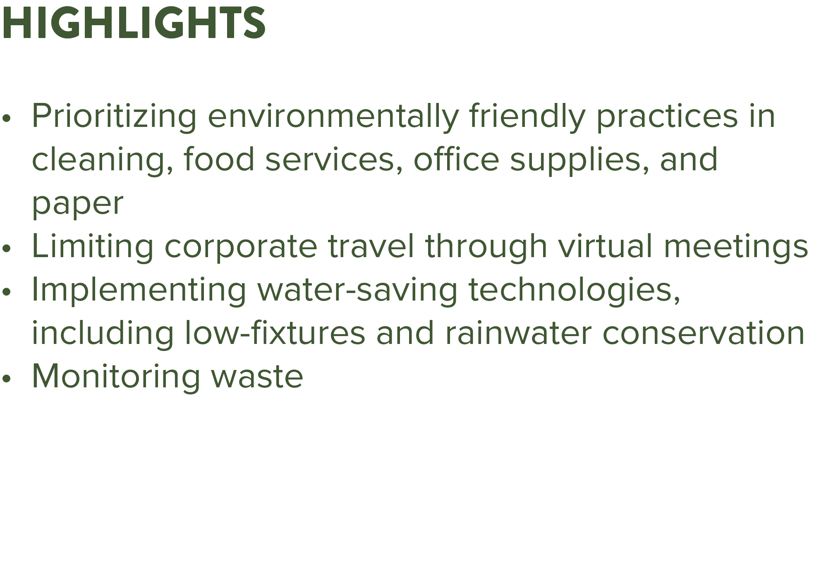
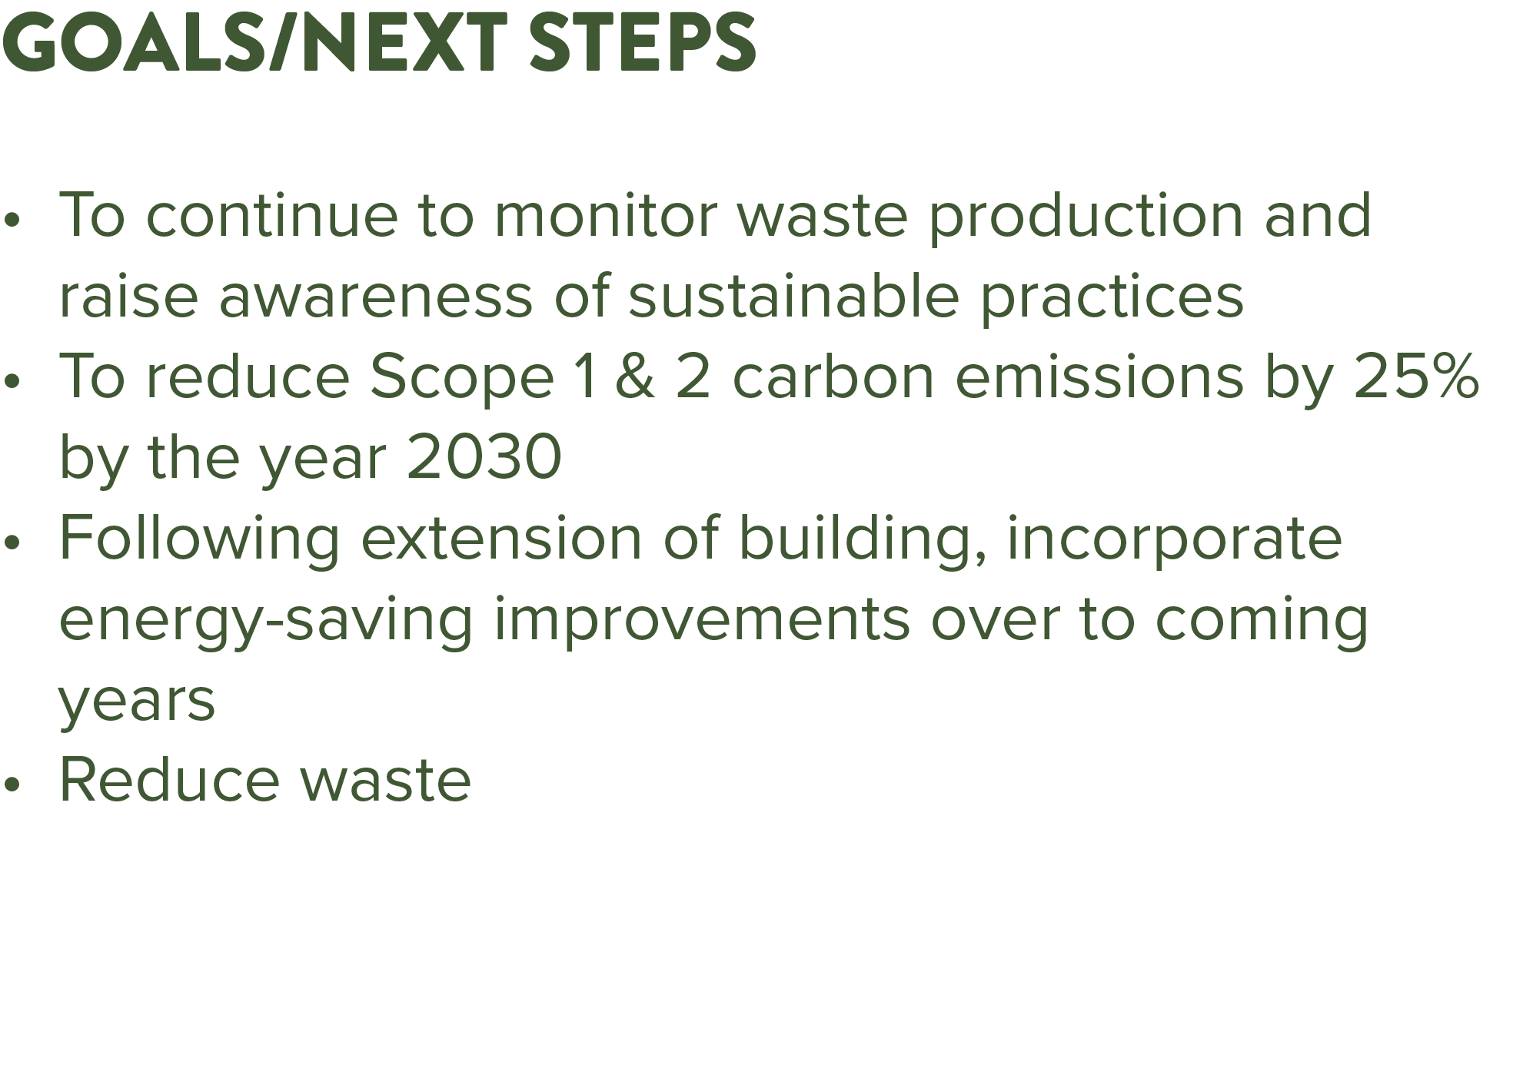
ENVIRONMENT
15.7

Slide 10
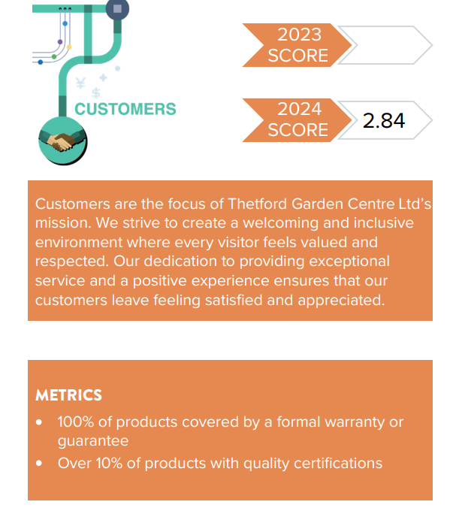
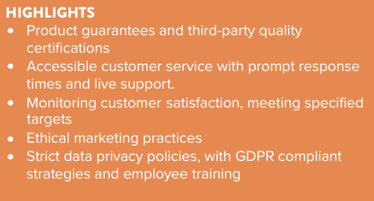
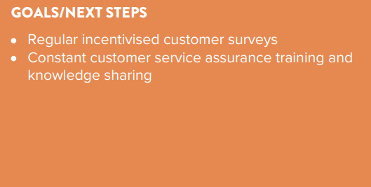
CUSTOMERS
2.8

Slide 11
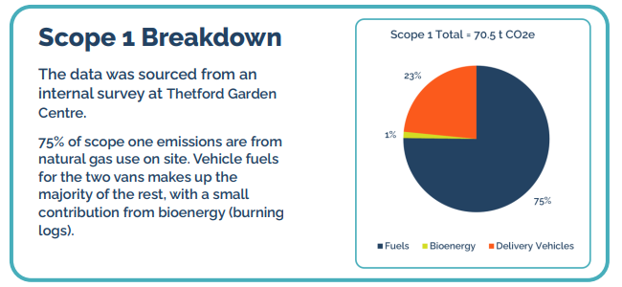
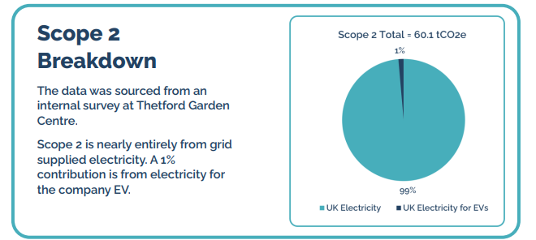
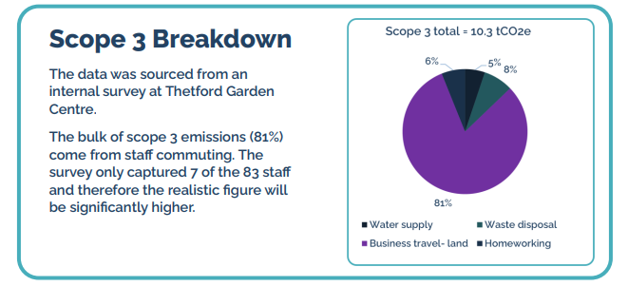
Our Business Carbon Footprint

Slide 12
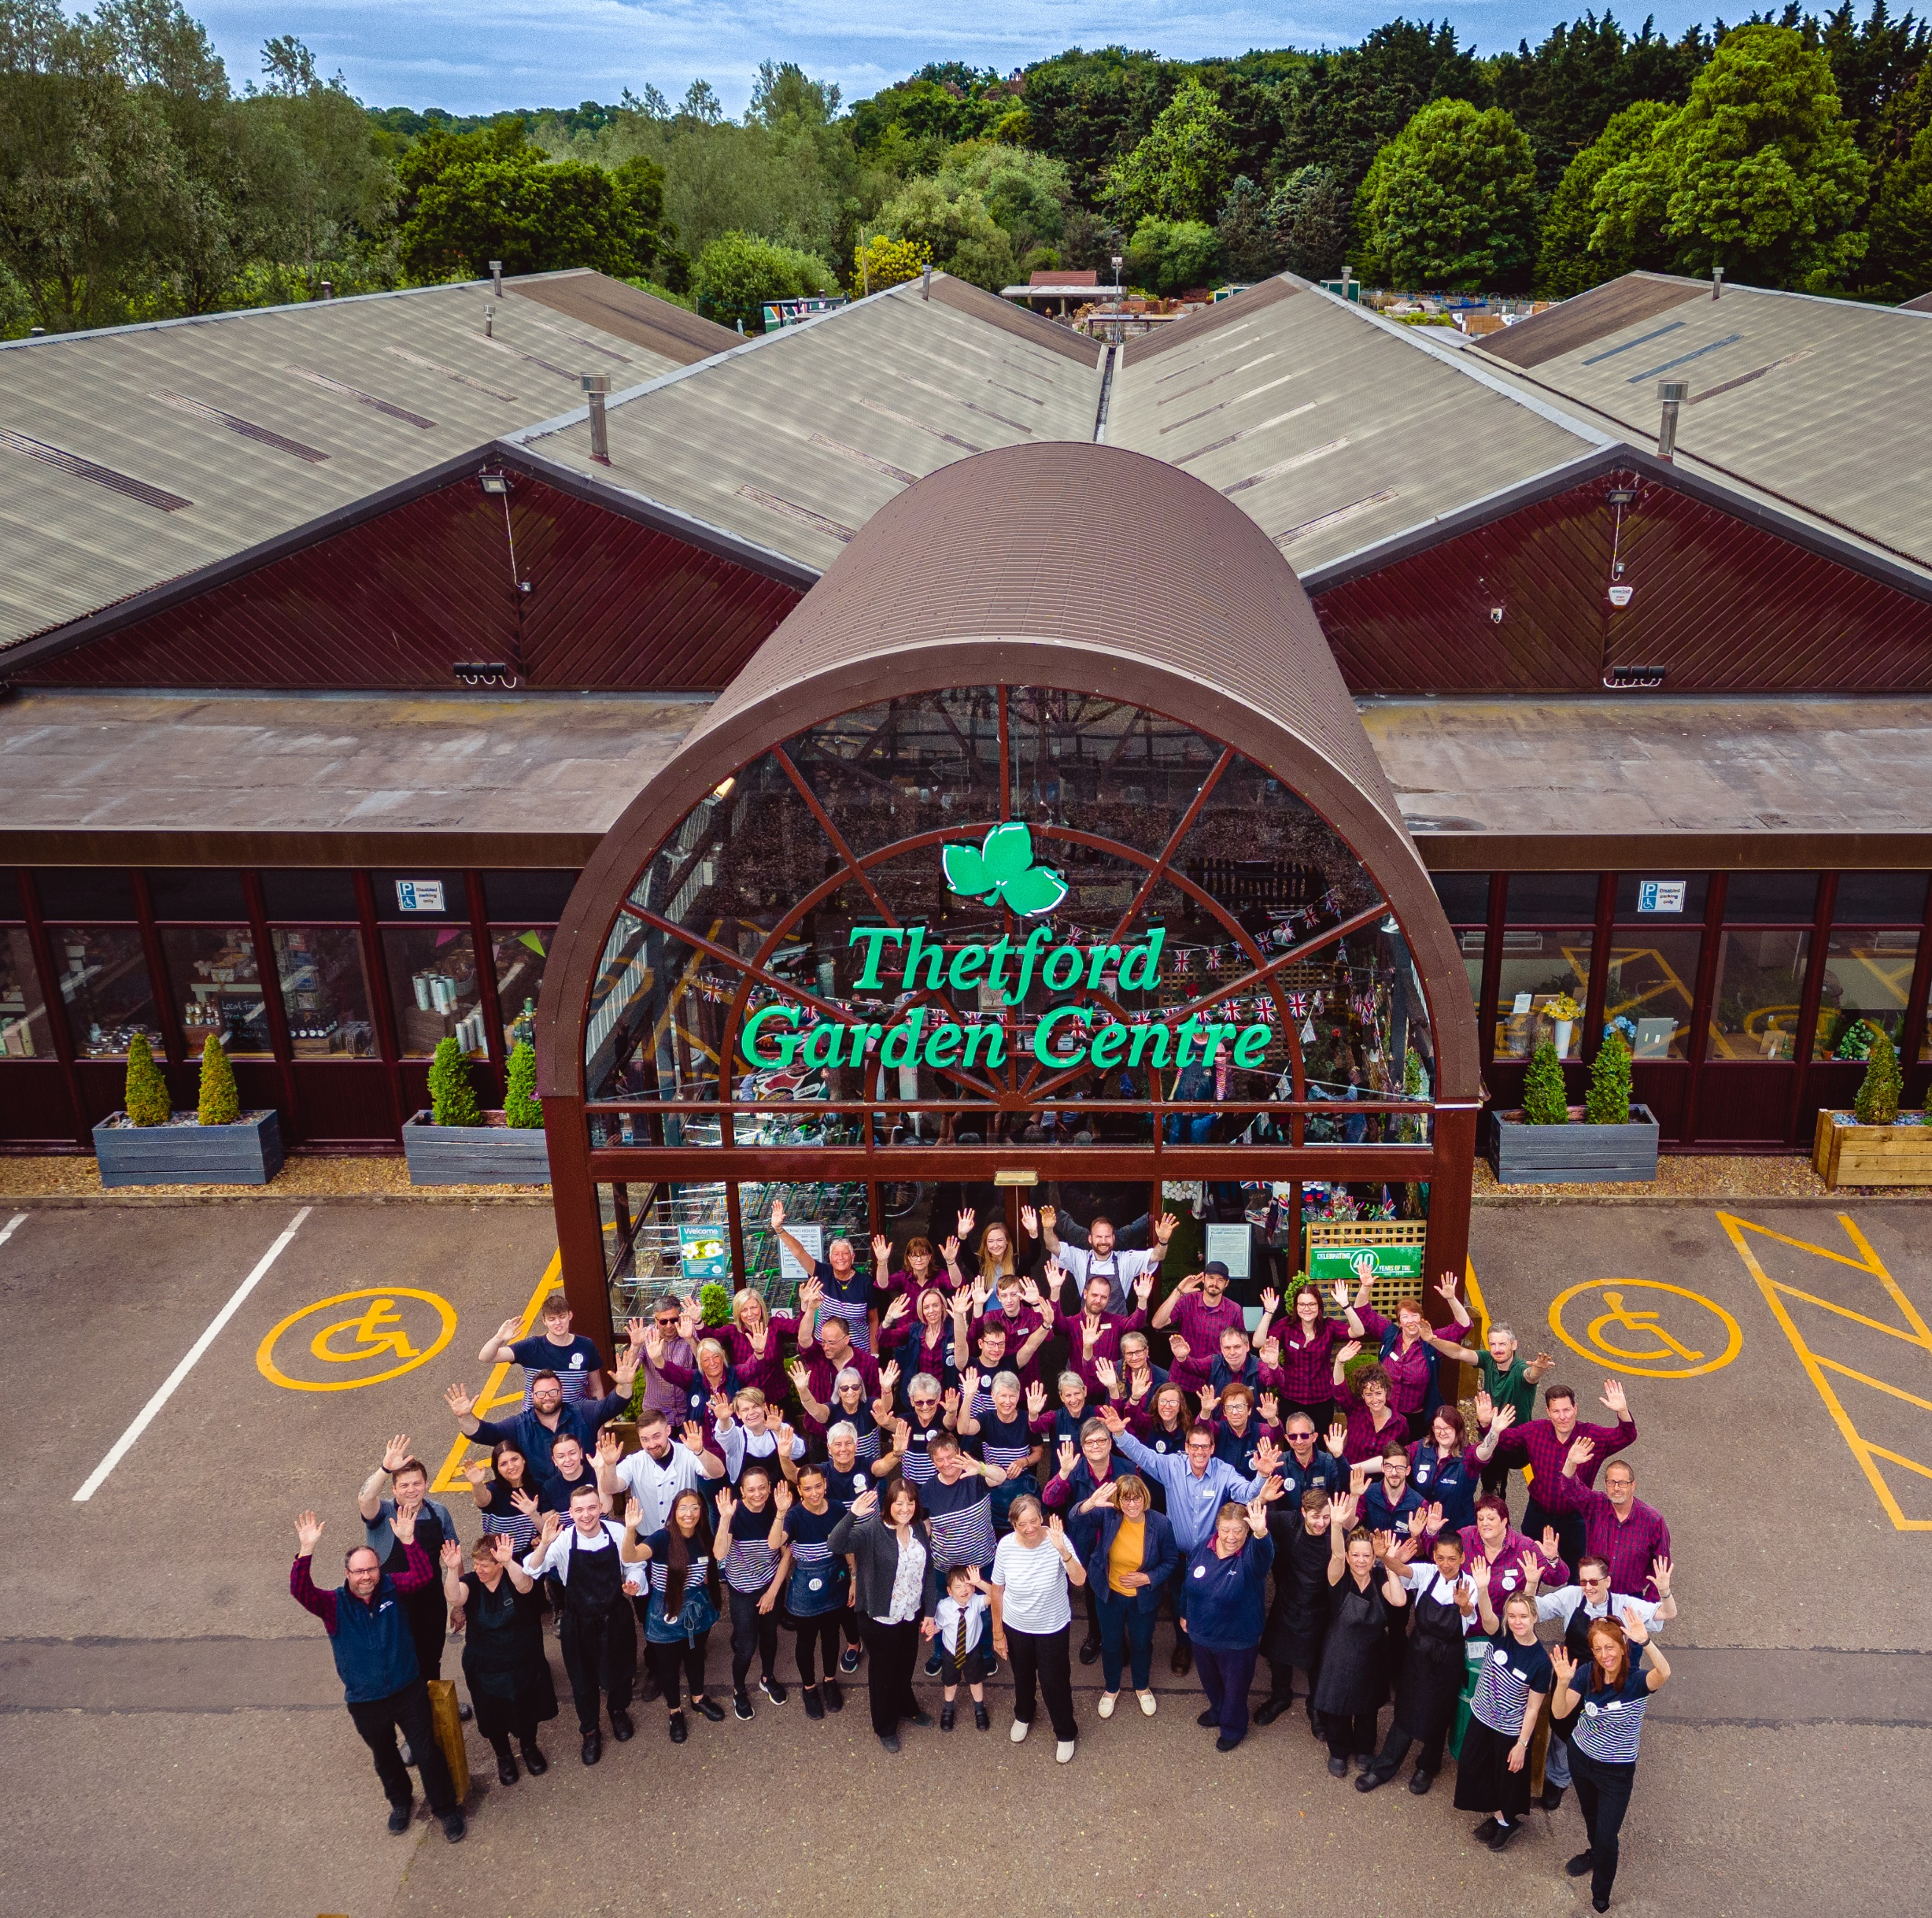
WHAT’S NEXT?
We plan to continue to create new ways in which to be more sustainable. With the creation of a new office facility within which we have incorporated energy saving devices, heating, and hopefully a reduction in our emissions, we will be improving standards for our staff and in turn, for our customers, and the planet.
Year on year we aim to reduce our electricity, gas, and water usage by approximately 8.5% in order to reach Net Zero by 2050. Obviously, some emissions are unavoidable but those that we can work on, we will strive to reduce.
Our in-house Sustainability Action Group will also continue to create ways in which we can help including sourcing more local suppliers, procurement from sustainable companies, and highlighting the benefits of becoming a Certified B Corporation.

Slide 13
Thank you for taking the time to read this report. If you have any questions, please e-mail us at customerservice@thetfordgardencentre.co.uk

