Slide 1

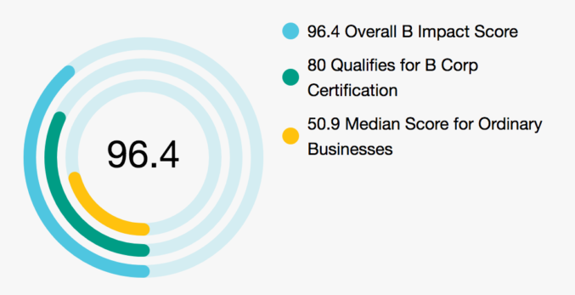

BpH Wealth Impact report
June 2023

Slide 2
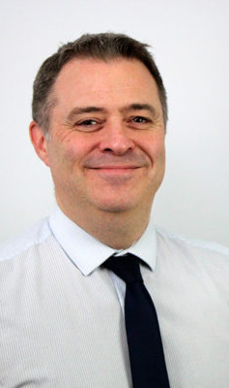
Leadership letter
Darren Weeks- Managing Partner
B Corp has helped us focus on being purposeful with our approach, enhancing our due diligence on some of our suppliers, raising issues such as inequality and community development as well as the positive impact on the environment, people as well as being profitable so they can continue this impact. We have also been much more deliberate in explaining our ESG and Sustainability investment options which has resulted in a significant uptake of this way of investing.
We’re excited about the next year, with the development of the Charity Committee and changing suppliers where appropriate to either B Corp companies, or ones we are satisfied their values are in line with B Corp and ours. We will continue with the client education of ESG & Sustainability portfolios; work with other financial planning companies and financial institutions for best practice ideas. Also, by changing some of the suppliers we can work with, ensuring we’re having a positive impact on society and the environment.
We were particularly proud of the initial score for certification, but also how team members are embracing B Corp, and the change in focus and clarity of the Charity Committee and the impact that this is going to have on local charities, not just financial help, but time too. We’re also proud of the ESG and sustainability funds ratio increasing, proving that clients are as interested as we are in aligning their social and environmental values with their investments.

Slide 3
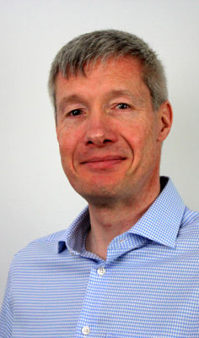
Leadership letter
Simon Brown- Partner
At BpH, we have always had a culture of high ethics, integrity and morals, which is one of the reasons why we have been in business for almost 40 years and having some clients and staff that have been working with us for nearly 30 years. We always put the client first, but staff and their welfare are equally central to our philosophy of promoting a ‘work family’ environment, supporting each other. We aspire to help our clients and team achieve a balance between life, money and society.
When we first reviewed B Corp, it was clear that our values were very aligned with B Corp ethos and aims. We felt attaining B Corp certification would give us more structure and focus to further continue to develop what we were already doing and to do this in a purposeful way. Additionally, we believe in the power of businesses to drive positive social and environmental change and believe we are in a unique position to do this with our ESG & Sustainability investment choices.
By undergoing the rigorous certification process, we’re delighted to be part of a global community of like-minded companies dedicated to using their influence and resources for the greater good. We were thrilled with our initial Certification score, but see this very much as the starting point to further build and develop what we have already created.

Slide 4

Our B Corp Journey so far
BpH Wealth are proud to be a business that is committed to providing our clients with the best service we can offer. We have a policy of never making a recommendation that we wouldn’t make to our own family, meaning we always put our clients' needs above those of the business. This is reflected by our high score of 3.67/5 for customer stewardship.
Furthermore, we take our obligations as an employer very seriously, and it is of paramount importance to us that working at BpH Wealth allows all our team to lead a good quality of life. This is reflected in our excellent score of 34.9/41.34 for the ‘Workers’ category.
Although we scored well on the areas we expected, we found there was lots to improve on, especially in the ‘Environment’ and ‘Community’ categories and this has been our focus since certification.
On the environmental side, we have begun to monitor our energy and gas usage and began switching office supplies to more sustainable versions. On the community side, we are in the process of formalising our charity and volunteering policy, and the role of our Charity Committee. We hope to explore ways where we as individuals can create impact in the local community through the unique skills that our team has, over and above the impact we would create with simple financial commitments.
Consistent improvement is our goal, and we remain committed to this. Having said that, it remains a challenge to balance such improvements given the time and resource it takes to consistently ensure the level of customer service we are committed to. We want to be proud of our progress by the time our recertification comes round, and we believe we are on the right track to be so.

Slide 5
Governance- 14.7
Overall, we were pleased with our governance score, and no improvements suggested by B Corp immediately jumped out as something that were both feasible and desirable in the short term. Many of the suggestions are around factoring social and environmental impact into governance documents, but as we did not track these metrics we were unable to set realistic material goals. Another problem with this is that as a fiduciary, we are legally always committed to work for the best interests of our clients, and careful examination would have to be made of whether any social or environmental goals ran counter to that. However, now we are at least tracking our environmental impact, we can consider setting goals related to this. For social impact, these goals will be covered by the new approach to charity and volunteering policy document that is currently being drafted. The only other major governance issue that we currently want to address is the lack of transparency to and input from the team on BpH Wealth’s company objectives. We plan to address this by holding more meetings to explain our vision, goals and strategy, as well as opportunities for the team to engage.
Plans for the next 12 months 1.Increase transparency to employees about financial, social and environmental performance. 2.Consider setting, tracking and reporting social and environmental goals. 3. Explore ways in which all staff can have more of a say in the direction of the business. In the future… 1. Continue to explore and improve upon the ideas listed above.

Slide 6
Workers- 34.9
The treatment of our team has always been of paramount importance for BpH Wealth. That is why we were thrilled to get such a high score for this category. As a company, we work every day to ensure our clients have the best possible chance of achieving a balanced life. However, we naturally want this for our team too and our package of financial compensation, benefits, flexible working and more is designed to achieve this. However, one place where we felt was lacking was asking the team about their own personal experience working for BpH Wealth. We have now remedied this with a recent survey, for which we will be getting the anonymised results very soon. After this we will be looking at measures to ensure all the team feels engaged, valued and has opportunities to develop in their workplace.
What we said we’d do | What we did
Track employee engagement and satisfaction. | We have commissioned a survey to gauge how staff feel about the Company, Leadership Team, how connected they feel to our mission, opportunities for development and advancement and more. We will implement a plan to address the findings of this report after it is received later this month.
Plans for the next 12 months 1. Peer and subordinate input into employee review process In the future… 1. Internship scheme (paid) 2. Consider procedures for staff who want to take short/long term leave, a sabbatical or secondment

Slide 7
Community- 16.2
What we said we’d do | What we did
Get all of our suppliers to answer a survey | We have sent out a survey to all our suppliers, but have only received about 50% of responses. Surprisingly, many larger companies gave us no response, when we assumed they would have faced many similar questions before, or at least have a standardised response. However, all new suppliers that we switch to are investigated for their environmental impact and do receive our survey to complete. When picking new suppliers, a large determinant of who we pick is how local they are, with UK based management and manufacturing getting a lot of weight in our decisions.
Formalise our policies around charitable giving and volunteering | We have just finalised a new policy document for charitable giving and volunteering, including formalising the charity committee, which currently exists but only sporadically meets. The new document is currently being drafted to set the objectives of the BpH Wealth charitable giving and volunteering policy, and the charity committee’s role in pursuing these objectives. The new strategy will involve consideration of how we can best make an impact over just donating money, and is expected to involve establishing partner charities which we give time and expertise, as well as a financial commitment to, each year.
Plans for the next 12 months 1.Implement volunteering days for the team. 2. Finalise policy on charitable giving and volunteering and pick our first partner charities. In the future… 1. Formal donation commitment as a % of revenue. 2. Set up a foundation/trust for community investments.

Slide 8
Environment- 4.2
When we obtained our certification, it was obvious to us that this area needed significant improvement. While our environmental impact was something we tried to minimise, e.g. by using 100% renewable energy and ensuring what can be is recycled, we did not track any of our usage or have targets to minimise or offset our impact. Now we have begun to monitor our, electricity, gas and water usage and once we have enough data we will be able to review consumption and set reduction targets where necessary. We have also begun a review into our office suppliers, which has resulted in a switch of many day-to-day supplies
What we said we’d do | What we did
Monitor the usage of utilities (water, electricity, gas) and set reduction targets. | We have begun to monitor our usage, but do not have reduction targets. As we have a small, variably used office and many of the team working from home we are not sure whether reduction targets will be practical. However, we have decided that every time a piece of equipment needs replacing we will look for those that minimise environmental impact.
Providing a list of environmentally preferred suppliers to the team for when working from home. | So far we have mainly been focusing on switching to sustainable office supplies. We have researched and replaced various office supplies, including cleaning supplies, toilet and kitchen roll, dishwasher tablets and a new energy saving kettle. Although we have a list of the suppliers we use, we have not yet drafted a list for the team for use at home.
Plans for the next 12 months 1. Review and potentially upgrade our client gifting offering to a luxury, sustainable company that effectively illustrates our philosophy that considering people and planet does not have to involve a trade-off. 2.Explore a carbon offsetting scheme. In the future… 1. Continue to replace old equipment broken or obsolete equipment with more sustainable alternatives and continue to ensure old equipment is disposed of or donated responsibly as appropriate.

Slide 9
Customers- 25.8
What we said we’d do | What we did
Have at least 25% of AuM screened by ESG criteria by the end of 2023. | We have continued to discuss our ESG and sustainability portfolios with clients. Our investment committee has also approved funds covering new asset classes where previously we didn't have an ESG or sustainability solution. These are now being used in our model portfolios. Because of these two factors, the proportion of assets invested in ESG screened funds has grown consistently every month, from around 15% at the time of certification to over 29% today, putting us significantly over our 25% target. We expect this to continue to grow over the short to medium term.
Plans for the next 12 months 1. Share reports on the environmental and social performance of our investment portfolios to employees and clients. 2. Begin measuring client satisfaction through new biannual survey In the future… Set targets for client satisfaction. Explore setting targets for client outcomes, this could include philanthropic giving and ESG investing as well as achieving life goals. Explore how we can make our impact and microfinance offering to clients more robust. Continue to grow our ESG screened investments as a proportion of AuM, potentially exploring making our ESG and sustainability options the default for new clients. Consider including questions about sustainability and ESG preferences as part of our onboarding and ongoing client assessment process.

