Slide 1
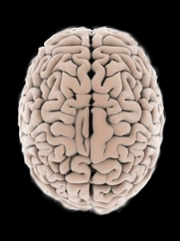
Epilepsy
1

Slide 2
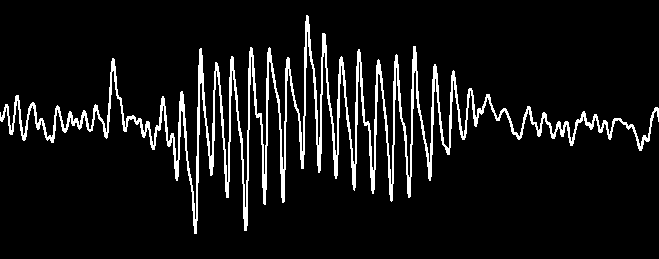
Epilepsy
1

Slide 3

Epilepsy
1

Slide 4
Epilepsy
2.2 million people in the U.S.
>40 subtypes.
Diverse etiologies.
70% are genetic.
1

Slide 5
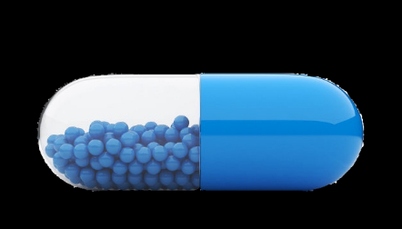
Epilepsy Drugs
Drug
Year
Vigabatrin
…………..….…... 1994
Gabapentin
……..…..……... 1993
2019!
Clonazepam
…......……….. 1975
Clobazam
……..……....…... 1975
Valproate
……….......……... 1960
Ethosuximide
……….…….. 1960
Acetazolamide
……..……... 1952
Phenobarbital
……..……... 1912
Phenytoin
……….…..……... 1908
1

Slide 6
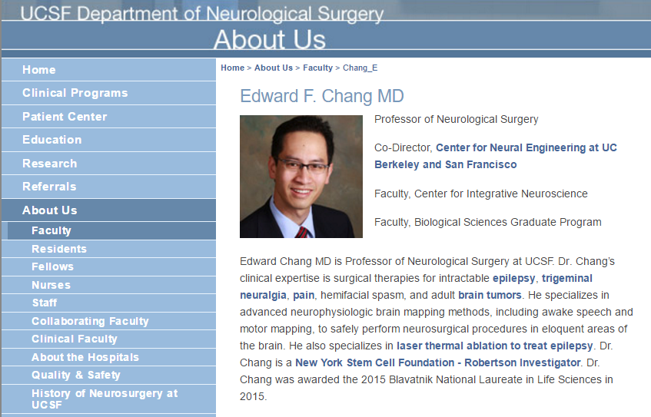
Alternative Strategies
1

Slide 7
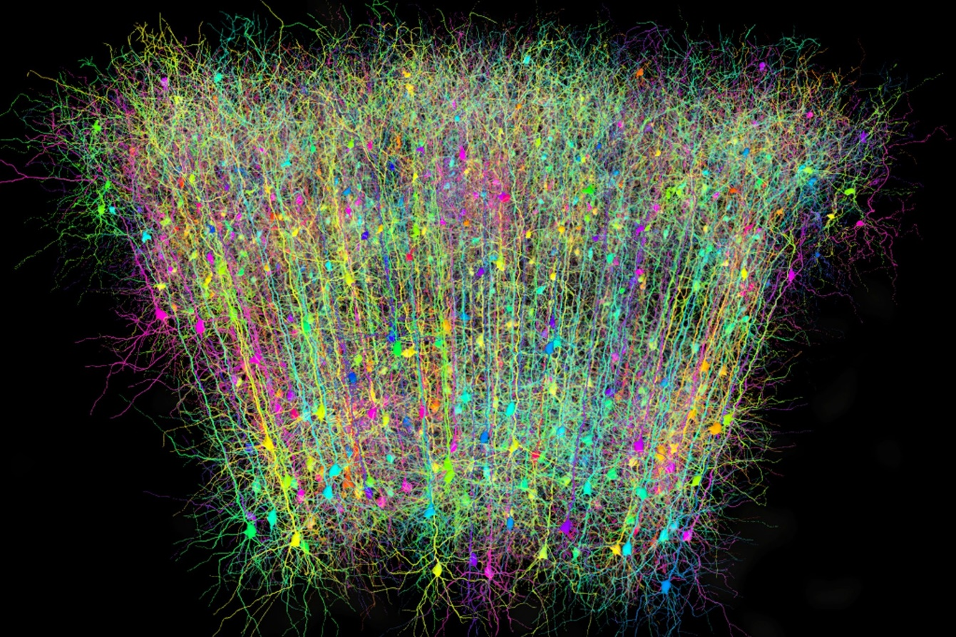
Why?
?
1

Slide 8
Why?
Many roads lead to Rome
Pathological homeostasis
1

Slide 9
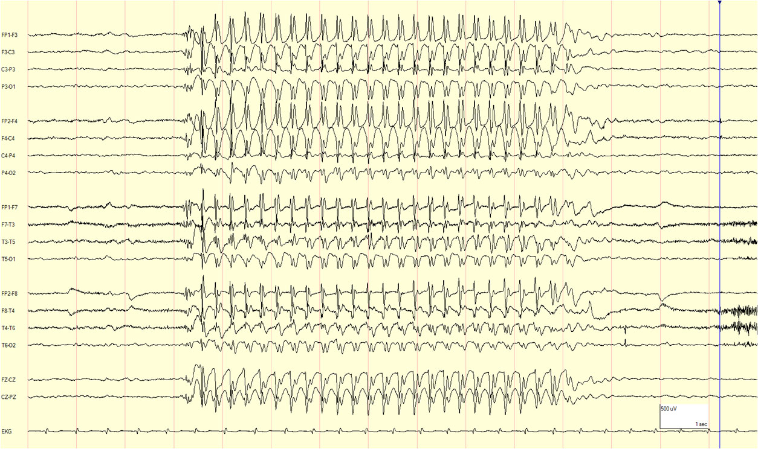
Absence Seizures: Highly Stereotyped
, Diverse Mechanisms
link
2

Slide 10
Absence Seizures: Highly Stereotyped
, Diverse Mechanisms
EEG Electrodes
CORTEX
CORTEX
RETICULAR
RETICULAR
THALAMUS
THALAMUS
DORSAL
THALAMUS
DORSAL
THALAMUS
3

Slide 11
Absence Seizures: Highly Stereotyped
, Diverse Mechanisms
EEG Electrodes
CORTEX
RETICULAR
THALAMUS
DORSAL
THALAMUS
3

Slide 12
Absence Seizures: Highly Stereotyped
, Diverse Mechanisms
CORTEX
RETICULAR
THALAMUS
DORSAL
THALAMUS
3

Slide 13
Absence Seizures: Highly Stereotyped
, Diverse Mechanisms
Absence Seizures: Identified Mutations
CORTEX
CACNA1H: Calcium Channel (T-Type)
GABRA1: GABA Receptor Subunit (α1)
A
RETICULAR
GABRB3: GABA Receptor Subunit (β3)
A
THALAMUS
GABRG2: GABA Receptor Subunit (γ2)
DORSAL
A
THALAMUS
3

Slide 14
Absence Seizures: Highly Stereotyped
, Diverse Mechanisms
CORTEX
RETICULAR
THALAMUS
DORSAL
THALAMUS
3

Slide 15

Absence Seizures: Highly Stereotyped
, Diverse Mechanisms
Drug
Year
CORTEX
Vigabatrin
…………..….…... 1994
Gabapentin
……..…..……... 1993
Clonazepam
…......……….. 1975
RETICULAR
Clobazam
……..……....…... 1975
THALAMUS
Valproate
……….......……... 1960
DORSAL
Ethosuximide
……….…….. 1960
THALAMUS
Acetazolamide
……..……... 1952
Phenobarbital
……..……... 1912
Phenytoin
……….…..……... 1908
4

Slide 16

Absence Seizures: Highly Stereotyped
, Diverse Mechanisms
Drug
Year
CORTEX
Vigabatrin
…………..….…... 1994
Gabapentin
……..…..……... 1993
Clonazepam
…......……….. 1975
RETICULAR
Clobazam
……..……....…... 1975
THALAMUS
Valproate
……….......……... 1960
DORSAL
Ethosuximide
……….…….. 1960
THALAMUS
Acetazolamide
……..……... 1952
Phenobarbital
……..……... 1912
Phenytoin
……….…..……... 1908
4

Slide 17
Absence Seizures: Highly Stereotyped
, Diverse Mechanisms
Why Are Hammers Bad?
CORTEX
Side Effects
Absence Epilepsy Age of Onset
3-5 years old
RETICULAR
Brain stops developing in 20s
THALAMUS
DORSAL
THALAMUS
5

Slide 18
Why?
Many roads lead to Rome
Pathological homeostasis
6

Slide 19
Activity Homeostasis
homeostasis
the tendency of a system, especially the physiological system of higher animals, to maintain internal stability, owing to the coordinated response of its parts to any situation or stimulus that would tend to disturb its normal condition or function.
parameter
set point
7

Slide 20

Activity Homeostasis
homeostasis
the tendency of a system, especially the physiological system of higher animals, to maintain internal stability, owing to the coordinated response of its parts to any situation or stimulus that would tend to disturb its normal condition or function.
Action Potentials
firing activity
parameter
time
set point
7

Slide 21
Activity Homeostasis
homeostasis
the tendency of a system, especially the physiological system of higher animals, to maintain internal stability, owing to the coordinated response of its parts to any situation or stimulus that would tend to disturb its normal condition or function.
Action Potentials
firing activity
time
set point
7

Slide 22
Activity Homeostasis
homeostasis
the tendency of a system, especially the physiological system of higher animals, to maintain internal stability, owing to the coordinated response of its parts to any situation or stimulus that would tend to disturb its normal condition or function.
Action Potentials
firing activity
time
set point
7

Slide 23
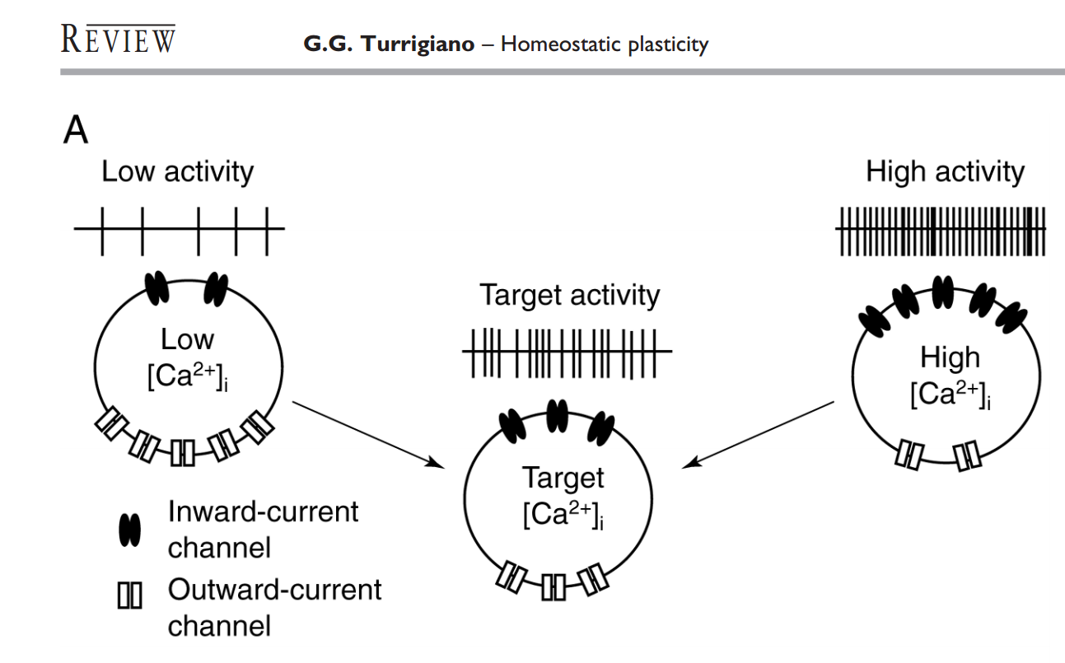
Activity Homeostasis
homeostasis
the tendency of a system, especially the physiological system of higher animals, to maintain internal stability, owing to the coordinated response of its parts to any situation or stimulus that would tend to disturb its normal condition or function.
firing activity
set point
8
Notes:
An important readout signal appears to be intracellular [Ca2+], which correlates with electrical activity due to voltage dependent Ca2+ channels and buffering mechanisms that average out fluctuations in time and space (Berridge 1998; Wheeler et al., 2012). Moreover, long-term changes in [Ca2+] are found to regulate many ion channel types.

Slide 24
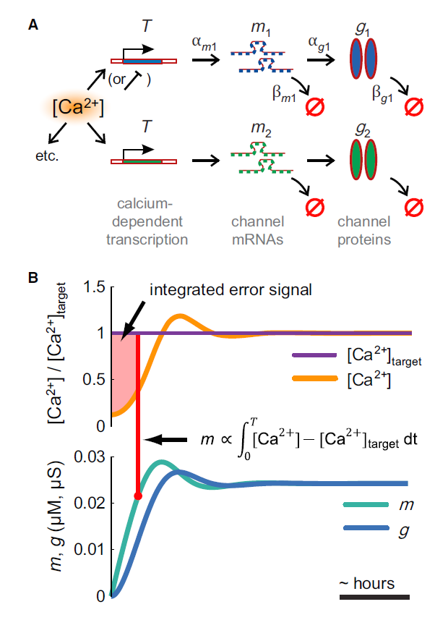
Activity Homeostasis
homeostasis
the tendency of a system, especially the physiological system of higher animals, to maintain internal stability, owing to the coordinated response of its parts to any situation or stimulus that would tend to disturb its normal condition or function.
firing activity
set point
O’ Leary et al., 2014
9
Notes:
m the concentration of mRNA for channel protein g and ax and bx are synthesis and degradation rates; dots denote time derivatives.
Many important transcription factors such as CREB are known to be Ca2+ dependent or dependent on other Ca2+-sensing enzymes
A technical message of this work is that a canonical model of channel expression can be interpreted as a well-known control law: the integral controller. Integral control has been suggested as a mechanism of neuronal homeostasis based on the available molecular machinery for integrating Ca2+ signals in neurons

Slide 25
Activity Homeostasis
homeostasis
the tendency of a system, especially the physiological system of higher animals, to maintain internal stability, owing to the coordinated response of its parts to any situation or stimulus that would tend to disturb its normal condition or function.
firing activity
set point
10

Slide 26
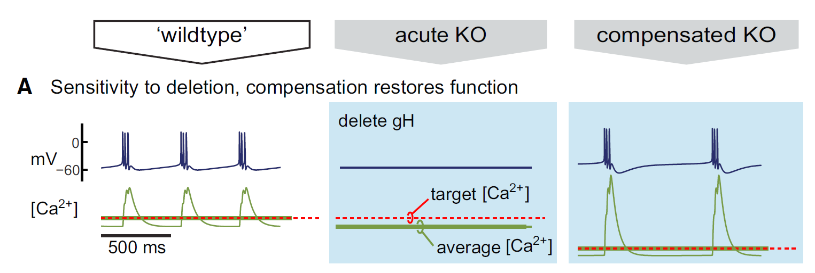
Activity Homeostasis: Solution Can Be Pathological
homeostasis
the tendency of a system, especially the physiological system of higher animals, to maintain internal stability, owing to the coordinated response of its parts to any situation or stimulus that would tend to disturb its normal condition or function.
firing activity
set point
O’ Leary et al., 2014
11

Slide 27
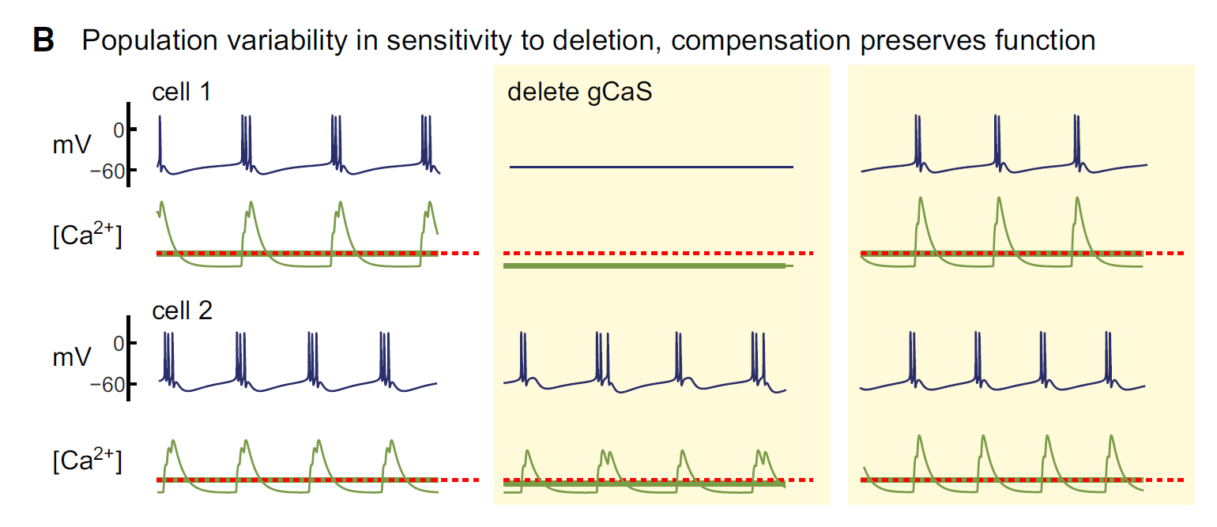
Activity Homeostasis: Solution Can Be Pathological
homeostasis
the tendency of a system, especially the physiological system of higher animals, to maintain internal stability, owing to the coordinated response of its parts to any situation or stimulus that would tend to disturb its normal condition or function.
firing activity
set point
O’ Leary et al., 2014
11

Slide 28
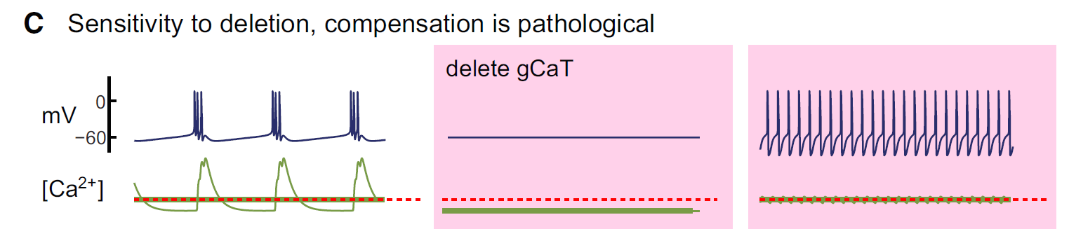
Activity Homeostasis: Solution Can Be Pathological
homeostasis
the tendency of a system, especially the physiological system of higher animals, to maintain internal stability, owing to the coordinated response of its parts to any situation or stimulus that would tend to disturb its normal condition or function.
firing activity
set point
O’ Leary et al., 2014
11

Slide 29
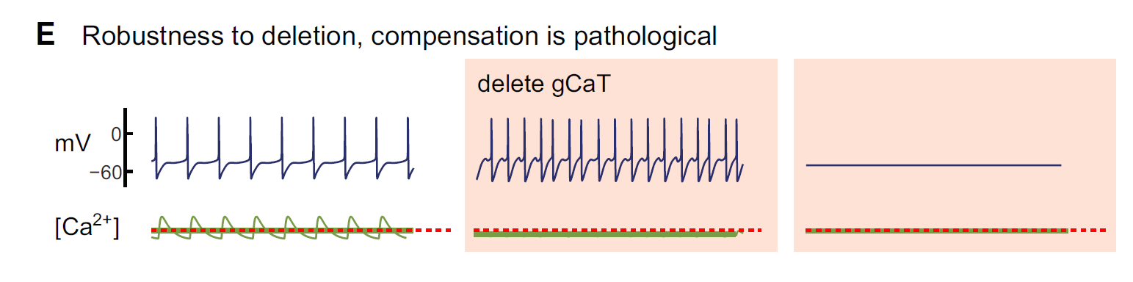
Activity Homeostasis: Solution Can Be Pathological
homeostasis
the tendency of a system, especially the physiological system of higher animals, to maintain internal stability, owing to the coordinated response of its parts to any situation or stimulus that would tend to disturb its normal condition or function.
firing activity
set point
O’ Leary et al., 2014
11

Slide 30
Activity Homeostasis: Solution Can Be Pathological
homeostasis
the tendency of a system, especially the physiological system of higher animals, to maintain internal stability, owing to the coordinated response of its parts to any situation or stimulus that would tend to disturb its normal condition or function.
firing activity
set point
O’ Leary et al., 2014
12

Slide 31
Activity Homeostasis: Solution Can Be Pathological
homeostasis
the tendency of a system, especially the physiological system of higher animals, to maintain internal stability, owing to the coordinated response of its parts to any situation or stimulus that would tend to disturb its normal condition or function.
calcium
firing activity
set point
O’ Leary et al., 2014
12

Slide 32


Activity Homeostasis: Solution Can Be Pathological
homeostasis
the tendency of a system, especially the physiological system of higher animals, to maintain internal stability, owing to the coordinated response of its parts to any situation or stimulus that would tend to disturb its normal condition or function.
most of the time
achieving target [Ca²⁺] = normal firing activity
disease
calcium
some of the time
firing activity
set point
achieving target [Ca²⁺] = abnormal firing activity
Bad but stable.
13

Slide 33
Epilepsy Drugs
Drug
Year
Vigabatrin
…………..….…... 1994
Gabapentin
……..…..……... 1993
Clonazepam
…......……….. 1975
Clobazam
……..……....…... 1975
Valproate
……….......……... 1960
Ethosuximide
……….…….. 1960
Acetazolamide
……..……... 1952
Phenobarbital
……..……... 1912
Phenytoin
……….…..……... 1908
14

Slide 34
Why?
Many roads lead to Rome
Pathological homeostasis
15

Slide 35

Do We Need New Strategies?
16

Slide 36
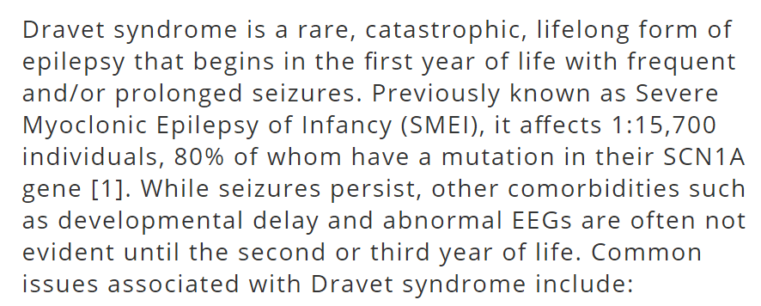
Dravet Syndrome
17

Slide 37
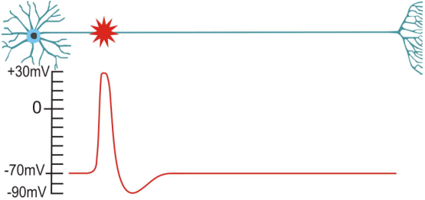
SCN1A & The Action Potential
APS Therapy
18

Slide 38
So?

Slide 39
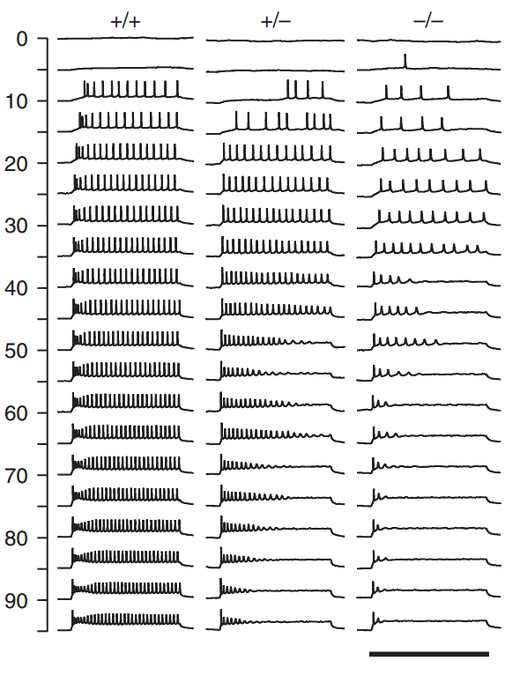
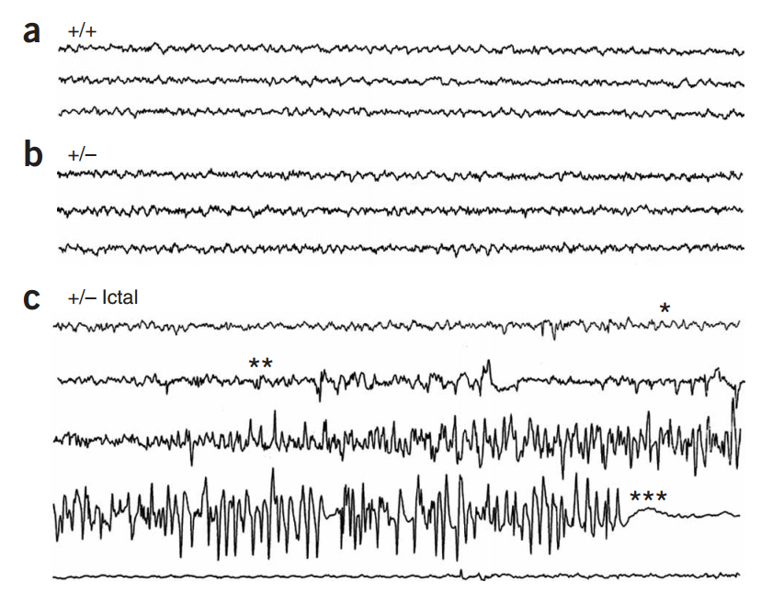
Action Potentials in SCN1A +/- Mice
Yu et al., 2006
19

Slide 40
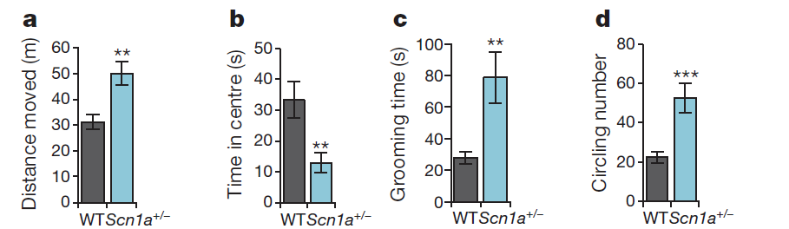
Autism in SCN1A +/- Mice
Han et al., 2012
20

Slide 41
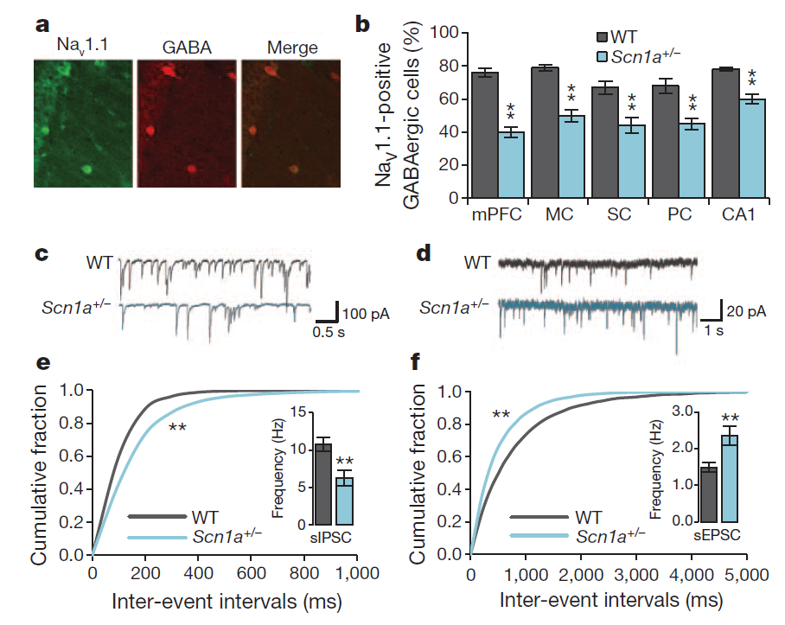
Synaptic Transmission in SCN1A +/- Mice
Han et al., 2012
22

Slide 42
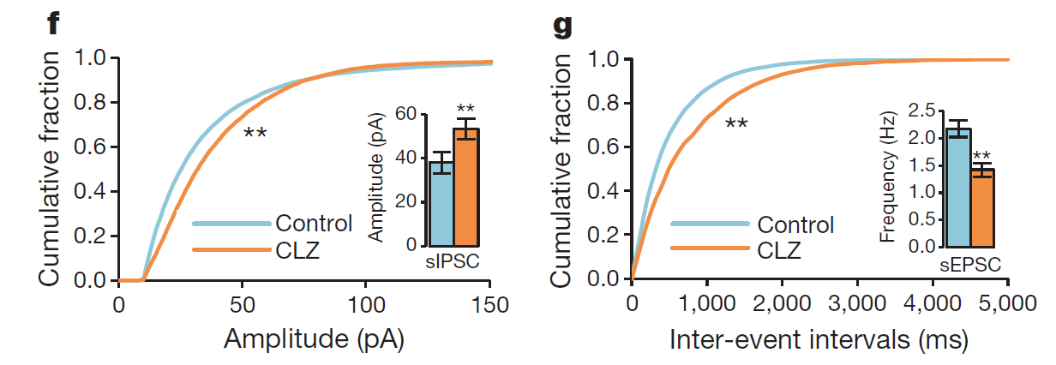
Benzos Augment Inhibition in SCN1A +/- Mice
Han et al., 2012
23

Slide 43
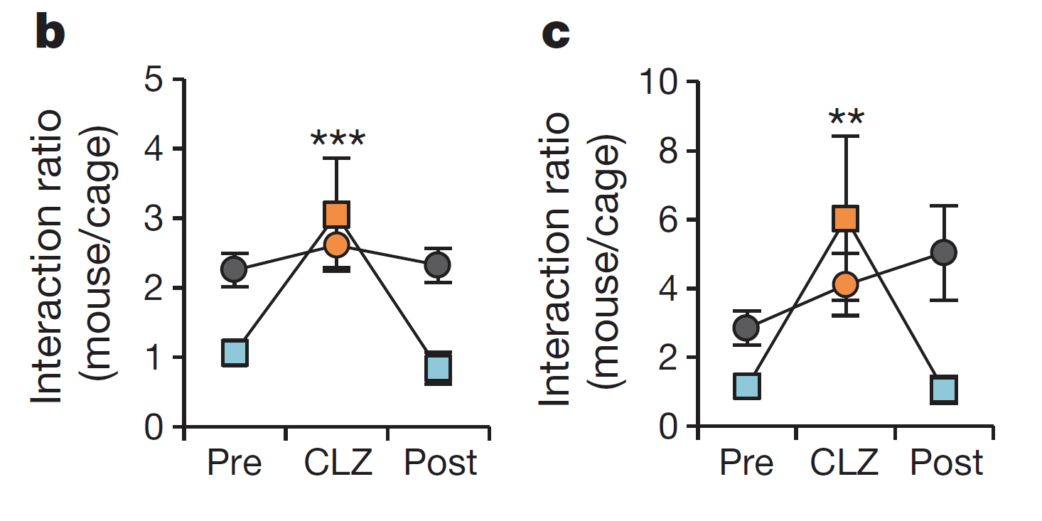
Benzos Rescue Behavior in SCN1A +/- Mice
Han et al., 2012
24

Slide 44
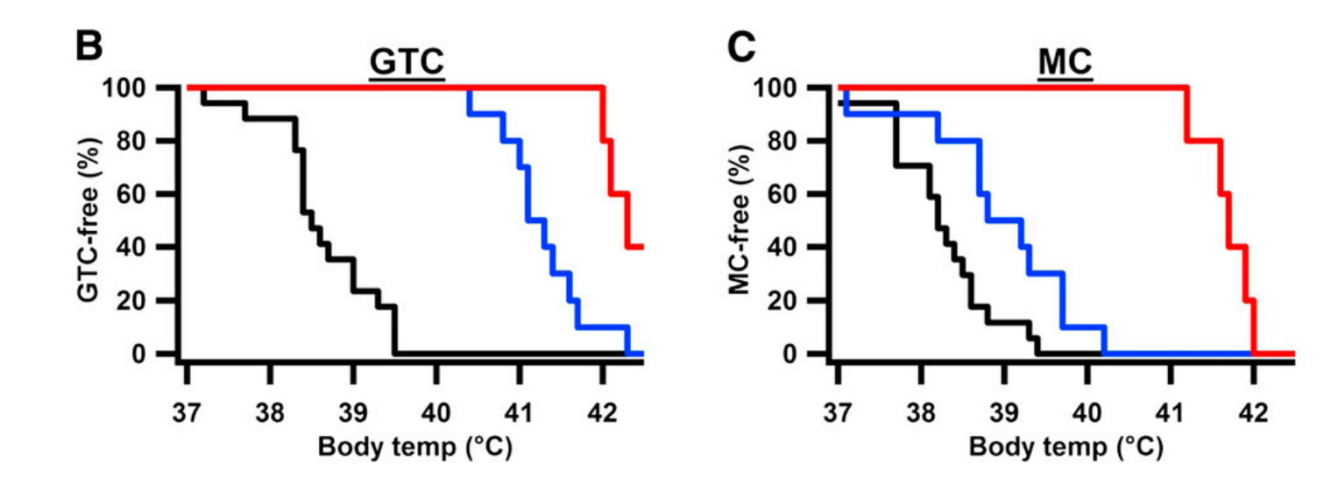
And Seizures?
clonazepam
tiagabine
Oakley et al., 2013
25
Notes:
Red = clonazepam; blue= tiagabine; black = control

Slide 45
Or Develop New Strategies?
26

Slide 46
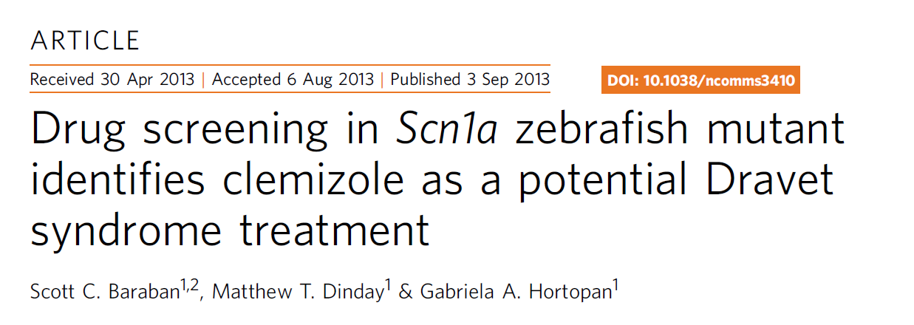
High-Throughput Drug Screening
27

Slide 47
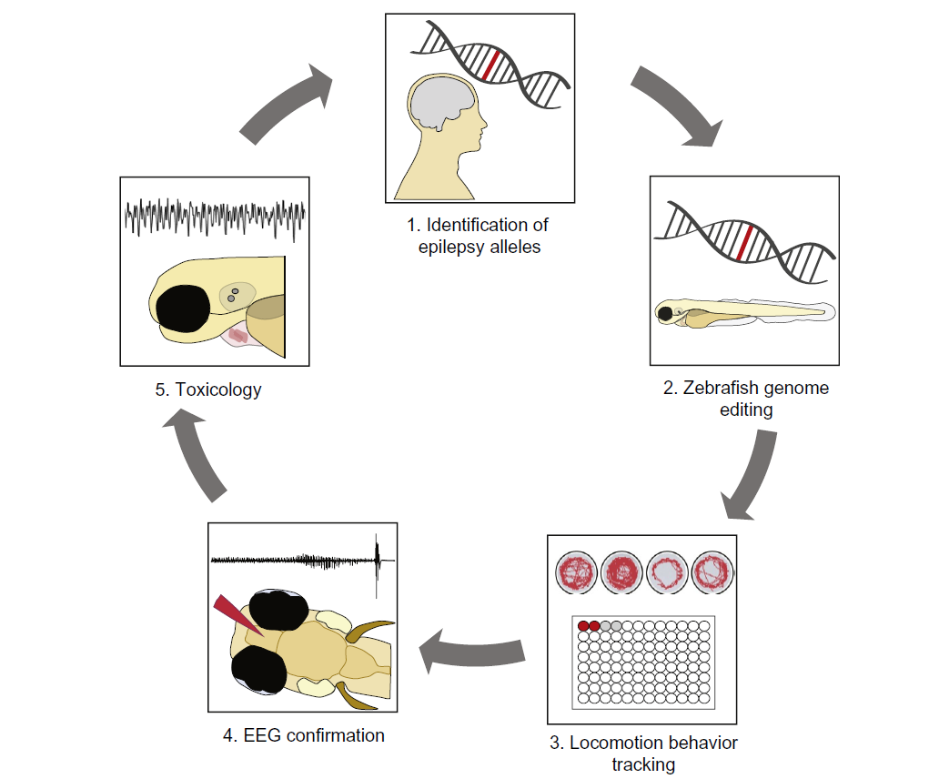
High-Throughput Drug Screening
Griffin et al., 2016
28

Slide 48
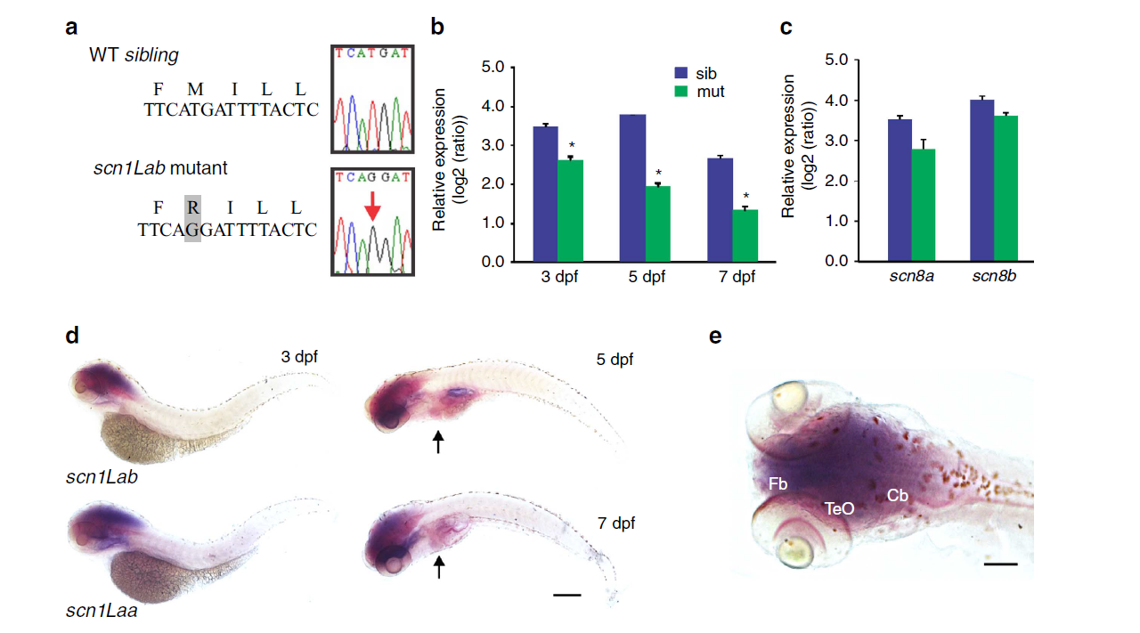
scn1Lab (SCN1A) Mutation
Baraban et al., 2013
29
Notes:
The zebrafish scn1Lab gene shares a 77% identity with human SCN1A and is expressed in the CNS.
These types of screens are based on inducing random point mutations using the alkylating agent N-ethyl-N-nitrosourea; the resulting mutations are typically loss-of-function and recessive
methionine (M) to arginine (R) mutation
Arrow = heart.
E =

Slide 49
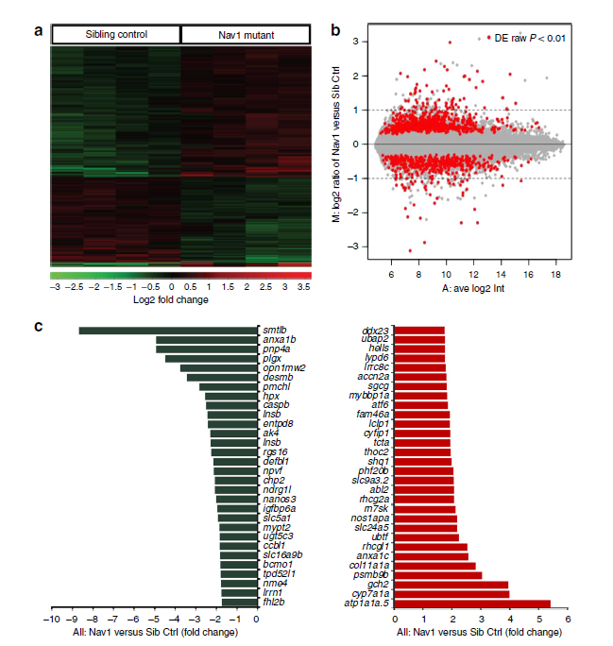
Transcriptional Changes
Baraban et al., 2013
30
Notes:
Micro-arrary analysis: investigation of transcriptional changes
B44,000 probes (Fig. 2a,b). Hierarchical clustering analyses showed that B2.5% (1,099) of these probes (see Supplementary Data 1) were differentially expressed between mutants and sibling controls at 5 dpf
these differences were modest as 90% (990/1,099) of the identified genes exhibited fold-changes between 0.8 and 2.0.
B: MA plot. The plot visualizes the differences between measurements taken in two samples, by transforming the data onto M (log ratio) and A (mean average) scales, then plotting these values. M is, therefore, the binary logarithm of the intensity ratio (or difference between log intensities) and A is the average log intensity for a dot in the plot.

Slide 50
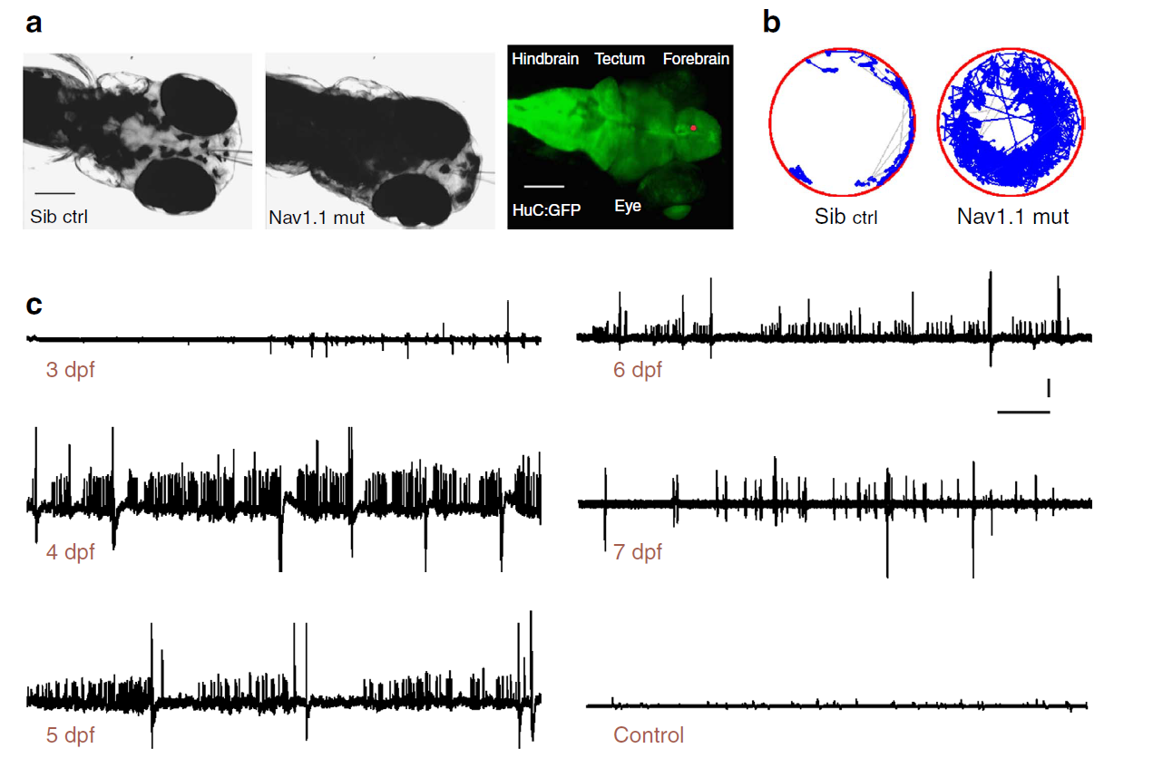
Mutants Have Seizures
Baraban et al., 2013
32

Slide 51
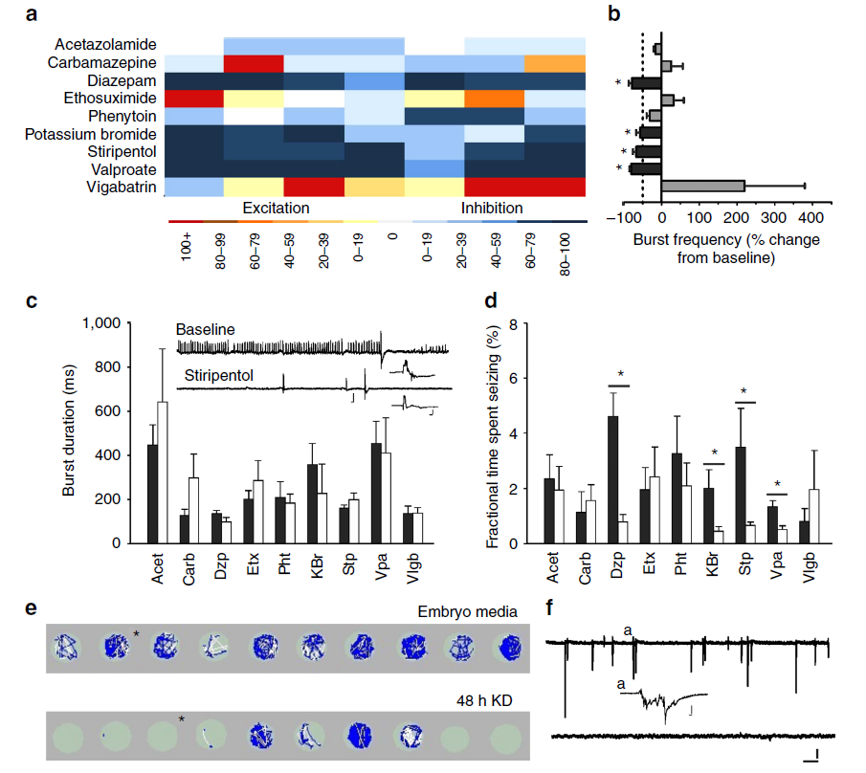
Seizures Respond to Some AEDs
Baraban et al., 2013
33
Notes:
Electrophysiological assay of known AEDs: fish validation
All drugs were bath applied at a concentration of 1 mM;

Slide 52
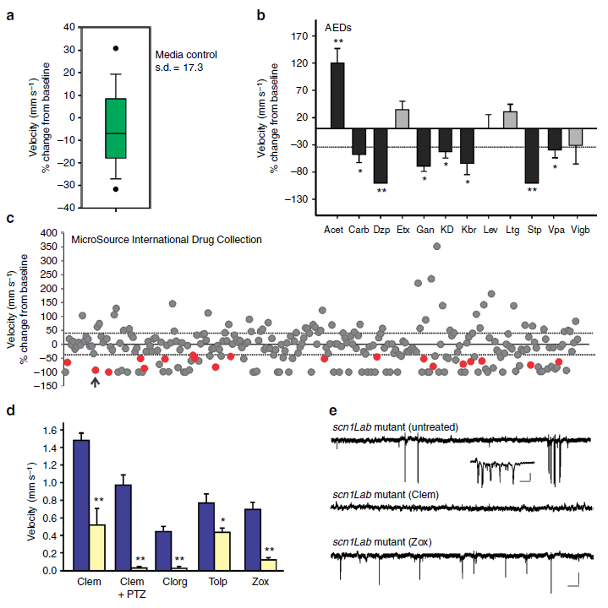
Swimming Assay to Screen Many Compounds
Baraban et al., 2013
34
Notes:
Locomotor assay for high throughput drug screen. D/E only chemozol reduced swimming and electrographic seizures.
we designed a relatively high-throughput phenotype-based strategy to screen chemical libraries for compounds that reduce mutant behaviour to Stage 0 (very little swim activity) or Stage I (increased, but non-convulsive, swim activity), for example, behaviour equivalent to that seen in normal WT controls.

Slide 53
High-Throughput Drug Screening
Griffin et al., 2016
35

Slide 54
Or Develop New Strategies?
36

Slide 55
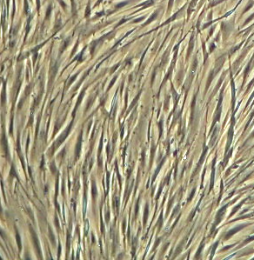
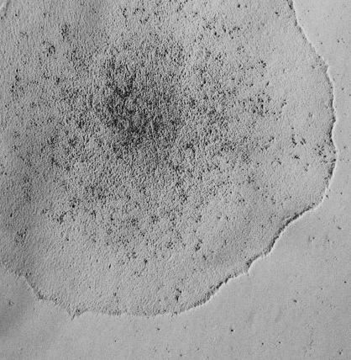
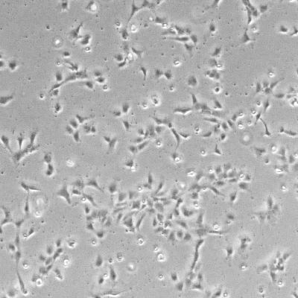
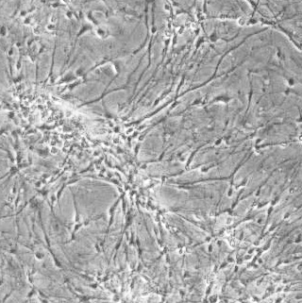
hiPSC-derived neurogenesis
adult fibroblasts
induced pluripotent stem (iPS) cells
neural progenitor cells (NPCs)
Neurons, neural networks
37

Slide 56

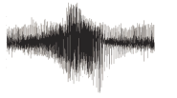


Modeling Epilepsy With Human Neurons
Hyperexcitable neurons lead to seizures
Many forms of epilepsy are poorly treated
Patient with epileptic phenotype
Apply Drugs to iPSC-derived Neurons
Reduce hyperexcitability to restore non-epileptic phenotype
38

Slide 57
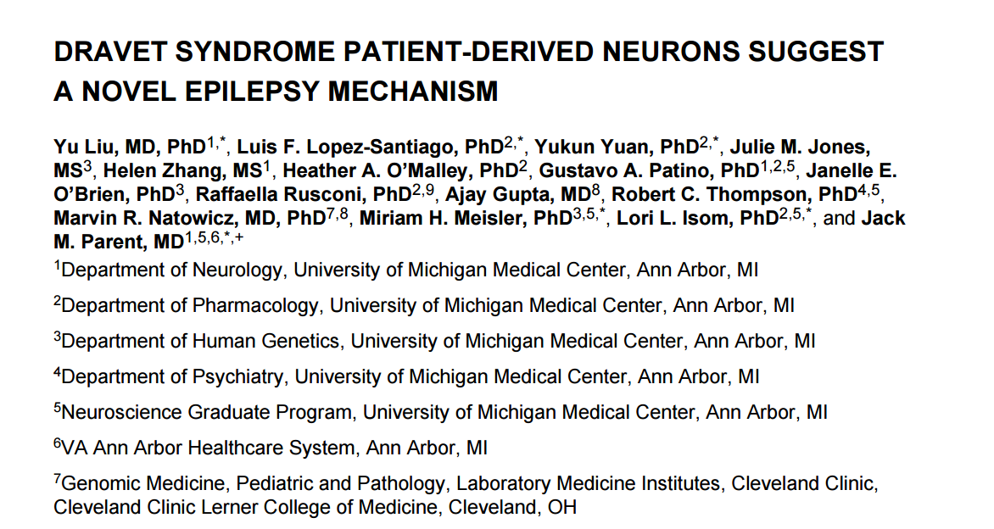
iPS & Dravet Syndrome
39

Slide 58
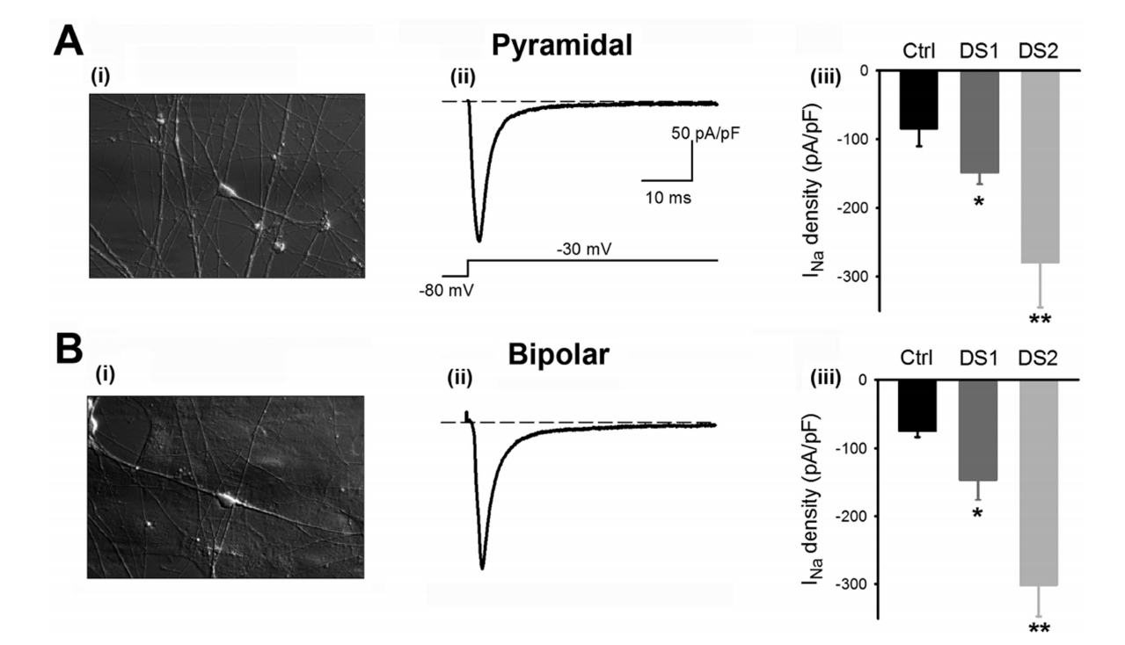
iPS & SCN1A Mutations
Liu et al., 2013
40

Slide 59
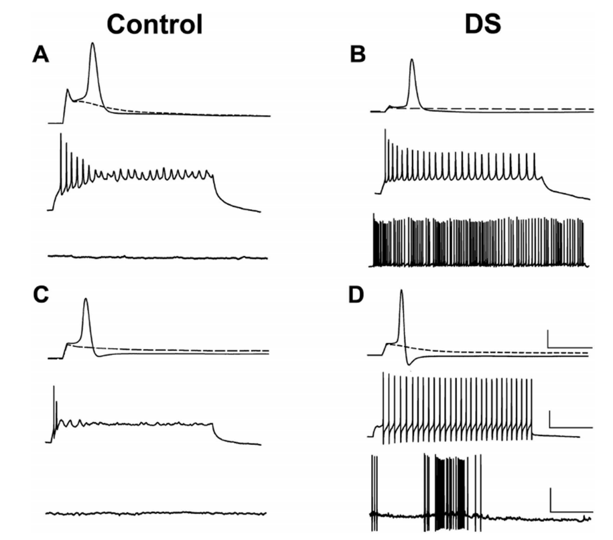
iPS & SCN1A Mutations
Liu et al., 2013
41

Slide 60
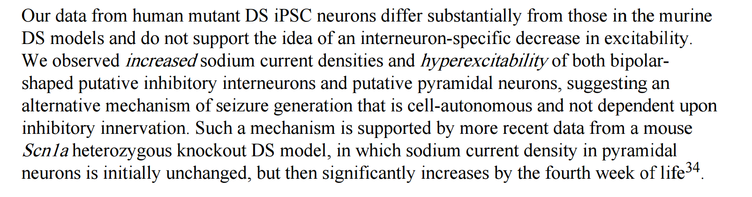
iPS & SCN1A Mutations
42

Slide 61
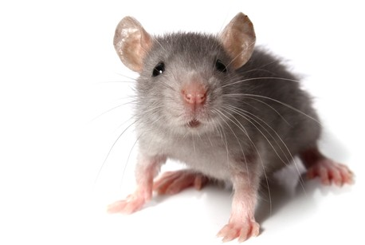
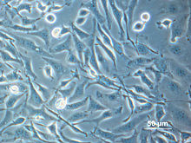
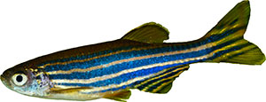
Pick Your Poison
43

Slide 62
Epilepsy Drugs
Drug
Year
Vigabatrin
…………..….…... 1994
Gabapentin
……..…..……... 1993
Clonazepam
…......……….. 1975
Clobazam
……..……....…... 1975
Valproate
……….......……... 1960
Ethosuximide
……….…….. 1960
Acetazolamide
……..……... 1952
Phenobarbital
……..……... 1912
Phenytoin
……….…..……... 1908
44

Slide 64
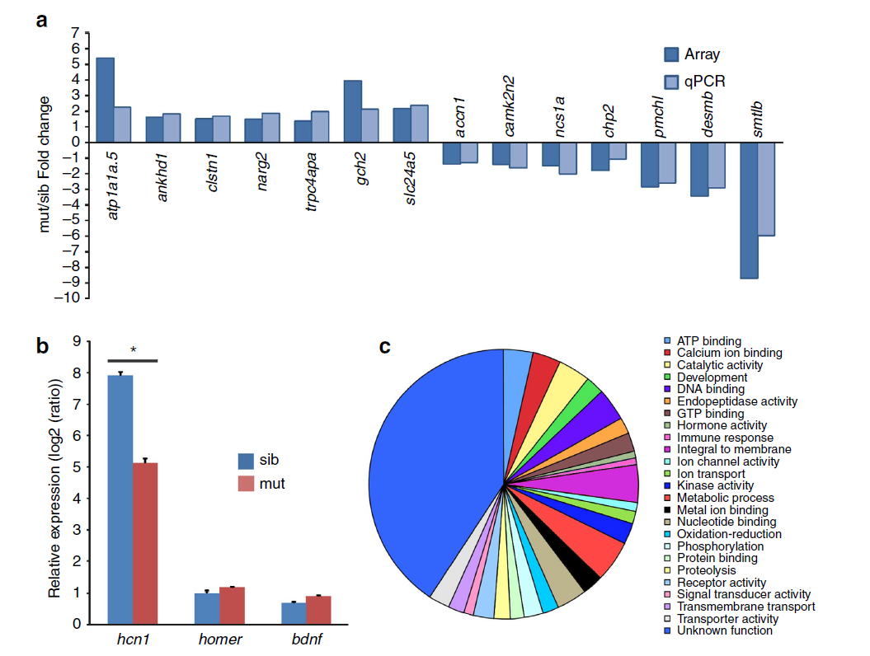
Figure 3
Baraban et al., 2013

Slide 65
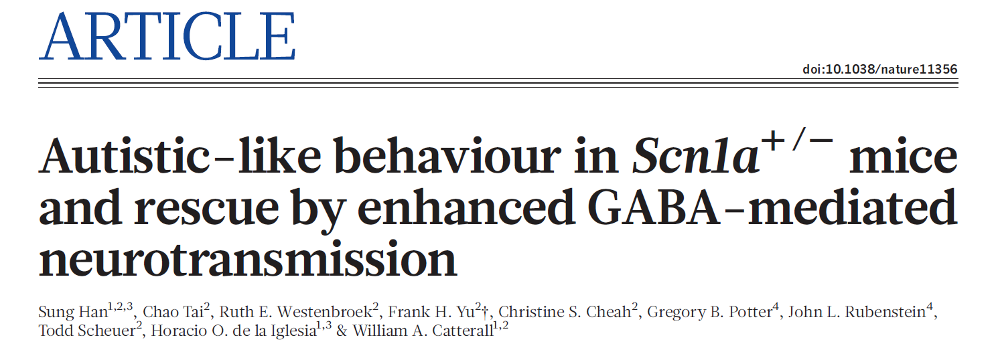
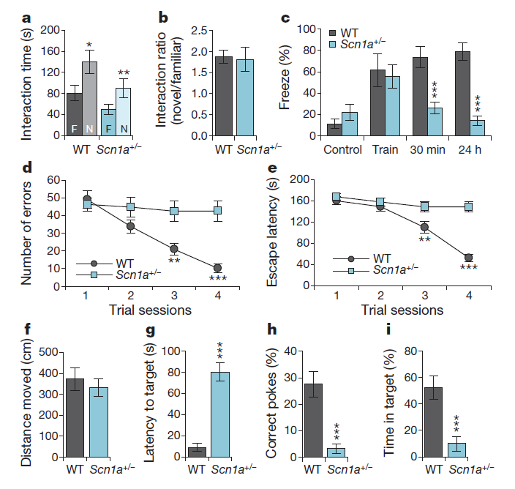
Figure 2

