Slide 1
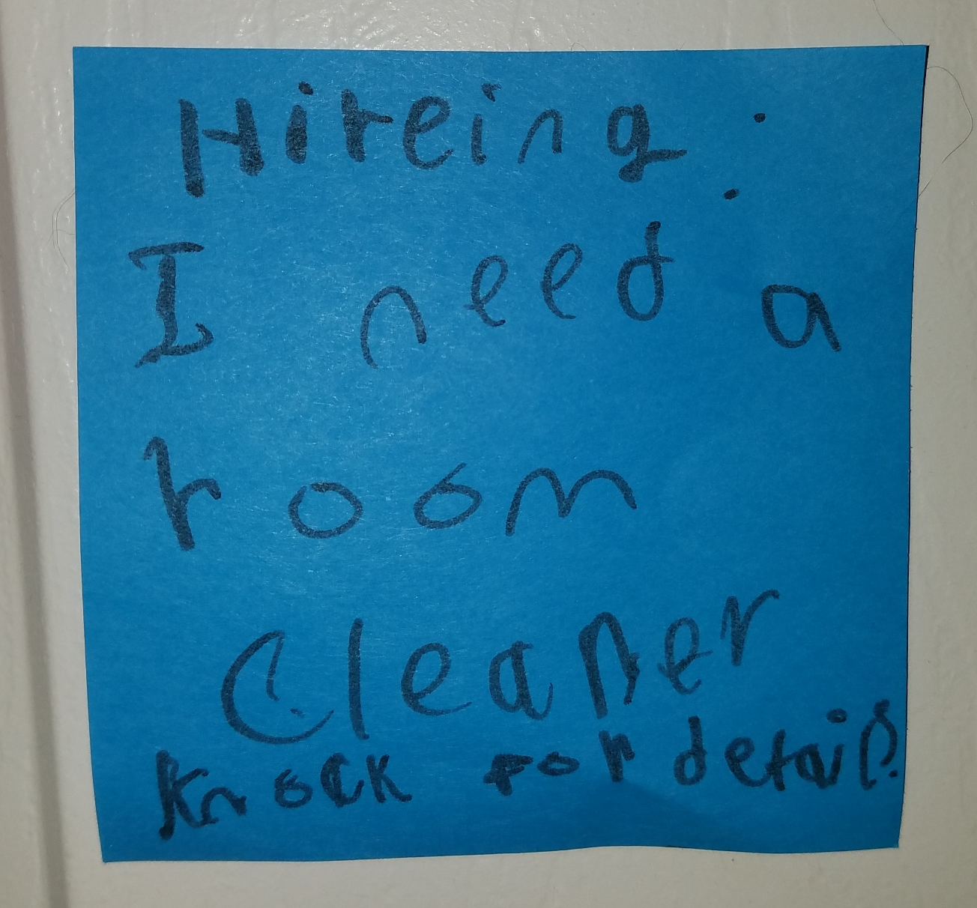

Slide 2
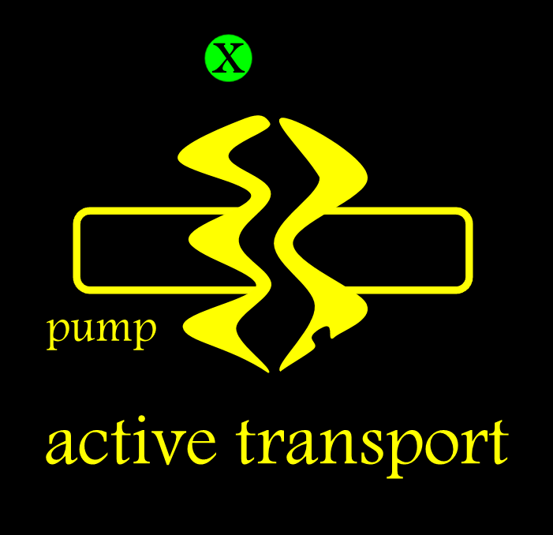
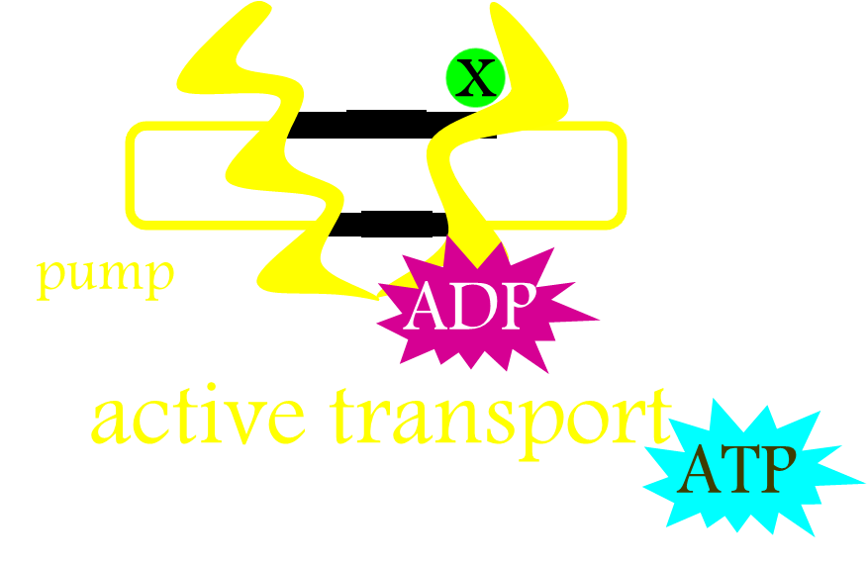
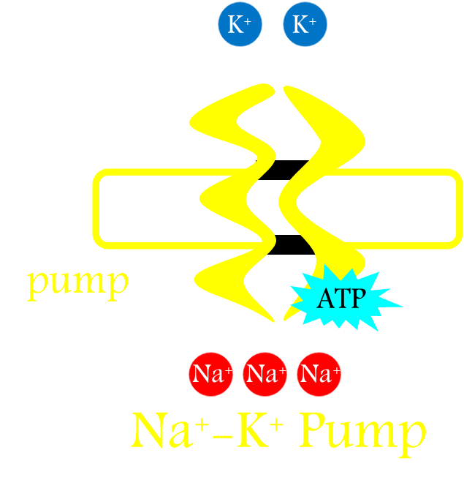
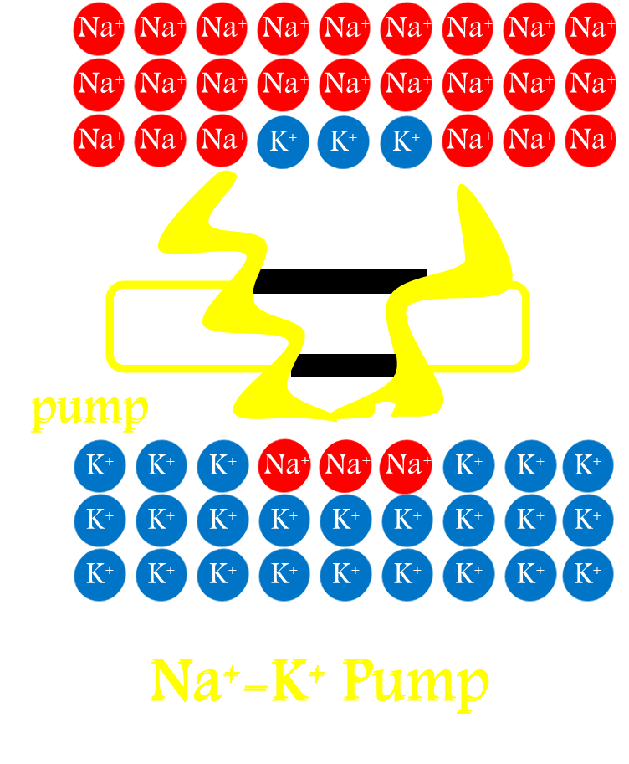
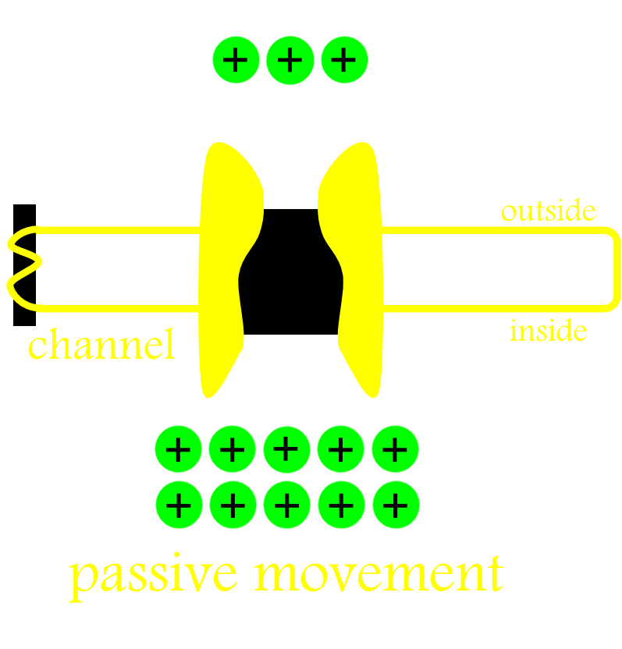
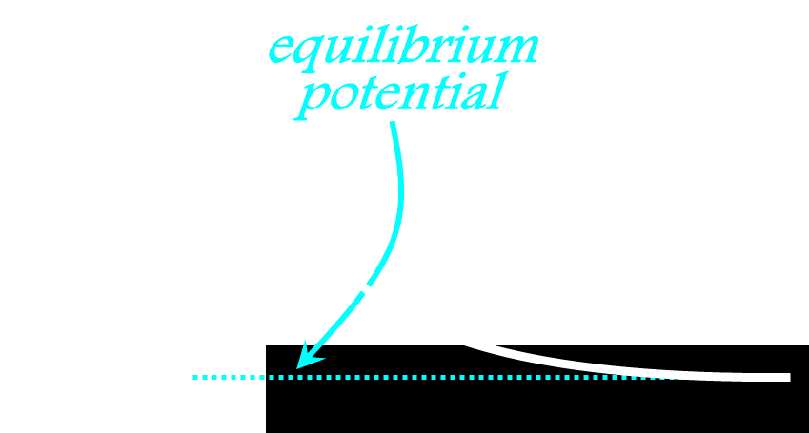
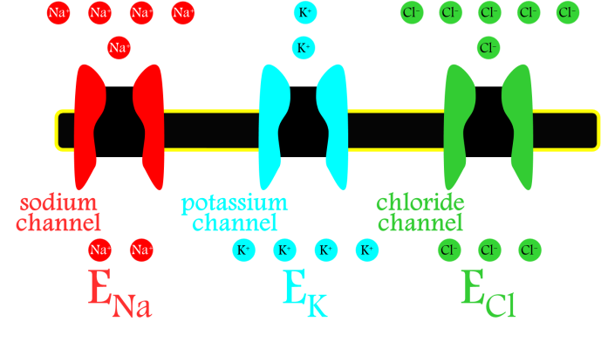
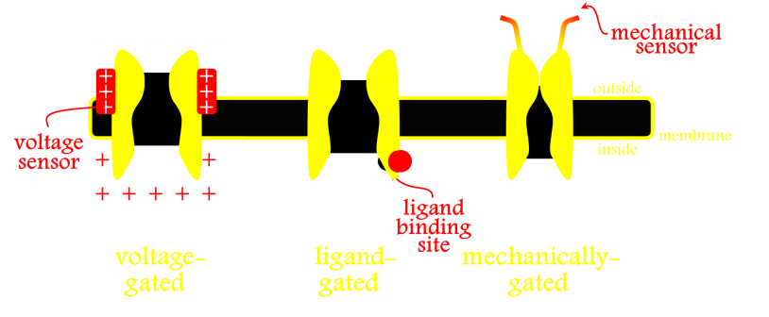
Ion Channels & Cellular Electrophysiology
Pumps
ATP-Driven Pumps
Na-K Pump
Na-K Gradients
Channels
Equilibrium Potential
Ion-Selective Channels
Channel Gating

Slide 3
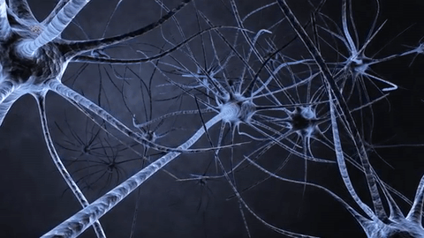
Synaptic Transmission
&
Neurotransmitter Receptors

Slide 4
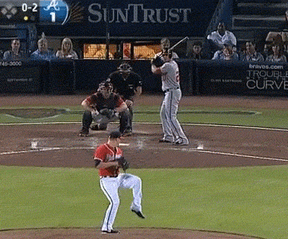

Slide 5
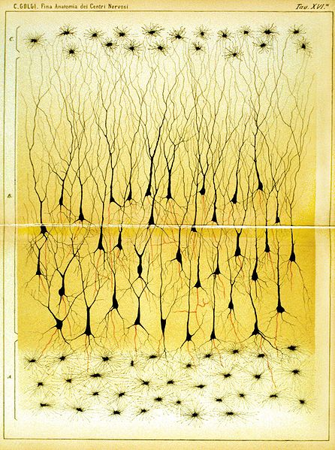
Two Ways Neurons Can Communicate
Notes:
Reticular theory VS the neurone doctrine

Slide 6
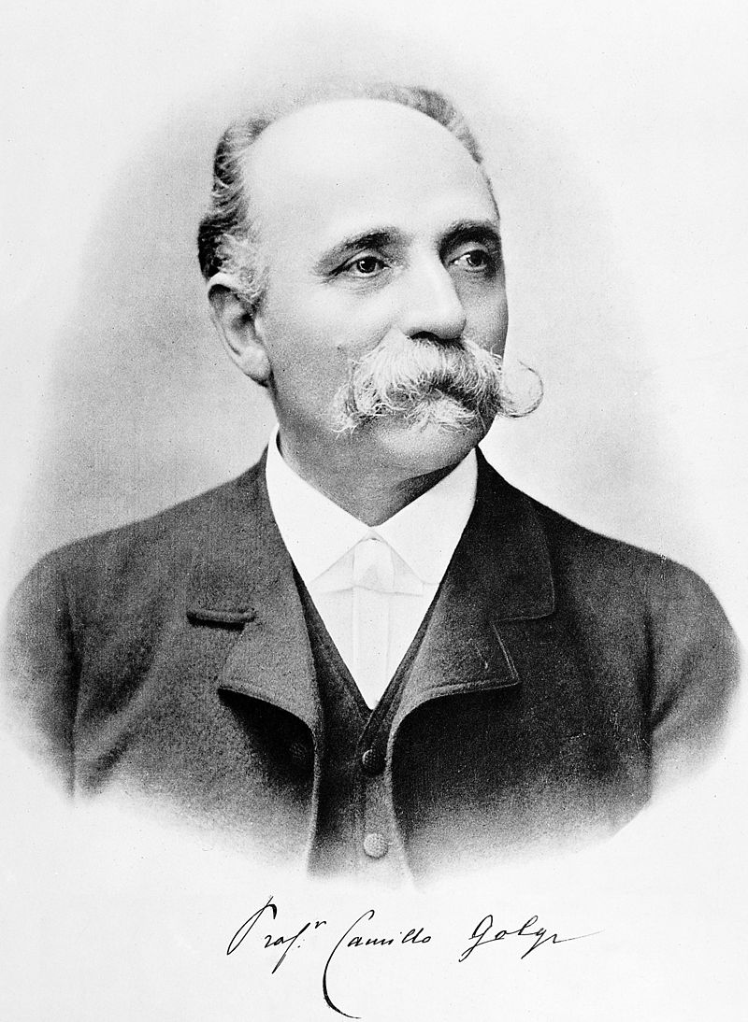
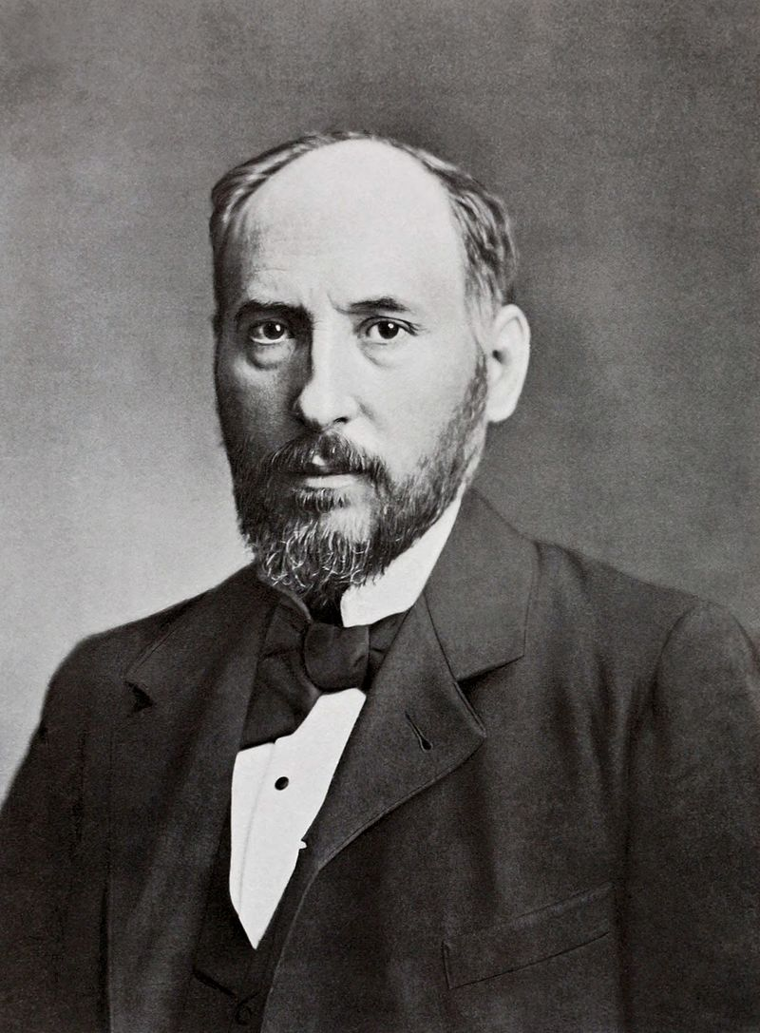
Two Ways Neurons Can Communicate
Camillo Golgi
Santiago Ramon y Cajal
Notes:
Nobel: 1906

Slide 7
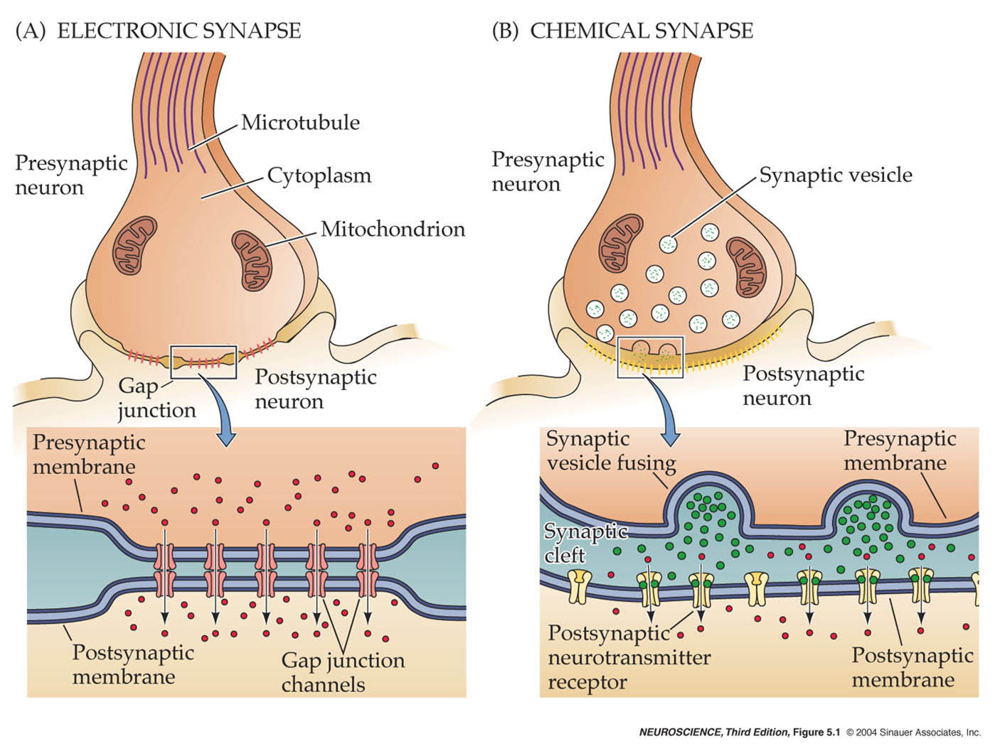
Two Ways Neurons Can Communicate

Slide 8
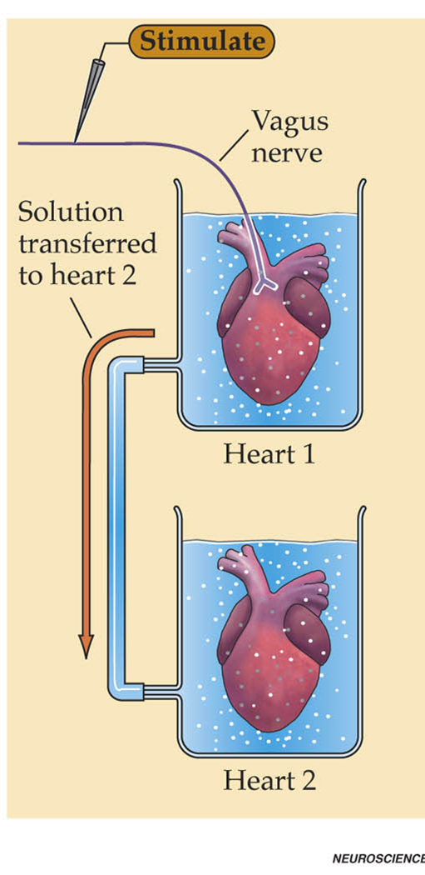
Two Ways Neurons Can Communicate

Slide 9
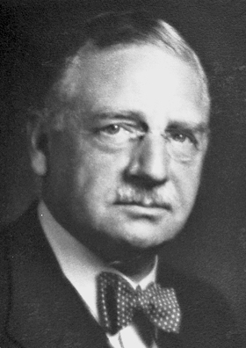
Two Ways Neurons Can Communicate
Otto Loewi
Notes:
Nobel 1936

Slide 10
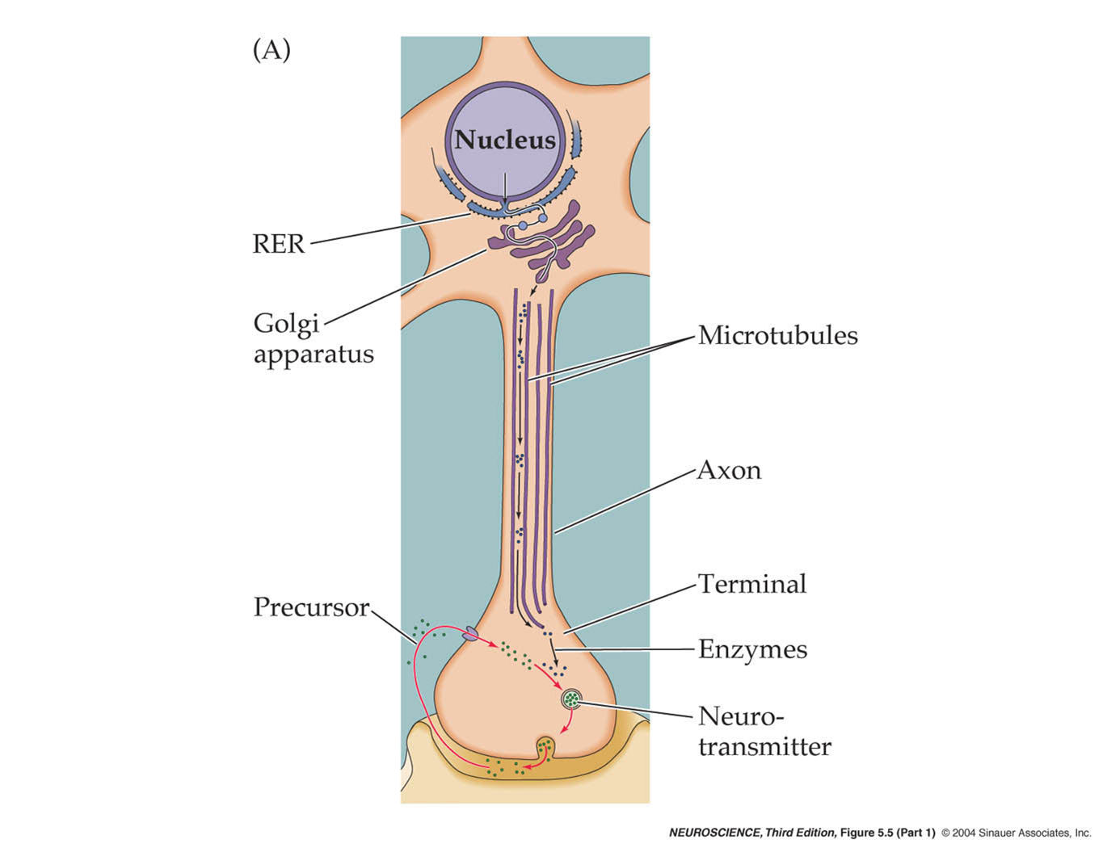
Special Structures For Neurotransmission

Slide 11
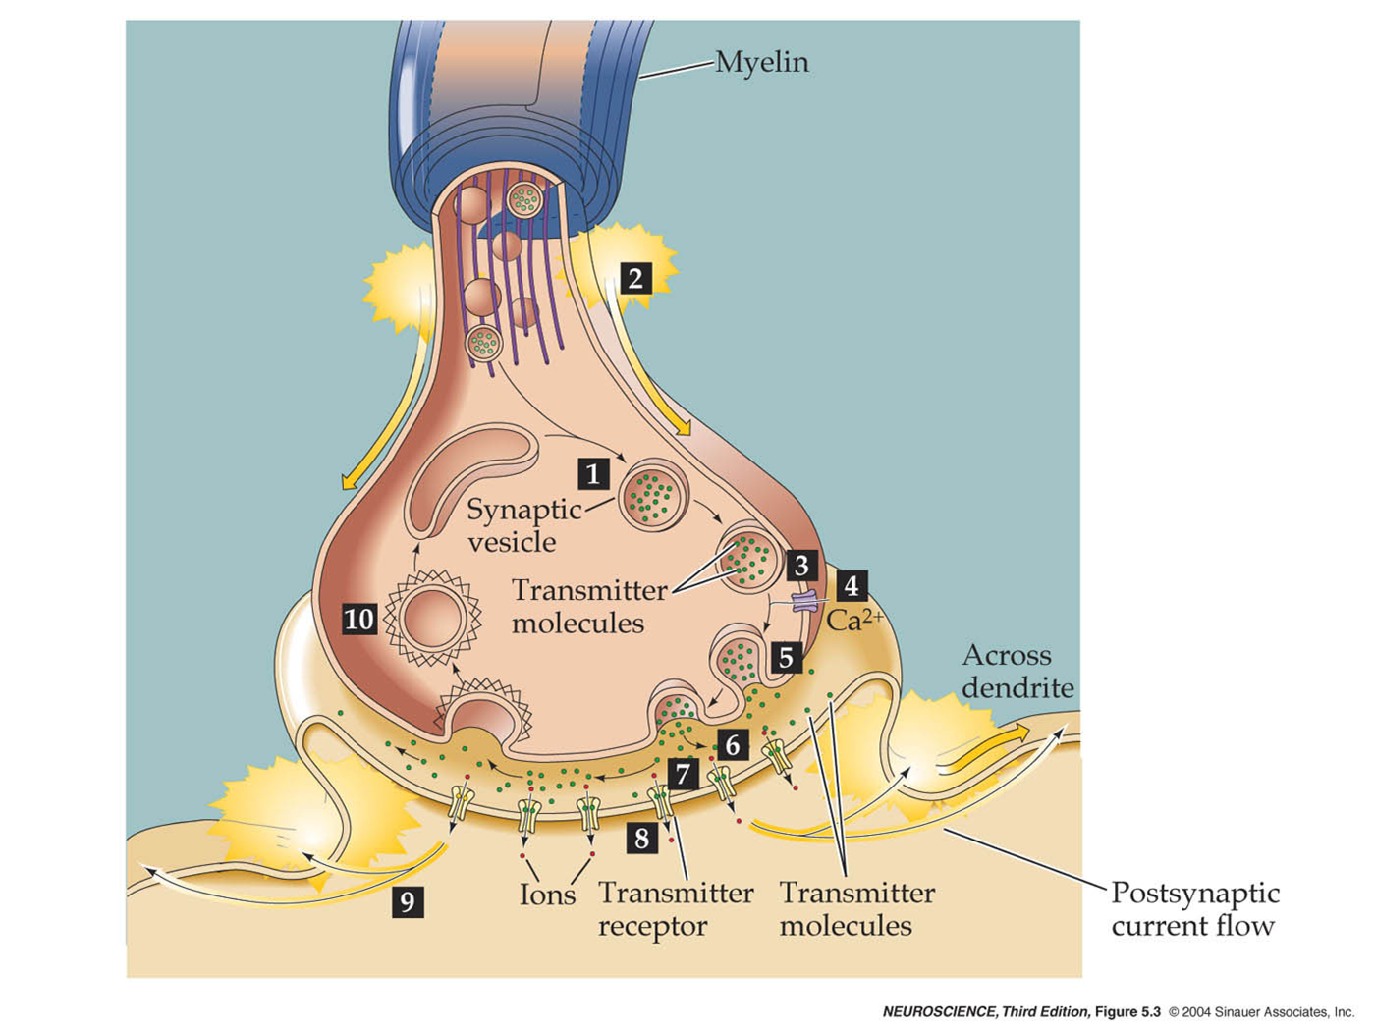
Steps of Neurotransmission

Slide 12
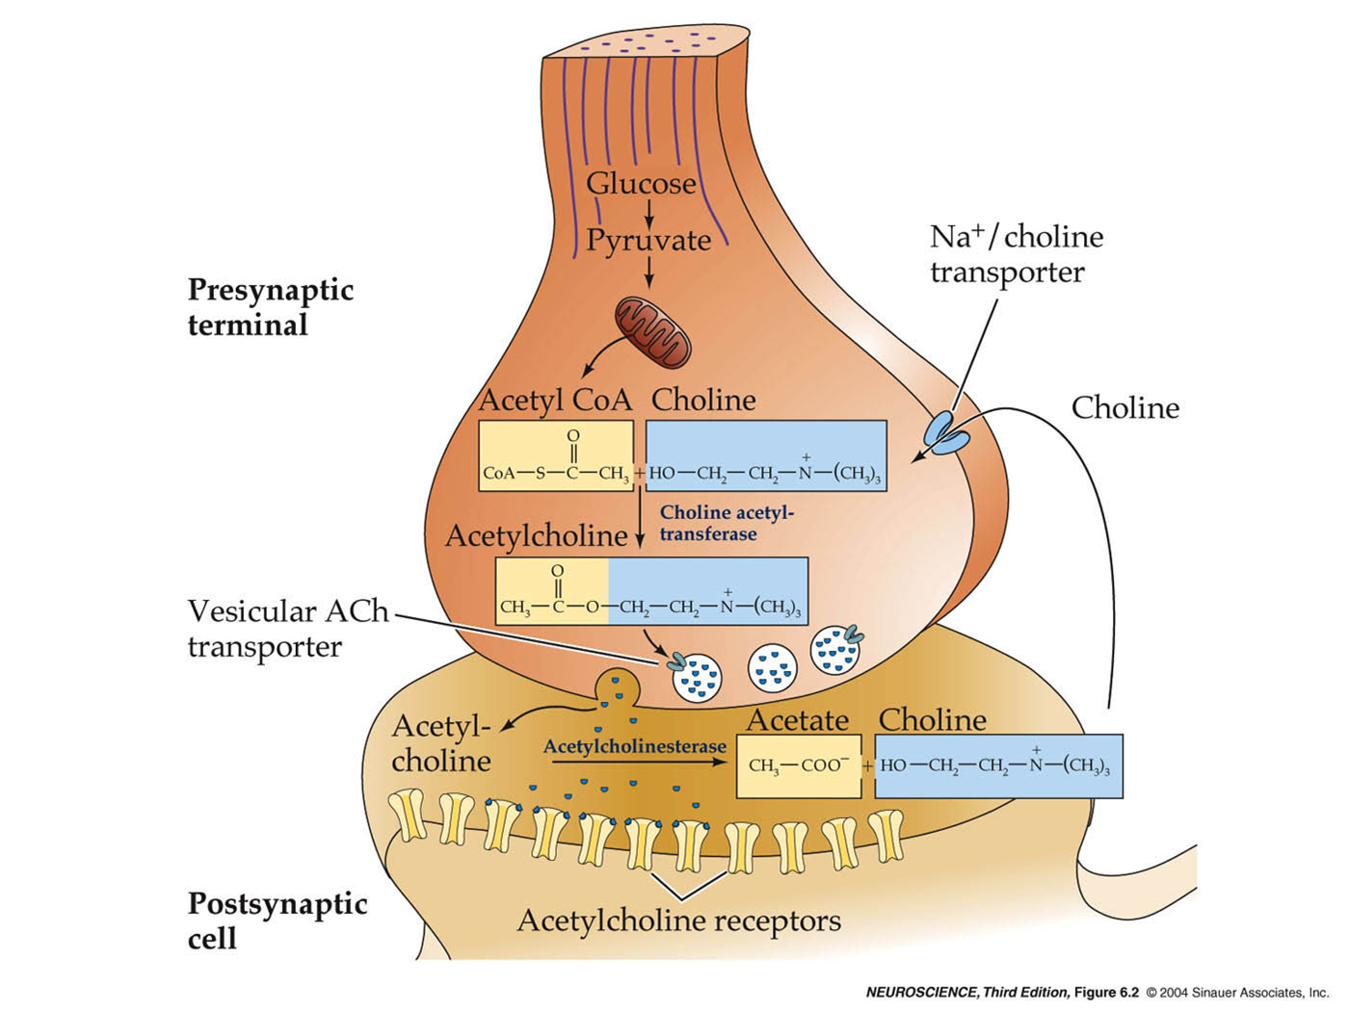
Cholinergic Synapse

Slide 13
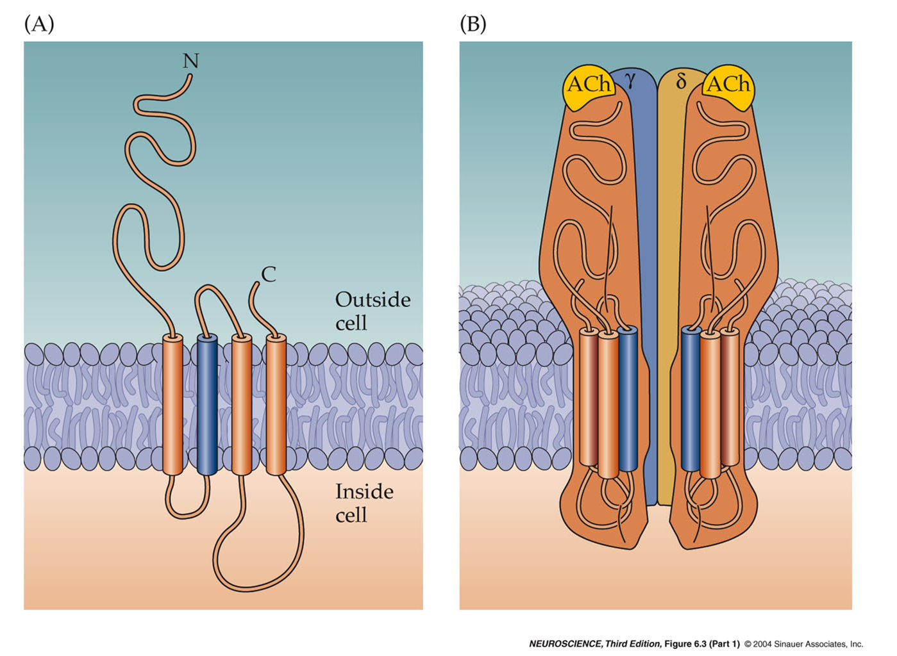
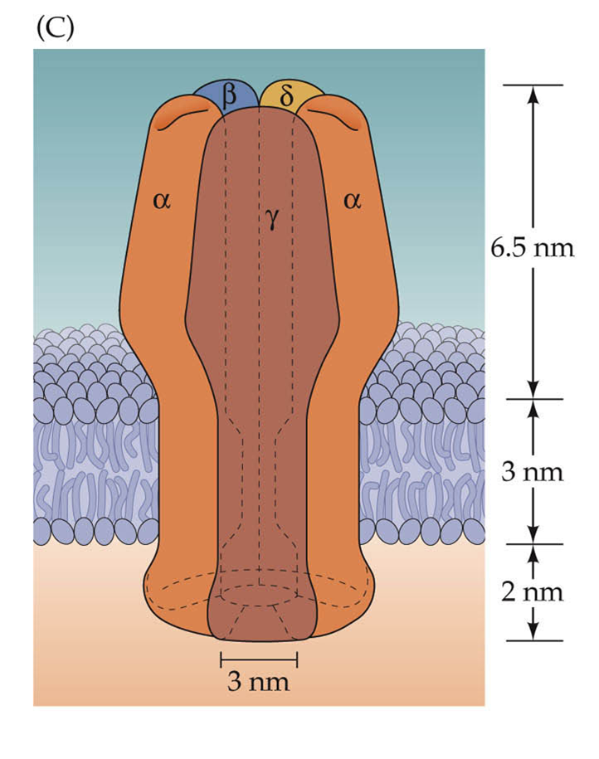
Acetylcholine Receptor

Slide 14
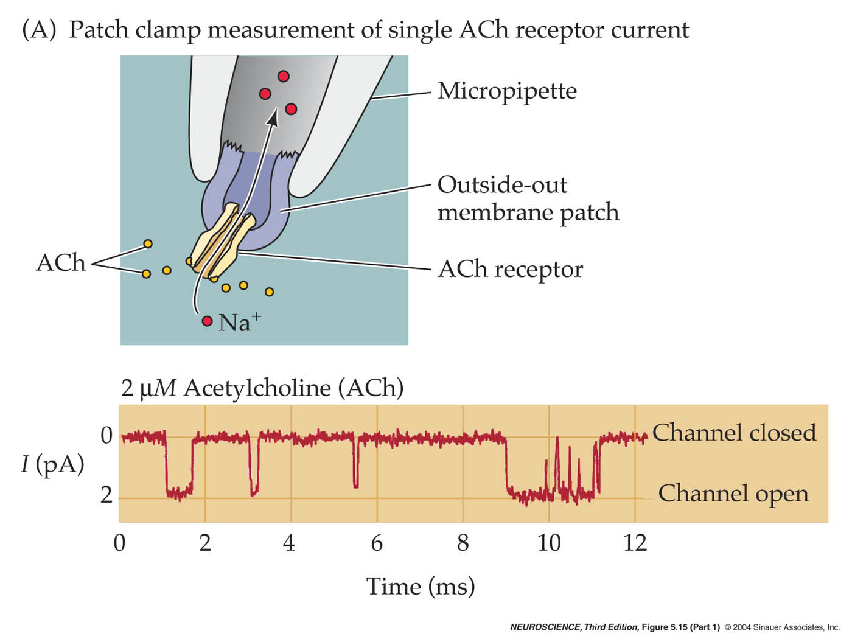
Cholinergic Currents

Slide 15
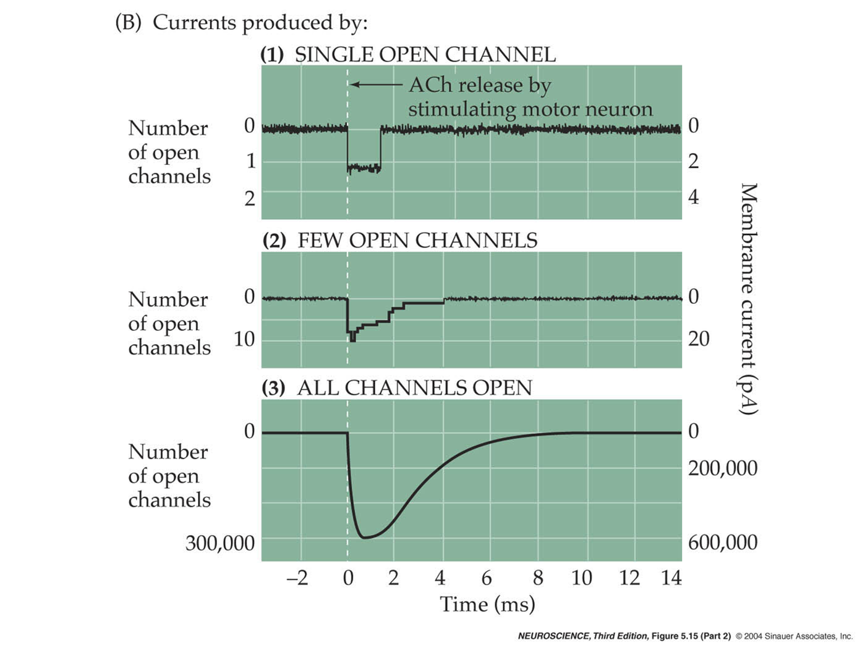
Cholinergic Currents

Slide 16
Cholinergic Currents

Slide 17
Recording Synapses
Presynaptic & Postsynaptic

Slide 18

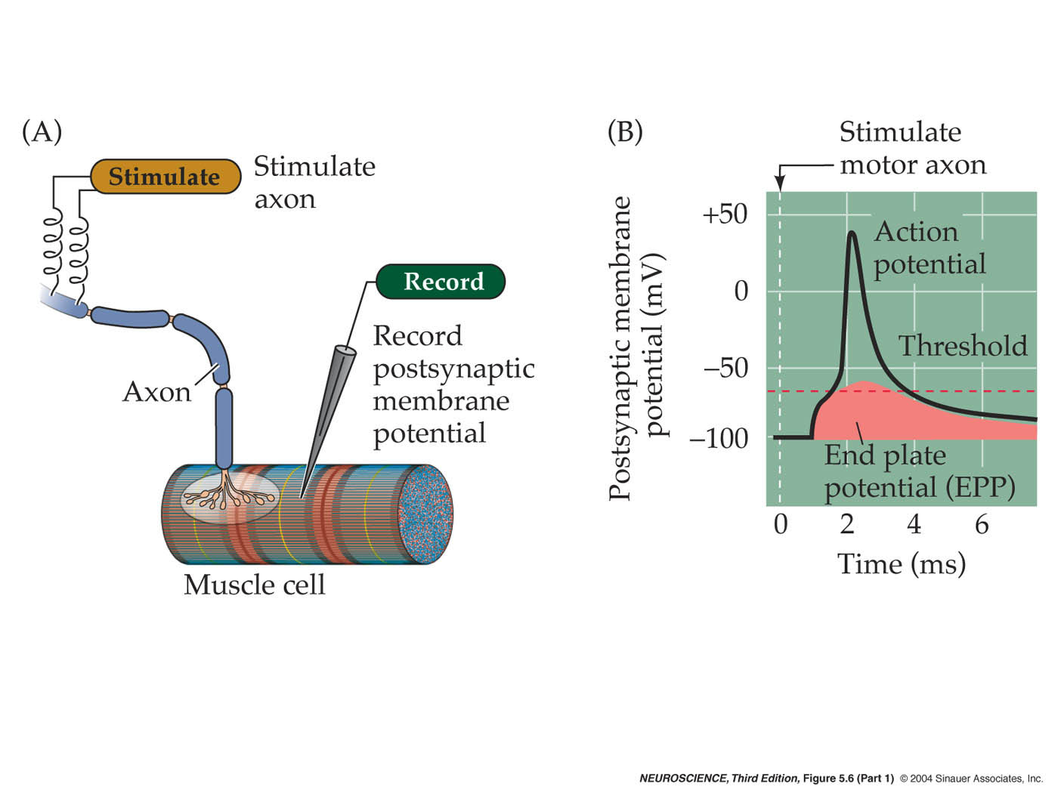
Recording Synapses
Presynaptic & Postsynaptic
Voltage

Slide 19
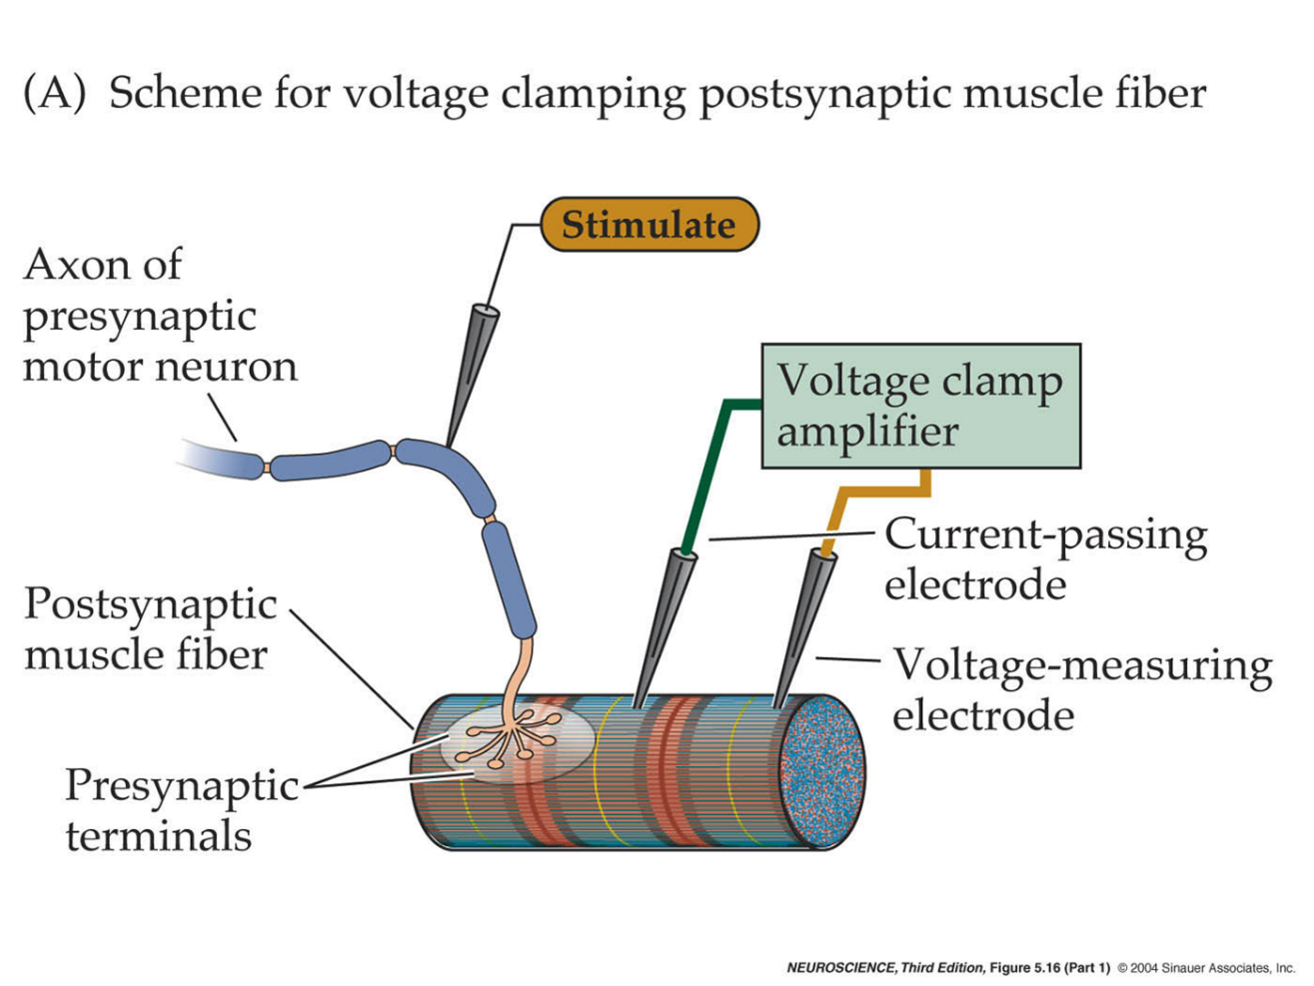
Recording Synapses
Presynaptic & Postsynaptic
Current
Voltage

Slide 20
Neuromuscular Junction: Model for Synaptic Function

Slide 21
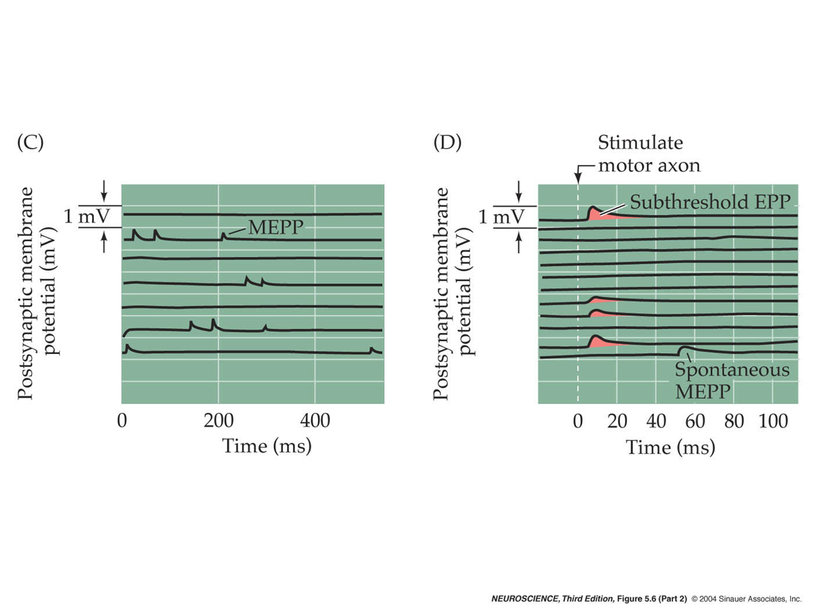
Muscle Recordings

Slide 22
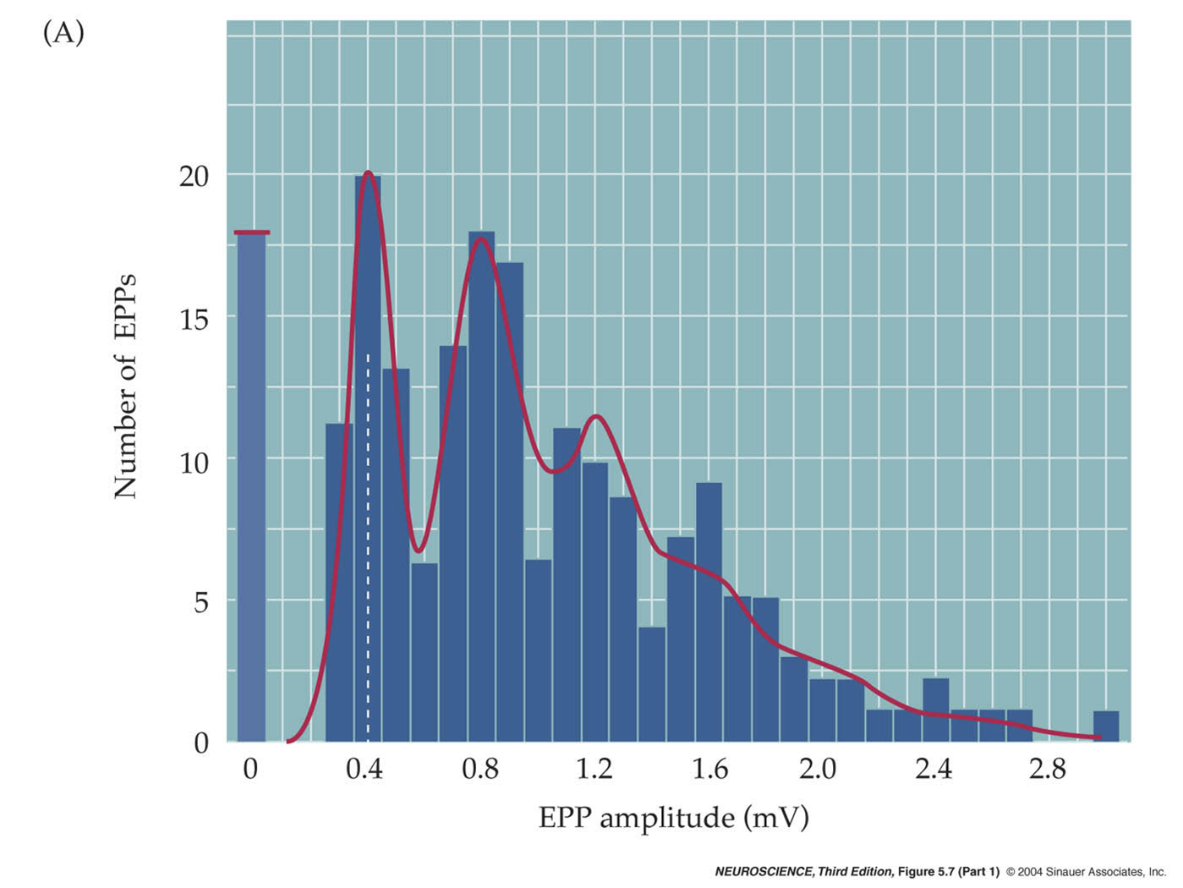
Distribution of EPP Amplitudes

Slide 23
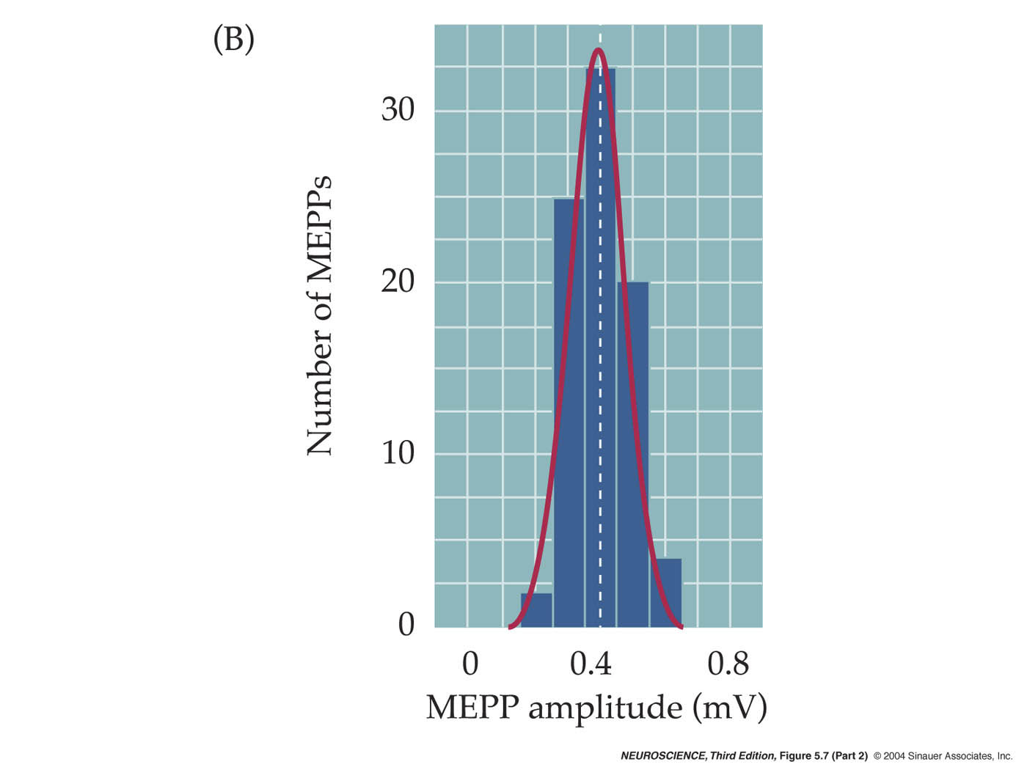
Quantal Transmission

Slide 24

Quanta Represent Single Vesicles

Slide 25
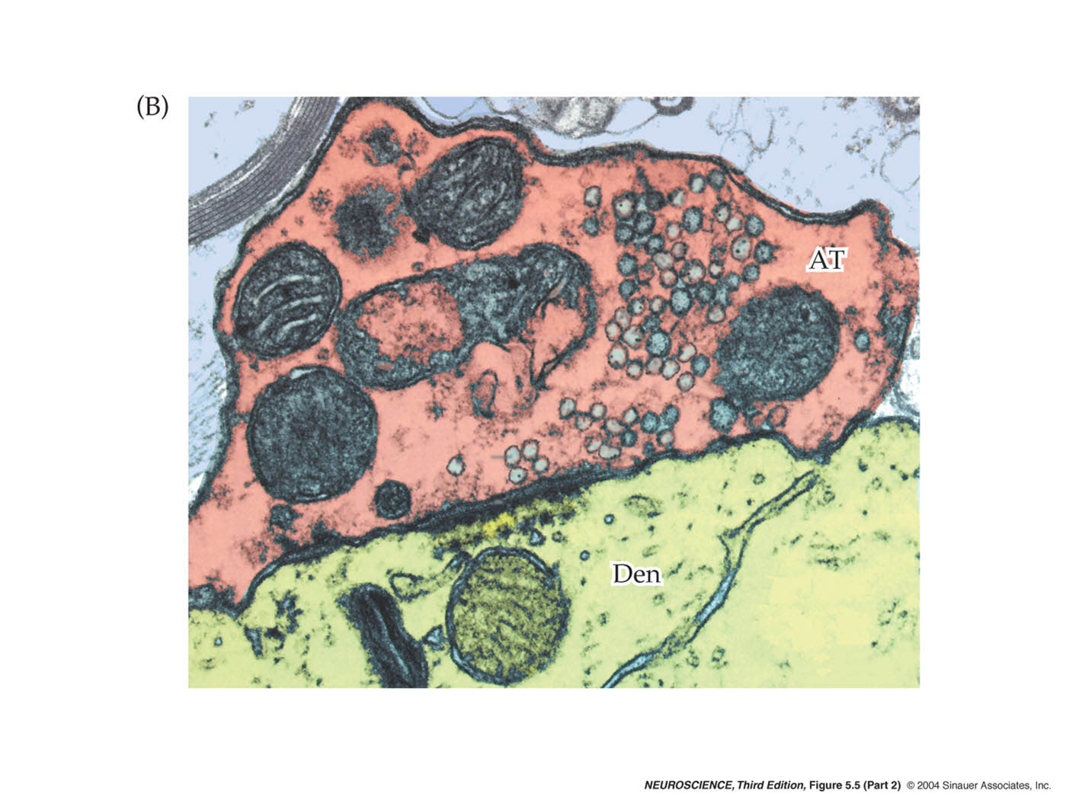
Vesicles at a Real Synapse

Slide 26
Cholinergic Synapse

Slide 27

Recording Synaptic Currents

Slide 28
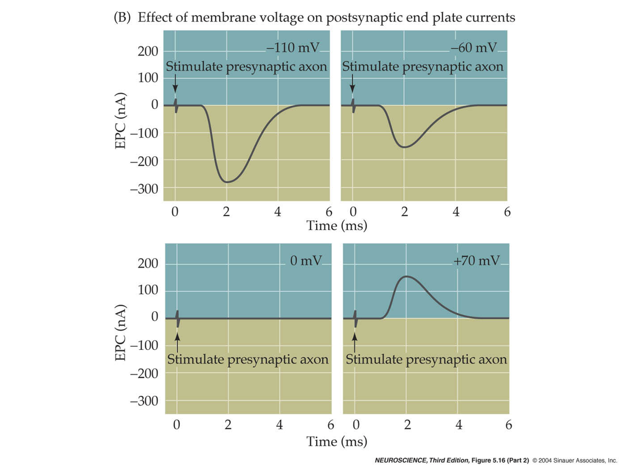
Membrane Potential Determines Current Flow

Slide 29
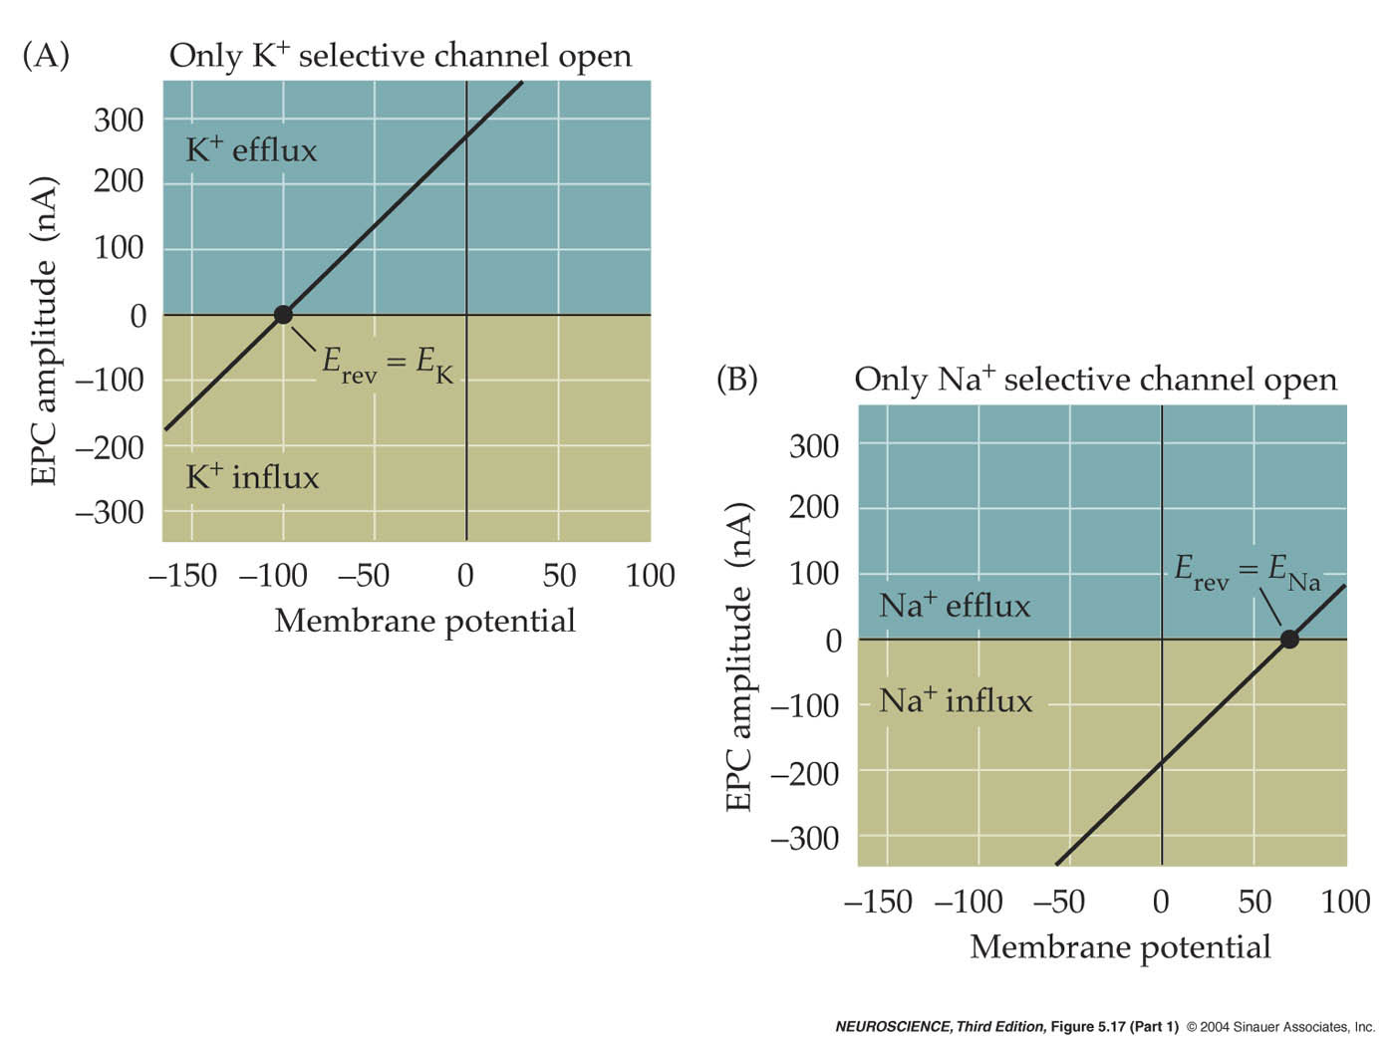
Equilibrium Potentials

Slide 30
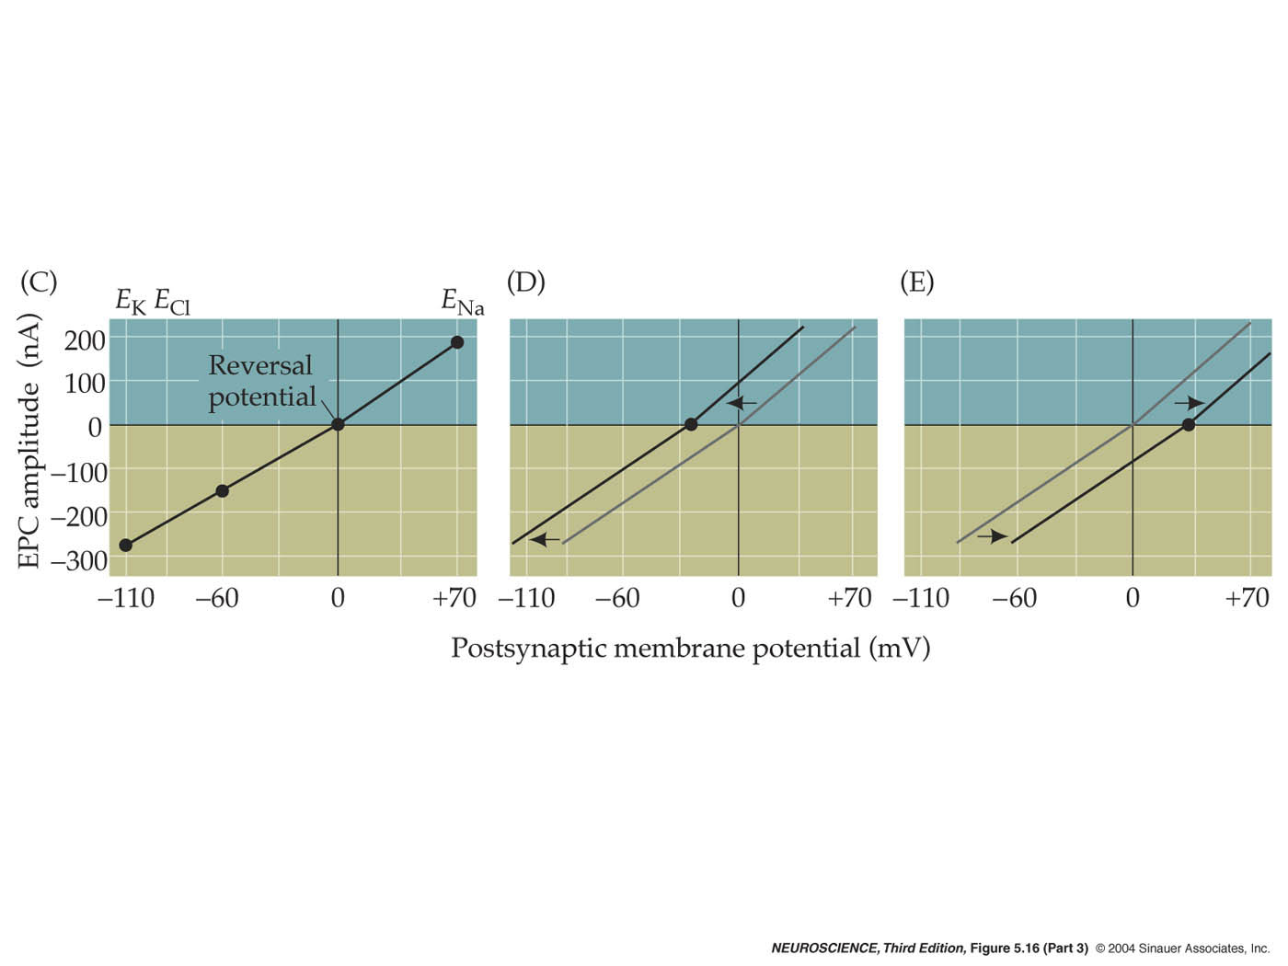
Test Your Hypothesis

Slide 31
Cholinergic Synapse

Slide 32
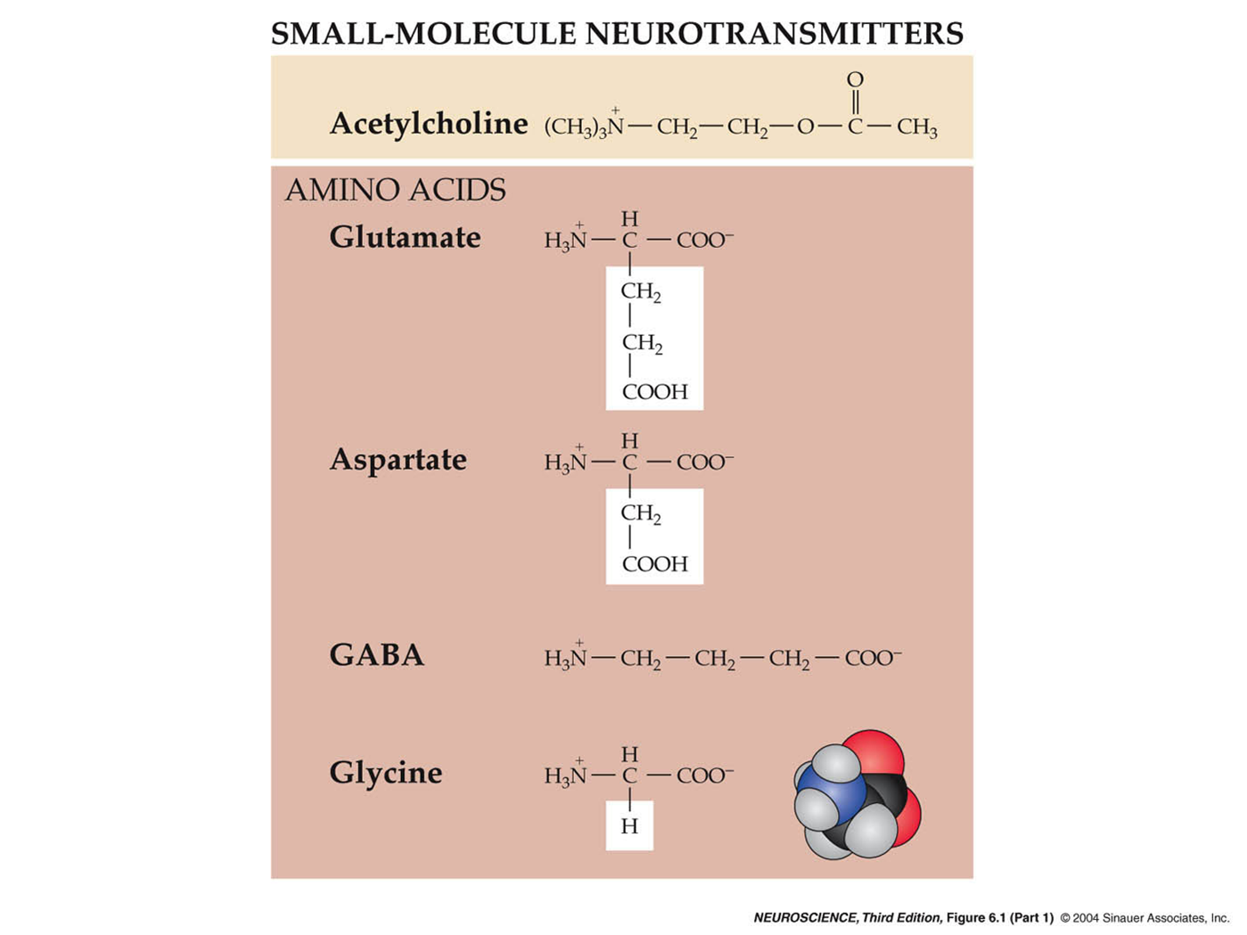
Neurotransmitters

Slide 33
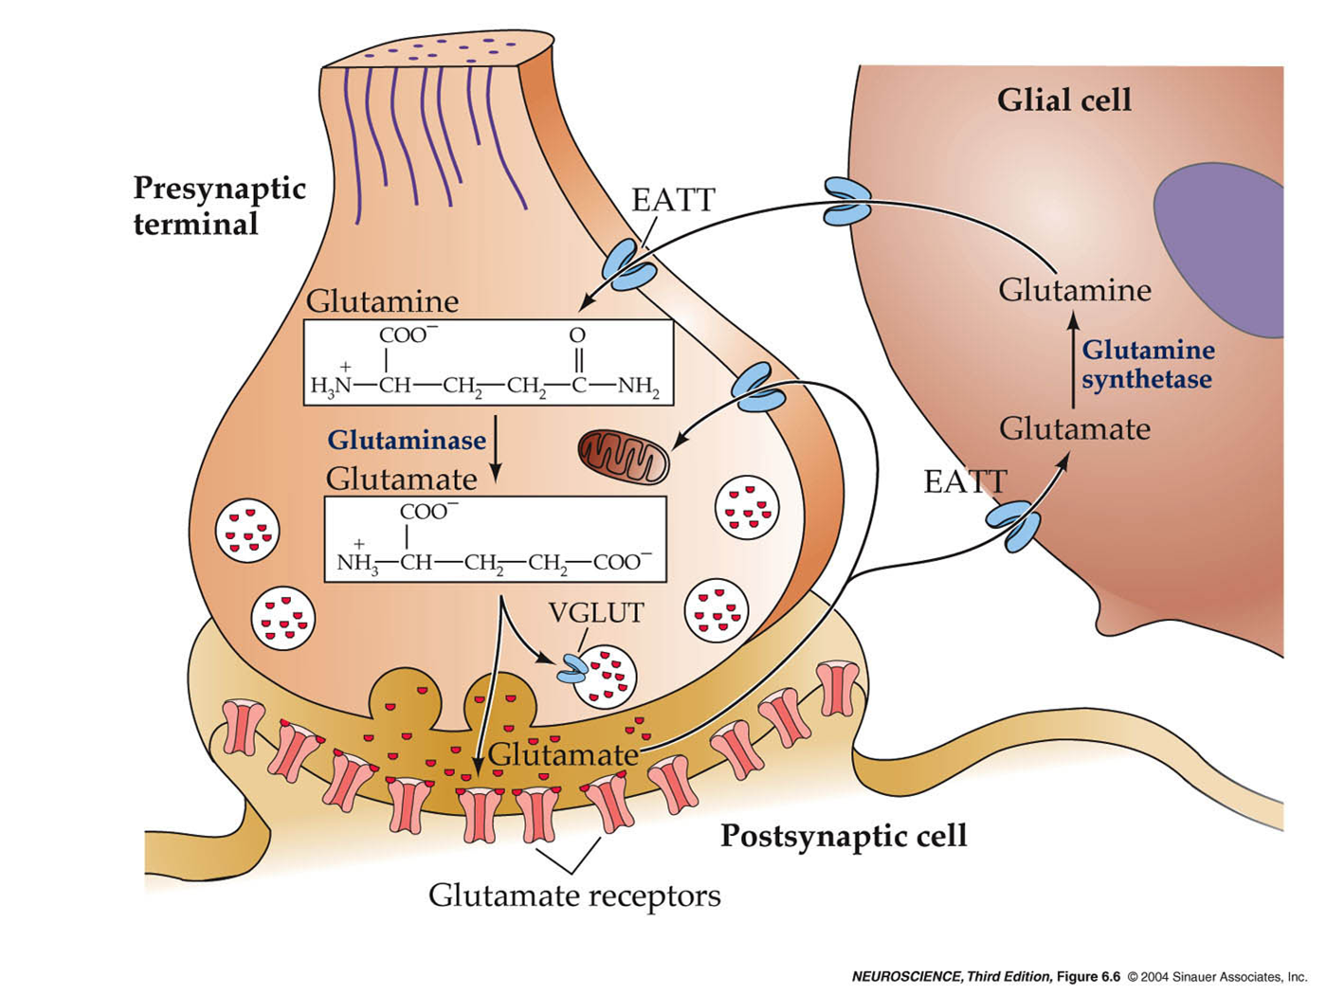
Glutamate Synthesis

Slide 34
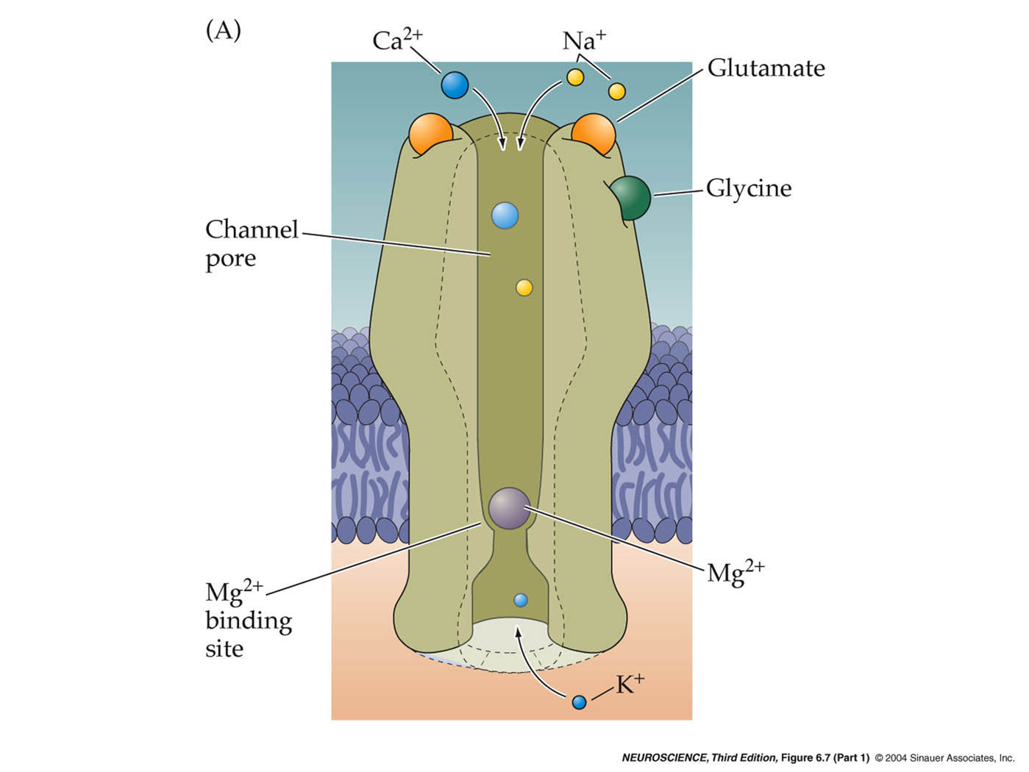
NMDA Glutamate Receptor

Slide 35
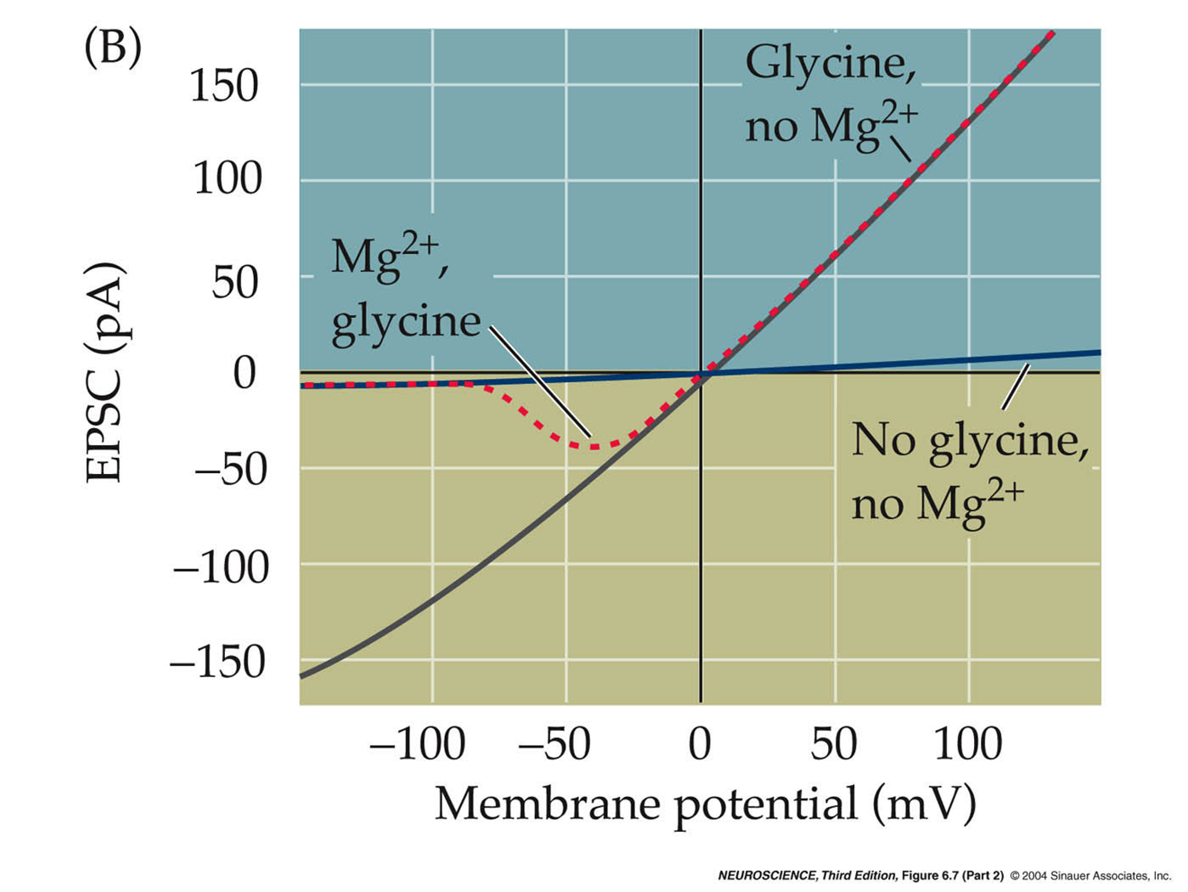
NMDA Glutamate Receptor

Slide 36
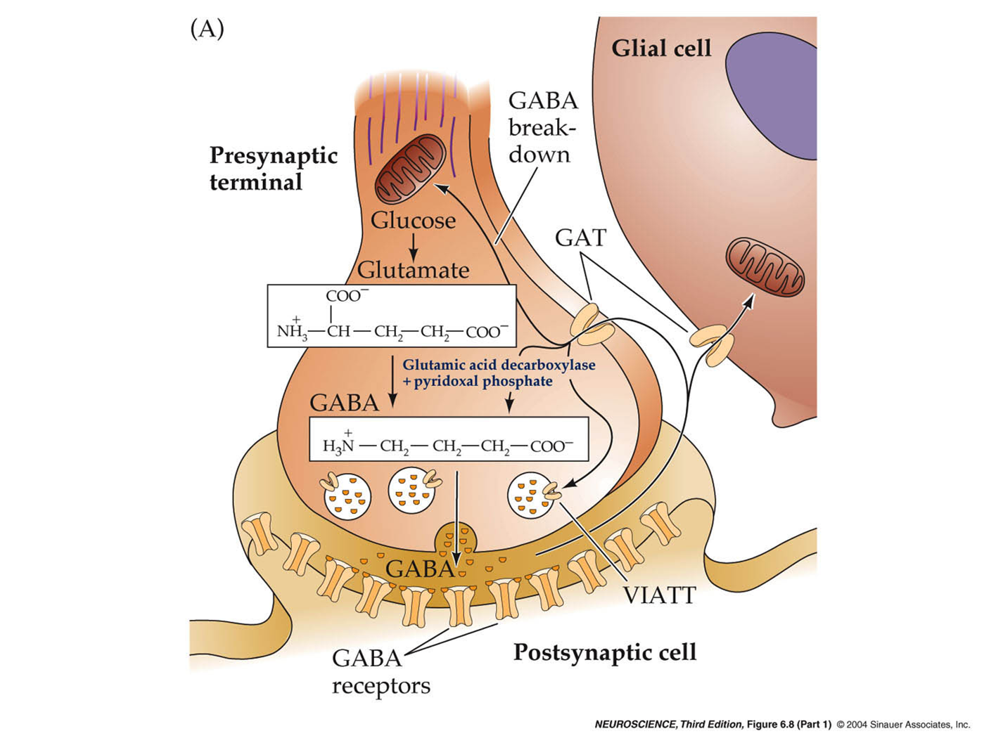
GABA Synthesis

Slide 37
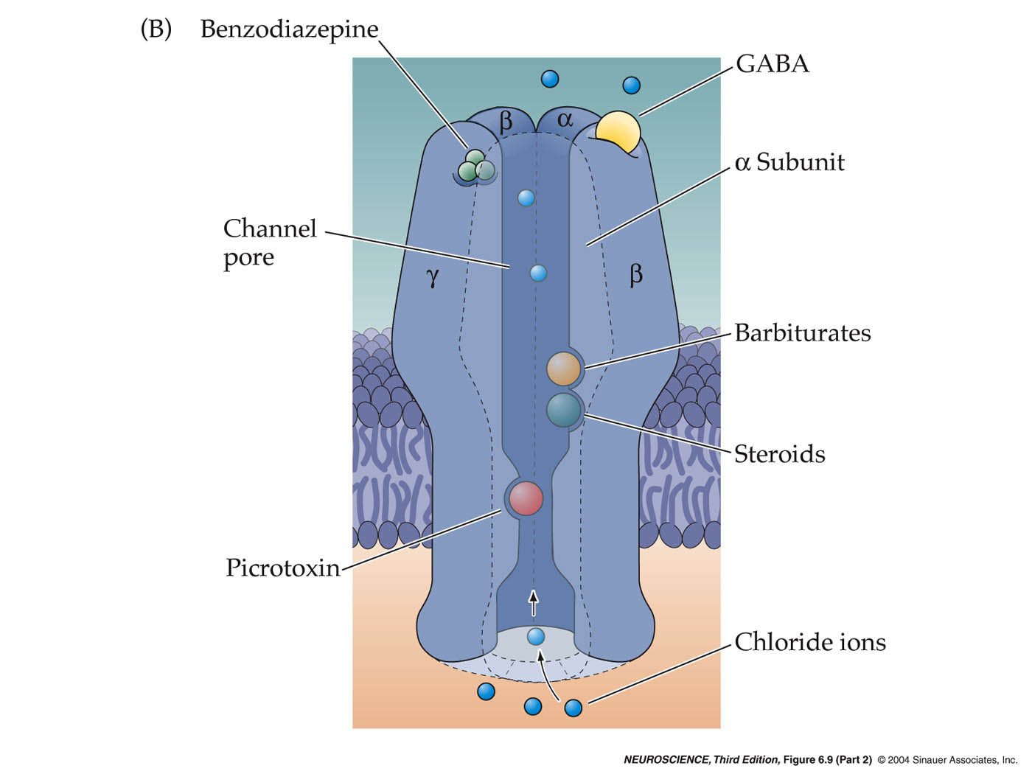
GABA Receptor: Ionotropic

Slide 38
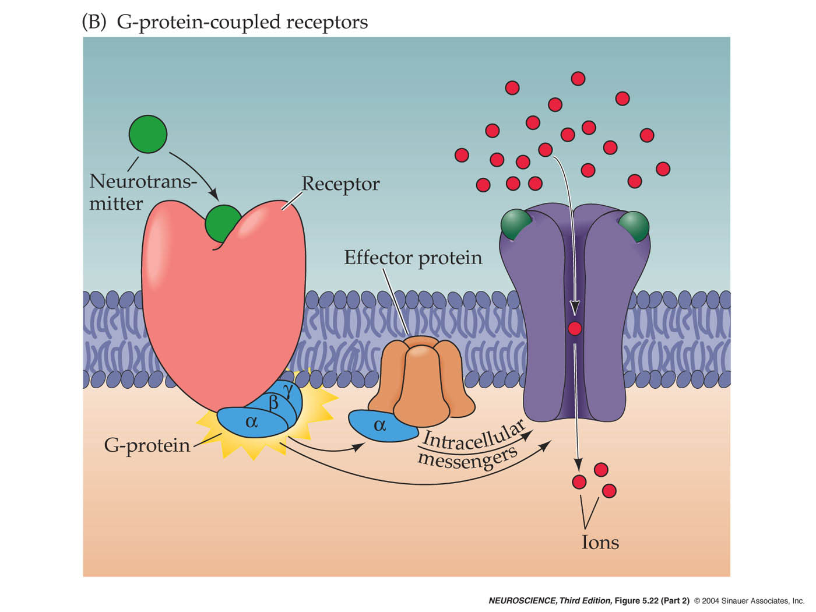
GABA Receptor: Metabotropic

Slide 39
Many Neurotransmitters & Receptors
To Fire or To Not Fire?

Slide 40

Many Neurotransmitters & Receptors
To Fire or To Not Fire?

Slide 41
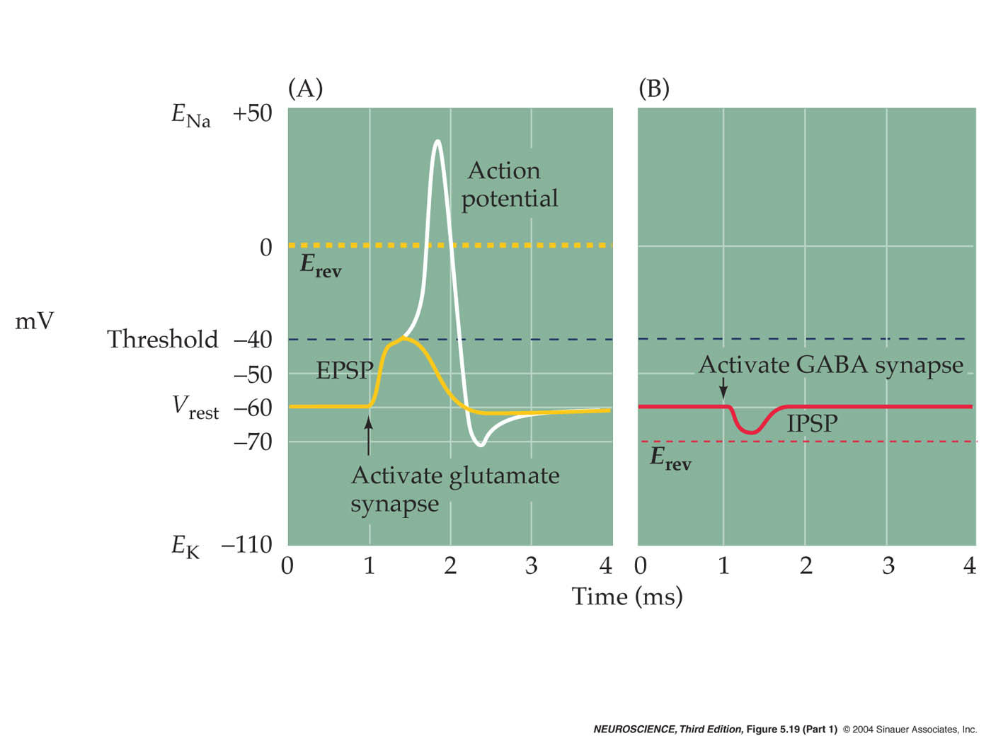
Excitatory & Inhibitory Currents

Slide 42
Excitatory & Inhibitory Currents

Slide 43
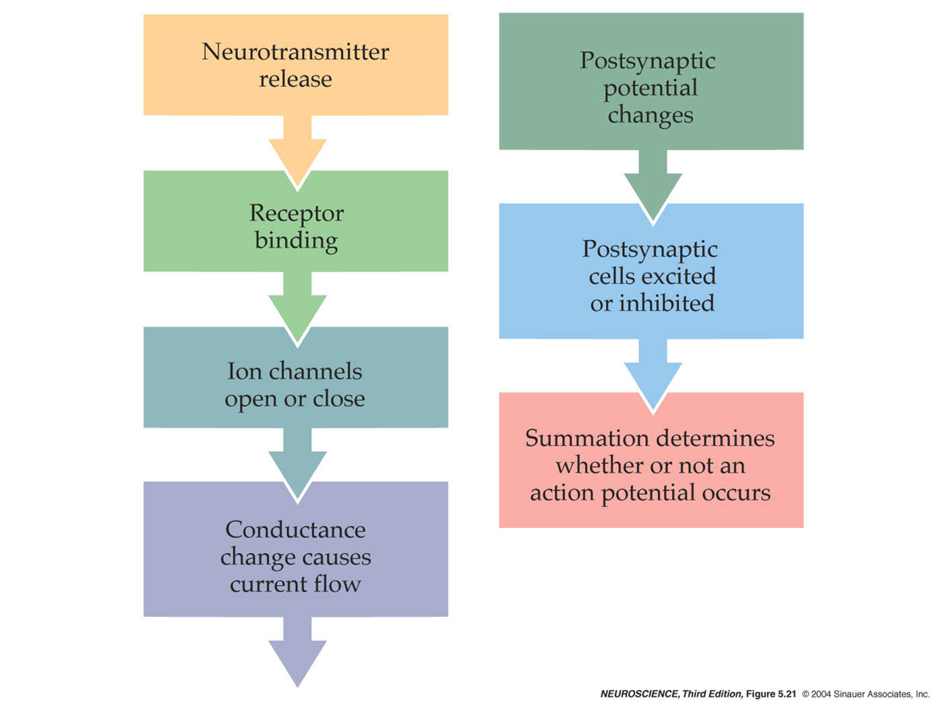
Excitatory & Inhibitory Currents

Slide 44





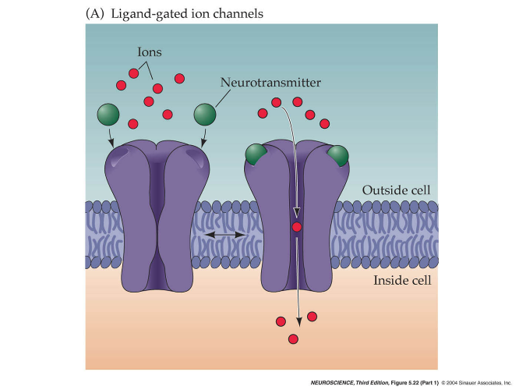


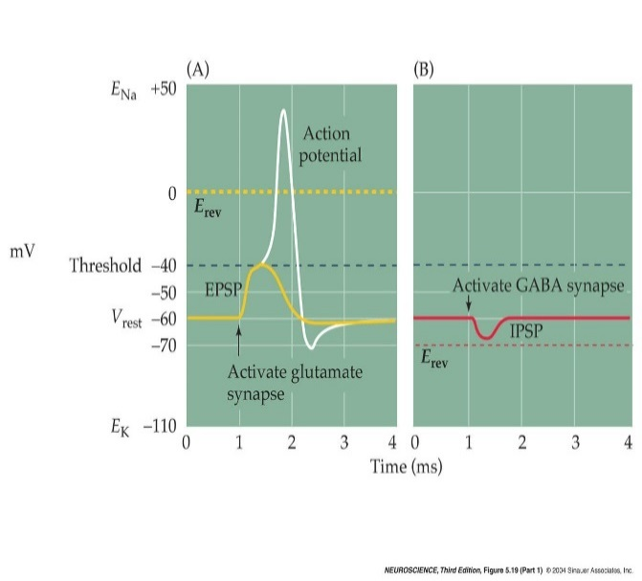
Summary

Slide 45
Ion Channels & Cellular Electrophysiology
Pumps
ATP-Driven Pumps
Na-K Pump
Na-K Gradients
Channels
Equilibrium Potential
Ion-Selective Channels
Channel Gating

Slide 46
Ion Channels & Cellular Electrophysiology
Pumps
ATP-Driven Pumps
Na-K Pump
Na-K Gradients
Channels
Equilibrium Potential
Ion-Selective Channels
Channel Gating

