Slide 1
Ion Channels & Cellular Electrophysiology
Mark Beenhakker
markbeen@virginia.edu
action potential
cell
pumps &
membrane
electrical
channels
voltage
signals

Slide 2
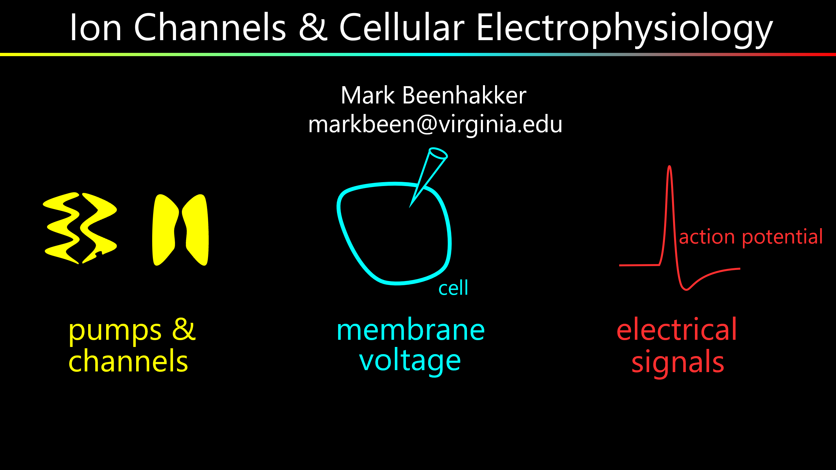
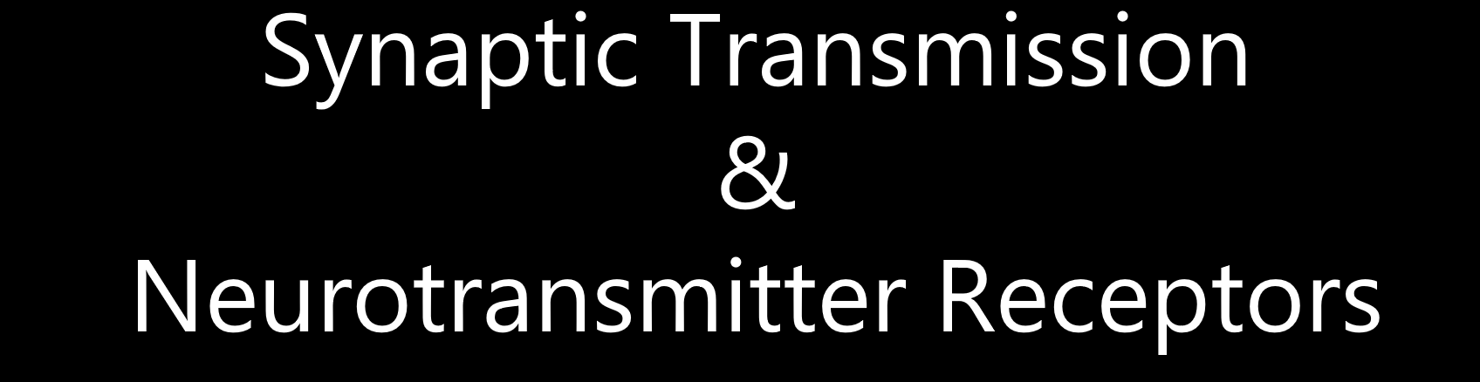

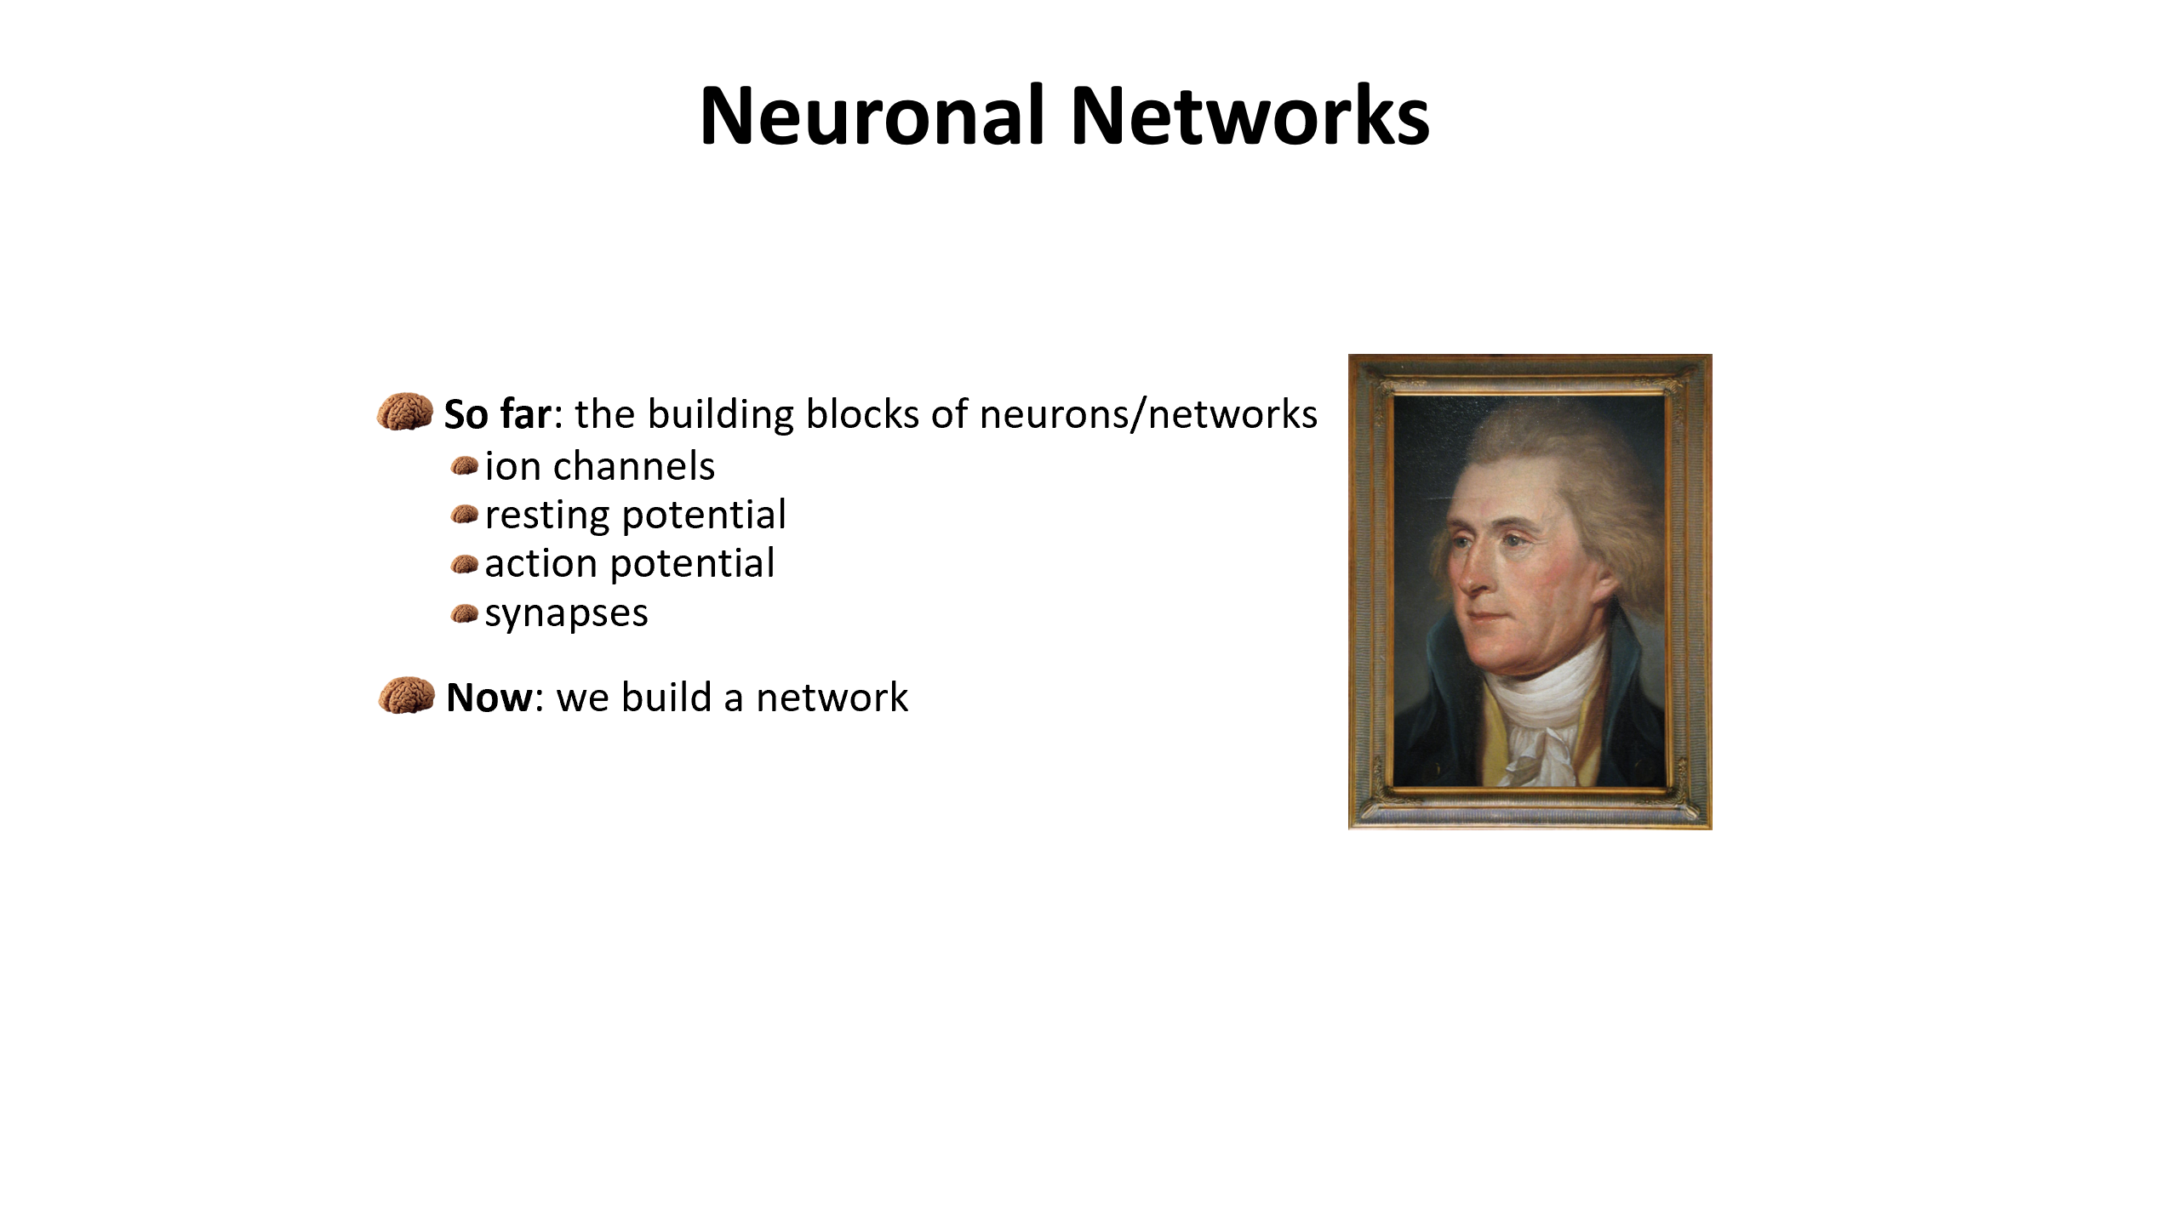
A Three-Hour Lecture with Three Parts

Slide 3
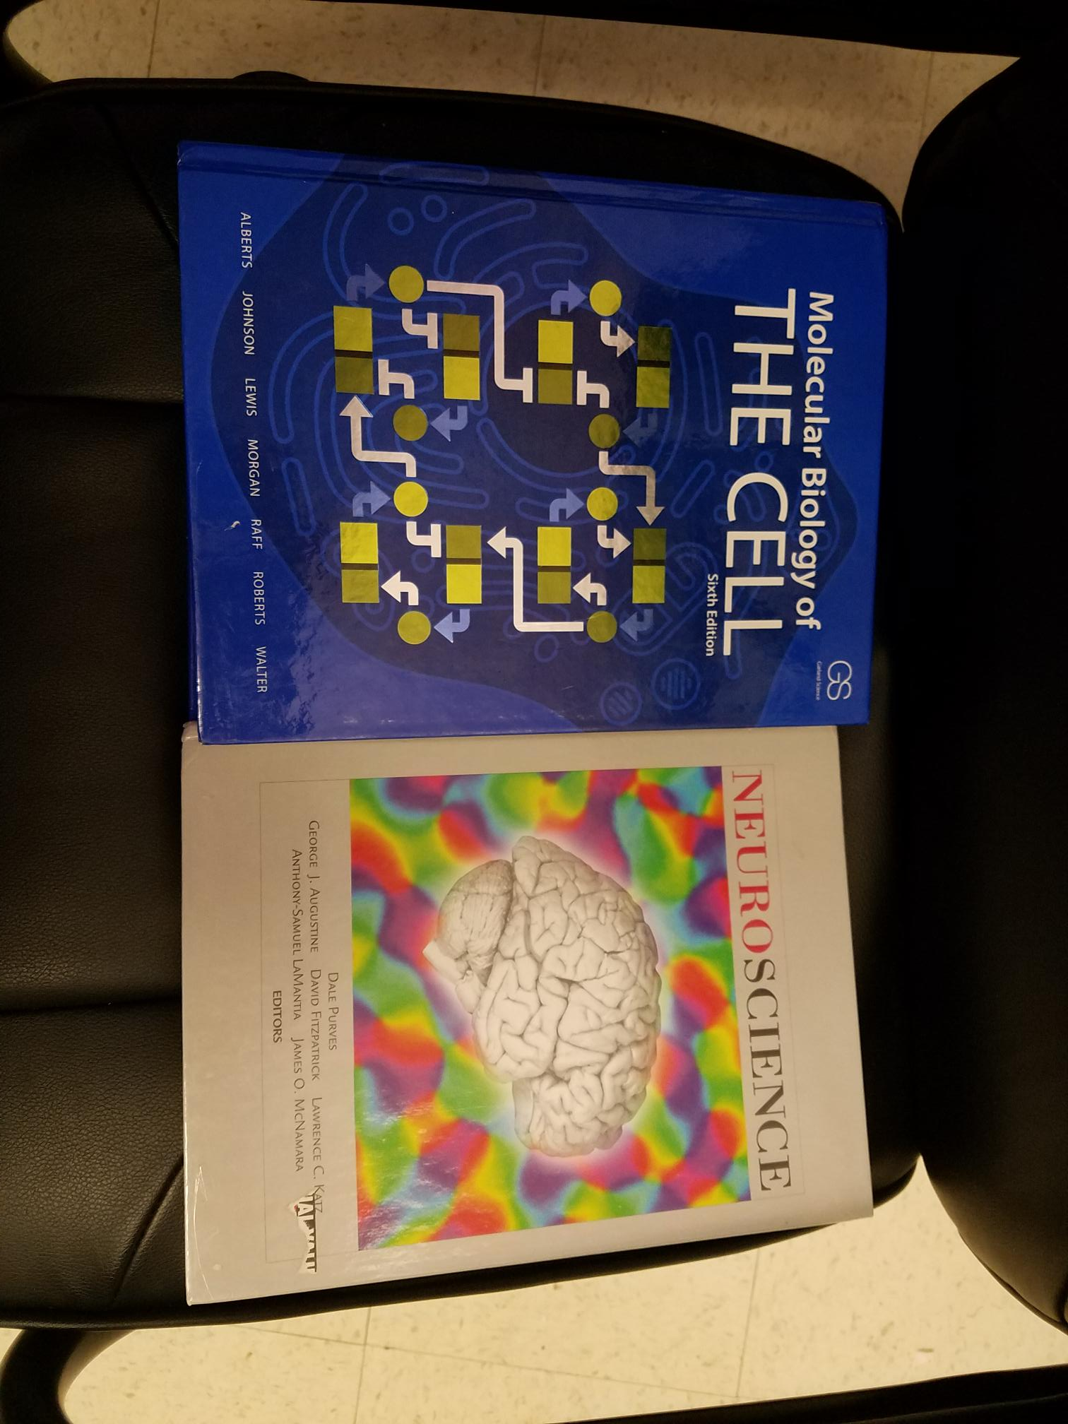
A Three-Hour Lecture with Three Parts

Slide 4
Ion Channels & Cellular Electrophysiology
Mark Beenhakker
markbeen@virginia.edu
action potential
cell
pumps &
membrane
electrical
channels
voltage
signals

Slide 5
Pumps & Channels
outside
membrane
pump
channel
inside

Slide 6
Pumps & Channels
x
outside
membrane
pump
channel
inside

Slide 7
Pumps & Channels
x
outside
membrane
pump
channel
inside

Slide 8
Pumps & Channels
x
x
x
x
x
x
x
x
x
x
x
x
x
x
x
x
x
x
x
x
x
x
x
x
x
x
x
x
x
x
x
x
x
x
x
x
x
x
x
x
x
x
x
x
x
x
x
x
x
outside
membrane
pump
channel
inside
x
x
x
x
x
x
x
x
x
x
x
x
x
x
x
x
x
x
x
x
x
x
x
x
x
x
x
x
x
x
x
x
x
x
x
x
x
x
x
x
x
x
x
x
x
x
x
x
active transport
passive transport

Slide 9
Pumps & Channels
x
outside
membrane
pump
channel
inside
ATP
active transport

Slide 10
Pumps & Channels
x
outside
membrane
pump
channel
inside
ATP
active transport

Slide 11
Pumps & Channels
x
x
x
x
x
outside
membrane
ATP
inside
ADP
pump
P
channel
P
x
x
x
x
x
x
x
x
x
x
x
x
x
x
x
x
x
x
x
x
x
x
x
x
x
x
x
x
x
x
x
x
x
active transport

Slide 12
Pumps & Channels
x
outside
membrane
pump
ATP
channel
inside
P
P
ATP-Driven Pumps
P-type pumps
ABC transporters
Na⁺-K⁺ Pump
V-type pumps

Slide 13
Pumps & Channels
K⁺
K⁺
outside
membrane
pump
channel
inside
ATP
P
Na⁺
Na⁺
Na⁺
Na⁺-K⁺ Pump

Slide 14
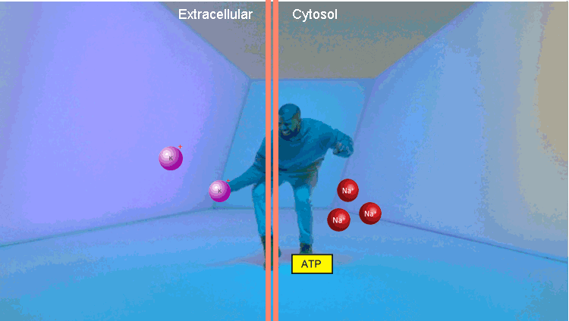
Pumps & Channels
Na⁺
Na⁺
Na⁺
Na⁺
Na⁺
Na⁺
Na⁺
Na⁺
Na⁺
Na⁺
Na⁺
Na⁺
Na⁺
Na⁺
Na⁺
Na⁺
Na⁺
Na⁺
Na⁺
Na⁺
Na⁺
Na⁺
Na⁺
Na⁺
Na⁺
Na⁺
Na⁺
Na⁺
Na⁺
Na⁺
Na⁺
Na⁺
Na⁺
Na⁺
Na⁺
Na⁺
Na⁺
Na⁺
Na⁺
K⁺
K⁺
K⁺
Na⁺
Na⁺
Na⁺
Na⁺
Na⁺
Na⁺
K⁺
K⁺
Na⁺
Na⁺
Na⁺
K⁺
K⁺
K⁺
K⁺
K⁺
outside
outside
membrane
membrane
inside
pump
channel
inside
pump
channel
Na⁺
Na⁺
Na⁺
Na⁺
K⁺
K⁺
K⁺
Na⁺
Na⁺
Na⁺
K⁺
K⁺
K⁺
Na⁺
Na⁺
Na⁺
K⁺
K⁺
K⁺
Na⁺
Na⁺
K⁺
K⁺
K⁺
K⁺
K⁺
K⁺
K⁺
K⁺
K⁺
K⁺
K⁺
K⁺
K⁺
K⁺
K⁺
K⁺
K⁺
K⁺
K⁺
K⁺
K⁺
K⁺
K⁺
K⁺
K⁺
K⁺
K⁺
K⁺
K⁺
K⁺
K⁺
K⁺
K⁺
K⁺
K⁺
K⁺
K⁺
K⁺
K⁺
Na⁺-K⁺ Pump
Na⁺-K⁺ Pump

Slide 15
Pumps & Channels
outside
membrane
pump
channel
inside
Key Points
The Na⁺-K⁺ pump uses ATP to drive Na⁺ out of — and K⁺ into — a cell, thereby establishing strong Na⁺ and K⁺ gradients across the membrane.
When permitted, ionic species want to achieve equilibrium, a state that is defined both chemically and electrically.
The equilibrium set point of each ionic species is associated with a specific membrane voltage.
Channels are activated by diverse mechanisms. When active, they transiently enable an ion to reach equilibrium. In doing so, channels can change the voltage of a cell.

Slide 16
Pumps & Channels
x
x
x
x
x
x
x
x
x
x
x
x
x
x
x
x
x
x
x
x
x
x
x
X
outside
membrane
pump
channel
inside
x
x
x
x
x
x
x
x
x
x
x
x
x
x
x
x
x
x
x
x
x
passive movement

Slide 17
Pumps & Channels
equilibrium
when will it end?
x
x
x
x
x
x
x
x
x
x
x
x
X
outside
membrane
pump
channel
inside
x
x
x
x
x
x
x
x
x
x
x
x
x
x
x
x
x
x
x
x
passive movement

Slide 18
Pumps & Channels
equilibrium
+
+
+
+
+
+
+
+
+
+
+
+
+
+
+
+
+
+
+
+
+
+
+
+
+
+
+
+
+
+
+
outside
membrane
pump
channel
inside
-
-
-
-
-
-
-
-
-
-
-
-
-
-
-
-
+
+
+
+
+
+
+
+
+
+
passive movement

Slide 19
Pumps & Channels
electrochemical
equilibrium
+
+
+
+
+
+
+
+
+
+
+
+
+
+
+
+
+
+
+
+
+
+
+
+
+
+
+
outside
membrane
pump
channel
inside
-
-
-
-
-
-
-
-
-
-
-
-
-
-
-
-
+
+
+
+
+
+
+
+
+
+
+
+
+
+
+
+
+
+
+
+
passive movement

Slide 20
Pumps & Channels
electrochemical
equilibrium
+
+
+
+
+
equilibrium
+
+
+
+
+
+
+
+
+
+
+
+
potential
+
+
+
+
+
+
+
+
+
+
Vm
outside
membrane
pump
channel
inside
-
-
-
-
-
-
-
-
-
-
-
-
-
-
-
-
+
+
+
+
+
+
+
+
+
+
+
+
+
+
+
+
+
+
+
+
passive movement

Slide 21
Pumps & Channels
electrochemical
equilibrium
+
+
+
+
+
+
+
+
+
equilibrium
+
+
+
+
+
+
potential
+
+
+
+
+
+
Vm
outside
membrane
channel
inside
-
-
-
-
-
-
-
Vm
+
+
+
+
+
+
+
+
+
+
“reversal” potential
“Nernst” potential
passive movement

Slide 22
Pumps & Channels
electrochemical
equilibrium
+
+
+
+
+
equilibrium
Nernst Equation
+
+
+
+
+
+
potential
+
+
+
+
+
+
RT
[X]
outside
V_{equilibrium}=
ln
o
zF
[X]
i
membrane
channel
inside
R = gas constant
-
-
-
-
-
-
-
T = temperature
Z = valence of the ion
+
+
+
+
+
Vm
F = Faraday’s constant
+
+
+
+
+
“reversal” potential
“Nernst” potential
passive movement

Slide 23
Pumps & Channels
electrochemical
equilibrium
+
+
+
+
+
Nernst Equation
+
+
+
+
+
+
+
+
+
+
+
+
RT
[X]
outside
V_{equilibrium}=
ln
o
zF
[X]
i
membrane
channel
inside
R = gas constant
-
-
-
-
-
-
-
T = temperature
Z = valence of the ion
+
+
+
+
+
+
+
+
+
F = Faraday’s constant
+
+
+
+
+
+
+
+
+
passive movement

Slide 24
Pumps & Channels
electrochemical
equilibrium
+
+
+
+
+
Nernst Equation
+
+
+
+
+
+
+
+
+
+
+
+
RT
[X]
outside
V_{equilibrium}
=
ln
o
zF
[X]
i
membrane
channel
inside
R = gas constant
-
-
-
-
Key Points
-
-
-
T = temperature
The Na⁺-K⁺ pump uses ATP to drive Na⁺ out of — and K⁺ into — a cell, thereby establishing strong Na⁺ and K⁺ gradients across the membrane.
Z = valence of the ion
+
+
+
+
+
+
+
+
+
+
+
F = Faraday’s constant
When permitted, ionic species want to achieve equilibrium, a state that is defined both chemically and electrically.
When permitted, ionic species want to achieve equilibrium, a state that is defined both chemically and electrically.
+
+
+
+
+
+
+
+
+
The equilibrium set point of each ionic species is associated with a specific membrane voltage.
passive movement
Channels are activated by diverse mechanisms. When active, they transiently enable an ion to reach equilibrium. In doing so, channels can change the voltage of a cell.

Slide 25
Pumps & Channels
outside
membrane
inside

Slide 26
Pumps & Channels
Na⁺
Na⁺
Na⁺
Na⁺
K⁺
Cl⁻
Cl⁻
Cl⁻
Cl⁻
Cl⁻
Na⁺
Cl⁻
Nernst Equation
outside
RT
[X]
membrane
V_{equilibrium} =
ln
o
inside
zF
[X]
sodium
potassium
i
K⁺
chloride
channel
channel
channel
Na⁺
Na⁺
K⁺
K⁺
K⁺
K⁺
Cl⁻
Cl⁻
Cl⁻
E_{Na}
E_{K}
E_{Cl}

Slide 27
Pumps & Channels
RT
P_{Na}[Na]_{o} + P_{K}[K]_{o} + P_{Cl}[Cl]_{i}
RT
[X ]
V_{m} =
V_{equilibrium} =
o
ln
ln
Na⁺
Na⁺
Na⁺
Na⁺
K⁺
Cl⁻
Cl⁻
Cl⁻
Cl⁻
Cl⁻
F
zF
[X ]
P_{Na}[Na]_{i} + P_{K}[K]_{i} + P_{Cl}[Cl]_{o}
i
Cl⁻
outside
membrane
inside
sodium
potassium
chloride
channel
channel
channel
Na⁺
Na⁺
K⁺
K⁺
K⁺
K⁺
Cl⁻
Cl⁻
Cl⁻
E_{Na}
E_{K}
E_{Cl}

Slide 28
Pumps & Channels
RT
P_{Na}[Na]_{o} + P_{K}[K]_{o} + P_{Cl}[Cl]_{i}
V_{m} =
ln
F
P_{Na}[Na]_{i} + P_{K}[K]_{i} + P_{Cl}[Cl]_{o}
outside
membrane
inside
sodium
potassium
chloride
channel
channel
channel

Slide 29
Pumps & Channels
per·me·a·bil·i·ty: the state or quality of a material
or membrane that causes it to allow liquids or
gases to pass through it.
outside
membrane
inside
sodium
potassium
chloride
channel
channel
channel

Slide 30
Pumps & Channels
per·me·a·bil·i·ty: the ability of an ion to pass
through the membrane.
outside
membrane
inside
sodium
potassium
chloride
channel
channel
channel

Slide 31
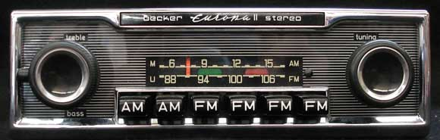
Pumps & Channels
RT
P_{Na}[Na]_{o} + P_{K}[K]_{o} + P_{Cl}[Cl]_{i}
V_{m} =
ln
F
P_{Na}[Na]_{i} + P_{K}[K]_{i} + P_{Cl}[Cl]_{o}
outside
membrane
inside
Key Points
sodium
potassium
chloride
channel
channel
channel
The Na⁺-K⁺ pump uses ATP to drive Na⁺ out of — and K⁺ into — a cell, thereby establishing strong Na⁺ and K⁺ gradients across the membrane.
When permitted, ionic species want to achieve equilibrium, a state that is defined both chemically and electrically.
The equilibrium set point of each ionic species is associated with a specific membrane voltage.
The equilibrium set point of each ionic species is associated with a specific membrane voltage.
Channels are activated by diverse mechanisms. When active, they transiently enable an ion to reach equilibrium. In doing so, channels can change the voltage of a cell.

Slide 32
Pumps & Channels
what opens a channel?
outside
membrane
inside
Key Points
The Na⁺-K⁺ pump uses ATP to drive Na⁺ out of — and K⁺ into — a cell, thereby establishing strong Na⁺ and K⁺ gradients across the membrane.
When permitted, ionic species want to achieve equilibrium, a state that is defined both chemically and electrically.
The equilibrium set point of each ionic species is associated with a specific membrane voltage.
Channels are activated by diverse mechanisms. When active, they transiently enable an ion to reach equilibrium. In doing so, channels can change the voltage of a cell.

Slide 33
Pumps & Channels
what opens a channel?
outside
membrane
inside

Slide 34
Pumps & Channels
what gates a channel?
outside
membrane
inside

Slide 35
Pumps & Channels
what gates a channel?
-
-
-
-
-
-
-
+
+
outside
+
+
+
+
voltage
membrane
+
+
inside
sensor
+
+
+
+
+
voltage-
gated

Slide 36
Pumps & Channels
what gates a channel?
-
-
-
-
-
-
+
+
-
+
+
outside
+
+
voltage
membrane
+
+
inside
sensor
1.0
+
+
+
+
+
ligand
0.5
open probability
binding
site
voltage-
ligand-
gated
0.0
gated
-100
-75
-50
-25
0
voltage (mV)

Slide 37
Pumps & Channels
what gates a channel?
-
-
-
-
-
mechanical
sensor
+
+
-
-
+
+
outside
+
+
voltage
membrane
+
+
inside
sensor
+
+
+
+
+
ligand
binding
site
voltage-
ligand-
mechanically-
gated
gated
gated

Slide 38
Pumps & Channels
what gates a channel?
-
-
-
-
-
mechanical
sensor
+
+
-
-
+
+
outside
+
+
voltage
membrane
+
+
inside
sensor
+
+
+
+
+
Key Points
ligand
The Na⁺-K⁺ pump uses ATP to drive Na⁺ out of — and K⁺ into — a cell, thereby establishing strong Na⁺ and K⁺ gradients across the membrane.
binding
site
When permitted, ionic species want to achieve equilibrium, a state that is defined both chemically and electrically.
voltage-
ligand-
mechanically-
gated
gated
gated
The equilibrium set point of each ionic species is associated with a specific membrane voltage.
Channels are activated by diverse mechanisms. When active, they transiently enable an ion to reach equilibrium. In doing so, channels can change the voltage of a cell.
Channels are activated by diverse mechanisms. When active, they transiently enable an ion to reach equilibrium. In doing so, channels can change the voltage of a cell.

Slide 39
Pumps & Channels
This equation defines the voltage across the membrane (Vm)
RT
P_{Na}[Na]_{o} + P_{K}[K]_{o} + P_{Cl}[Cl]_{i}
V_{m} =
ln
F
P_{Na}[Na]_{i} + P_{K}[K]_{i} + P_{Cl}[Cl]_{o}
Key Points
The Na⁺-K⁺ pump uses ATP to drive Na⁺ out of — and K⁺ into — a cell, thereby establishing strong Na⁺ and K⁺ gradients across the membrane.
When permitted, ionic species want to achieve equilibrium, a state that is defined both chemically and electrically.
The equilibrium set point of each ionic species is associated with a specific membrane voltage.
Channels are activated by diverse mechanisms. When active, they transiently enable an ion to reach equilibrium. In doing so, channels can change the voltage of a cell.

Slide 40
Pumps & Channels
Key Points
The Na⁺-K⁺ pump uses ATP to drive Na⁺ out of — and K⁺ into — a cell, thereby establishing strong Na⁺ and K⁺ gradients across the membrane.
When permitted, ionic species want to achieve equilibrium, a state that is defined both chemically and electrically.
The equilibrium set point of each ionic species is associated with a specific membrane voltage.
Channels are activated by diverse mechanisms. When active, they transiently enable an ion to reach equilibrium. In doing so, channels can change the voltage of a cell.

Slide 41
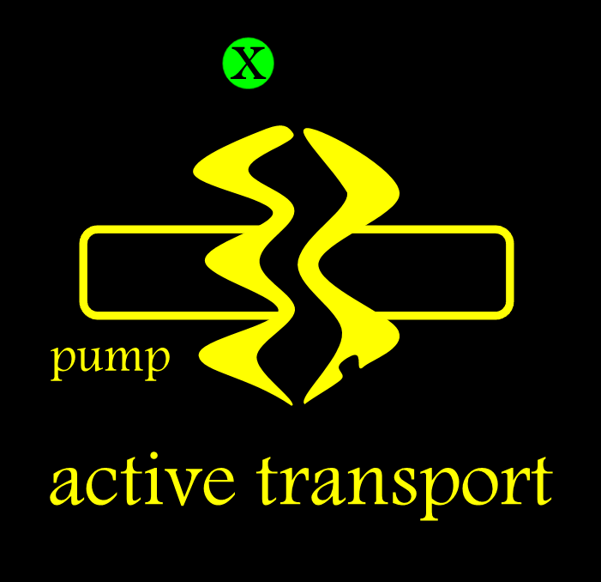
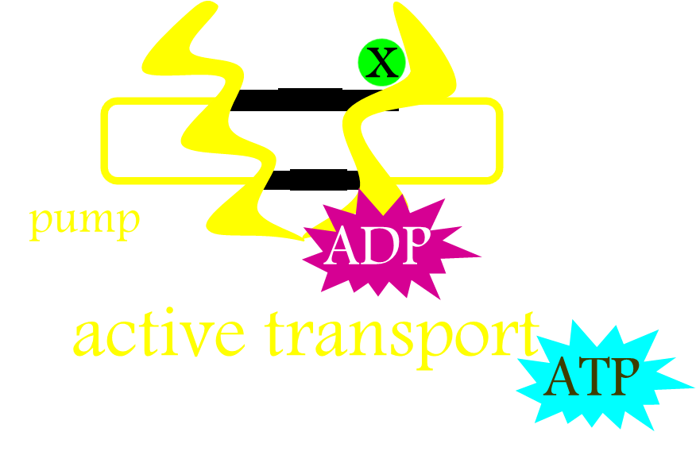
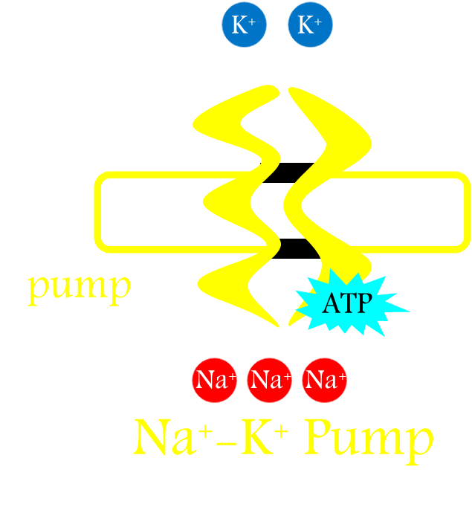
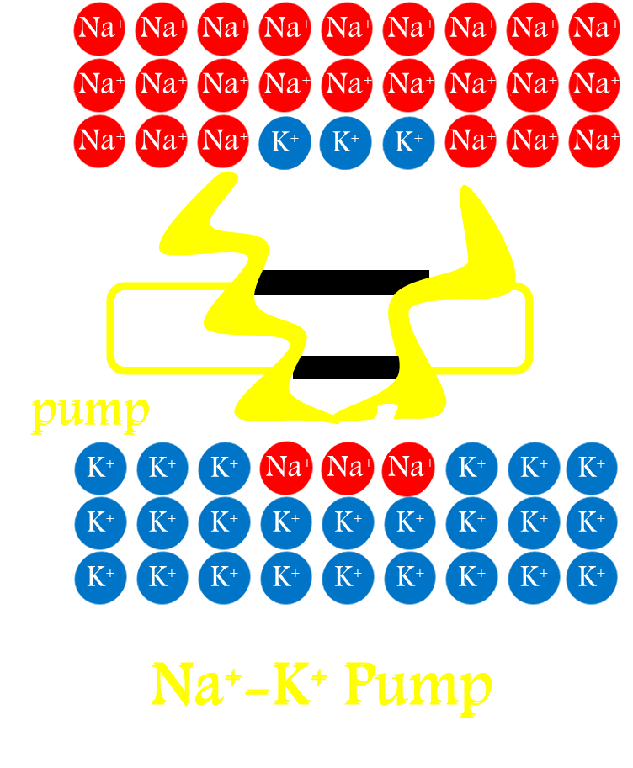
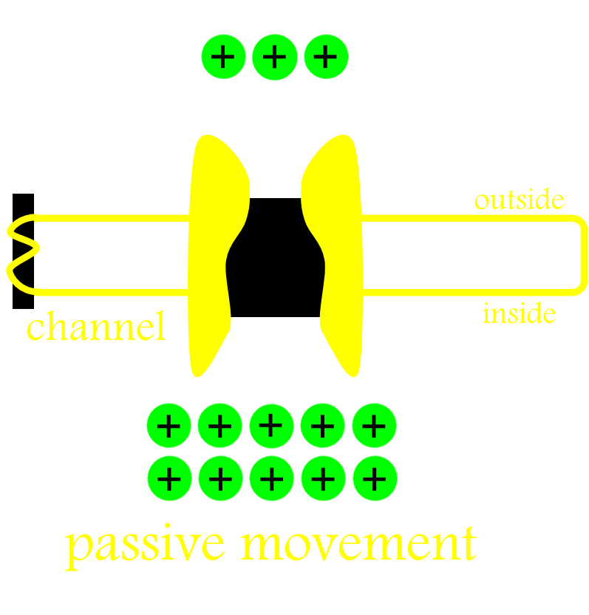
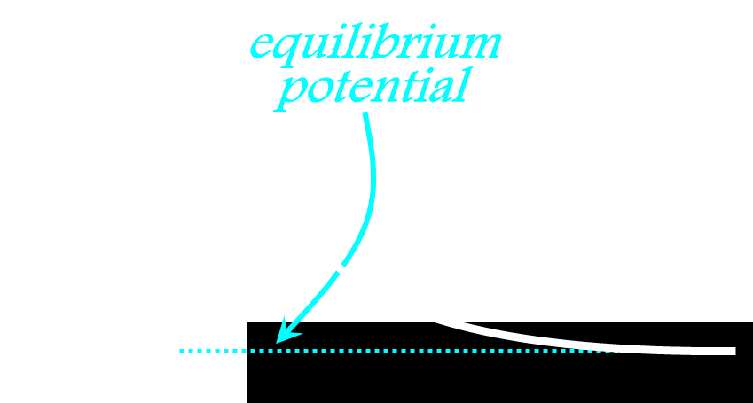
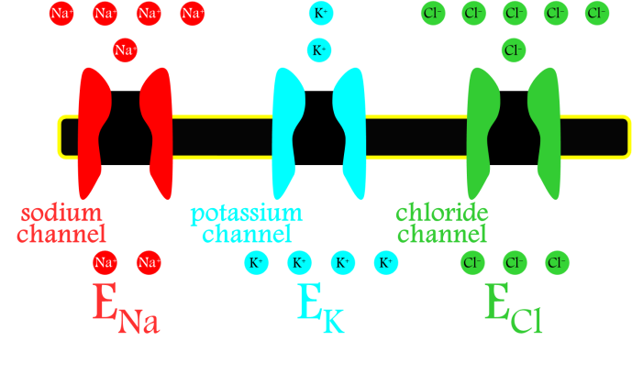
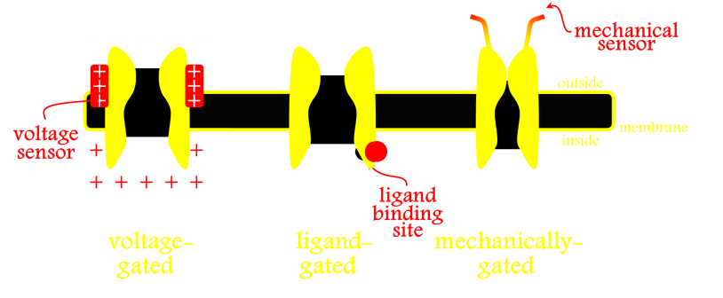
Ion Channels & Cellular Electrophysiology
Pumps
ATP-Driven Pumps
Na-K Pump
Na-K Gradients
Channels
Equilibrium Potential
Ion-Selective Channels
Channel Gating

Slide 42
Ion Channels & Cellular Electrophysiology
action potential
cell
pumps &
membrane
electrical
channels
voltage
signals

Slide 43
Ion Channels & Cellular Electrophysiology
action potential
cell
pumps &
membrane
electrical
channels
voltage
signals

Slide 44
Ion Channels & Cellular Electrophysiology
Pumps
ATP-Driven Pumps
Na-K Pump
Na-K Gradients
Channels
Equilibrium Potential
Ion-Selective Channels
Channel Gating

Slide 45
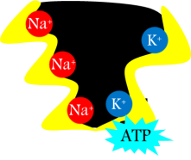

Ion Channels & Cellular Electrophysiology
Na⁺
Na⁺
K⁺
Na⁺
Na⁺
Na⁺
Na⁺
Na⁺
Na⁺
Na⁺
Na⁺
Na⁺
Na⁺
K⁺
K⁺
Na⁺
K⁺
K⁺
Na⁺
Na⁺
Na⁺
K⁺
K⁺
K⁺
Na⁺
K⁺
Na⁺
Na⁺
Na⁺
K⁺
K⁺
K⁺
K⁺
K⁺
Na⁺
Na⁺
Na⁺
Na⁺
K⁺
K⁺
K⁺
K⁺
K⁺
K⁺
Na⁺
K⁺
Na⁺
Na⁺
Na⁺
Na⁺
K⁺
K⁺
K⁺
K⁺
Na⁺
K⁺
K⁺
K⁺
Na⁺
K⁺
K⁺
K⁺
Na⁺
K⁺
K⁺
K⁺
K⁺
K⁺
K⁺
Na⁺
K⁺
Na⁺
K⁺
Na⁺
K⁺
K⁺
Na⁺
K⁺
K⁺
K⁺
Na⁺
Na⁺
K⁺
Na⁺
Na-K Pump
Na⁺
Na⁺
K⁺
K⁺
K⁺
Na⁺
K⁺
Na⁺
Na⁺
K⁺
K⁺
Na⁺
K⁺
K⁺
Na⁺
Na⁺
K⁺
Na⁺
K⁺
cell
Na⁺
Na⁺
Na⁺
K⁺
Na⁺
Na⁺
Na⁺
Na⁺
K⁺
Na⁺

Slide 46







Ion Channels & Cellular Electrophysiology
Na⁺
Na⁺
Membrane Potential
K⁺
Na⁺
Na⁺
Na⁺
Na⁺
Na⁺
Na⁺
Na⁺
P_{Na}[Na]_{o} + P_{K}[K]_{o} + P_{Cl}[Cl]_{i}
Na⁺
Na⁺
RT
Na⁺
K⁺
ln
K⁺
F
Na⁺
P_{Na}[Na]_{i} + P_{K}[K]i + P_{Cl}[Cl]_{o}
K⁺
K⁺
Na⁺
Na⁺
Na⁺
K⁺
K⁺
K⁺
Na⁺
K⁺
Na⁺
Na⁺
Na⁺
K⁺
K⁺
K⁺
K⁺
K⁺
Na⁺
Na⁺
Na⁺
Na⁺
K⁺
K⁺
K⁺
K⁺
K⁺
K⁺
Na⁺
K⁺
Na⁺
Na⁺
Na⁺
Na⁺
K⁺
K⁺
K⁺
K⁺
Na⁺
K⁺
K⁺
K⁺
Na⁺
K⁺
K⁺
K⁺
Na⁺
K⁺
K⁺
K⁺
K⁺
K⁺
K⁺
Na⁺
K⁺
Na⁺
K⁺
Na⁺
K⁺
K⁺
Na⁺
K⁺
K⁺
K⁺
Na⁺
Na⁺
K⁺
Na⁺
Na-K Pump
Na⁺
Na⁺
K⁺
K⁺
K⁺
Na⁺
K⁺
Na⁺
Na⁺
Sodium Channel
K⁺
K⁺
K⁺
K⁺
Na⁺
Na⁺
Na⁺
K⁺
Na⁺
K⁺
cell
Na⁺
Na⁺
Potassium Channel
Na⁺
K⁺
Na⁺
Na⁺
Na⁺
Chloride Channel
Na⁺
K⁺
Na⁺

Slide 47
Ion Channels & Cellular Electrophysiology
Na⁺
Na⁺
Membrane Potential
K⁺
Na⁺
Na⁺
Na⁺
Na⁺
Na⁺
Na⁺
Na⁺
RT
P_{Na}[Na]_{o} + P_{K}[K]_{o} + P_{Cl}[Cl]_{i}
Na⁺
Na⁺
ln
K⁺
F
P_{Na}[Na]_{i} + P_{K}[K]i + P_{Cl}[Cl]_{o}
K⁺
K⁺
Na⁺
Na⁺
K⁺
K⁺
K⁺
Na⁺
K⁺
Na⁺
Na⁺
Na⁺
K⁺
K⁺
K⁺
K⁺
K⁺
Na⁺
Na⁺
Na⁺
Na⁺
K⁺
K⁺
K⁺
Nernst Equation
K⁺
K⁺
K⁺
Na⁺
K⁺
Na⁺
Na⁺
Na⁺
Na⁺
K⁺
K⁺
K⁺
K⁺
Na⁺
K⁺
K⁺
RT
P_{K}[K]_{o}
K⁺
Na⁺
K⁺
K⁺
E_{K} =
ln
Na⁺
K⁺
K⁺
K⁺
K⁺
K⁺
K⁺
Na⁺
E_{K} = -90mV
K⁺
Na⁺
K⁺
Na⁺
K⁺
K⁺
zF
P_{K}[K]i
K⁺
K⁺
Na⁺
Na⁺
K⁺
Na⁺
K⁺
K⁺
E_{Na} = +50mV
Na-K Pump
Na⁺
Na⁺
Na⁺
K⁺
K⁺
K⁺
Na⁺
E_{Cl} = -70mV
Na⁺
Na⁺
K⁺
Sodium Channel
K⁺
K⁺
K⁺
K⁺
Na⁺
Na⁺
Na⁺
K⁺
Na⁺
K⁺
cell
Na⁺
Na⁺
Potassium Channel
Na⁺
K⁺
Na⁺
Na⁺
Na⁺
Chloride Channel
Na⁺
K⁺
Na⁺

Slide 48
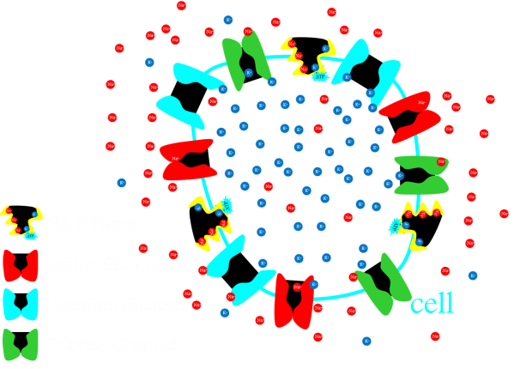
Ion Channels & Cellular Electrophysiology
Na-K Gradients
Ion-Selective Channels
Membrane Voltage

Slide 49
Ion Channels & Cellular Electrophysiology
action potential
cell
pumps &
membrane
electrical
channels
voltage
signals

Slide 50
Ion Channels & Cellular Electrophysiology
action potential
cell
pumps &
membrane
electrical
channels
voltage
signals

Slide 51




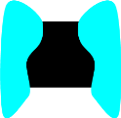





Ion Channels & Cellular Electrophysiology
Membrane Potential
RT
P_{Na}[Na]_{o} + P_{K}[K]_{o} + P_{Cl}[Cl]_{i}
ln
F
P_{Na}[Na]_{i} + P_{K}[K]_{i} + P_{Cl}[Cl]_{o}
E_{Na} = +50mV
E_{K} = -90mV
E_{Cl} = -70mV
cell
Na-K Pump
Sodium Channel
Potassium Channel
Chloride Channel

Slide 52
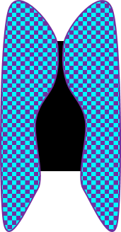
Ion Channels & Cellular Electrophysiology
Membrane Potential
RT
P_{Na}[Na]_{o} + P_{K}[K]_{o} + P_{Cl}[Cl]_{i}
ln
F
P_{Na}[Na]_{i} + P_{K}[K]_{i} + P_{Cl}[Cl]_{o}
E_{Na} = +50mV
E_{K} = -90mV
E_{Cl} = -70mV
cell
Na-K Pump
Sodium Channel
Vm
Potassium Channel (leak)
Delayed Rectifier
Potassium Channel
Chloride Channel

Slide 53

Ion Channels & Cellular Electrophysiology
Membrane Potential
RT
P_{Na}[Na]_{o} + P_{K}[K]_{o} + P_{Cl}[Cl]_{i}
ln
F
P_{Na}[Na]_{i} + P_{K}[K]_{i} + P_{Cl}[Cl]_{o}
E_{Na} = +50mV
E_{K} = -90mV
E_{Cl} = -70mV
cell
Na-K Pump
Sodium Channel
Vm
Potassium Channel (leak)
Delayed Rectifier
Potassium Channel
Chloride Channel

Slide 54
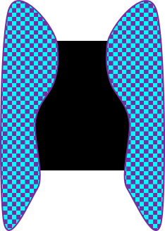
Ion Channels & Cellular Electrophysiology
Membrane Potential
RT
P_{Na}[Na]_{o} + P_{K}[K]_{o} + P_{Cl}[Cl]_{i}
ln
F
P_{Na}[Na]_{i} + P_{K}[K]_{i} + P_{Cl}[Cl]_{o}
E_{Na} = +50mV
E_{K} = -90mV
E_{Cl} = -70mV
cell
Na-K Pump
Sodium Channel
Vm
Potassium Channel (leak)
Delayed Rectifier
Potassium Channel
Chloride Channel
action potential

Slide 55
Ion Channels & Cellular Electrophysiology
Membrane Potential
RT
P_{Na}[Na]_{o} + P_{K}[K]_{o} + P_{Cl}[Cl]_{i}
ln
F
P_{Na}[Na]_{i} + P_{K}[K]_{i} + P_{Cl}[Cl]_{o}
E_{Na} = +50mV
E_{K} = -90mV
E_{Cl} = -70mV
cell
Na-K Pump
Sodium Channel
Vm
Potassium Channel (leak)
Delayed Rectifier
Potassium Channel
Chloride Channel
action potential

Slide 56
Ion Channels & Cellular Electrophysiology
Membrane Potential
RT
P_{Na}[Na]_{o} + P_{K}[K]_{o} + P_{Cl}[Cl]_{i}
ln
F
P_{Na}[Na]_{i} + P_{K}[K]_{i} + P_{Cl}[Cl]_{o}
E_{Na} = +50mV
E_{K} = -90mV
E_{Cl} = -70mV
cell
Na-K Pump
Sodium Channel
Potassium Channel (leak)
Delayed Rectifier
Potassium Channel
Chloride Channel

Slide 57
Ion Channels & Cellular Electrophysiology
Na-K Gradients
Ion-Selective Channels
Membrane Voltage

Slide 58
Ion Channels & Cellular Electrophysiology
Mark Beenhakker
markbeen@virginia.edu
action potential
cell
pumps &
membrane
electrical
channels
voltage
signals

