Slide 1
Sedative-Hypnotics & the
Treatment of Hypersomnia
Mark Beenhakker
Pharmacology
markbeen@virginia.edu

Slide 2
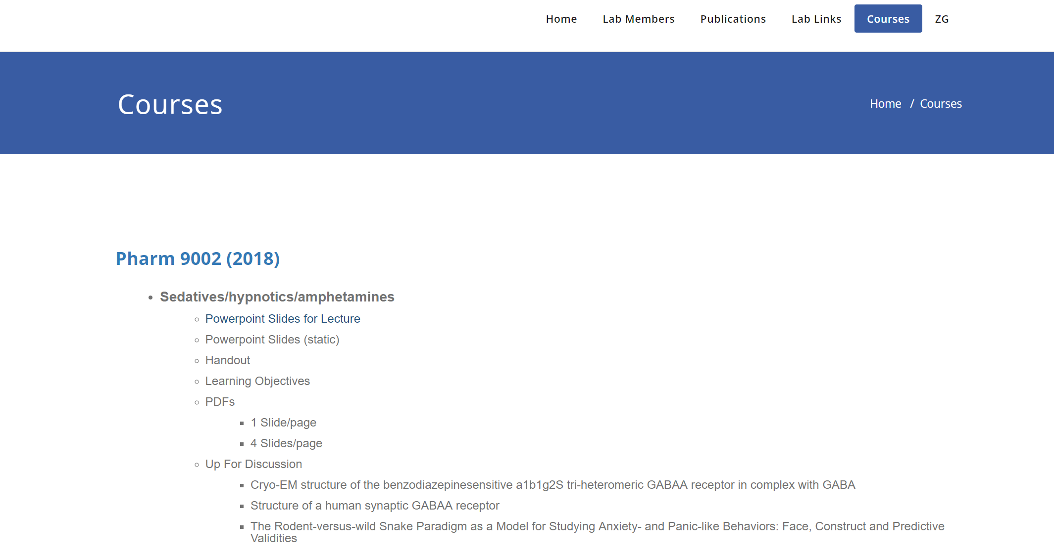
b e e n h a k k e r l a b . o r g

Slide 3
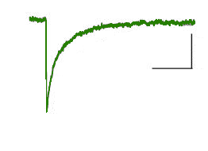
Sedative-Hypnotics & the
Treatment of Hypersomnia
20 pA
20 pA
100 ms
100 ms

Slide 4
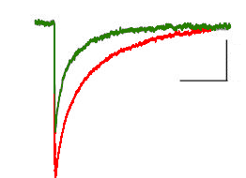

Sedative-Hypnotics & the
Treatment of Hypersomnia
+ benzodiazepine
20 pA
100 ms
anxiolysis
sedation-hypnosis
anticonvulsant

Slide 5

Sedative-Hypnotics & the
Treatment of Hypersomnia
LO
+ benzodiazepine
20 pA
100 ms
anxiolysis
sedation-hypnosis
anticonvulsant

Slide 6
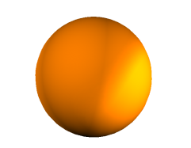

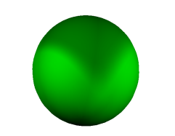


Inhibition in the Brain
cell body
axon
synapse
Inhibitory Current
GABA
20 pA
GABA
100 ms
receptor
1

Slide 7

Inhibition in the Brain
cell body
axon
synapse
Inhibitory Current
+ benzodiazepine
GABA
20 pA
GABA
100 ms
Today
receptor
GABA Receptors
Benzodiazepines
Barbiturates
Amphetamines
1

Slide 8
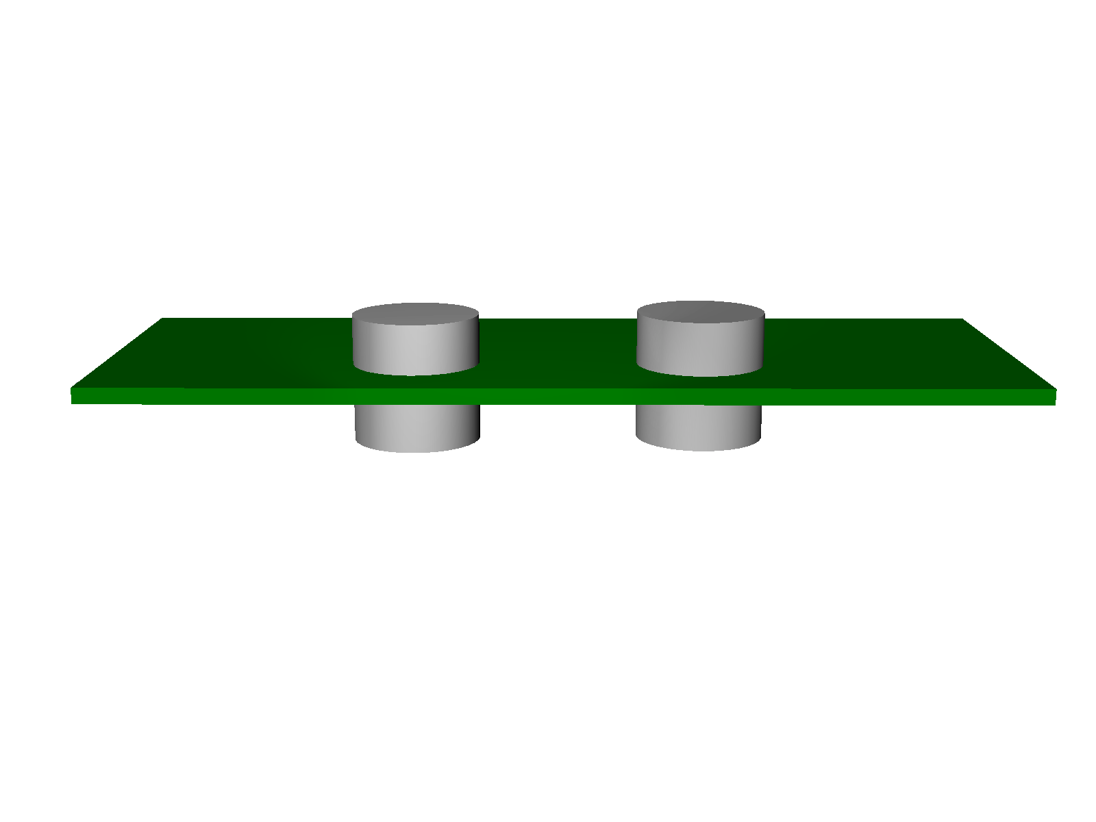
Two Types of GABA Receptors
ionotropic
metabotropic
outside of neuron
inside of neuron
GABA_{A}
GABA_{B}
2

Slide 9

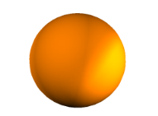
Two Types of GABA Receptors
GABA
ionotropic
metabotropic
outside of neuron
binding site
inside of neuron
GABA_{A}
GABA_{B}
2

Slide 10


Two Types of GABA Receptors
chloride
GABA
outside of neuron
GABA
binding site
inside of neuron
chloride
GABA_{A}
GABA_{B}
Inhibitory Current
20 pA
100 ms
2

Slide 11
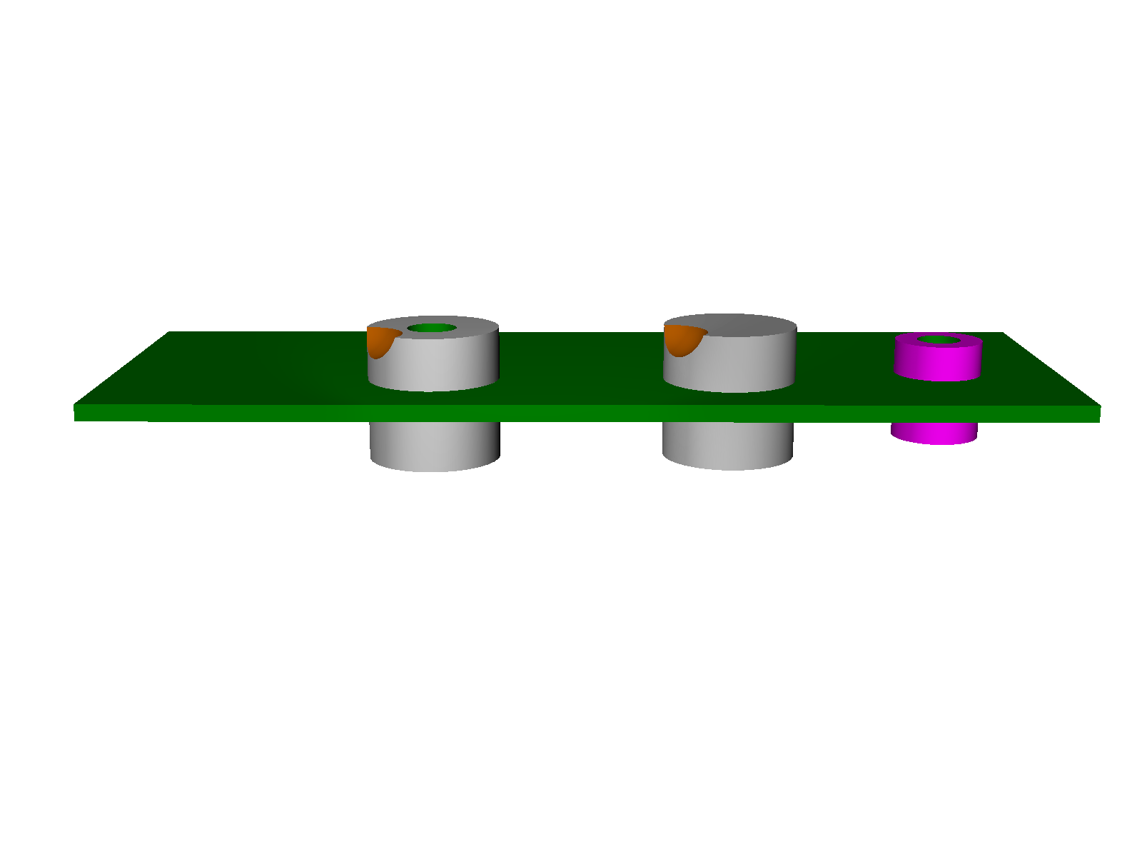
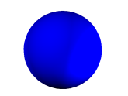

Two Types of GABA Receptors
outside of neuron
potassium/calcium
GABA
GABA
binding site
inside of neuron
chloride
2nd m.
GABA_{A}
GABA_{B}
Inhibitory Current
epilepsy
20 pA
addiction
100 ms
anxiety & depression
2
3

Slide 12
Two Types of GABA Receptors
outside of neuron
potassium/calcium
GABA
GABA
binding site
inside of neuron
2nd m.
chloride
GABA_{A}
GABA_{B}
Inhibitory Current
+ benzodiazepine
epilepsy
20 pA
addiction
100 ms
anxiety & depression
2
3

Slide 13
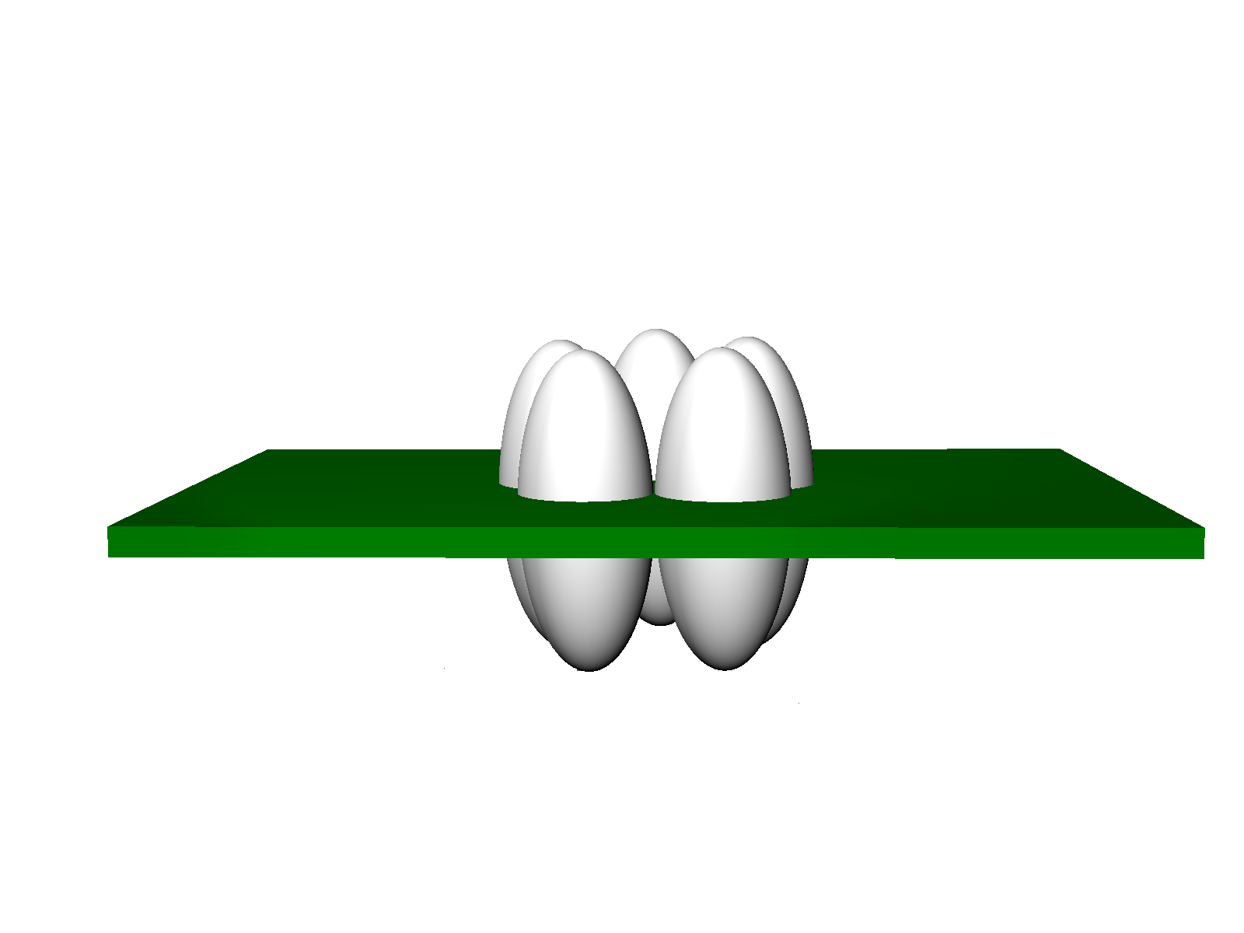
GABA_{A} Receptor
outside of neuron
inside of neuron

Slide 14
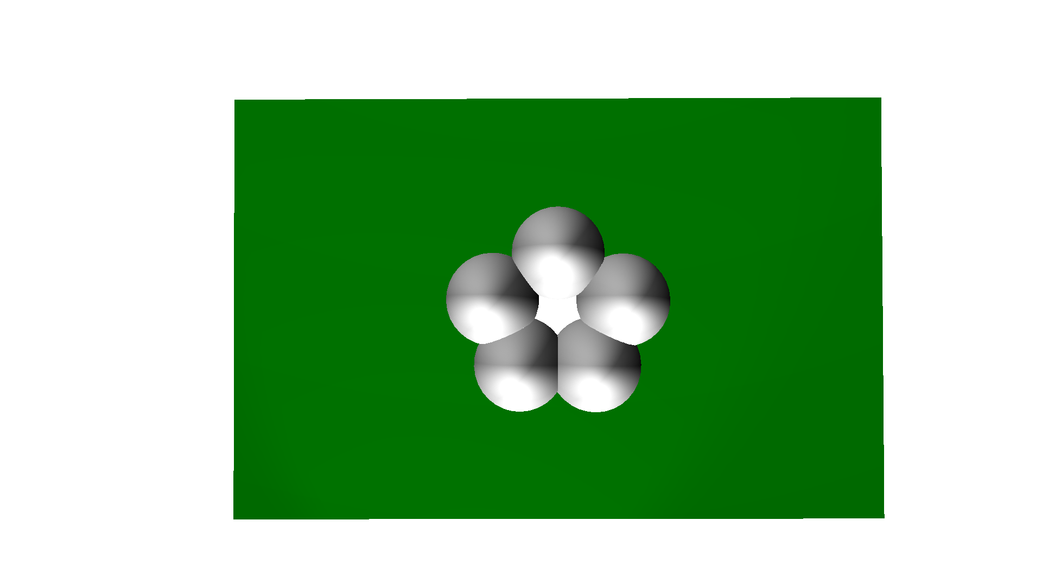
GABA_{A} Receptor
(from above)
5 subunits
(i.e. pentameric)
chloride pore

Slide 15
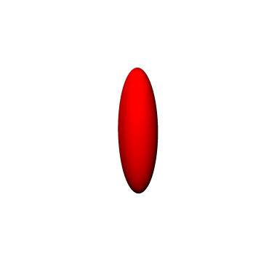
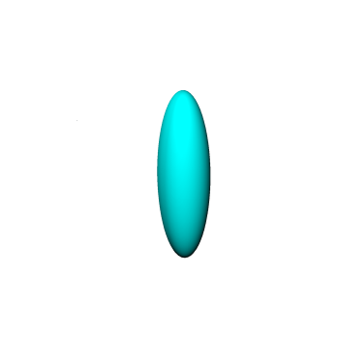


GABA_{A} Receptor
(from above)
5 subunits
(i.e. pentameric)
chloride pore
α
β
γ
δ
subunits

Slide 16
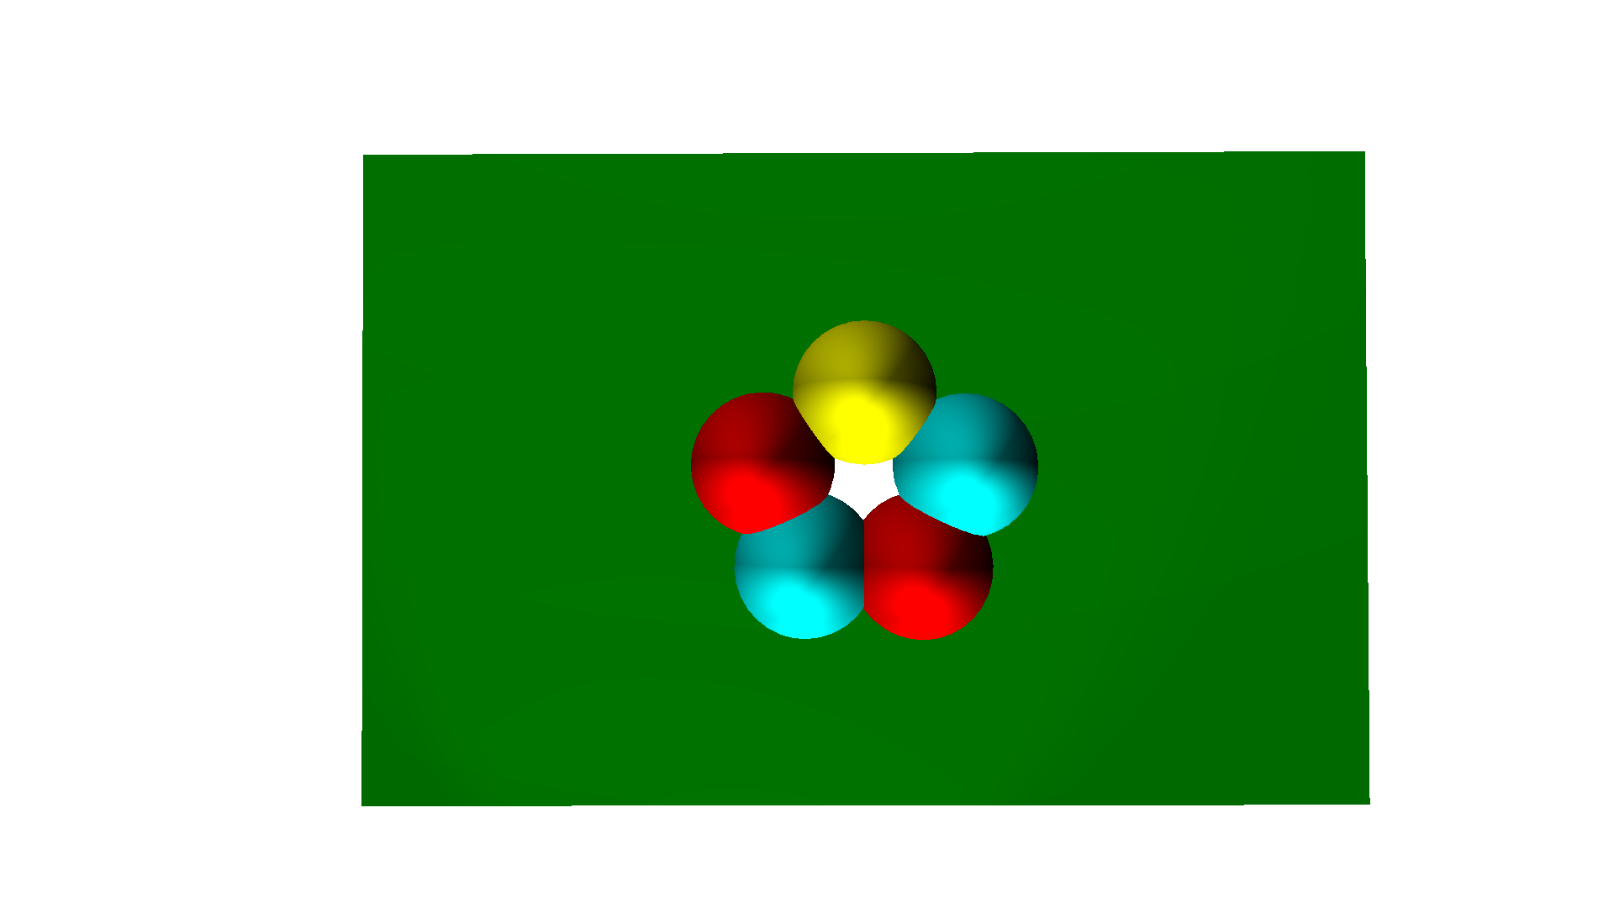
GABA_{A} Receptor
(from above)
5 subunits
(i.e. pentameric)
γ
α
β
β
α
chloride pore
α
β
γ
δ
subunits

Slide 17
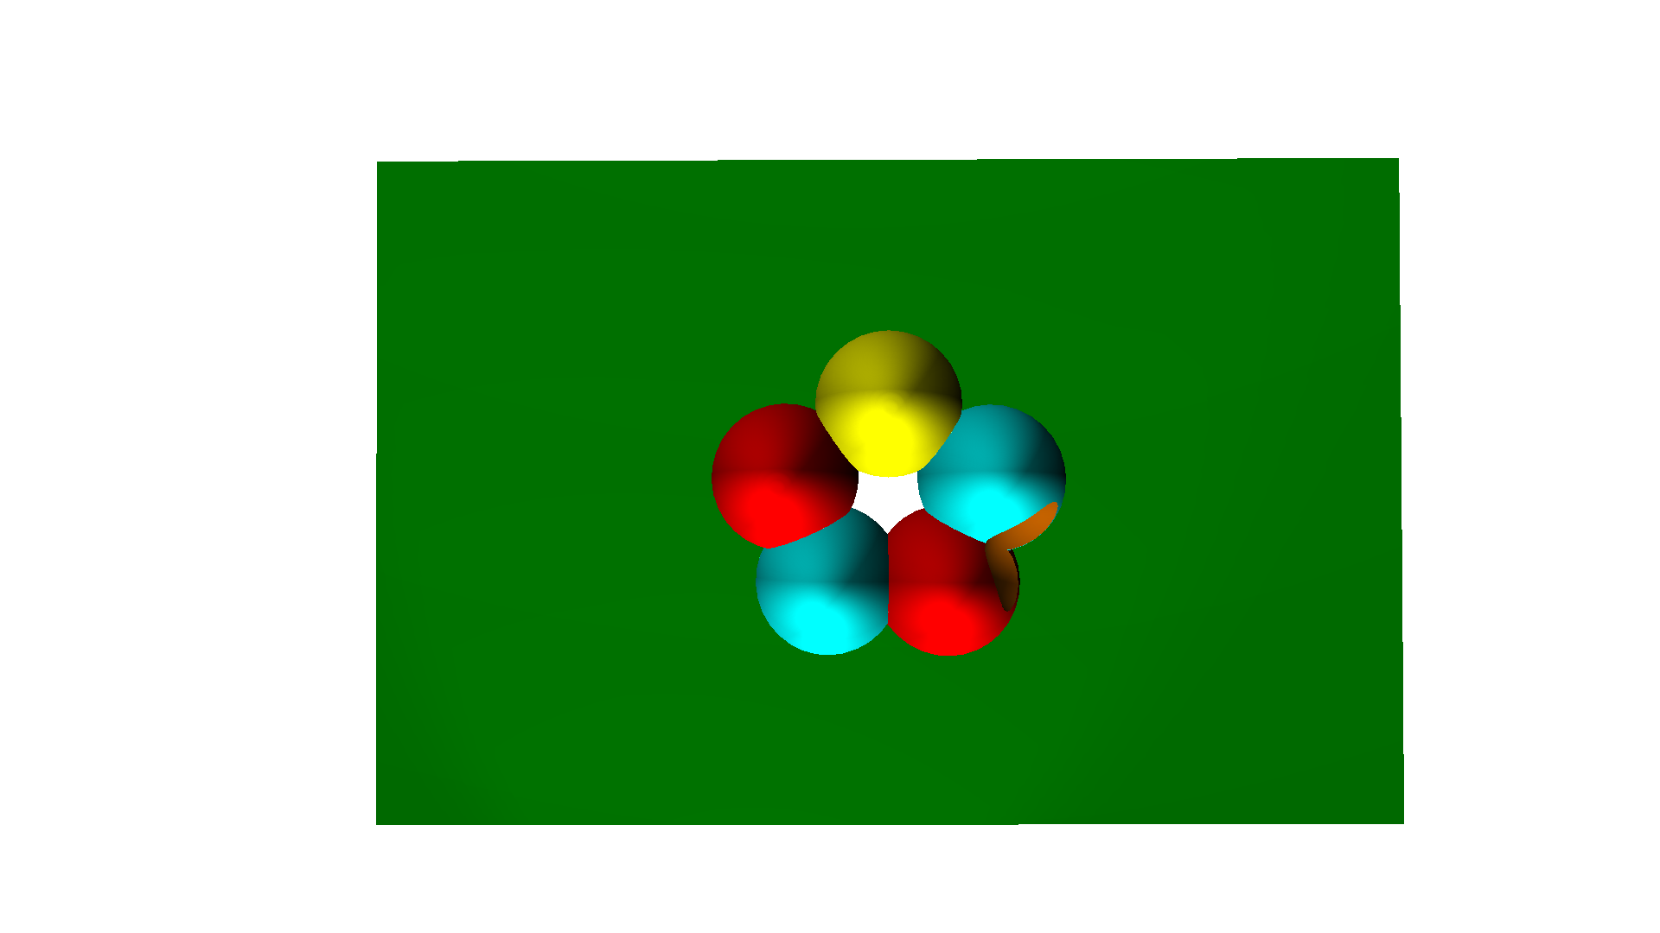
GABA_{A} Receptor
(from above)
5 subunits
(i.e. pentameric)
γ
GABA
binding
α
β
site
β
α
GABA
chloride pore
Inhibitory Current
20 pA
α
β
γ
δ
100 ms
subunits

Slide 18
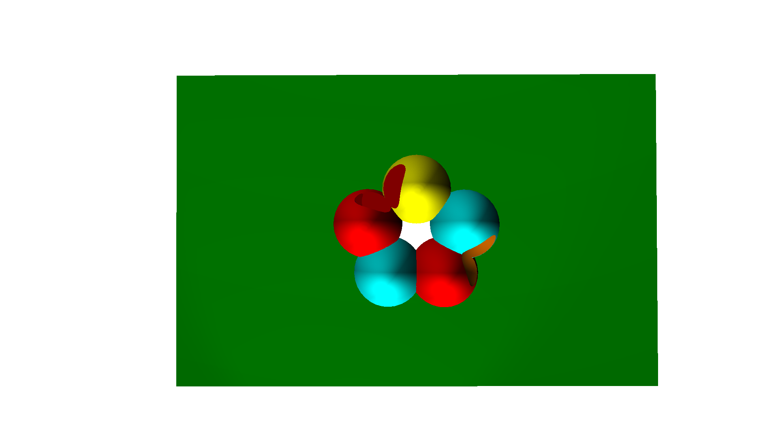

GABA_{A} Receptor
4
(from above)
5 subunits
(i.e. pentameric)
BDZ
γ
GABA
benzo
binding
binding
α
β
site
site
β
α
GABA
chloride pore
Inhibitory Current
Inhibitory Current
+ benzodiazepine
20 pA
20 pA
α
γ
100 ms
β
δ
100 ms
subunits

Slide 19


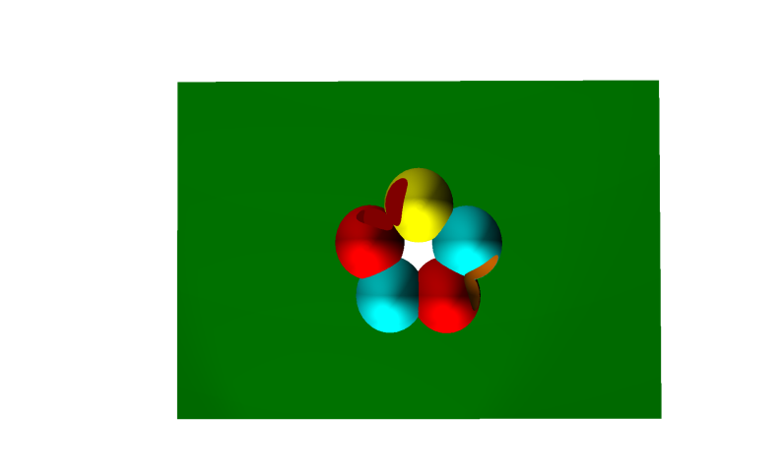




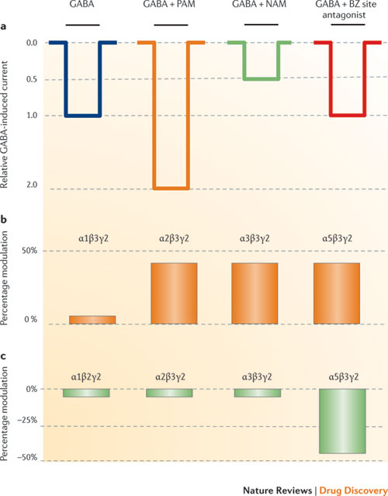
5
Allosteric Modulation
definition:
modulation achieved by binding of a drug to a site distinct
from the site required for activation.
- Rudolph & Knoflach, 2011
BDZ
γ
α
β
α
β
GABA
7
types:
GABA
positive (agonism)
0
benzodiazapines
0.5
Relative GABA-
negative (inverse agonism)
induced current
1.0
βCCE
6
antagonist (blocker)
2.0
- Rudolph & Knoflach, 2011
Flumazenil

Slide 20
5
Allosteric Modulation
definition:
modulation achieved by binding of a drug to a site distinct
from the site required for activation.
- Rudolph & Knoflach, 2011
BDZ
γ
α
β
α
β
GABA
7
types:
GABA
GABA
+ pos mod
positive (agonism)
0
benzodiazapines
0.5
Relative GABA-
negative (inverse agonism)
induced current
1.0
βCCE
6
antagonist (blocker)
2.0
- Rudolph & Knoflach, 2011
Flumazenil

Slide 21
5
Allosteric Modulation
definition:
modulation achieved by binding of a drug to a site distinct
from the site required for activation.
- Rudolph & Knoflach, 2011
BDZ
γ
α
β
α
β
GABA
7
types:
GABA
GABA
GABA
+ pos mod
+ neg mod
positive (agonism)
0
benzodiazapines
0.5
Relative GABA-
negative (inverse agonism)
induced current
1.0
βCCE
6
antagonist (blocker)
2.0
- Rudolph & Knoflach, 2011
Flumazenil

Slide 22
5
Allosteric Modulation
definition:
modulation achieved by binding of a drug to a site distinct
from the site required for activation.
- Rudolph & Knoflach, 2011
BDZ
γ
α
β
α
β
GABA
7
types:
GABA
GABA
GABA
GABA
+ pos mod
+ neg mod
+ antag
positive (agonism)
0
benzodiazapines
0.5
Relative GABA-
negative (inverse agonism)
induced current
1.0
βCCE
6
antagonist (blocker)
2.0
- Rudolph & Knoflach, 2011
Flumazenil

Slide 23
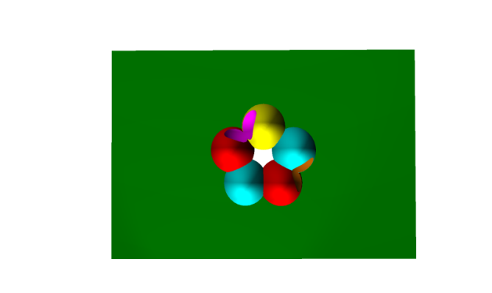



Benzodiazepines
there are many
Diazepam (Valium) among the first (launched 1963).
4 benzodiazepines are among the 200 most commonly
prescribed drugs in the U.S.
Alprazolam (Xanax)
Clonazepam (Klonopin)
Diazepam (Valium)
Lorazepam (Ativan)
actions are dose-dependent:
most sedative hypnotics
γ
(e.g. barbiturates)
α
β
α
death
β
BAR
GABA binding site
anesthesia
8
benzos by themselves do not:
CNS effects
produce anesthesia
hypnosis
Benzodiazepines
sedation
cause fatalities
anxiolysis
BUT
they lower the lethal dose
of other CNS depressants
(e.g. alcohol)
dose
9
from Patrice Guyenet, UVA Pharm Dept.

Slide 24
Benzodiazepines
there are many
Diazepam (Valium) among the first (launched 1963).
4 benzodiazepines are among the 200 most commonly
prescribed drugs in the U.S.
Alprazolam (Xanax)
Clonazepam (Klonopin)
Diazepam (Valium)
Lorazepam (Ativan)
actions are dose-dependent:
most sedative hypnotics
γ
(e.g. barbiturates)
α
β
α
death
β
BAR
GABA binding site
anesthesia
8
benzos by themselves do not:
CNS effects
produce anesthesia
hypnosis
Benzodiazepines
sedation
cause fatalities
+ alcohol
BUT
anxiolysis
they lower the lethal dose
of other CNS depressants
(e.g. alcohol)
dose
9
from Patrice Guyenet, UVA Pharm Dept.

Slide 25

Benzodiazepines
there are many
Diazepam (Valium) among the first (launched 1963).
4 benzodiazepines are among the 200 most commonly
prescribed drugs in the U.S.
Alprazolam (Xanax)
Clonazepam (Klonopin)
Diazepam (Valium)
Lorazepam (Ativan)
actions are dose-dependent:
death
Problems
anesthesia
pharmacokinetics
redistribution
side effects
CNS effects
ideal hypnotic
hypnosis
Benzodiazepines
sedation
flurazepam
anxiolysis
metabolism
ideal anxiolytic
0
8
dose
16
24
time (hours)
from Patrice Guyenet, UVA Pharm Dept.

Slide 26
Benzodiazepine Metabolism
metabolized by the liver (CYPs)
pharmacokinetics highly variable
100
10
75
Goodman & Gilman, 2011
T1/2 (hours)
50
25
0
diazepam
oxazepam
triazolam
estazolam
lorazepam
quazepam
alprazolam
clorazepate
flurazepam
midazolam
temazepam
clonazepam
chlordiazepoxide

Slide 27




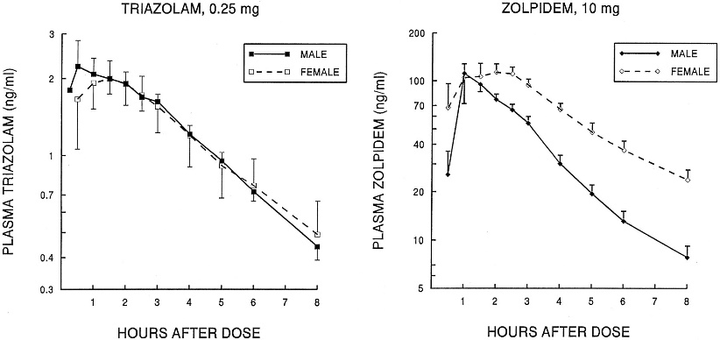
Benzodiazepine Metabolism
metabolized by the liver (CYPs)
pharmacokinetics highly variable
100
short-acting (t1/2<6hrs)
10
75
Goodman & Gilman, 2011
intermediate-
acting (t1/2: 6-24hrs)
T1/2 (hours)
50
25
long-acting (t1/2>24hrs)
0
diazepam
oxazepam
triazolam
estazolam
lorazepam
quazepam
alprazolam
clorazepate
flurazepam
midazolam
temazepam
clonazepam
chlordiazepoxide
age-dependent
100
11
75
50
T1/2 (hours)
25
0
40
80
Age (years)
from Patrice Guyenet, UVA Pharm Dept.
over-sedation can occur with ‘standard doses’
can be sex-dependent
Greenblatt et al., 2000

Slide 28
Benzodiazepines: Effect Selectivity
death
anesthesia
CNS effects
ideal hypnotic
hypnosis
Benzodiazepines
sedation
anxiolysis
ideal anxiolytic
0
8
16
24
time (hours)
12
CNS effects

Slide 29
GABA_{A} Receptor
(from above)
5 subunits
(i.e. pentameric)
γ
GABA
benzo
binding
binding
α
β
site
site
β
α
chloride pore
Inhibitory Current
+ benzodiazapene
20 pA
α
β
γ
δ
100 ms
subunits

Slide 30
GABA_{A} Receptor
(from above)
5 subunits
(i.e. pentameric)
γ
GABA
benzo
binding
binding
α
β
site
site
β
α
chloride pore
Inhibitory Current
+ benzodiazapene
20 pA
α₁₋₆
β₁₋₃
γ₁₋₃
δ
100 ms
subunits

Slide 31
GABA_{A} Receptor
(from above)
5 subunits
(i.e. pentameric)
γ
GABA
benzo
binding
binding
α
β
site
site
β
α
chloride pore
Inhibitory Current
α₅
α₁
+ benzodiazapene
α₃
α₂
20 pA
other
α₁₋₆
β₁₋₃
γ₁₋₃
δ
100 ms
subunits

Slide 32
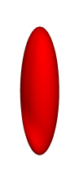
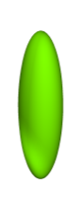
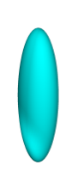

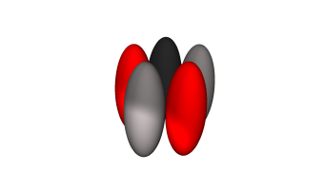
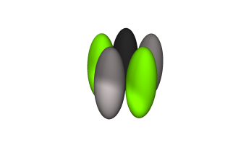
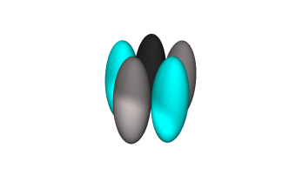
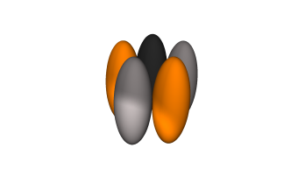
α Subunits and Selectivity
α₁
α₂
α₃
α₅
the good
the bad
Muscle
Anti-
Sedation
Anxiolysis
Relaxation
Convulsant
Amnesia
Addiction
Tan et al., 2011

Slide 33
α Subunits and Selectivity
α₁
α₂
α₃
α₅
the good
the bad
Muscle
Anti-
Sedation Anxiolysis
Relaxation
Convulsant
Amnesia
Addiction
Tan et al., 2011

Slide 34
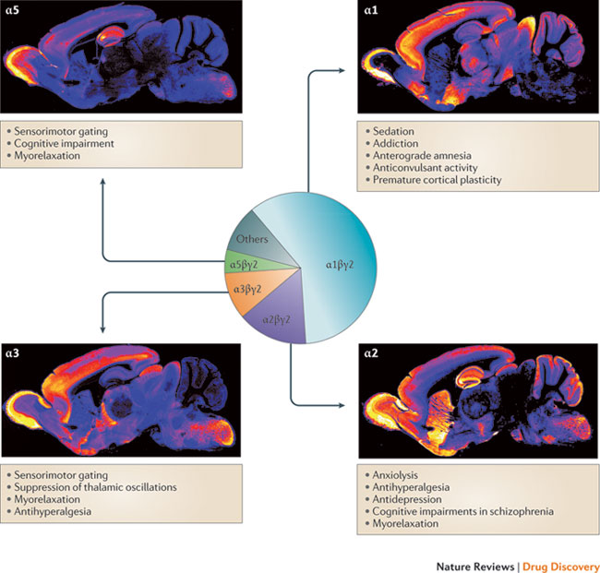


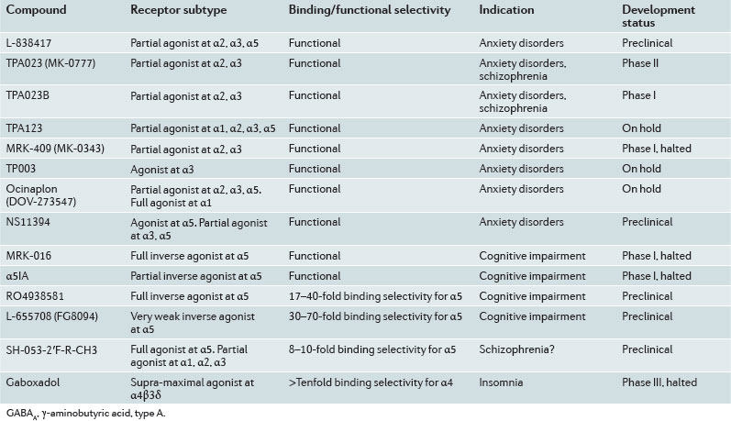

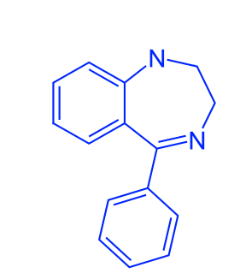
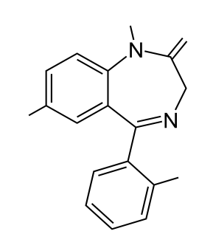
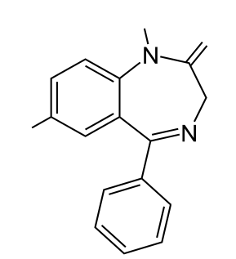
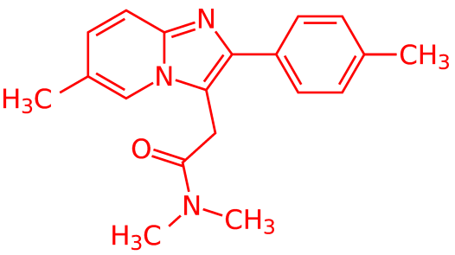
α Subunits and Selectivity
α₁
α₂
α₃
α₅
α₁
α₂-selective agents
α₁-selective agents
α₂
non-sedating anxiolytics
20-fold higher affinity for
receptors containing α1
subunits
hopefully soon…
‘Z compounds’
technically non-benzos
good for insonmia
α₃
α₅
CH₃
O
H
O
Cl
O₂N
14
Cl
diazepam
13
clonazepam
benzodiazepine
imidazopyridine
(zolpidem)
Rudolph & Knoflach, 2011

Slide 35


Benzodiazepines: Therapeutic Uses
15
maximize therapy, minimize side-effects
sedation-hypnosis
true benzodiazepines
Triazolam (closest to ‘ideal hypnotic’)
Flurazepam (less ‘early morning insomnia’)
death
Z compounds
anesthesia
ideal hypnotic
Zolpidem (Ambien)
hypnosis
Zaleplon (Sonata)
sedation
anxiolysis
Eszopiclone (Lunesta)
0
8
16
24
16
time (hours)

Slide 36



Benzodiazepines: Therapeutic Uses
15
maximize therapy, minimize side-effects
sedation-hypnosis
true benzodiazepines
Triazolam (closest to ‘ideal hypnotic’)
Flurazepam (less ‘early morning insomnia’)
death
Z compounds
anesthesia
ideal hypnotic
Zolpidem (Ambien)
hypnosis
Zaleplon (Sonata)
sedation
ideal anxiolytic
anxiolysis
Eszopiclone (Lunesta)
0
8
16
24
16
anxiolysis
time (hours)
most benzos with medium- to long-T_{1/2} work
low doses often used
α₂-selective benzos are actively being developed
severe anxiety:
associated with prominent autonomic signs (e.g. panic disorders)
high-potency benzos used
Alprazolam (Xanax)
Clonazepam (Klonopin)
Lorazepam (Ativin)
anticonvulsant
only a few used (e.g. lorazepam, clonazepam, clorozepate)

Slide 37
Benzodiazepines: Last Couple of Things
Tolerance
primarily observed with anticonvulsant actions
17
limited tolerance observed with sedative-hypnotic &
anxiolytic effects
Dependence/Addiction
physical dependence is usually mild
follows general rule of drug dependence:
higher dosage = more severe withdrawal
longer t1/2 = less severe withdrawal
estimated that 0.1-0.2% of adult population abuse or are
dependent upon benzos (300,000-600,000 people in the U.S.)
GABA receptors live in the VTA (ventral tegmental area)
modulating GABA receptor activity in the VTA hypothesized
to increase dopamine release
Benzodiazepine blocker
Flumazenil (Romazicon)
18
benzodiazepine stupor
potential risk of seizures

Slide 38
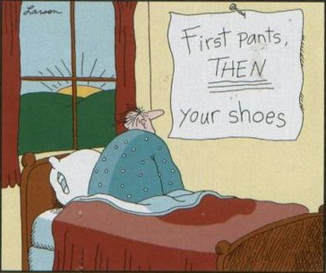
Sedative-Hypnotics & the
Treatment of Hypersomnia

Slide 39



Barbiturates
Directly bind to GABA binding site (at high doses)
activates channel and causes chloride conductance
γ
α
β
19
α
β
BAR
GABA binding site
High doses are fatal
most sedative hypnotics
(e.g. barbituates)
alcohol
death
anesthesia
20
hypnosis
Benzodiazepines
CNS effects
sedation
anxiolysis
dose
Once extensively used as sedative-hypnotics. Now largely
replaced by the much safer benzos.
noteworthy exceptions:
Pentobarbital (insomnia, pre-op sedation, seizures)
Phenobarbital (seizures)
Thiopental (induction/maintenance of anesthesia)….short-lasting

Slide 40
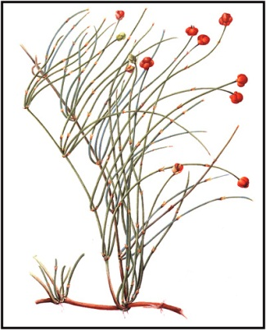

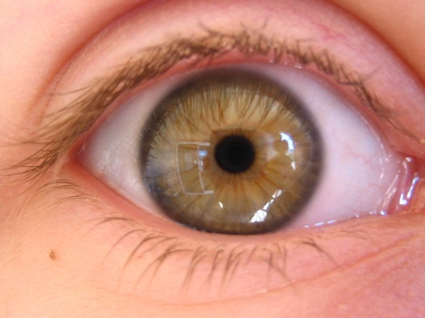


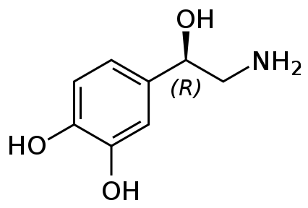

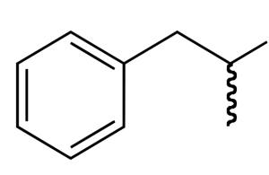
Amphetamine
Ma huang
‘looking for trouble’
Resembles catecholamines but more lipid soluble (can cross BBB)
catecholamines: norepinephrine, dopamine, serotonin
indirectly-acting sympathomimetic amine
amphetamine and related drugs stimulate release of:
NH₂
dopamine stimulates reward mechanisms, causes psychosis/addiction
CNS
norepinephrine increased vigilance, anorexia
serotonin increased vigilance, anorexia
norepinephrine
amphetamine
sympathetic
norepinephrine hypertension, strokes, arrhythmias
21
nerve
terminals

Slide 41
Amphetamine: Mechanism
cell body
axon
synapse
GABA
GABA
receptor

Slide 42



Amphetamine: Mechanism
cell body
axon
22
synapse
norepinephrine

Slide 43
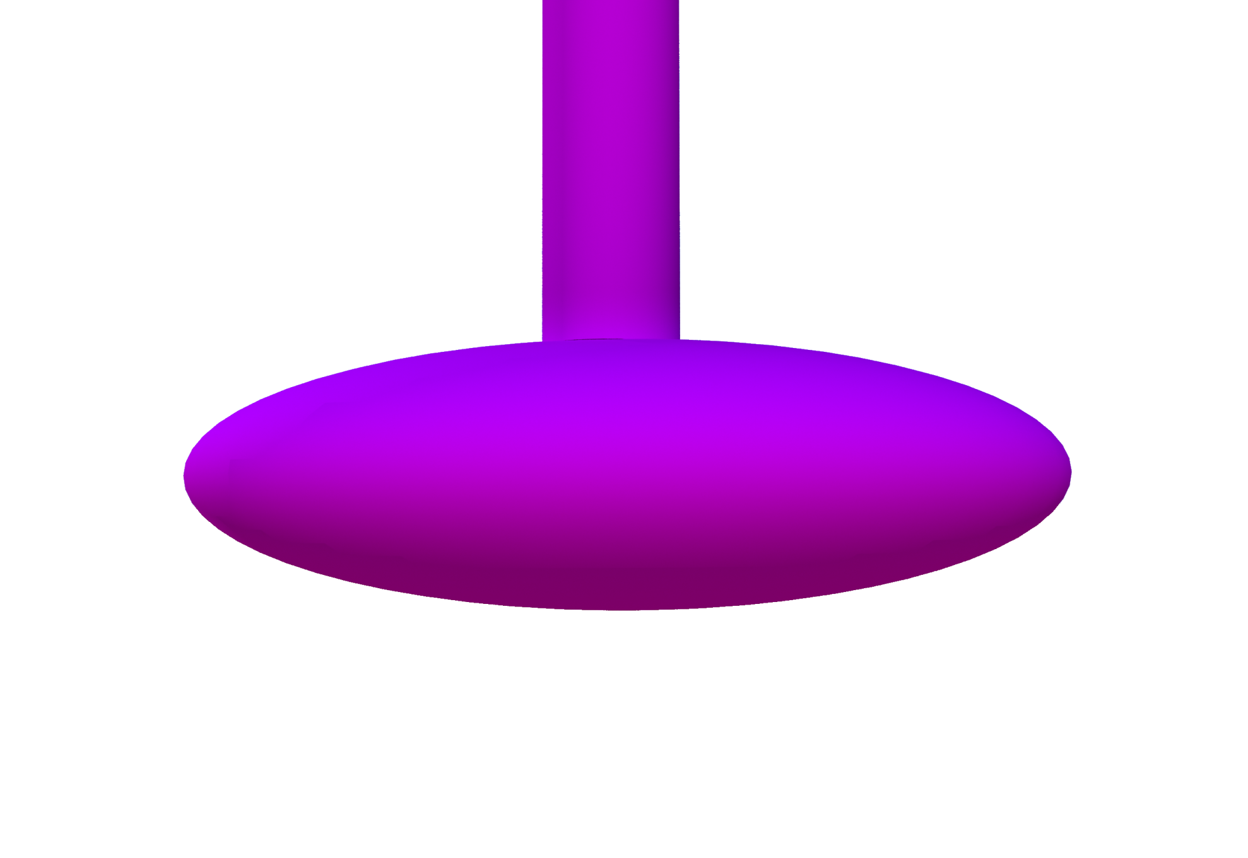
Amphetamine: Mechanism
22
axon terminal

Slide 44
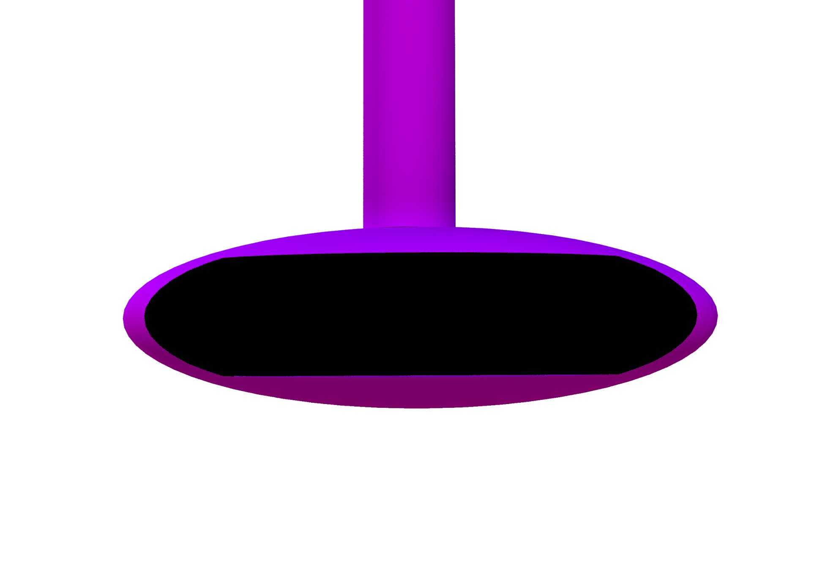
Amphetamine: Mechanism
22
axon terminal

Slide 45
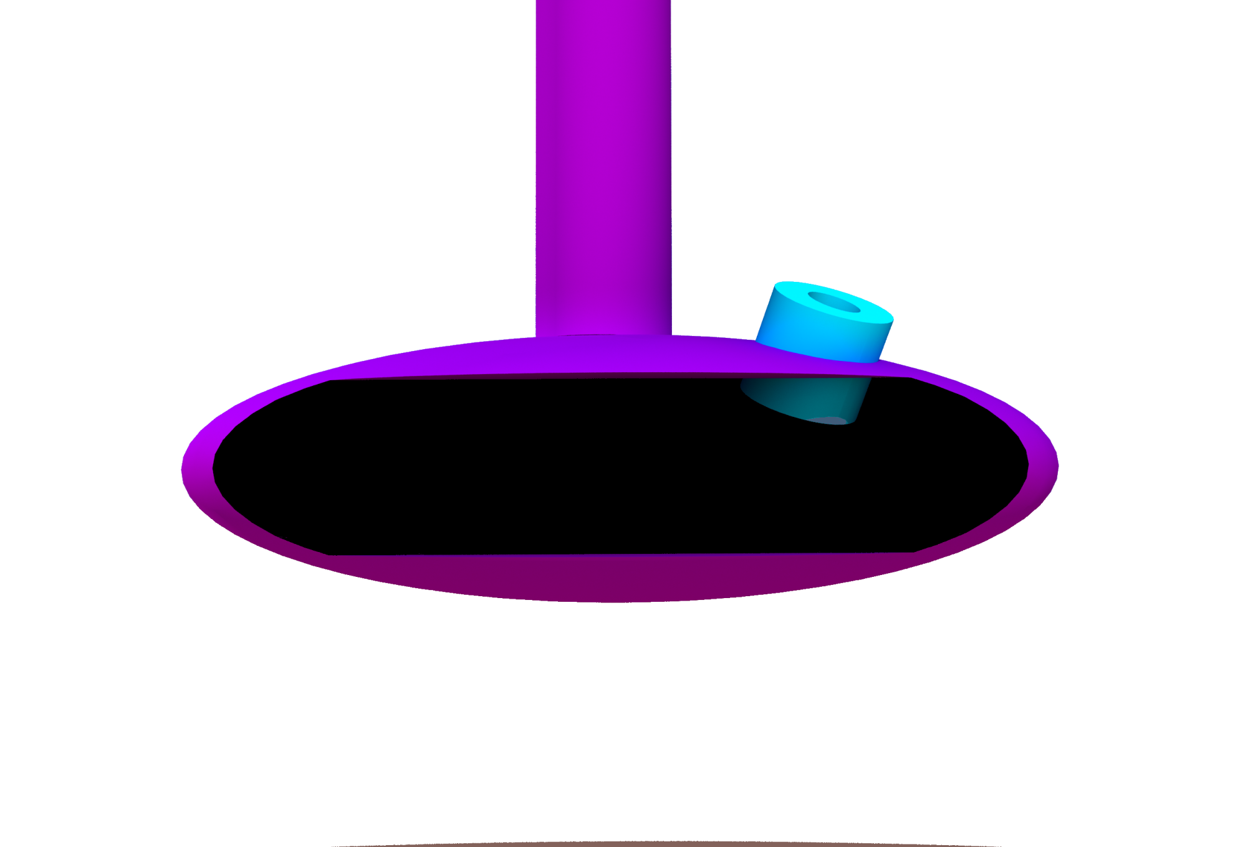




Amphetamine: Mechanism
22
norepinephrine
NET (NE Transporter)
axon terminal
vesicle
VMAT2 (vesicular monoamine
transporter 2)
Catecholamine uptake via
plasmalemmal transporter
Packaged in vesicles for
subsequent release

Slide 46


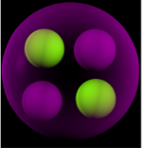
Amphetamine: Mechanism
22
norepinephrine
amphetamine
amphetamine is a
weak lipophilic base
(pKa = 9.9)
NET (NE Transporter)
reverse transport
axon terminal
vesicle
Catecholamine uptake via
Reverse transport leads to
plasmalemmal transporter
plus amphetamine
catecholamine release
Packaged in vesicles for
Alkalinization shuts down vesicular
subsequent release
catecholamine sequestration

Slide 47


Amphetamine
Powerful CNS stimulant
d-isomer 3-4 times more potent than l-isomer
d-amphetamine: Dextroamphetamine (Dexedrine, Dextrostat)
Lisdexamfetamine (Vyvanse): inactive, prodrug of d-amphetamine
Clinical uses:
Hypersomnia (Excessive Daytime Sleepiness [EDS])
narcolepsy (0.03-0.06% of the US population)
obstructive sleep apnea
shift-worker disorder (EDS affects >30% of night-shift workers)
23
Attention Deficit Hyperactivity Disorder
Adverse/toxic effects
Usually result from overdosage
Acute toxic effects usually an extension of therapeutic effects.
restlessness, dizziness, tenseness, insomnia
Cardiovascular/GI side effects
Alternatives
Modafinil (Provigil): promotes wakefulness, reduces EDS in narcoleptics
24
mechanism(s) not well-understood (but activates wake-promoting neurons)
little/no cardiovascular/cognitive side effects (main side effect = headaches)
may be used to reduce cocaine dependence

Slide 48
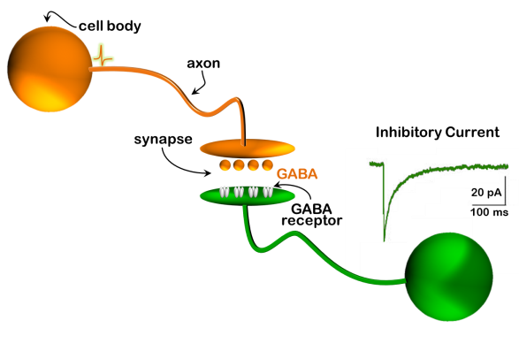
Sedative-Hypnotics & the
Treatment of Hypersomnia
Inhibition in the Brain

Slide 49


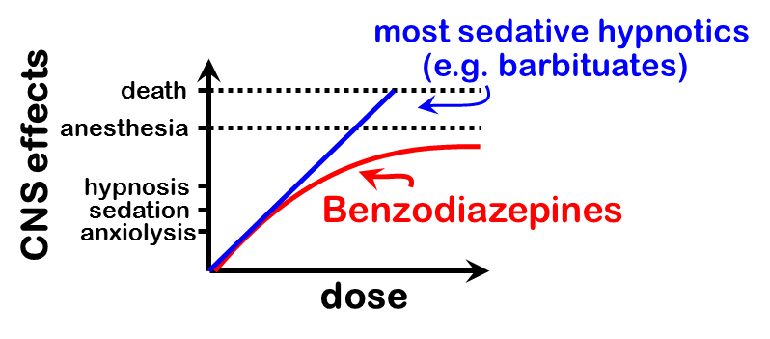

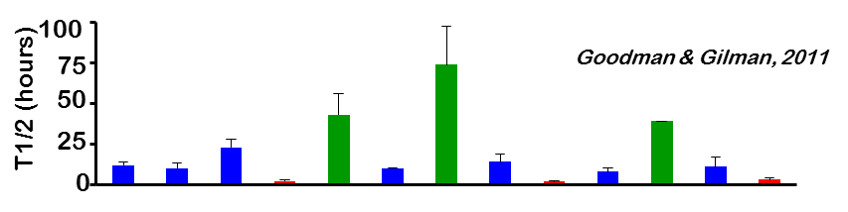
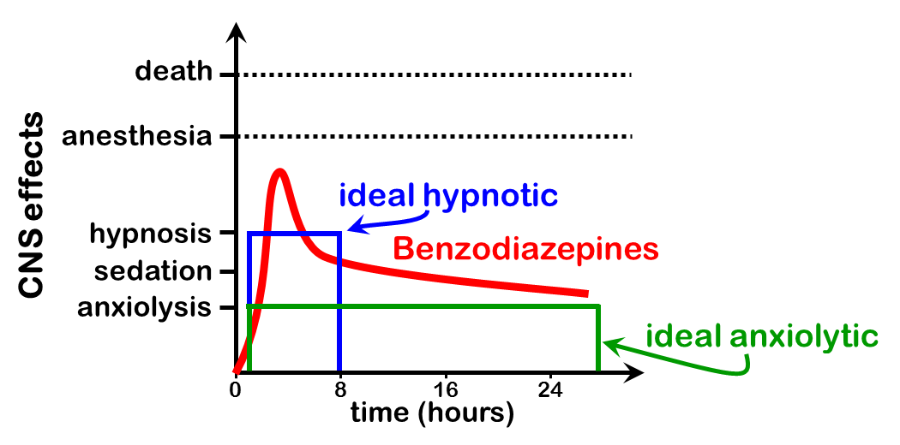
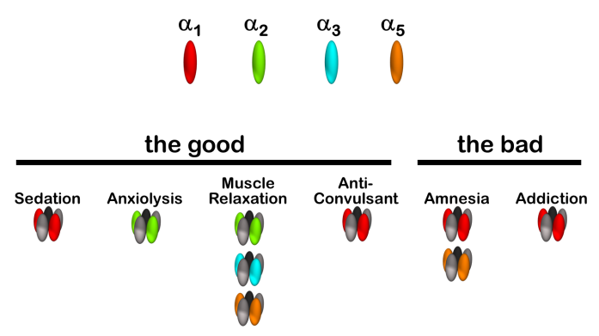
Sedative-Hypnotics & the
Treatment of Hypersomnia
Inhibition in the Brain
Benzodiazepines: positive
allosteric modulators of GABA_{A} R’s
Benzodiazepines: dose-
dependent effects
γ
20 pA
BDZ
β
Benzodiazepines: T1/2’s highly
α
100 ms
variable
α
β
GABA
Benzodiazepines: ideal
hypnotic VS anxiolytic
Benzodiazepines: α subunits

Slide 50
Sedative-Hypnotics & the
Treatment of Hypersomnia
Inhibition in the Brain
Benzodiazepines: positive
Barbiturates: directly
allosteric modulators of GABA_{A} R’s
activate GABA_{A} R’s
Benzodiazepines: dose-
dependent effects
20 pA
γ
20 pA
γ
BDZ
BDZ
β
Benzodiazepines: T1/2’s highly
β
100 ms
α
100 ms
α
variable
BAR
α
α
β
GABA
β
Benzodiazepines: ideal
hypnotic VS anxiolytic
Benzodiazepines: α subunits

Slide 51
Sedative-Hypnotics & the
Treatment of Hypersomnia
Inhibition in the Brain
Barbituates: directly
activate GABA_{A} R’s
Benzodiazepines: dose-
dependent effects
γ
20 pA
BDZ
β
Benzodiazepines: T1/2’s highly
α
100 ms
variable
BAR
β
α
Benzodiazepines: ideal
hypnotic VS anxiolytic
Benzodiazepines: α subunits

Slide 52
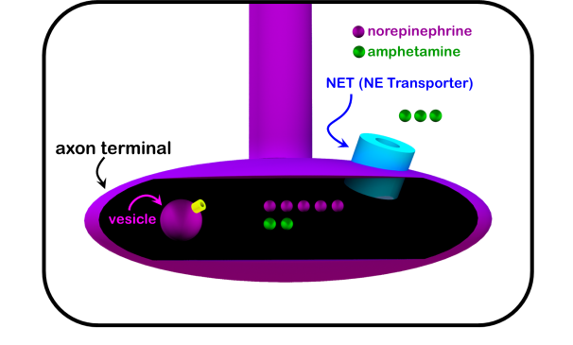
Sedative-Hypnotics & the
Treatment of Hypersomnia
Inhibition in the Brain
Barbituates: directly
activate GABA_{A} R’s
Benzodiazepines: dose-
dependent effects
20 pA
20 pA
20 pA
γ
Amphetamine: catecholamine
BDZ
Benzodiazepines: T1/2’s highly
release
100 ms
α
β
100 ms
100 ms
BAR
variable
β
α
Benzodiazepines: ideal
hypnotic VS anxiolytic
Benzodiazepines: α subunits
suggested reading
Basic & Clinical Pharmacology, 12th ed. (chapter 22)
Bertram G. Katzung, Susan B. Masters, Anthony J. Trevor
Pharmacological Basis of Therapeutics, 12th ed. (Chapter 17)
Goodman & Gilman
questions:
markbeen@virginia.edu

Slide 53
