Slide 1

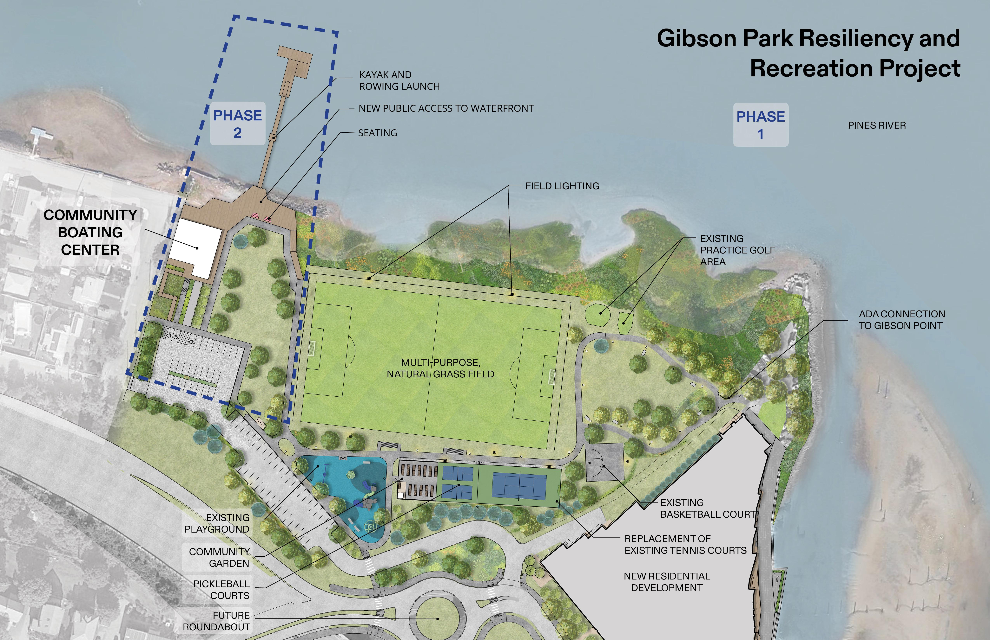
Gibson Park Resiliency and Recreation-Construction
Update: 7/28/26
Project Type: Construction
Status: In Progress
Cost: $2,646,730
Timeline:
May 2026-November 2026
Construction includes a new multipurpose field, high mast lighting, ADA accessible walkways, and the relocation of the community garden, a tennis court, pickleball court, and resurfacing of the basketball court, relocation of memorial benches, parking lot improvements, bleachers. The resiliency design includes a subsurface chambers to hold stormwater, significant drainage improvements beneath the field, soil blending to optimize drainage in the field, professionally selected turf planting and native plant species and bioswales throughout.
Soil Blending is complete and passed the stringent drainage test to support maximum drainage for the field.
Remaining organic soil is actively being removed from the site.
Cultec Chambers and irrigation is being installed to be completed next week.
Electrical conduit installed up to the cabinet and inspected.
Field will be planted in September

