Slide 2
Marriage Matters
Intimacy

Slide 3
Marriage Matters
Intimacy
Let’s Be Friends
This is my beloved and this is my friend, O daughters of Jerusalem.
Song of Songs 5:16b (ESV)

Slide 4
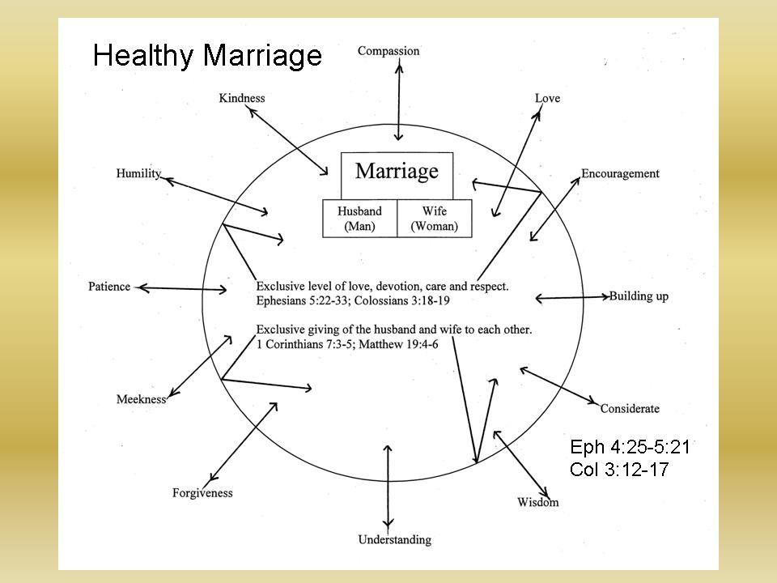

Slide 5
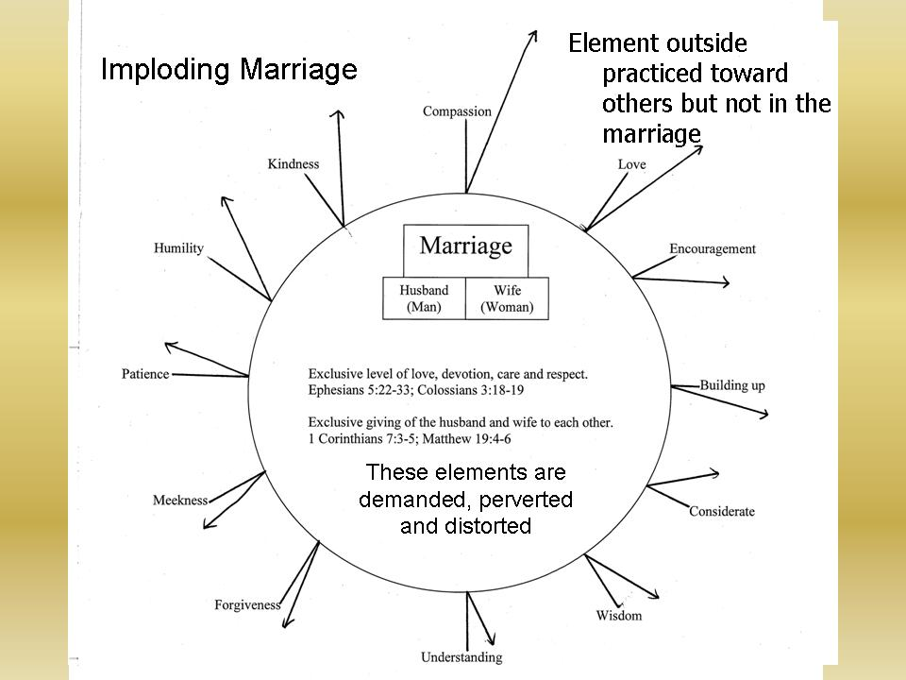

Slide 6
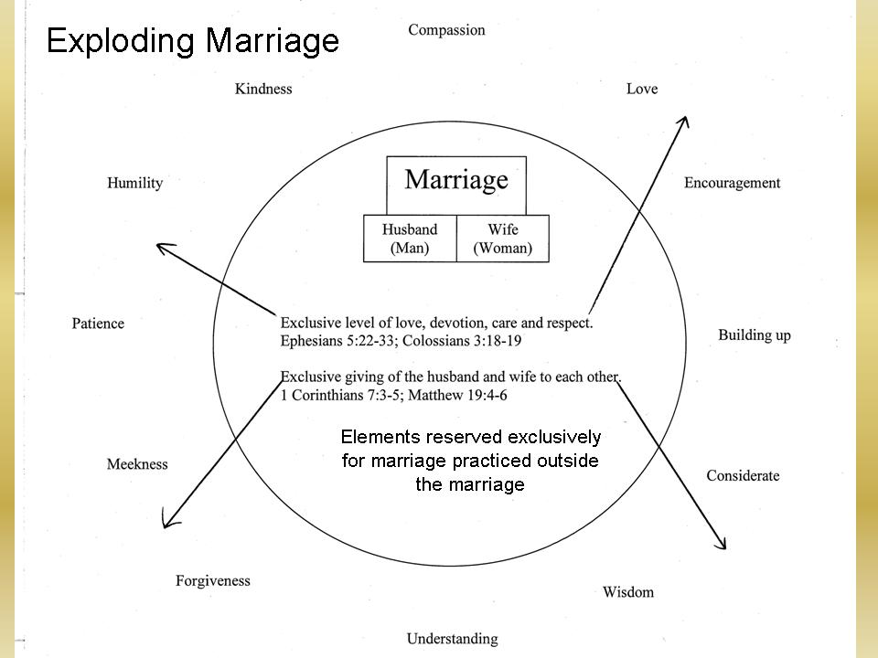

Slide 7
Barriers to Friendship
Desertion during adversity
  ¹⁰ My heart throbs; my strength fails me, and the light of my eyes—it also has gone from me. ¹¹ My friends and companions stand aloof from my plague, and my nearest kin stand far off.
  Psalm 38:10-11 (ESV)

Slide 8
Barriers to Friendship
Betrayal
  ⁹ Even my close friend in whom I trusted, who ate my bread, has lifted his heel against me.
  Psalm 41:9 (ESV)

Slide 9
Barriers to Friendship
Breaking Covenant (Promises)
  ²⁰ My companion stretched out his hand against his friends; he violated his covenant.
  Psalm 55:20 (ESV)

Slide 10
Barriers to Friendship
Deceit
  ²¹ His speech was smooth as butter, yet war was in his heart; his words were softer than oil, yet they were drawn swords.
  Psalm 55:21 (ESV)
  ²² Behold, all the women left in the house of the king of Judah were being led out to the officials of the king of Babylon and were saying, “‘Your trusted friends have deceived you and prevailed against you; now that your feet are sunk in the mud, they turn away from you.’
  Jeremiah 38:22 (ESV)

Slide 11
Barriers to Friendship
Corrupt or malicious counsel
  ²⁸ A dishonest man spreads strife, and a whisperer separates close friends.
  Proverbs 16:28 (ESV)
  ⁹ Whoever covers an offense seeks love, but he who repeats a matter separates close friends.
  Proverbs 17:9 (ESV)

Slide 12
Barriers to Friendship
Focus on what the relationship offers me
  ⁴ Wealth brings many new friends, but a poor man is deserted by his friend.
  Proverbs 19:4 (ESV)
  ⁶ Many seek the favor of a generous man, and everyone is a friend to a man who gives gifts.
  Proverbs 19:6 (ESV)

Slide 13
Building Friendship
Open communication
  ¹¹ Thus the LORD used to speak to Moses face to face, as a man speaks to his friend.
  Exodus 33:11a (ESV)
  ¹⁵ No longer do I call you servants, for the servant does not know what his master is doing; but I have called you friends, for all that I have heard from my Father I have made known to you.
  John 15:15 (ESV)

Slide 14
Building Friendship
Absolute commitment
  ⁷ Did you not, our God, drive out the inhabitants of this land before your people Israel, and give it forever to the descendants of Abraham your friend?
  2 Chronicles 20:7 (ESV)
  ⁸ But you, Israel, my servant, Jacob, whom I have chosen, the offspring of Abraham, my friend
  Isaiah 41:8 (ESV)
  ²³ and the Scripture was fulfilled that says, “Abraham believed God, and it was counted to him as righteousness”—and he was called a friend of God.
  James 2:23 (ESV)

Slide 15
Building Friendship
Unfailing love
  ¹⁷ A friend loves at all times, and a brother is born for adversity.
  Proverbs 17:17 (ESV)

Slide 16
Building Friendship
Loyalty
  ²⁴ A man of many companions may come to ruin, but there is a friend who sticks closer than a brother.
  Proverbs 18:24 (ESV)
  ¹⁴ You are my friends if you do what I command you.
  John 15:14 (ESV)

Slide 17
Building Friendship
Integrity
  ¹¹ He who loves purity of heart, and whose speech is gracious, will have the king as his friend.
  Proverbs 22:11 (ESV)

Slide 18
Building Friendship
Encouragement
  ¹¹ He who loves purity of heart, and whose speech is gracious, will have the king as his friend.
  Proverbs 22:11 (ESV)

Slide 19
Building Friendship
Appropriate confrontation
  ⁶ Faithful are the wounds of a friend; profuse are the kisses of an enemy.
  Proverbs 27:6 (ESV)

Slide 20
Building Friendship
Sacrifice
  ¹³ Greater love has no one than this, that someone lay down his life for his friends.
  John 15:13 (ESV)

