Slide 1

Sky Hopinka: Red Metal Dust An installation of 11 new works by the American artist.
The Barnes commissioned Hopinka to create site-specific work that explores and interrogates the American experience and its histories.
The installation runs from March 21, 2026–January 18, 2027, and consists of 11 photographic landscapes with copper sheeting.

Slide 2
About the Artist
Sky Hopinka (Ho-Chunk Nation/Pechanga Band of Luiseño Indians) was born and raised in Ferndale, Washington, and Palm Springs, California.
In Portland, Oregon, Hopinka studied and taught Chinuk Wawa, a language indigenous to the Lower Columbia River Basin.
His films, videos, and photographs are in collections at the Museum of Modern Art, the Solomon R. Guggenheim Museum, the Whitney Museum, the San Francisco Museum of Modern Art, the Amon Carter Museum of American Art, the Walker Art Center, and Museum für Moderne Kunst in Frankfurt, Germany, among others.

Slide 3
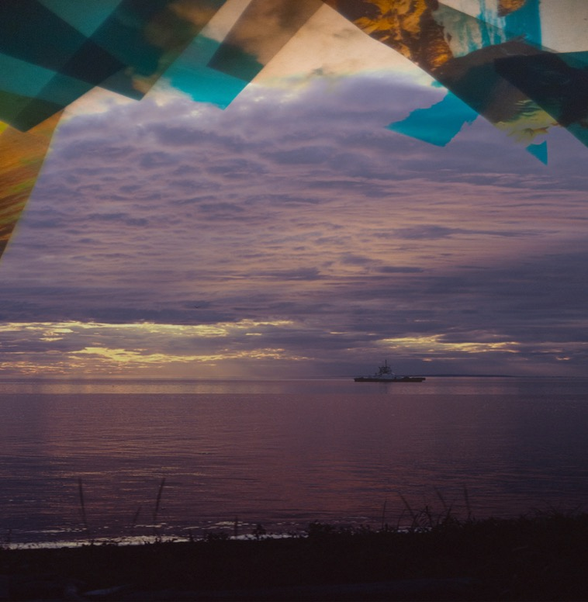
Red Metal Dust
Red Metal Dust is an installation by Sky Hopinka (Ho-Chunk Nation/Pechanga Band of Luiseño Indians), a widely celebrated Native American artist who works in video, photography, and text.
Hopinka creates works that center on personal positions of Indigenous homeland and landscape and designs of language as containers of culture.
From the series Red Metal Dust, 2026. Sky Hopinka

Slide 4
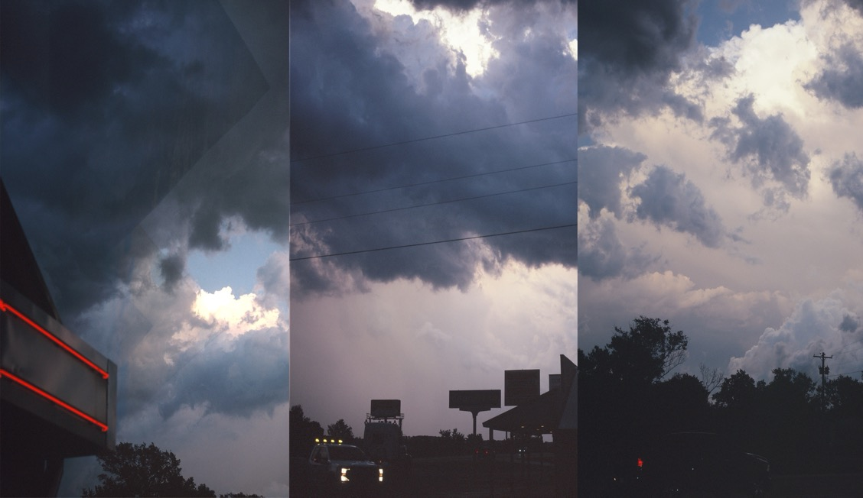
Discussion Questions
In what ways do you think the images in this artwork evoke the American experience?
Why do you think the artist used copper sheets alongside photographic images in this installation?
From the series Red Metal Dust, 2026. Sky Hopinka

Slide 5
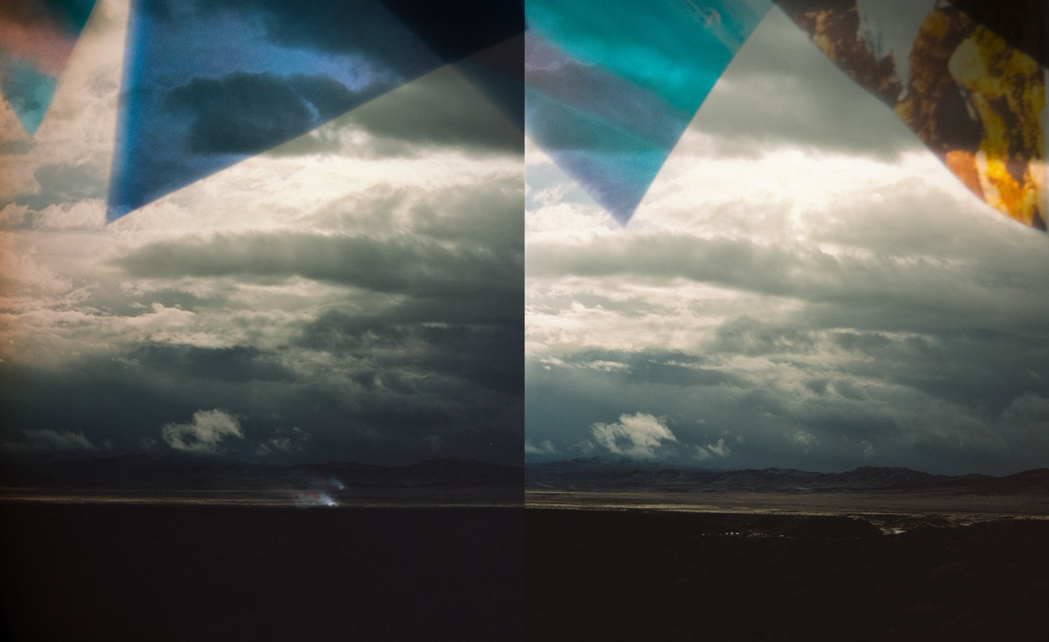
How do you think the colors in this artwork highlight aspects of the American experience?
How do you think this artwork would tell a different story if it were all black and white? ​
From the series Red Metal Dust, 2026. Sky Hopinka

Slide 6
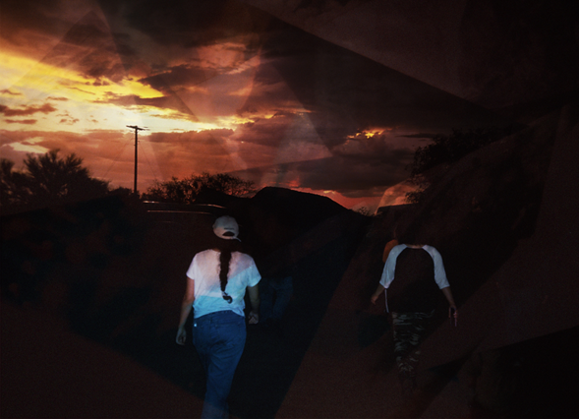
What story do you think this artwork is telling?
How do you interpret the visual imagery in these pieces?
From the series Red Metal Dust, 2026. Sky Hopinka

Slide 7
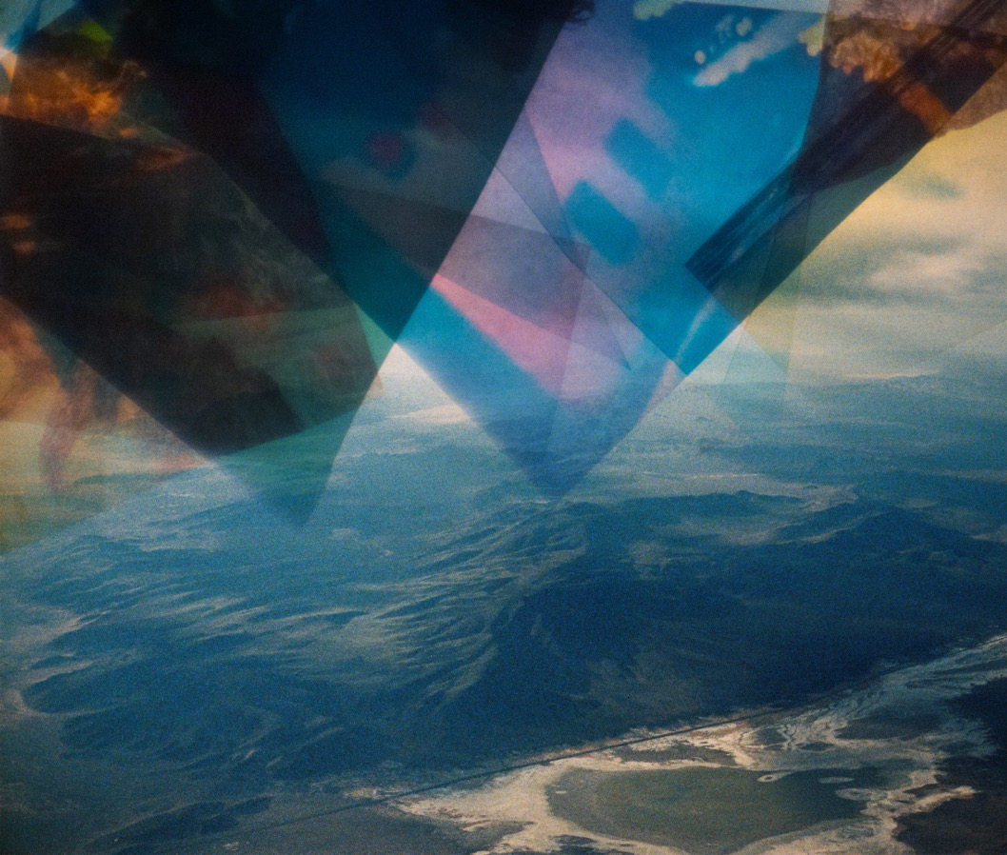
What do you think is the purpose of highlighting different perspectives of reality in this image?
Why do you think the artist chose to fracture the sky with different colors?
From the series Red Metal Dust, 2026. Sky Hopinka

