Slide 1
A Guide to Exploring the Special Exhibition Henri Rousseau: A Painter’s Secrets
October 19, 2025–February 22, 2026

Slide 2
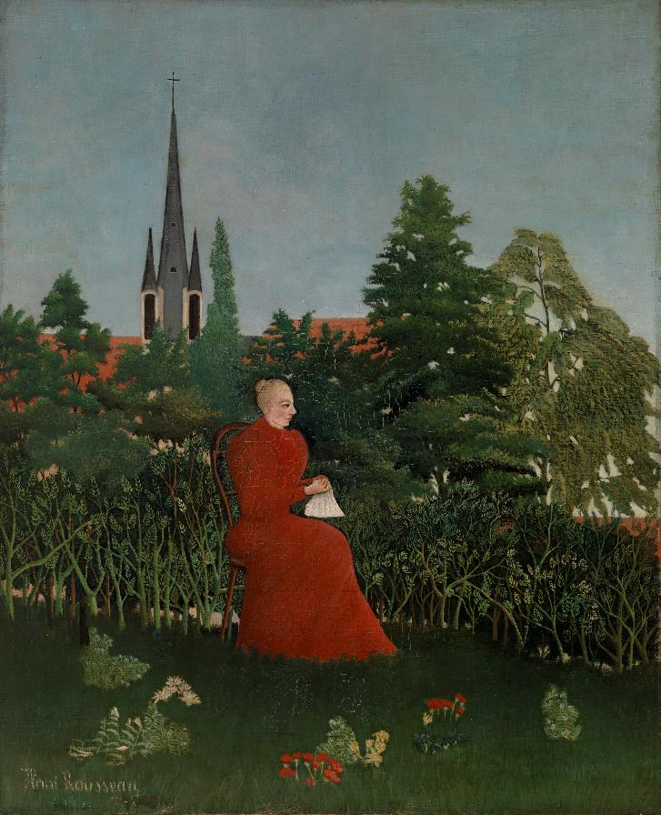
What techniques do you think Rousseau used to create paintings?
Do you think self-taught artists can be considered just as skilled as artists who went to school for art?
Henri Rousseau. Portrait of a Woman in a Landscape, 1899. Oil on canvas.
The Barnes Foundation, BF260

Slide 3
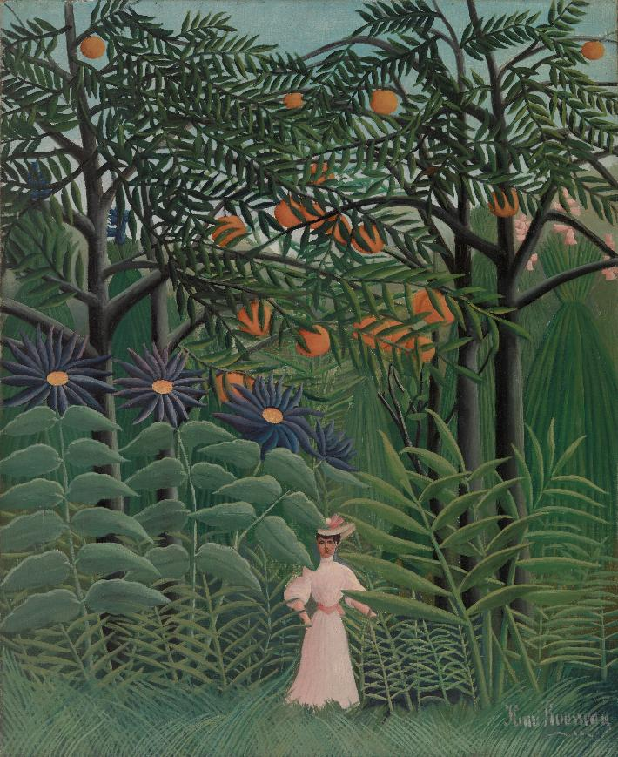
Do you think that precise proportions matter within an artwork?
Why do you think Rousseau continued to revisit the theme of the jungle throughout his art career?
Henri Rousseau. Woman Walking in an Exotic Forest, c. 1910.
Oil on canvas. The Barnes Foundation, BF388

Slide 4
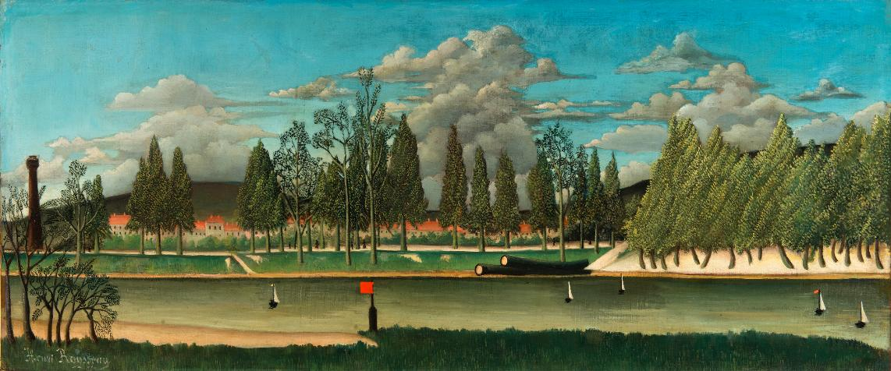
How did Rousseau use color, light, line, and space in this artwork?
How do you think the audience of Rousseau’s time responded to his art? How do you respond to his art?
Henri Rousseau. View of the Quai d’Asnières, 1900–1902. Oil on canvas.
The Barnes Foundation, BF583

Slide 5
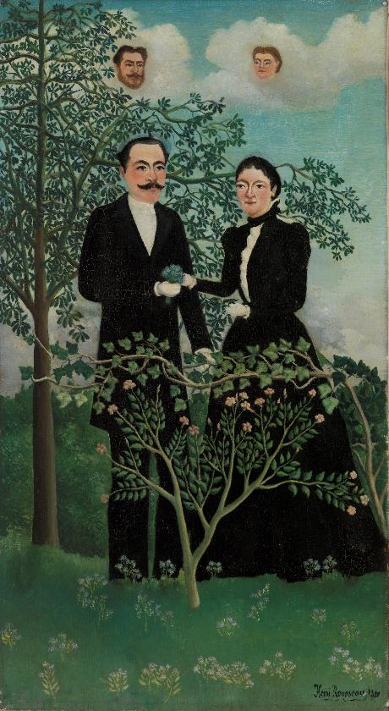
How do you think Rousseau's paintings compare to the paintings of other artists?
If you were able to change one thing about Rousseau's artwork, what would you change?
Henri Rousseau. The Past and the Present, or Philosophical Thought, 1899. Oil on canvas. The Barnes Foundation, BF582

Slide 6
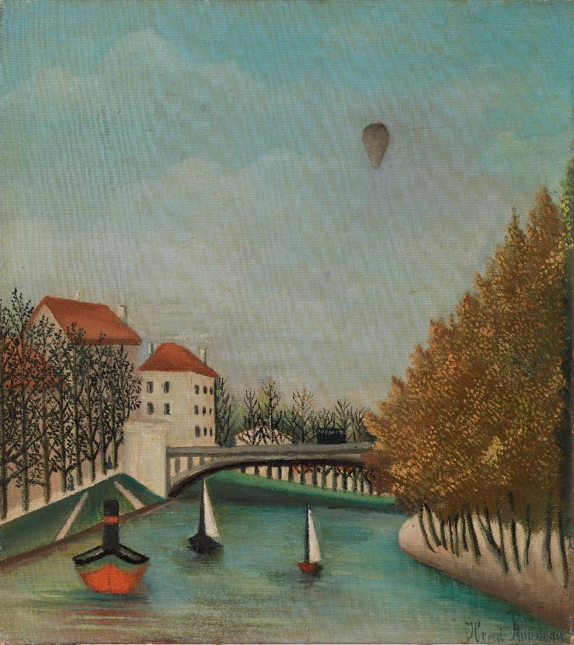
Do you think artworks should look realistic?
Can you find any ways in which Rousseau challenged the idea of “fine art” in his artwork?
Henri Rousseau. View of Clichy Bridge at Asnières, 1908.
Oil on canvas. The Barnes Foundation, BF861

Slide 7
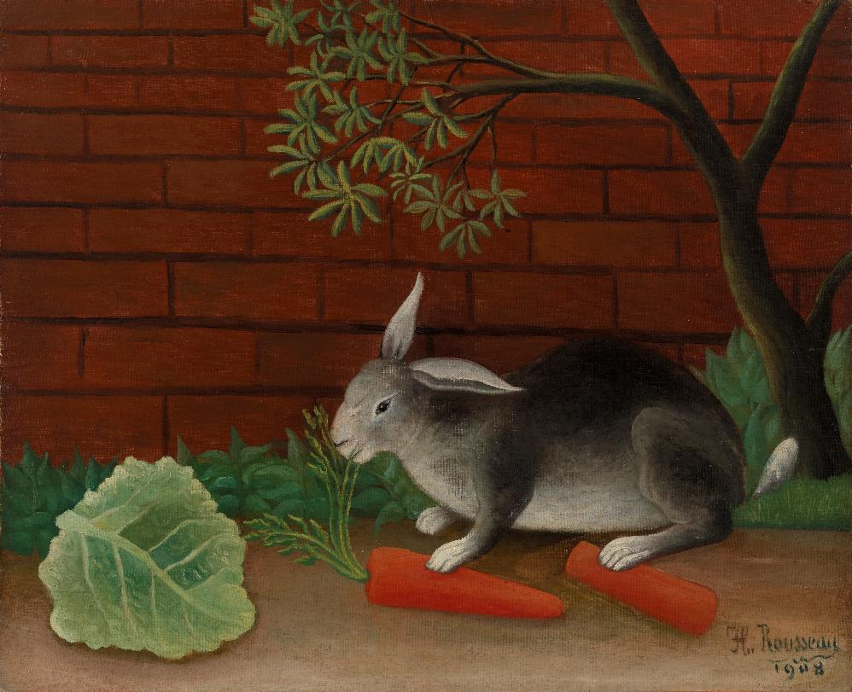
Rousseau’s art was inspired by and frequently featured nature. What are some ways you are inspired by nature?
In what ways could Rousseau’s art have inspired artists of his day?
Henri Rousseau. The Rabbit's Meal, 1908. Oil on canvas.
The Barnes Foundation, BF578

Slide 8
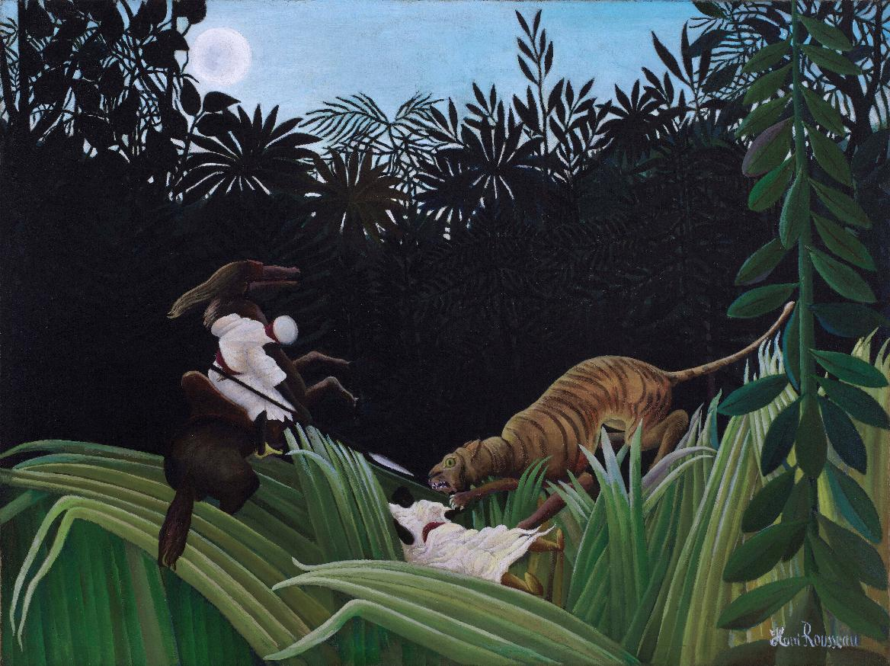
Do you think the moon depicted in Rousseau’s artwork adds to a sense of mystery or suspense? Would the absence of the moon change anything? Why or why not?
Do you think that the use of copying tools such as a pantograph can add to or detract from the impact of Rousseau's art?
Henri Rousseau. Scouts Attacked by a Tiger, 1904. Oil on canvas. The Barnes Foundation, BF584

Slide 9
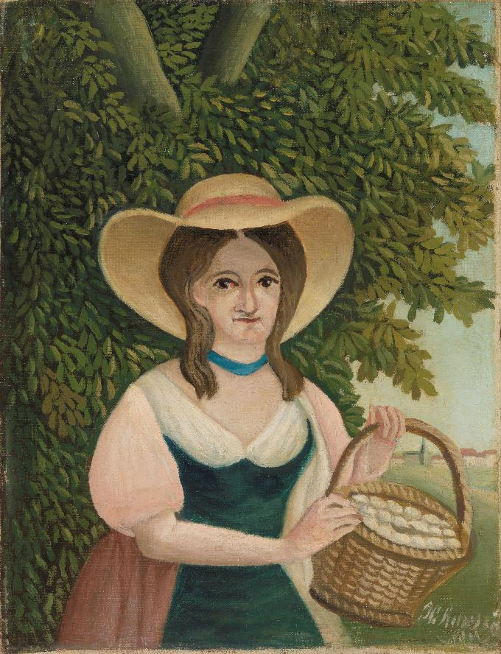
Do you believe that the world Rousseau lived in affected the art he made or the process of his art making?
In what ways can Rousseau’s artwork inspire us today?
Henri Rousseau. Woman with Basket of Eggs, c. 1889–95. Oil on canvas.
The Barnes Foundation, BF544

Slide 10
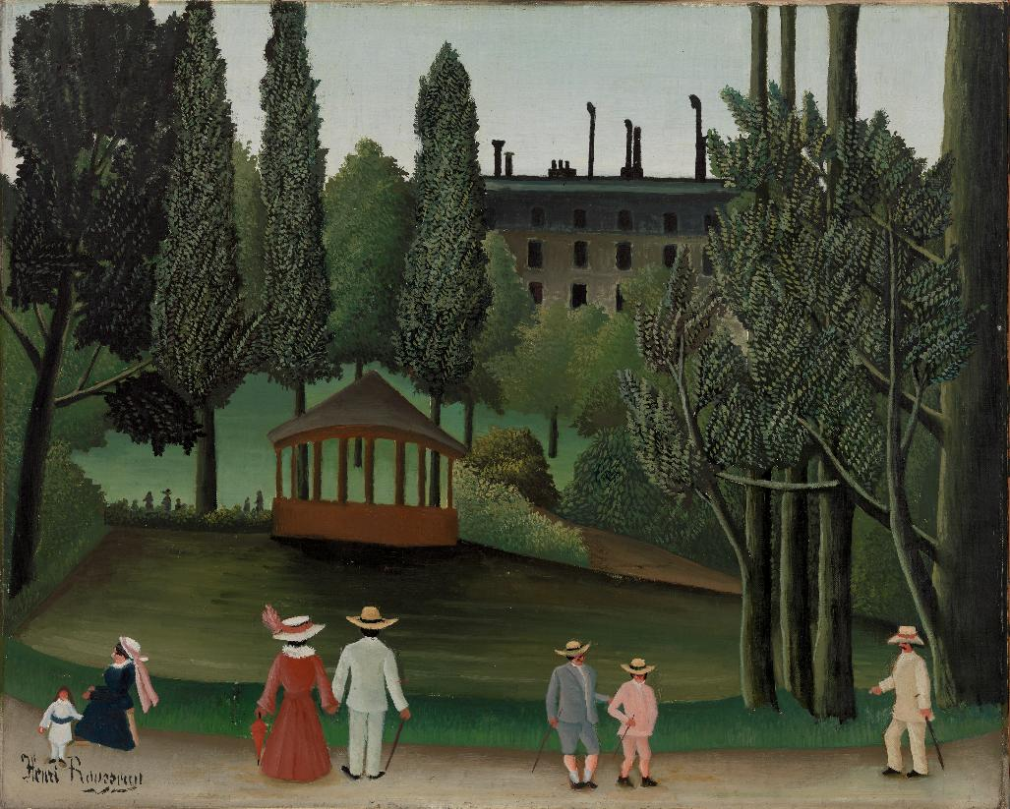
What do you think Rousseau’s art tells us about the time that he was living in?
What message do you think Rousseau is trying to give us through his artwork?
Henri Rousseau. View of Montsouris Park, the Kiosk, c. 1908–10. Oil on canvas. The Barnes Foundation, BF570

Slide 11
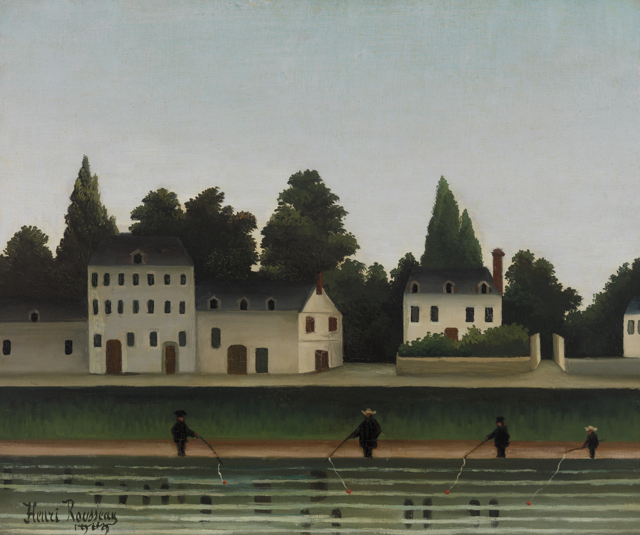
If Rousseau were painting today, do you think he would paint the same subject matter, or do you think he would paint different subject matter?
Henri Rousseau. Landscape and Four Fisherman, 1909. Oil on canvas.
The Barnes Foundation, BF545

