Slide 1
Noguchi to Asawa:
Designing Postwar America
September 20, 2026–January 10, 2027
Iconic sculpture and design by two generations of Japanese American artists.

Slide 2
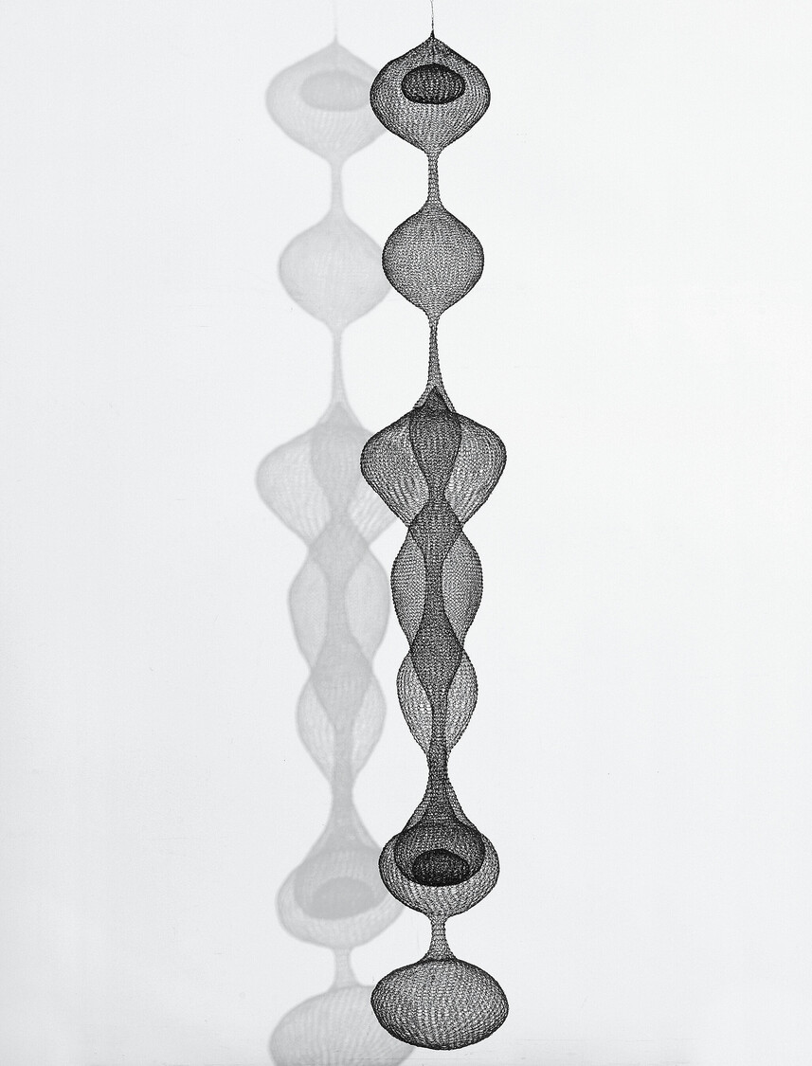
Ruth Asawa
How do you think the artist might have made this piece?
Where would you display an artwork like this?
Ruth Asawa (1926–2013). Untitled (S.272, Hanging Seven-Lobed Continuous Interlocking Form with Spheres in the First and Sixth Lobes), c. 1954. Copper and iron wire. 111 × 14 × 14 in.

Slide 3
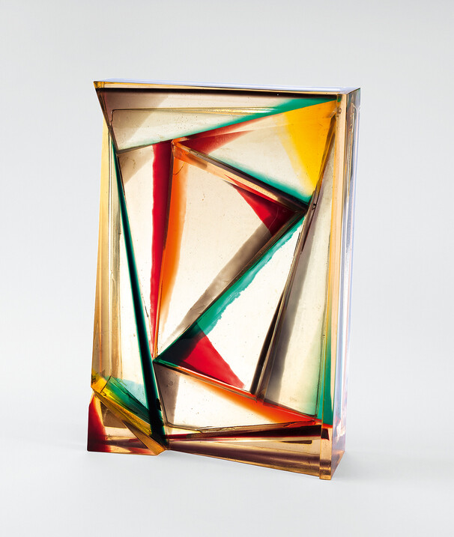
Leo Amino
If you were to shine light at this artwork, what would it look like?
This is made using polyester resin. How do you think modern materials might change the way artists make art?
Leo Amino (1911–1989). Refractional #21, 1967. Polyester resin. 20 × 13 5/8 × 4 3/8 in.

Slide 4
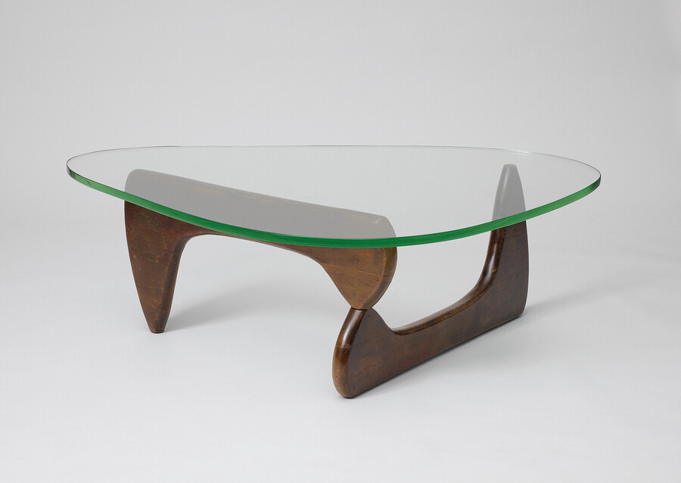
Isamu Noguchi
Imagine the room this coffee table was designed for. What do you think the room would look like?
Isamu Noguchi (1904–1988). Model IN-50 Coffee Table, 1944. Manufactured by Herman Miller Furniture Company, Zeeland, Michigan. Glass and birch. 15 3/4 × 50 × 36 in.

Slide 5
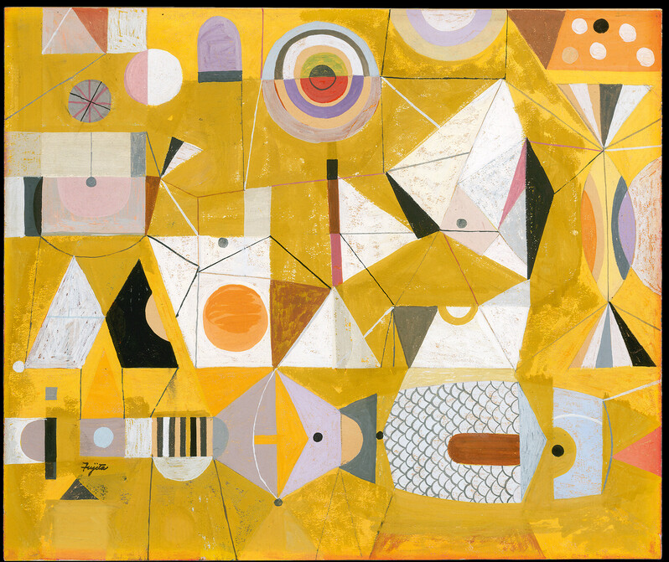
S. Neil Fujita
This painting was used as an album cover. What kind of music would you expect to hear on this album?
If you designed an album cover for your favorite song, what would you create?
S. Neil Fujita (1921–2010). Composition for album cover design, 1957. Gouache on paper. 9 3/4 × 11 13/16 in.

Slide 6
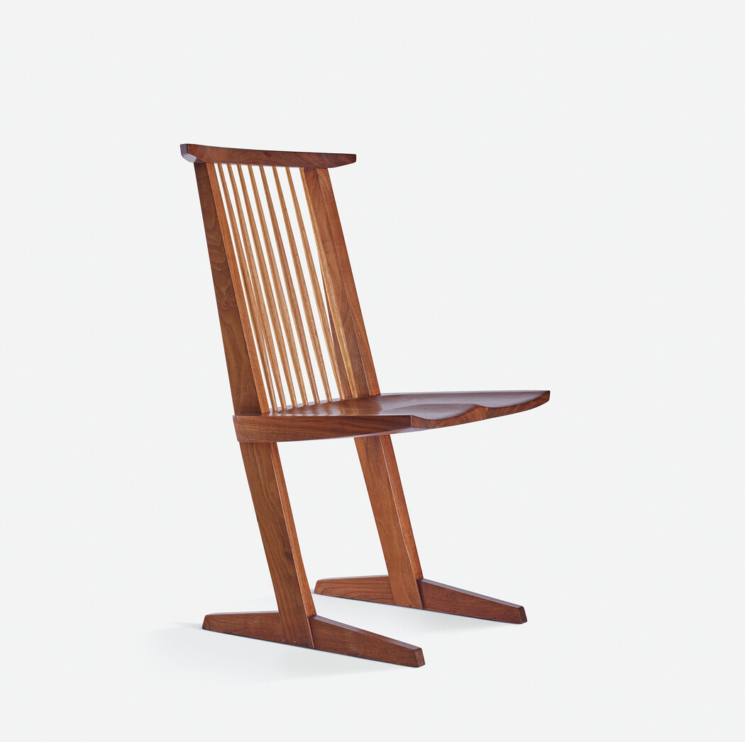
George Nakashima
What do you think it would feel like to sit in this chair?
Who do you think this chair was created for?
George Nakashima (1905–1990). Conoid Chair, 1967. Black walnut and hickory. 36 × 21 1/2 × 16 1/4 in.

Slide 7
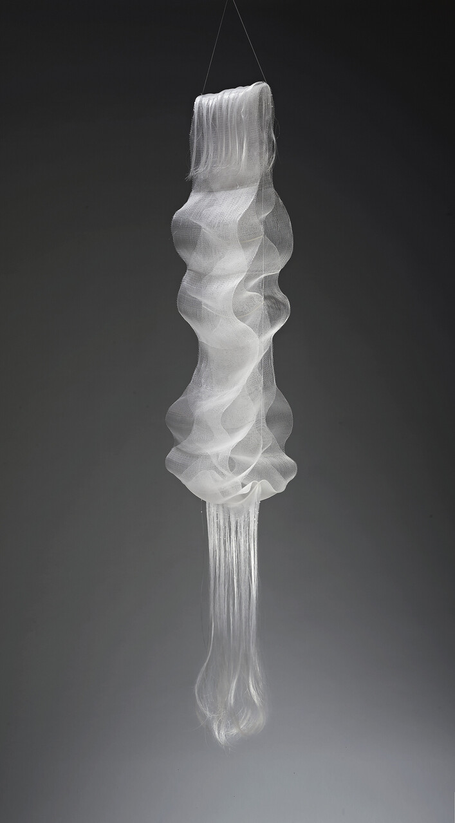
Kay Sekimachi
What do the shapes of this sculpture remind you of?
Kay Sekimachi (b. 1926). Ogawa II, 1969. Nylon monofilament, glass beads, and plastic tubing.
76 × 12 × 10 1/2 in.

