Slide 1
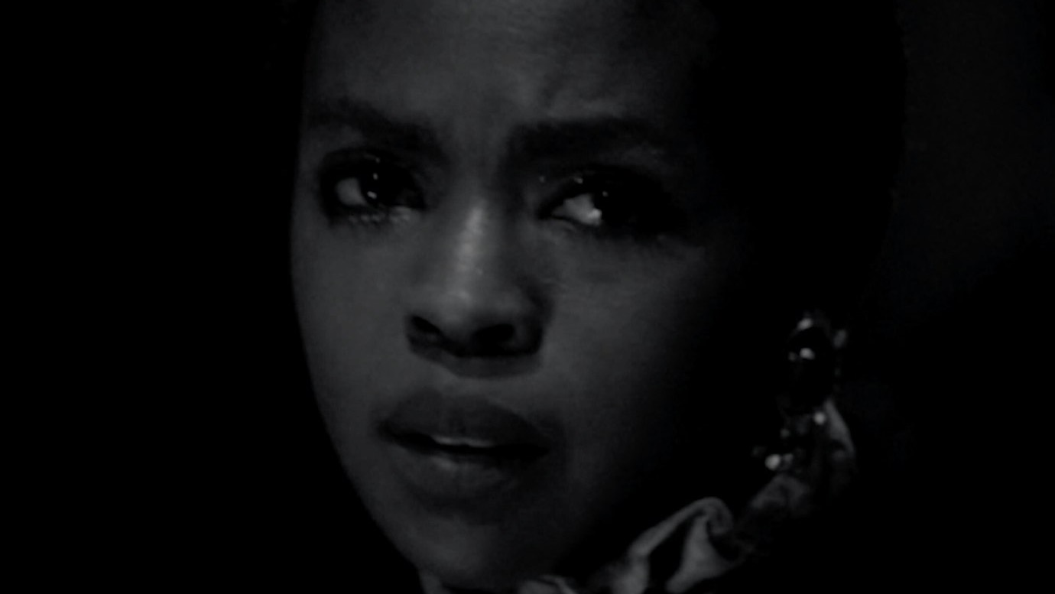
Freedom Dreams
April 12–August 9, 2026
A meditation on the memories, dreams, and histories of America, featuring moving-image artists Arthur Jafa,
David Hartt, Garrett Bradley, Ja’Tovia Gary, and Tourmaline.
Arthur Jafa. Love is the Message, The Message is Death, 2016. Detail of video still. Courtesy of the artist and Gladstone

Slide 2
Freedom Dreams
The special exhibition Freedom Dreams brings together powerful works by five artists in film, video, and installation that invite viewers to immerse themselves in the memories, dreams, and histories of Black Americans. Featured works by Arthur Jafa, David Hartt, Garrett Bradley, Ja’Tovia Gary, and Tourmaline touch on different elements of the complexity of lived experiences in America, exploring identity, memory, perspective, and expression. Using new imagery and historic black-and-white film, the artists create visual vehicles through which we can contemplate the themes presented. Use the following discussion questions to enhance your visit.

Slide 3
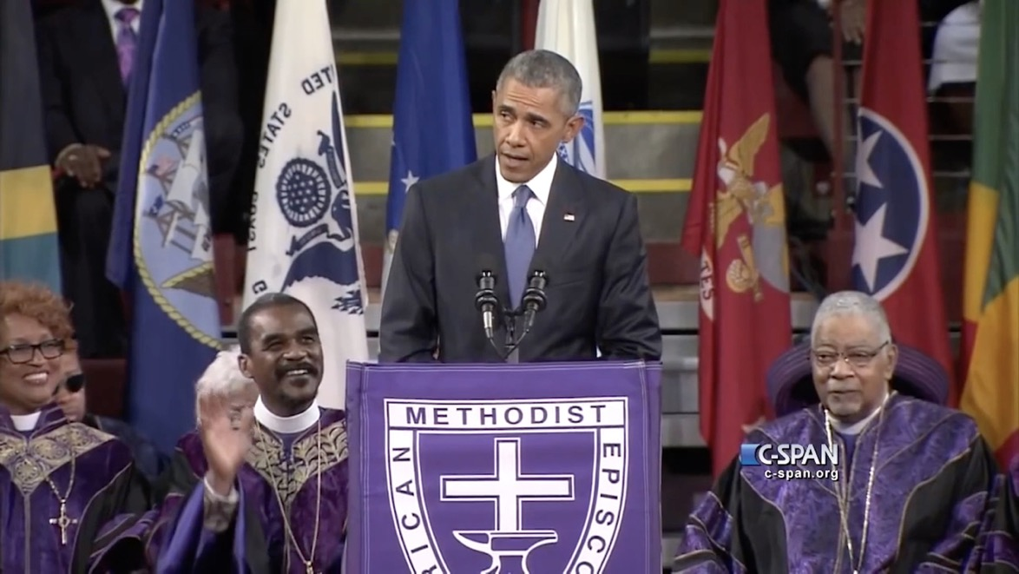
Arthur Jafa: Love is the Message,
The Message is Death
What message do you think the artist wants viewers to take away from the film?
What do you think is
the purpose of showing repeated images of joy
and despair?
How would the film be different with no music?
Arthur Jafa. Love is the Message, The Message is Death, 2016. Detail of video still. Courtesy of the artist and Gladstone

Slide 4

Ja’Tovia Gary: Quiet as It’s Kept
Why do you think
an artist would use
archival film to connect with an audience?
In what ways does the artist present viewers with themes of identity or memory?
Ja’Tovia Gary. Quiet as It’s Kept, 2023. Detail of video still. © Ja’Tovia Gary.

Slide 5

Tourmaline: Pollinator
How does this film explore
the theme of identity?
In what ways does music affect your experience of
the artwork?
Why do you think the artist decided to present their film in black and white?
Tourmaline. Pollinator, 2024. Detail of video still. Courtesy of the artist and Chapter NY, New York

Slide 6
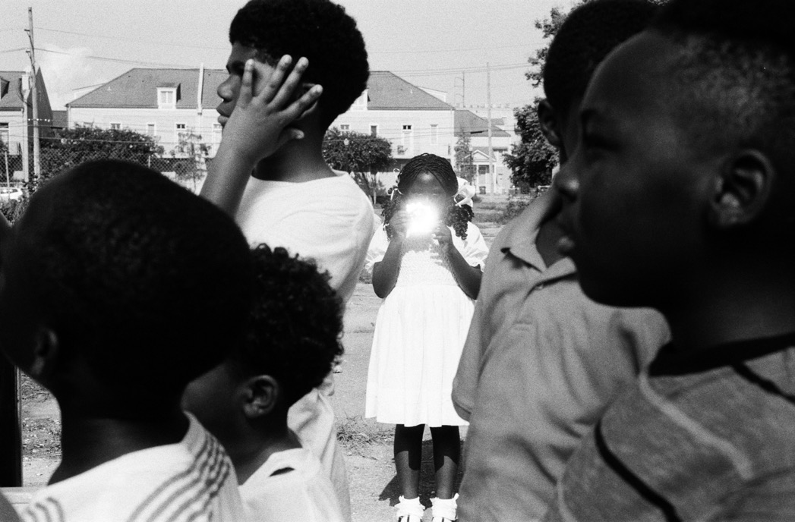
Garrett Bradley: America
What do you think is
the message of this film?
How does the film make you think about the past, present, or future of America?
Garrett Bradley. America, 2019. Detail of video still. Courtesy of the artist

Slide 7

David Hartt:
On Exactitude in Science (Watts)
Does the way that this artwork was filmed seem natural to you?
Why or why not?
What do the visual elements
remind you of?
How does the vertical format of the film affect the viewing experience?
David Hartt: On Exactitude in Science (Watts), 2021. Video still. © David Hartt. Courtesy of Galerie Thomas Schulte

