Slide 1

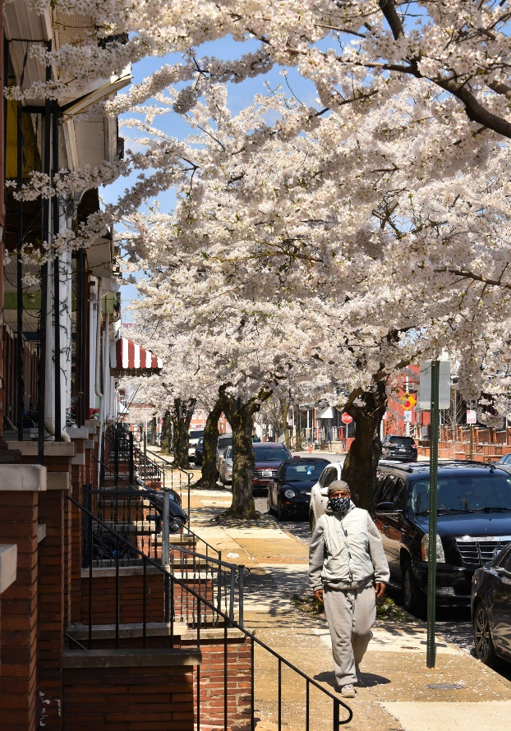
Board of Directors Meeting
May 12, 2026
Via Videoconference
4:00 pm – 5:00 pm

Slide 2
PABC Board of Directors
Meeting Agenda
May 12, 2026
Board Approvals
Board Meeting Minutes of March 10, 2026
Off-Street Parking (David Morgan)
Review of Metrics
Projects and Updates
New Business
  Facilities Rate Adjustment Recommendations
Capital Projects (John Genda)
Projects and Updates
New Business
  Fleet & Eden Garage Engineering Services Expense Approval
  West Street Garage Engineering Services Expense Approval
On-Street Parking
Residential Permit Parking / Permits (Shamir Cole-Butler)
  Review of Metrics
  Financials
  Projects and Updates
  New Business - None
Parking Meters (Norman Chase)
  Review of Metrics
  Financials
  Projects and Updates
  New Business
    Mobile Payment App and Text-to-Pay Recommendations
Residential Reserved Disabled Parking (Michelle Thompson)
  Review of Metrics
  Projects and Updates
  New Business - None
Valet Regulations (Andre Poole)
  Review of Metrics
  Financials
  Projects and Updates
  New Business - None
Parking Planning (Fran Burnszynski)
Review of Metrics
Projects and Updates
New Business - None
Electric Vehicle Charging (Nicole Caesar)
Review of Metrics
Projects and Updates
New Business
  Electric Vehicle Charging Stations Purchase and Installation Expense Approval
Administration (Pete Little)
Review of Metrics
Financials
Projects and Updates
New Business
  FY 2027 IT Budget Software Subscription Renewal Expense Approval
  FY 2027 Administrative Budget Recommendation

