Slide 1

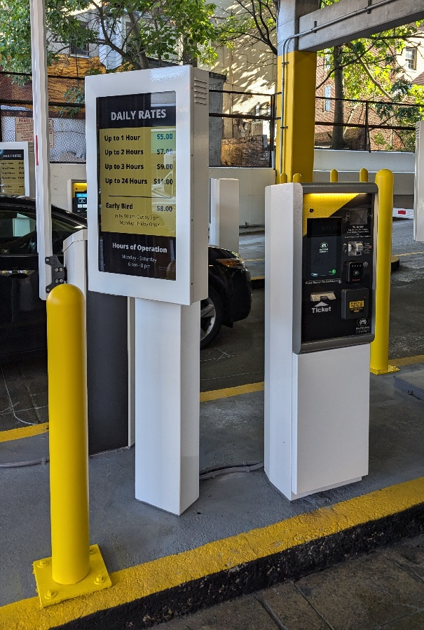
Board of Directors Meeting
February 11, 2025
Via Videoconference
4:00 pm – 5:00 pm

Slide 2
PABC Board of Directors
Meeting Agenda
February 11, 2025
Introduction of New Board Member, Councilman Blanchard
Board Approvals
Board Meeting Minutes of January 14, 2025
Off-Street Parking (David Morgan)
Review of Metrics
Projects and Updates
New Business
  Facilities Rate Adjustment Recommendations
Capital Projects (Na’Jah Jackson)
Projects and Updates
New Business - None
On-Street Parking
Residential Permit Parking / Permits (Shamir Cole-Butler)
  Review of Metrics
  Financials
  Projects and Updates
  New Business - None
Parking Meters (Norman Chase)
  Review of Metrics
  Financials
  Projects and Updates
  New Business - None
Residential Reserved Disabled Parking (Michelle Thompson)
  Review of Metrics
  Projects and Updates
  New Business - None
Valet Regulations (Andre Poole)
  Review of Metrics
  Financials
  Projects and Updates
  New Business - None
Parking Planning (Fran Burnszynski)
Review of Metrics
Projects and Updates
New Business - None
Electric Vehicle Charging (Nicole Caesar)
Review of Metrics
Projects and Updates
New Business - None
Administration (Pete Little)
Review of Metrics
Financials
Projects and Updates
New Business
  New Position Recommendation: Parking Data Analyst

