Slide 1

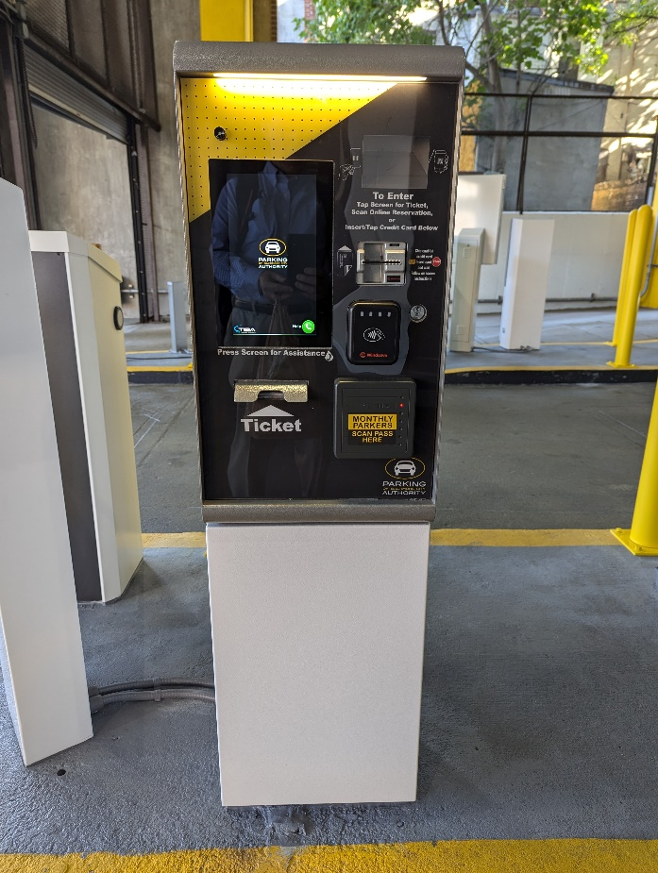
Board of Directors Meeting
December 10, 2024
Via Videoconference
4:00 pm – 5:00 pm

Slide 2
PABC Board of Directors
Meeting Agenda
December 10, 2024
Board Approvals
Board Meeting Minutes of November 12, 2024
Off-Street Parking (David Morgan)
Review of Metrics
Projects and Updates
New Business - None
Capital Projects (Na’Jah Jackson)
Projects and Updates
New Business
  Market Center Garage Fire Suppression Repair Expense Approval
On-Street Parking
Residential Permit Parking / Permits (Shamir Cole-Butler)
  Review of Metrics
  Financials
  Projects and Updates
  New Business
    Lexington Street Garage Elevator Repairs Expense Approval
Parking Meters (Norman Chase)
  Review of Metrics
  Financials
  Projects and Updates
  New Business - None
Residential Reserved Disabled Parking (Michelle Thompson)
  Review of Metrics
  Projects and Updates
  New Business - None
Valet Regulations (Andre Poole)
  Review of Metrics
  Financials
  Projects and Updates
  New Business - None
Parking Planning (Fran Burnszynski)
Review of Metrics
Projects and Updates
New Business - None
Electric Vehicle Charging (Nicole Caesar)
Review of Metrics
Projects and Updates
New Business - None
Administration (Pete Little)
Review of Metrics
Financials
Projects and Updates
New Business - None

