Slide 1
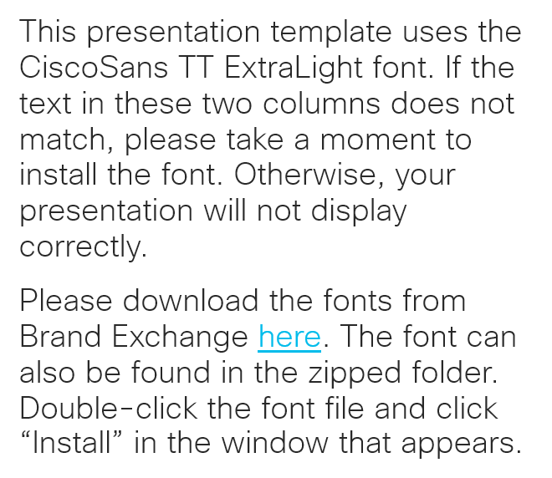
Please read
This presentation template uses the CiscoSans TT ExtraLight font. If the text in these two columns does not match, please take a moment to install the font. Otherwise, your presentation will not display correctly.
Please download the fonts from Brand Exchange here. The font can also be found in the zipped folder. Double-click the font file and click “Install” in the window that appears.

Slide 4
Use this slide for transitions

Slide 5
Use this slide for transitions

Slide 6
“Design is the silent ambassador of your brand.”
Paul Rand

Slide 7
“Design is the silent ambassador of your brand.”
Paul Rand

Slide 8
This is a sample headline
This is the standard
bullet slide
Keep bullet points brief
Adjust font sizes as needed
to fill the space
Use line spacing to clearly separate each point
Use the two-column layout
for text-heavy slides

Slide 9
This is a sample headline
Instead of bullet points, you can use a few words here if needed.
Keep sentences short and use no more than three.
Audiences should be
able to take them in at
a glance.

Slide 10
This is a sample headline
Secondary information
goes here
Keep bullets brief
Use line spacing to clearly separate each point
Use the two-column layout
for text-heavy slides
Put your main point here. Use this space for a brief paragraph – no more than two or three sentences. Font size should be around 24 pt.

Slide 11
Two-column layout
Use this layout when you have to show six or more bullets
Text size should be approximately 20 pt
Use paragraph spacing to clearly separate each point
Use bold or italic text sparingly
Use this layout when you have to show six or more bullets
Text size should be approximately 20 pt
Use paragraph spacing to clearly separate each point
Use bold or italic text sparingly

Slide 12
This is a sample headline

Slide 13
This is a sample headline

Slide 14
This is a sample headline

Slide 15
Bar charts
Add source here

Slide 16
Line charts
Add source here

Slide 17
This is a sample headline
Heading 1 | Heading 2 | Heading 3
100 | 100 | 100
100 | 100 | 100
100 | 100 | 100
100 | 100 | 100
100 | 100 | 100

Slide 18
Slide title
Heading 1 | Heading 2 | Heading 3
100 | 100 | 100
100 | 100 | 100
100 | 100 | 100
100 | 100 | 100
100 | 100 | 100
100 | 100 | 100
Enter source information here

Slide 19
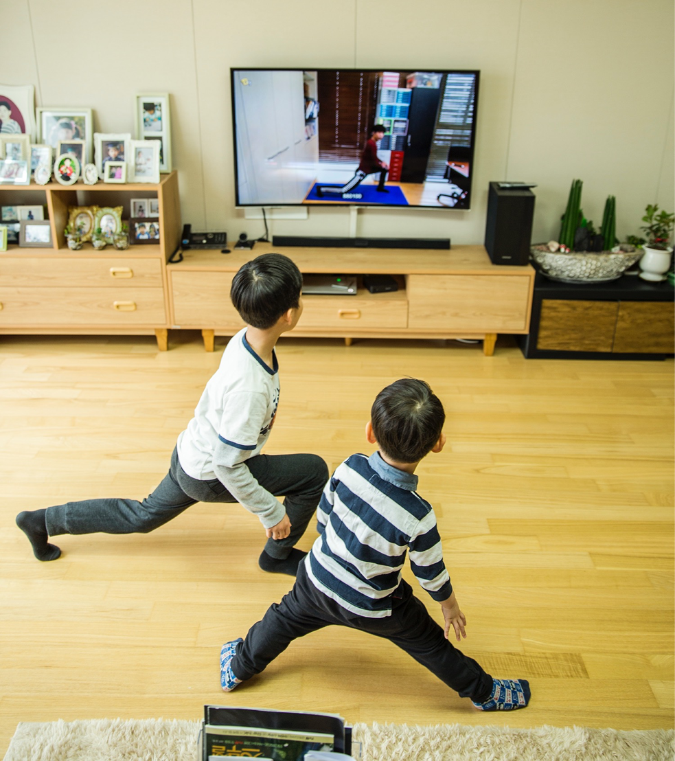
Use this layout when pairing words with a picture.

Slide 20

Use this layout when pairing words with a picture.
Use this space to provide details if needed.

Slide 21

Use this space to provide a bit of detail.

Slide 22
Best practices

Slide 23
Color palette
Hero
Use the hero palette colors as much as possible.
Accent colors should only be used to call attention to important details, such as in a chart.
Cisco Blue
R 0
G 188
B 235
Indigo Blue
R 0
G 80
B 115
Green
R 110
G 190
B 74
Accent
Orange
R 251
G 171
B 24
Red
R 227
G 36
B 27

Slide 24
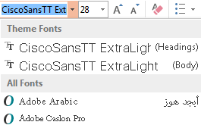
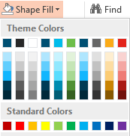
Only use the themes provided
Always use the template themes. It ensures consistency and reduces editing time when
you share content between presentations.
Theme fonts
PowerPoint provides two theme fonts – for headings and body.
They are found at the top of the font menu.
Do not select fonts from the “All Fonts” section of the list.
Theme colors
Our brand colors are included in the theme color section.
Use only these colors and associated tints/shadows.
Do not use Standard Colors or create custom colors.

Slide 25
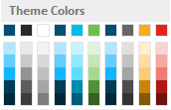
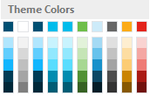
Color themes
The white and dark templates both use the same set of colors. However, they are arranged differently in each palette.
This helps you move content from one template to another easily and preserve legibility. See the guide below.
White template
Cisco Blue
This swatch is the same in both white and dark templates. Use this for charts.
Dark template
Cisco Blue (2)
This swatch is the same in both white and dark templates. Use this for charts.
Indigo (3)
This will change to Light Blue when copied into the dark template. Use this swatch for charts.
Light Blue
This will change to Indigo when copied into the white template. Use this swatch for charts.
Indigo (1)
This swatch is the same in both white and dark templates.
Indigo (1)
This swatch is the same in both white and dark templates.
Green
Gray
Orange
Red
These swatches are the same in both the white and dark templates.
Green
Gray
Orange
Red
These swatches are the same in both the white and dark templates.
Black
Use this swatch for all body copy in this template. This will change to white when copied into the dark template.
Indigo (2)
This will change to Cisco Blue when copied into the dark template. Use this for headlines.
White
Use this swatch for all body copy in this template. This will change to black when copied into the white template.
Cisco Blue (1)
This will change to Indigo when copied into the white template. Use this for headlines.
White
This will change to Indigo when copied into the dark template. Use this swatch for backgrounds.
Indigo (2)
This will change to white when copied into the white template. Use this swatch for backgrounds.

Slide 26
Seven tips for better presentations
Tell a story—make them care
Start with what’s most important to them
Keep it simple, and short
Use more slides with less on them, and cut any slides that
you can
Use clear, natural language
Make it a conversation and leave time to listen
Tell them what to do next—get them to act
Notes:
Short and relevant: Stay focused on what your audience cares about. Think about what you want them to know, feel and do. Then, say what you need to say and no more.
Bold and human: Be confident in your ideas and in the words you use to express them. Use clear, natural language to connect with your audience and make your message stick.
Show what’s possible and make it real: We call this Dreaming and Doing. When we do it right it's powerful, inspiring, convincing and persuasive.
To learn more, download the brand language guidelines: https://cisco.jiveon.com/docs/DOC-660269

Slide 27
Everyone is responsible for security
Cisco Confidential
is our most common data classification.
Go to the master page view if you need to change it.
To learn more, please visit the Data Protection page on CEC.

