Slide 1




DataCamp for [Customer Name]
Build Data & AI Skills
Notes:
=== === ===
Presenter note:

Slide 2
Agenda
DataCamp Overview: who we are + what we do DataCamp content strategy and roadmap
DataCamp learning methodology
DataCamp case studies
Strategies for launching a data and AI program
DataCamp partnership
1
2
3
4
5
5

Slide 3
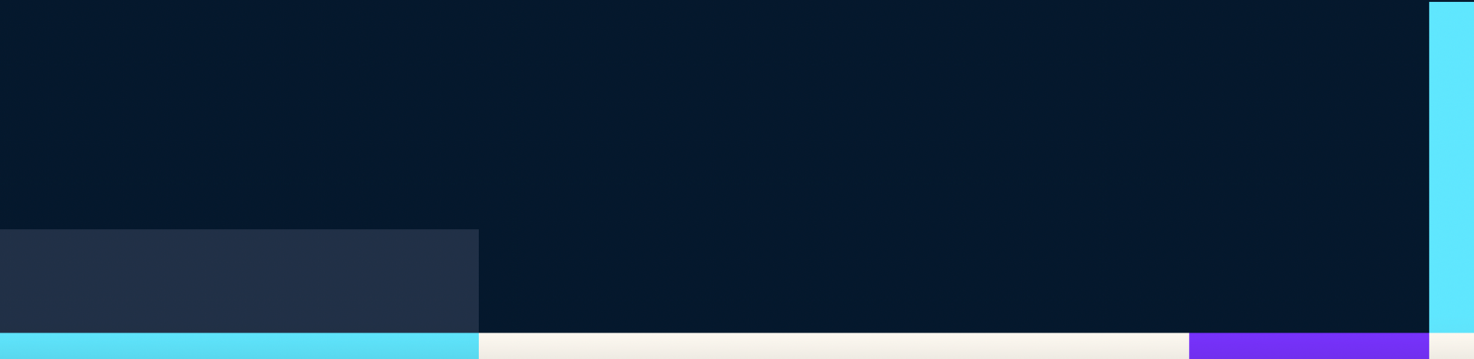
Our mission is to democratize data & AI skills for everyone
Companies and teams of every size use DataCamp to close their skill gaps and make better data-driven decisions.

Slide 4









Trusted by 4,000 data-driven companies
Notes:
As part of the UNL plan, we organizations a wide range of learning materials and pedagogical tools.
You’ll access 380+ interactive courses taught by 270+ instructors, 80+ real-life projects, 60+ curated learning paths, 50+ practice sessions, and 20+ skill assessments.
The platform is ideal for use cases such as onboarding standardization, organization skill assessments, internal programs to upskill the entire organization, or unlimited seat rotations for data-driven companies.

Slide 5






Thrive in the era of data & AI with DataCamp
Make data-driven decisions
Drive technology adoption
Accelerate growth & innovation
Increase company-wide data and AI literacy to make better data-driven decisions and be confident in your choices.
Transition to a modern data stack and maximize data tooling adoption across your organization.
Unlock time savings on daily routine processes and find time for strategic data and AI initiatives.

Slide 6

For Every Skill Level
Data Experts Machine Learning Engineer,
AI Engineer
Data Practitioners
Data Engineer, Data Analyst, Data Scientist
Citizen Data
Practitioners
Power BI Analyst, Tableau Analyst, Marketing Analyst, Financial Analyst, …
Data Consumers & Business Leaders
CXO, management layer, individual contributors in sales, HR, supply chain, …

Slide 7
02
Content Strategy and Roadmap

Slide 8
Curriculum
430+ interactive courses, 100+ real-life projects, 25+ case studies, 90+ curated learning paths, 60+ practice sessions, 5+ certifications, and 20+ skill assessments.
Content Areas
Content Themes
Data Literacy and Essentials & AI
Data Literacy
Data Governance & Compliance
Data Ethics
AI Literacy for Business
Business Intelligence
Power BI
Tableau
Excel
Alteryx
Data and Machine Learning Engineering
Julia
Docker
MLOps
Data Engineering
Analytics and Data Science
SQL
Python
R
AI for Data Scientists
AI Skills
ChatGPT
Generative AI
Large Language Models
Deep Learning

Slide 9
Highlight: AI Curriculum
Target audience
Courses
Q3 & Q4 Roadmap
Everyone
Introduction to ChatGPT
Understanding Artificial Intelligence
AI Fundamentals Assessment & Skill Track
Prompt Engineering for Everyone
Explainable AI (XAI) Applications
Business Leaders & AI Product Managers
AI Ethics
Implementing AI Solutions in Business
MLOps
for Business
Artificial Intelligence Strategy
AI Business Fundamentals
Skill Track
Engineers and Data Scientists
Working with OpenAI API
Introduction to Deep Learning with PyTorch
ASL Recognition with Deep Learning
ChatGPT Prompt Engineering for Developers
Building a Chatbot with OpenAI

Slide 10
03
DataCamp Learning Methodology

Slide 11
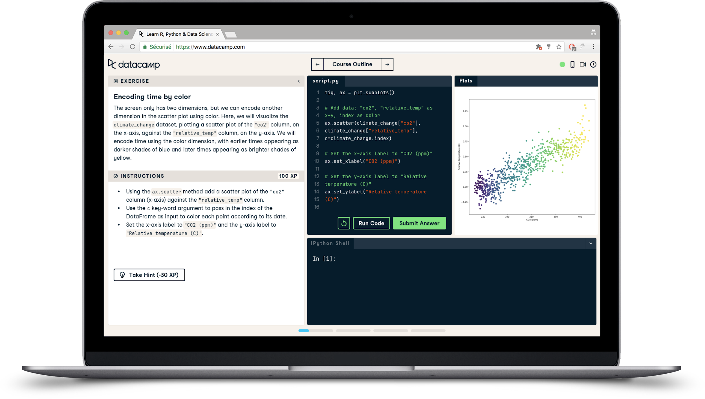
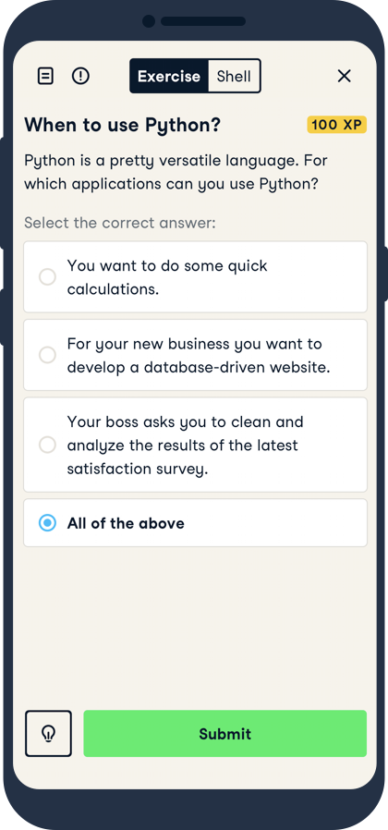
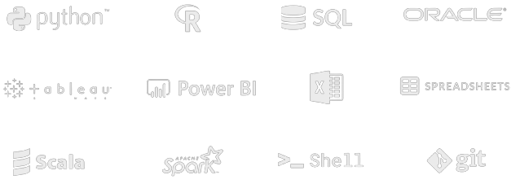








Hands-on skill building

Slide 12
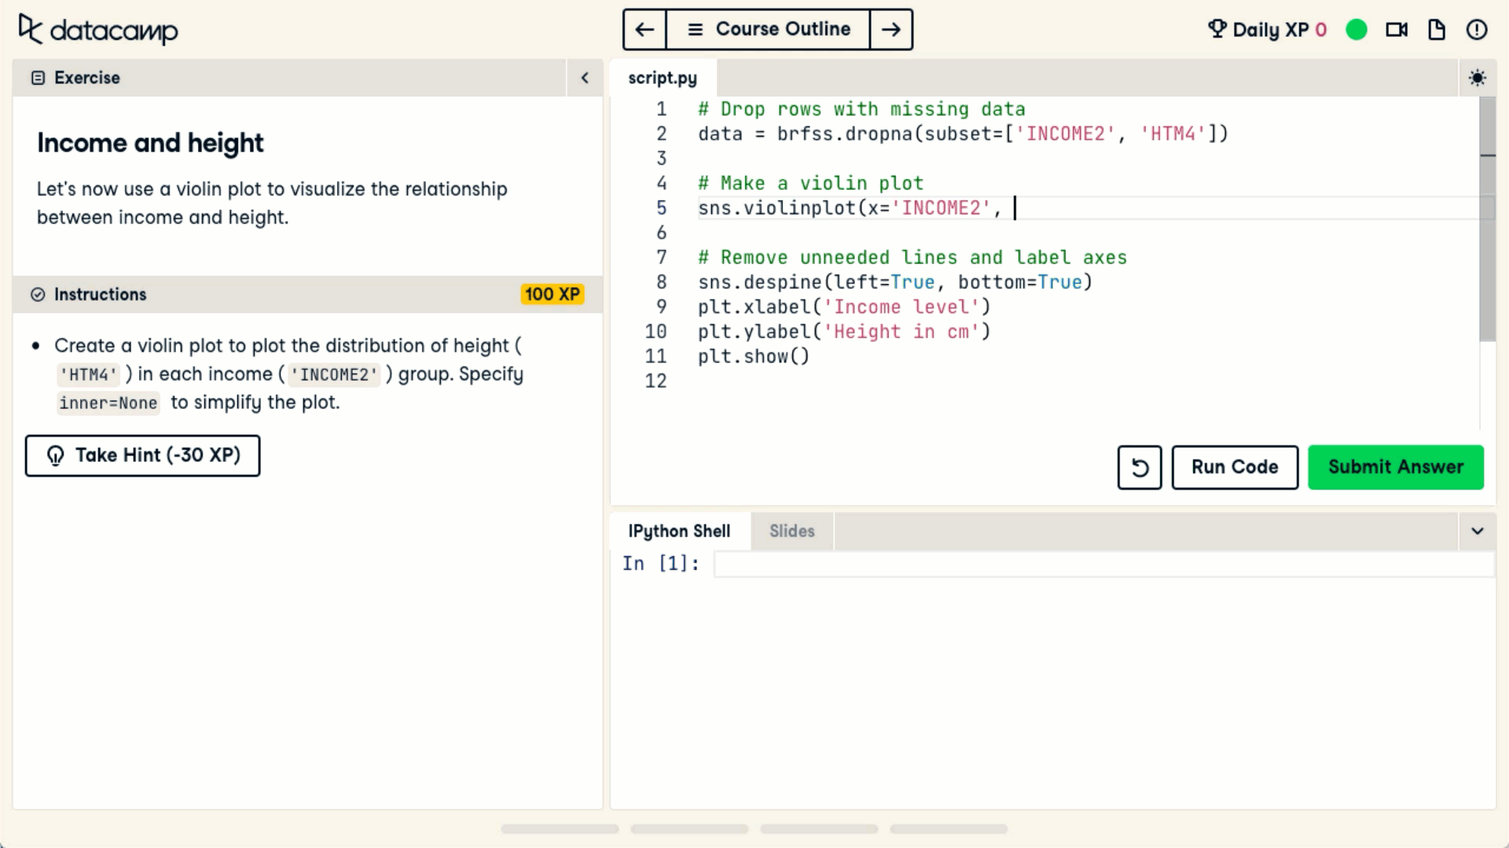
DataCamp: Seamless, hands-on data training
AI-powered feedback
No installation or download
Accessible from anywhere
Practical Skill Application

Slide 13
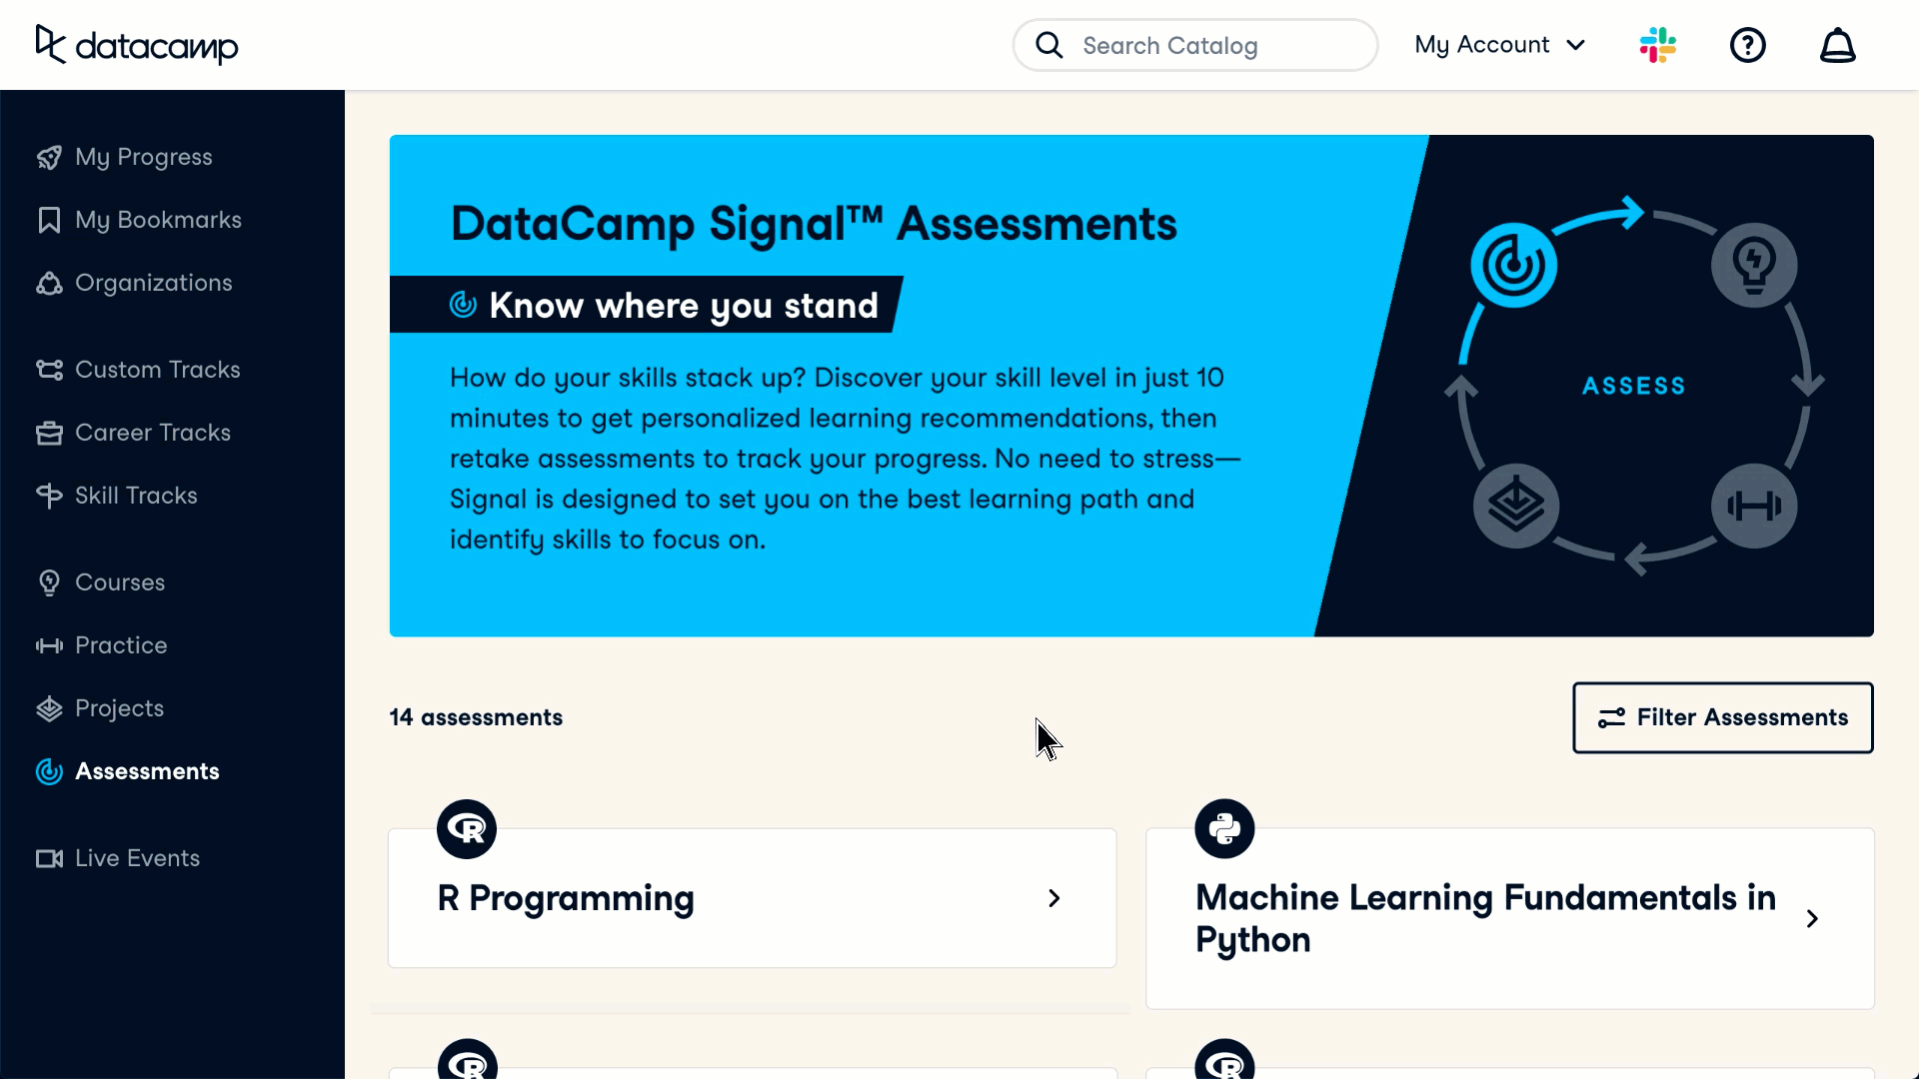
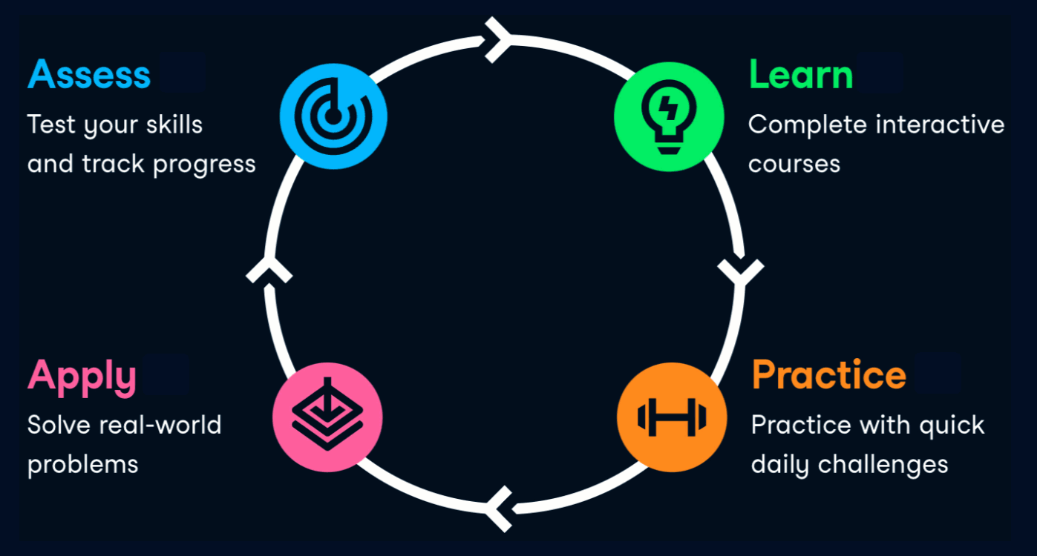
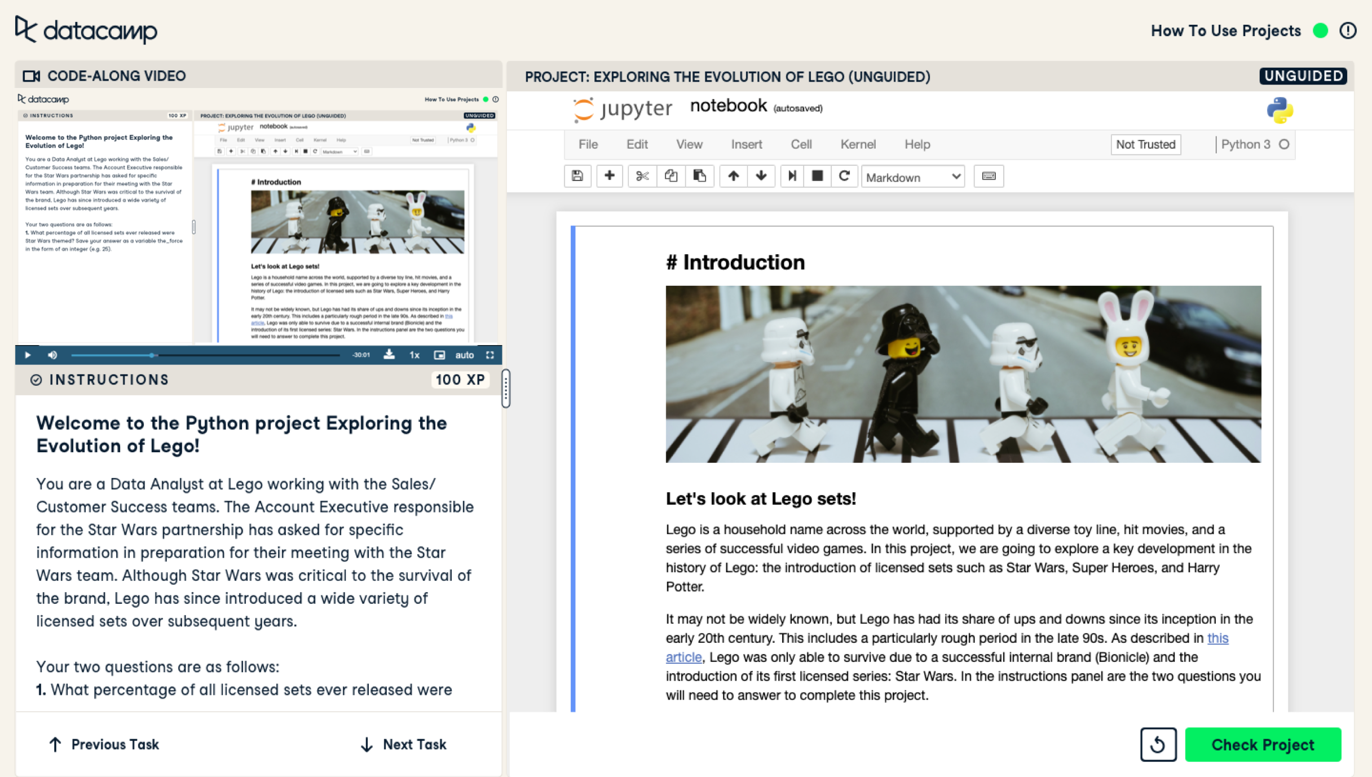
Our Approach
Result: 6x higher completion rates

Slide 14
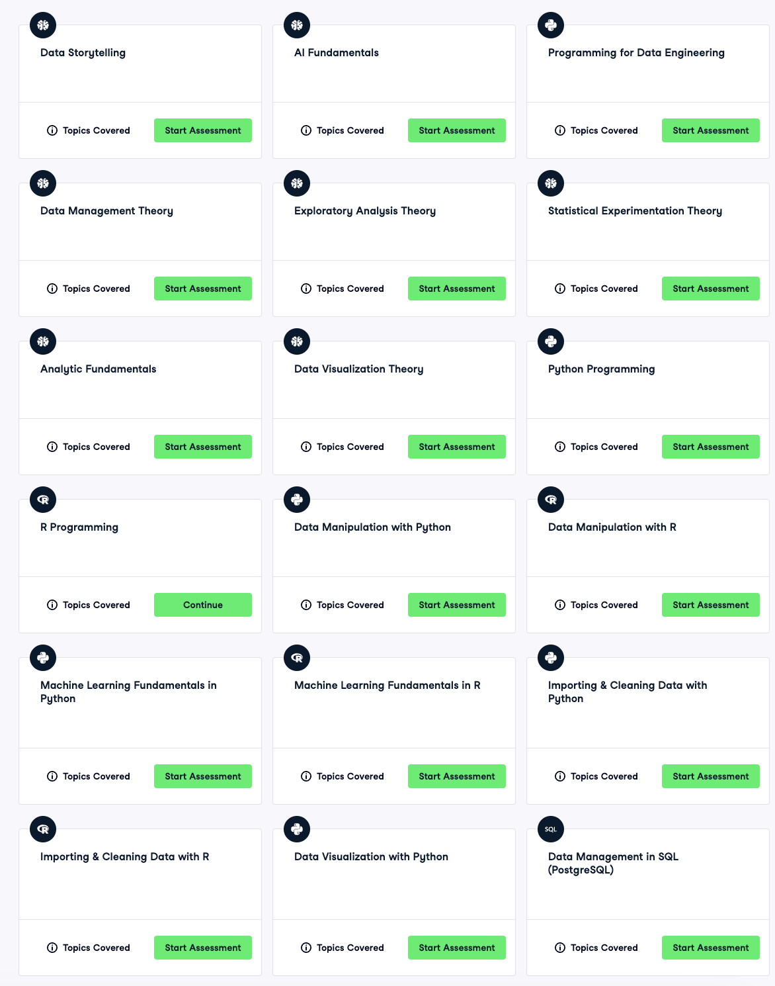

1. Prescribed
Assessments
Prescribe 2-4 assessments per Persona based on relevancy
Notes:
=== === ===
Presenter note:

Slide 15
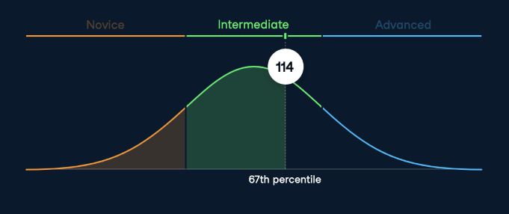
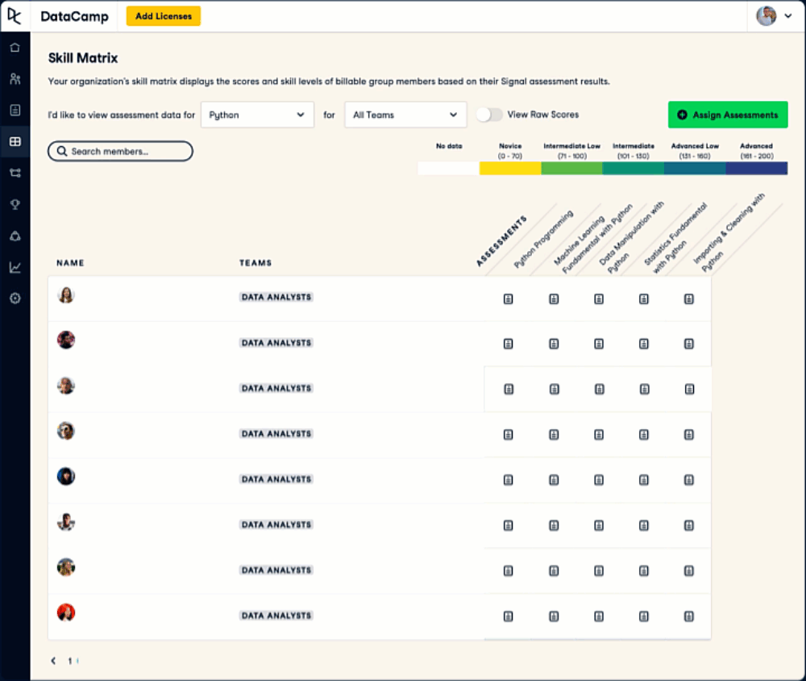
2. [Customer name]Skills Proficiency Analysis
Measure [customer name] employees’ skills against other DataCamp learners
Notes:
=== === ===
Presenter note:

Slide 16
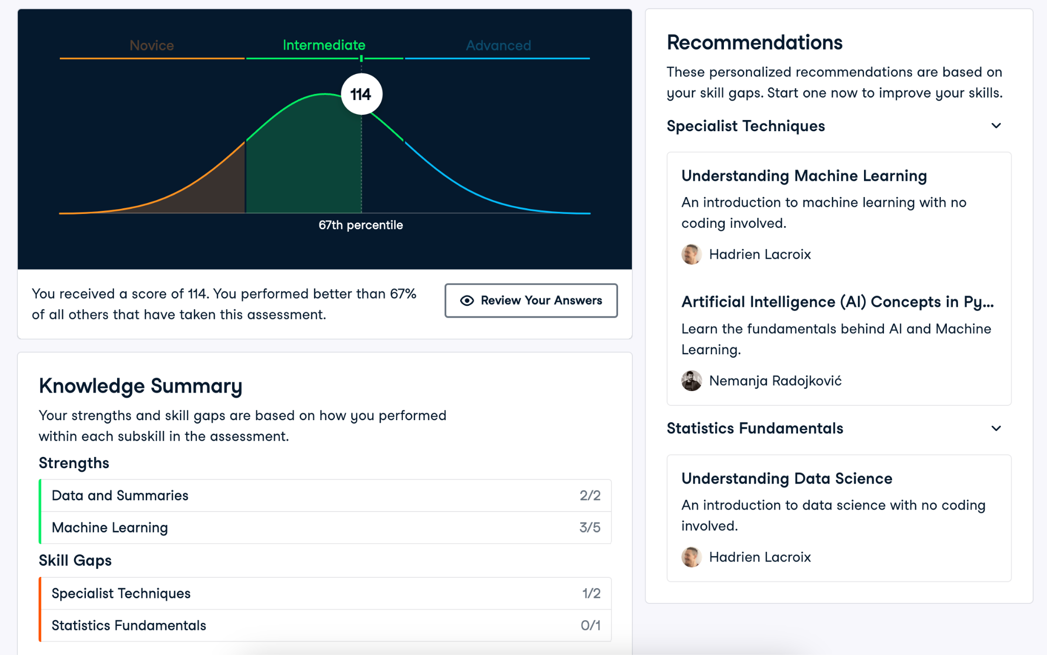




3. Create Curated Learning Paths
TOP-DOWN
Defining recommendations based on conversations between DataCamp Experts and [customer name] leaders
Assess skills on an individual basis via (a) Skills Assessments & (b) Precision Learning (next slide)
Build and deliver [customer name] focused learning paths according to skill gaps
BOTTOM-UP
Notes:
=== === ===
Presenter note:

Slide 17
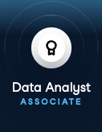
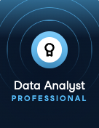
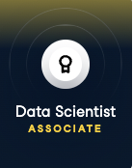
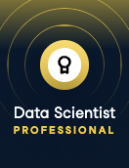
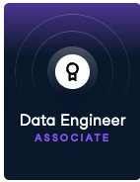
Data Analyst Associate
Data Analyst Professional
Associate
(SQL + Python)
Professional
(SQL + R or Python)
3. DataCamp Certifications
Data Scientist Associate
Data Scientist Professional
Associate
(SQL + R or Python)
Professional
(SQL + R or Python)
Verify and prove your skills are job-ready
Data Scientist Associate
Data Scientist Professional
Associate
(SQL only)
Professional
(SQL + Python)
SOON
Notes:
=== === ===
Presenter note:

Slide 18
04
Case Studies

Slide 19






CHALLENGE
Staying competitive in the rapidly evolving market
Upskilling the entire organization in data literacy to enable data-driven decisions
DATA & AI LITERACY AT Colgate-Palmolive
SOLUTION
Tailored learning paths to suit audiences from C-suite executives to general employees
Degreed LMS and SSO integration to enable access at scale
Colgate partnered with
DataCamp to upskill 14,000+ employees on data & AI. Program resulted in enhanced data driven decision making, time savings and new technology adoption.
RESULTS
80% of learners reported being able to apply their new skills in real-world settings
Colgate’s unbiased data insights supported the shift from being a supplier to a strategic partner

Slide 20

CHALLENGE
Build awareness and understanding of data analytics for all employees
Provide a one-stop-shop for data analytics learning content
DATA TRANSFORMATION AT Allianz
SOLUTION
22 learning paths for specific technologies and functions
Built 3 private capstone projects for marketing and claims use cases
Allianz upskilled 6,000+ employees worldwide using personalized learning paths and projects so their workforce could go from learning data skills to applying them to insurance business use cases—faster.
RESULTS
30,000 hands-on learning hours across Python, Data literacy, SQL, Power BI, Spreadsheets and more
1.9 hours average time-saved per week per employee using the skills learned on DataCamp

Slide 21

CHALLENGE
Manual data handling processes were time too slow
No centralized training program
DATA TRANSFORMATION AT Rolls-Royce
SOLUTION
Created custom learning paths for all skill levels and roles, including Python for engineers and a data literacy path
Rolls-Royce’s engineering team was able to automate and speed up manual processes by a factor of 100—freeing them up to work on more valuable initiatives.
RESULTS
100x’ed the speed of their data handling processes
Data program for technical & non-technical roles, part of promotion evaluation
Roll out in process to all Rolls-Royce Aerospace employees

Slide 22

CHALLENGE
Heavy reliance on Excel
Lack of Power BI and Databricks skills hindered employee efficiency and placed a strain on the central analytics team
DATA UPSKILLING AT Specsavers
SOLUTION
Tailored learning paths to address PySpark, Power BI and SQL skill gaps
Promoting a vibrant data culture through Hackathons and DataCamp Workspace Challenges
Specsavers partnered with DataCamp to address critical skill gaps in Power BI and Databricks, resulting in automating routine Excel tasks and realizing up to 4 hours of weekly time savings per employee.
RESULTS
4 hours of weekly time savings per employee
Shifted from Excel to Power BI and Databricks
Reduced load on core
analytics teams

Slide 23

CHALLENGE
Drive efficiencies to enhance client outcomes
Scalable, and inclusive data upskilling solution to support their 2000+ employees in the
UK and Ireland
DATA LITERACY AT CBRE
SOLUTION
Created personalized learning paths for various departments: Data Literacy, Excel, Tableau, Power BI, Python, and SQL
DataCamp & CBRE partnership to launch their Data Upskilling program
CBRE partnered with
DataCamp for Business
to upskill 2,000+ employees
and drive an average of 1-2 hours time saved per learner per week using newly acquired data skills.
RESULTS
On site data days
95% of leaders now feel data confident
100% have completed learning
86% possess a clear understanding of data

Slide 24

CHALLENGE
Make WGU’s MSc. in Data Analytics Program inclusive for non-technical backgrounds
Deliver training to 2000+ students
DATA SCIENCE EDUCATION AT Western Governors University
SOLUTION
7 tailored learning paths aligned with WGU’s competency-based framework
SSO-integration for a smooth roll-out
WGU partnered with DataCamp to make their Master of Science in Data Analytics degree accessible for students without technical backgrounds. This yielded in a 12% increase in student ROI.
RESULTS
Yearly 2000 students complete learning on DataCamp
12% increase in Student ROI
36% increase in the 2-year graduation rate

Slide 25
05
Strategies for Launching a
Data and AI Program

Slide 26




A guide to building an organization-wide data program
Program goals and mission Raising awareness of the program.
Using a
pilot program
to explore
data literacy
Roll out activities
across the organisation
Communication
& engagement strategy
Curated
learner pathways
02
04
06
08
10
01
03
05
07
09
11
Executive
Sponsor
Define the program team
Understand the current availability and required adoption
Define
key personas
based on data literacy confidence and expertise, motivation to upskill, and current level of data literacy
Define
early adopters and success criteria
Managers
Briefings & Toolkit.
Celebrate your wins.
Creating a community of learning

Slide 27











Helping enterprises build a Data Academy
Benchmark & track data skills evolution
Create curated & tailored pathways
Online & blended learning initiatives
Creating data fluent organizations
Verify skills with certification
Tracking adoption & continuous improvement

Slide 28
06
DataCamp Partnership

Slide 29
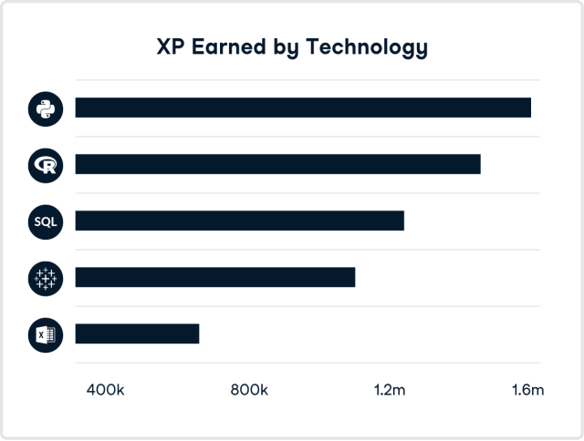
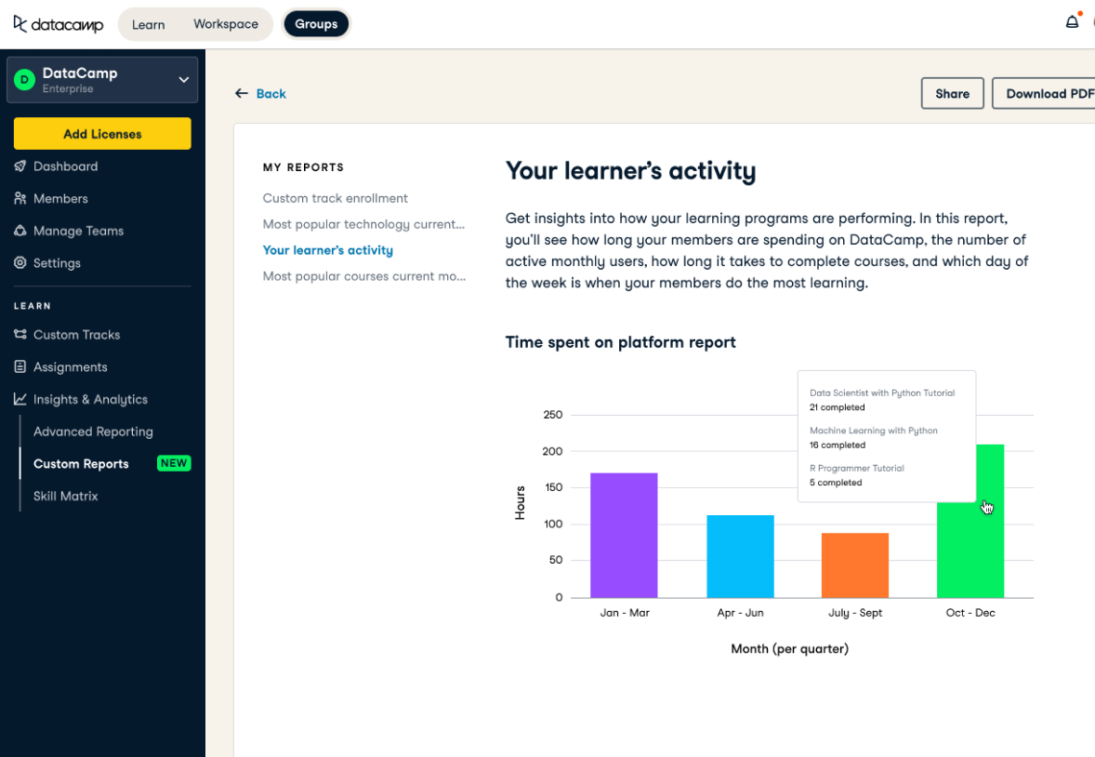

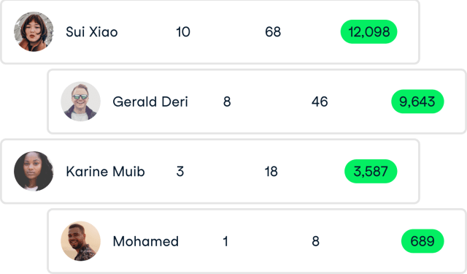
Included: Curated Learning Paths and Reporting
Guide your team’s learning Easily invite new learners and create customized learning paths to support the unique needs and goals of all learners and teams.
Monitor adoption and engagement
Track engagement and course completions to confidently assess and manage progress. Compare with industry peers to set benchmarks and focus your learning strategy.
Report on progress Measure and report on progress over time to demonstrate impact, make informed decisions about learning, and advance company goals.
* Note: Single Sign-On and LMS/LXP integrations support included

Slide 30

Included: A team of experts
DataCamp is more than a technology provider — we are a partner on your data journey.
Dedicated customer success manager
Stay on track towards organization-wide data fluency. Your customer success manager provides you with resources and guidance on everything from adoption best practices to tracking and reviewing your learning ROI.
Setup and launch
We partner with you and share best practices you can use to launch your company’s learning on DataCamp. From setting up your SSO & LMS integrations and creating assignments to finding your champions and developing dedicated webinars.
Access to our team of data curriculum experts
Work with our team of learning solution architects to create tailored onboarding programs, custom learning paths, and get expert training recommendations that fit your data & AI literacy objectives.
How we did it with

Slide 31

Your Questions

