Slide 1

OPPORTUNITIES
Summer
2025

Slide 2

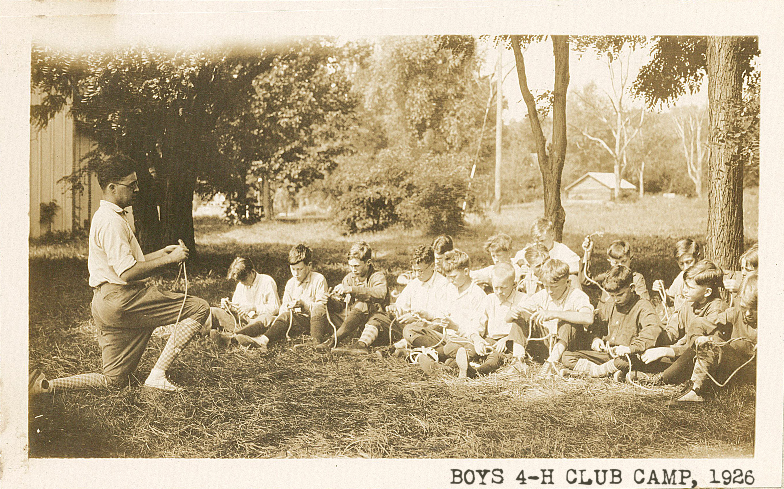

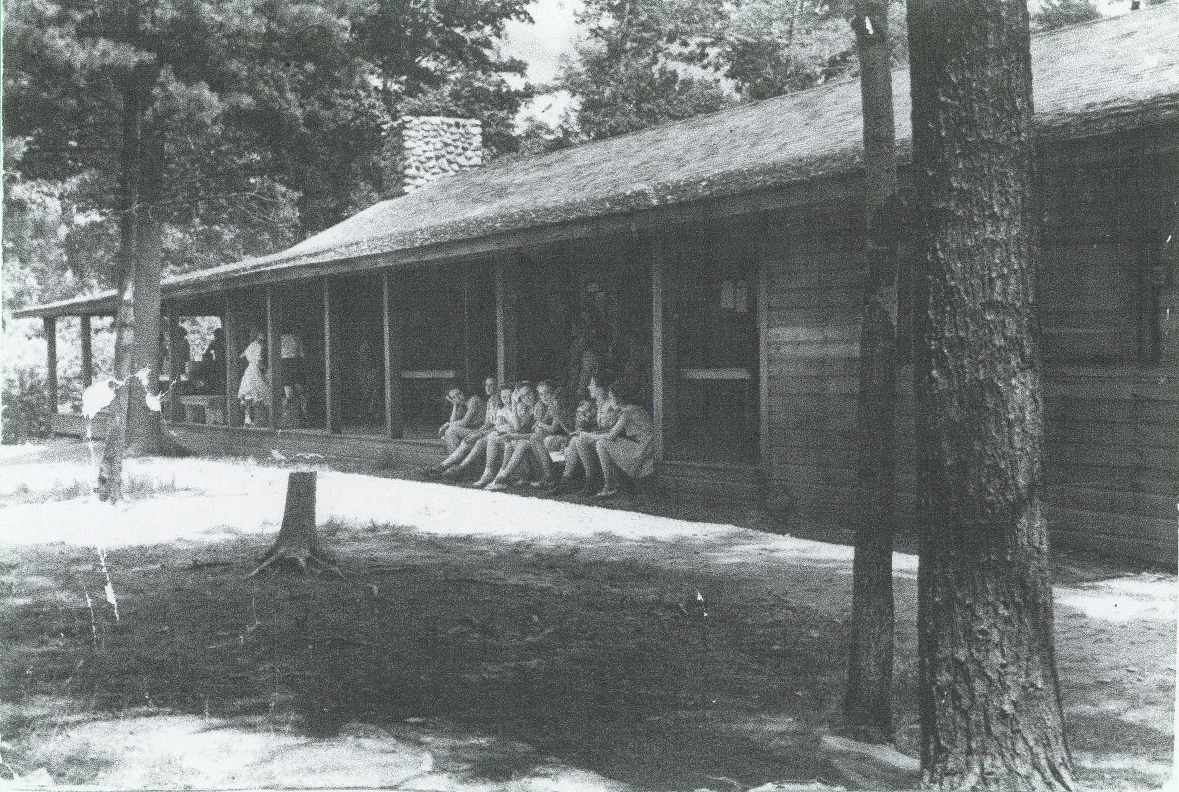
100 YEARS
OF CAMPING EXCELLENCE

Slide 3
FOUNDATIONS
For 100 years, 4-H Camp Bristol Hills has offered
a variety of summer camp programs for youth 5-16 years of age

Slide 4
Who We Serve
Campers come from all walks of life, and have no eligibility requirements regarding
  4-H membership
  Ontario County Residency
  Financial status
  At-Risk status
  Any protected status
Any child 5-16 years of age.

Slide 5



DAY PROGRAMS
.

Slide 6


OVERNIGHT PROGRAMS
.
  *These programs based on age.

Slide 7


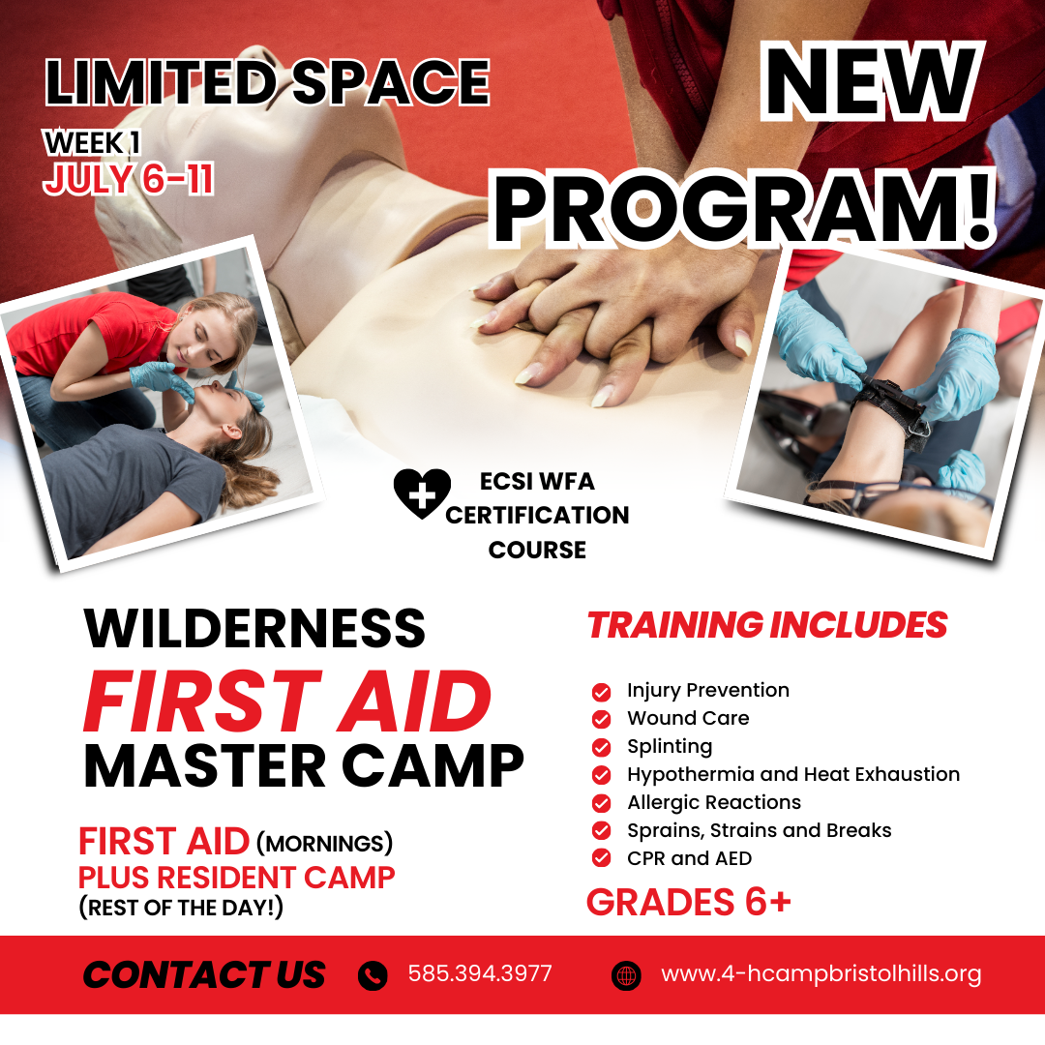
OVERNIGHT PROGRAMS
.

Slide 8


OVERNIGHT PROGRAMS
.
  *These programs based on age.

Slide 9
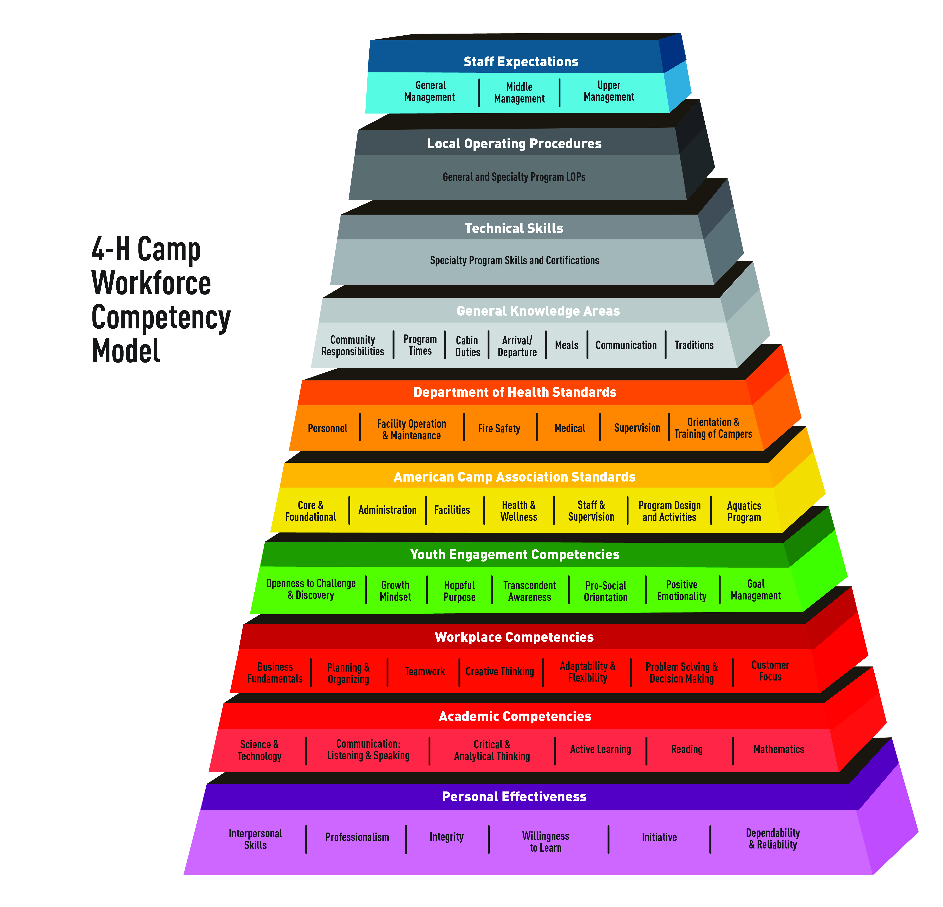
As an
Employer…

Slide 10
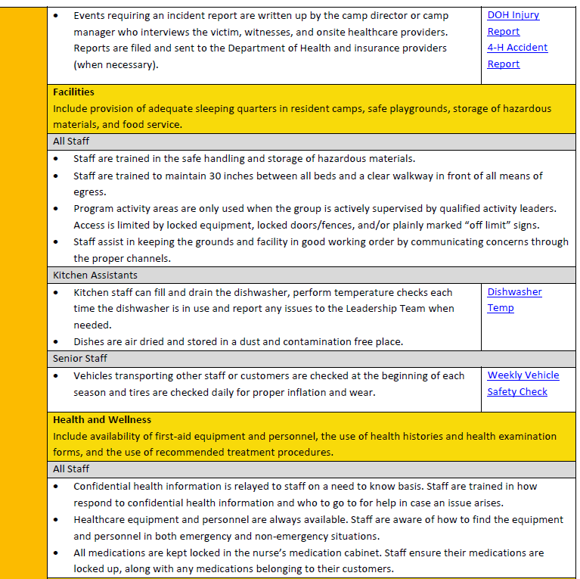
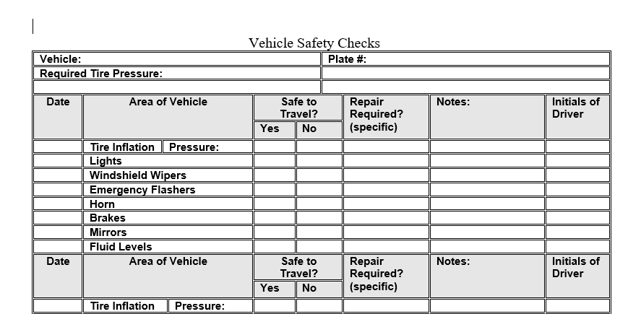
Staff Recruitment
Goal Setting
Performance Evaluation
& More!
Workforce Competency Model
Professional Development
Documentation &
Business Continuity

Slide 11
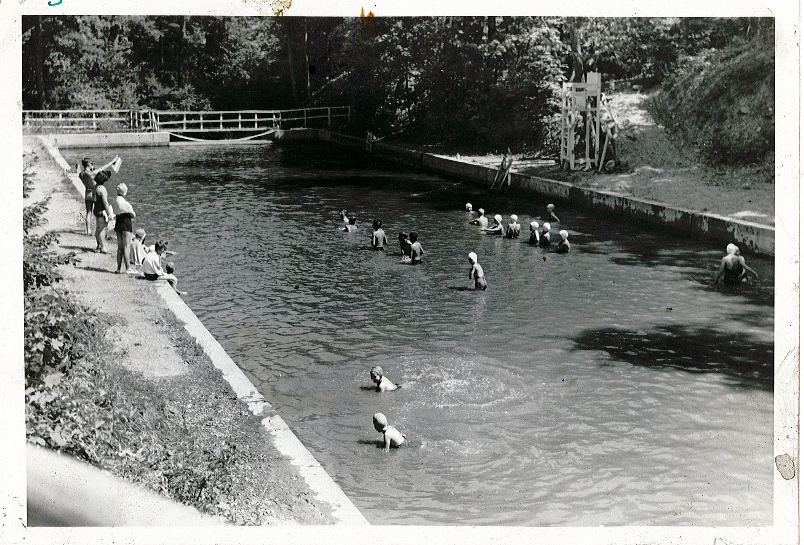
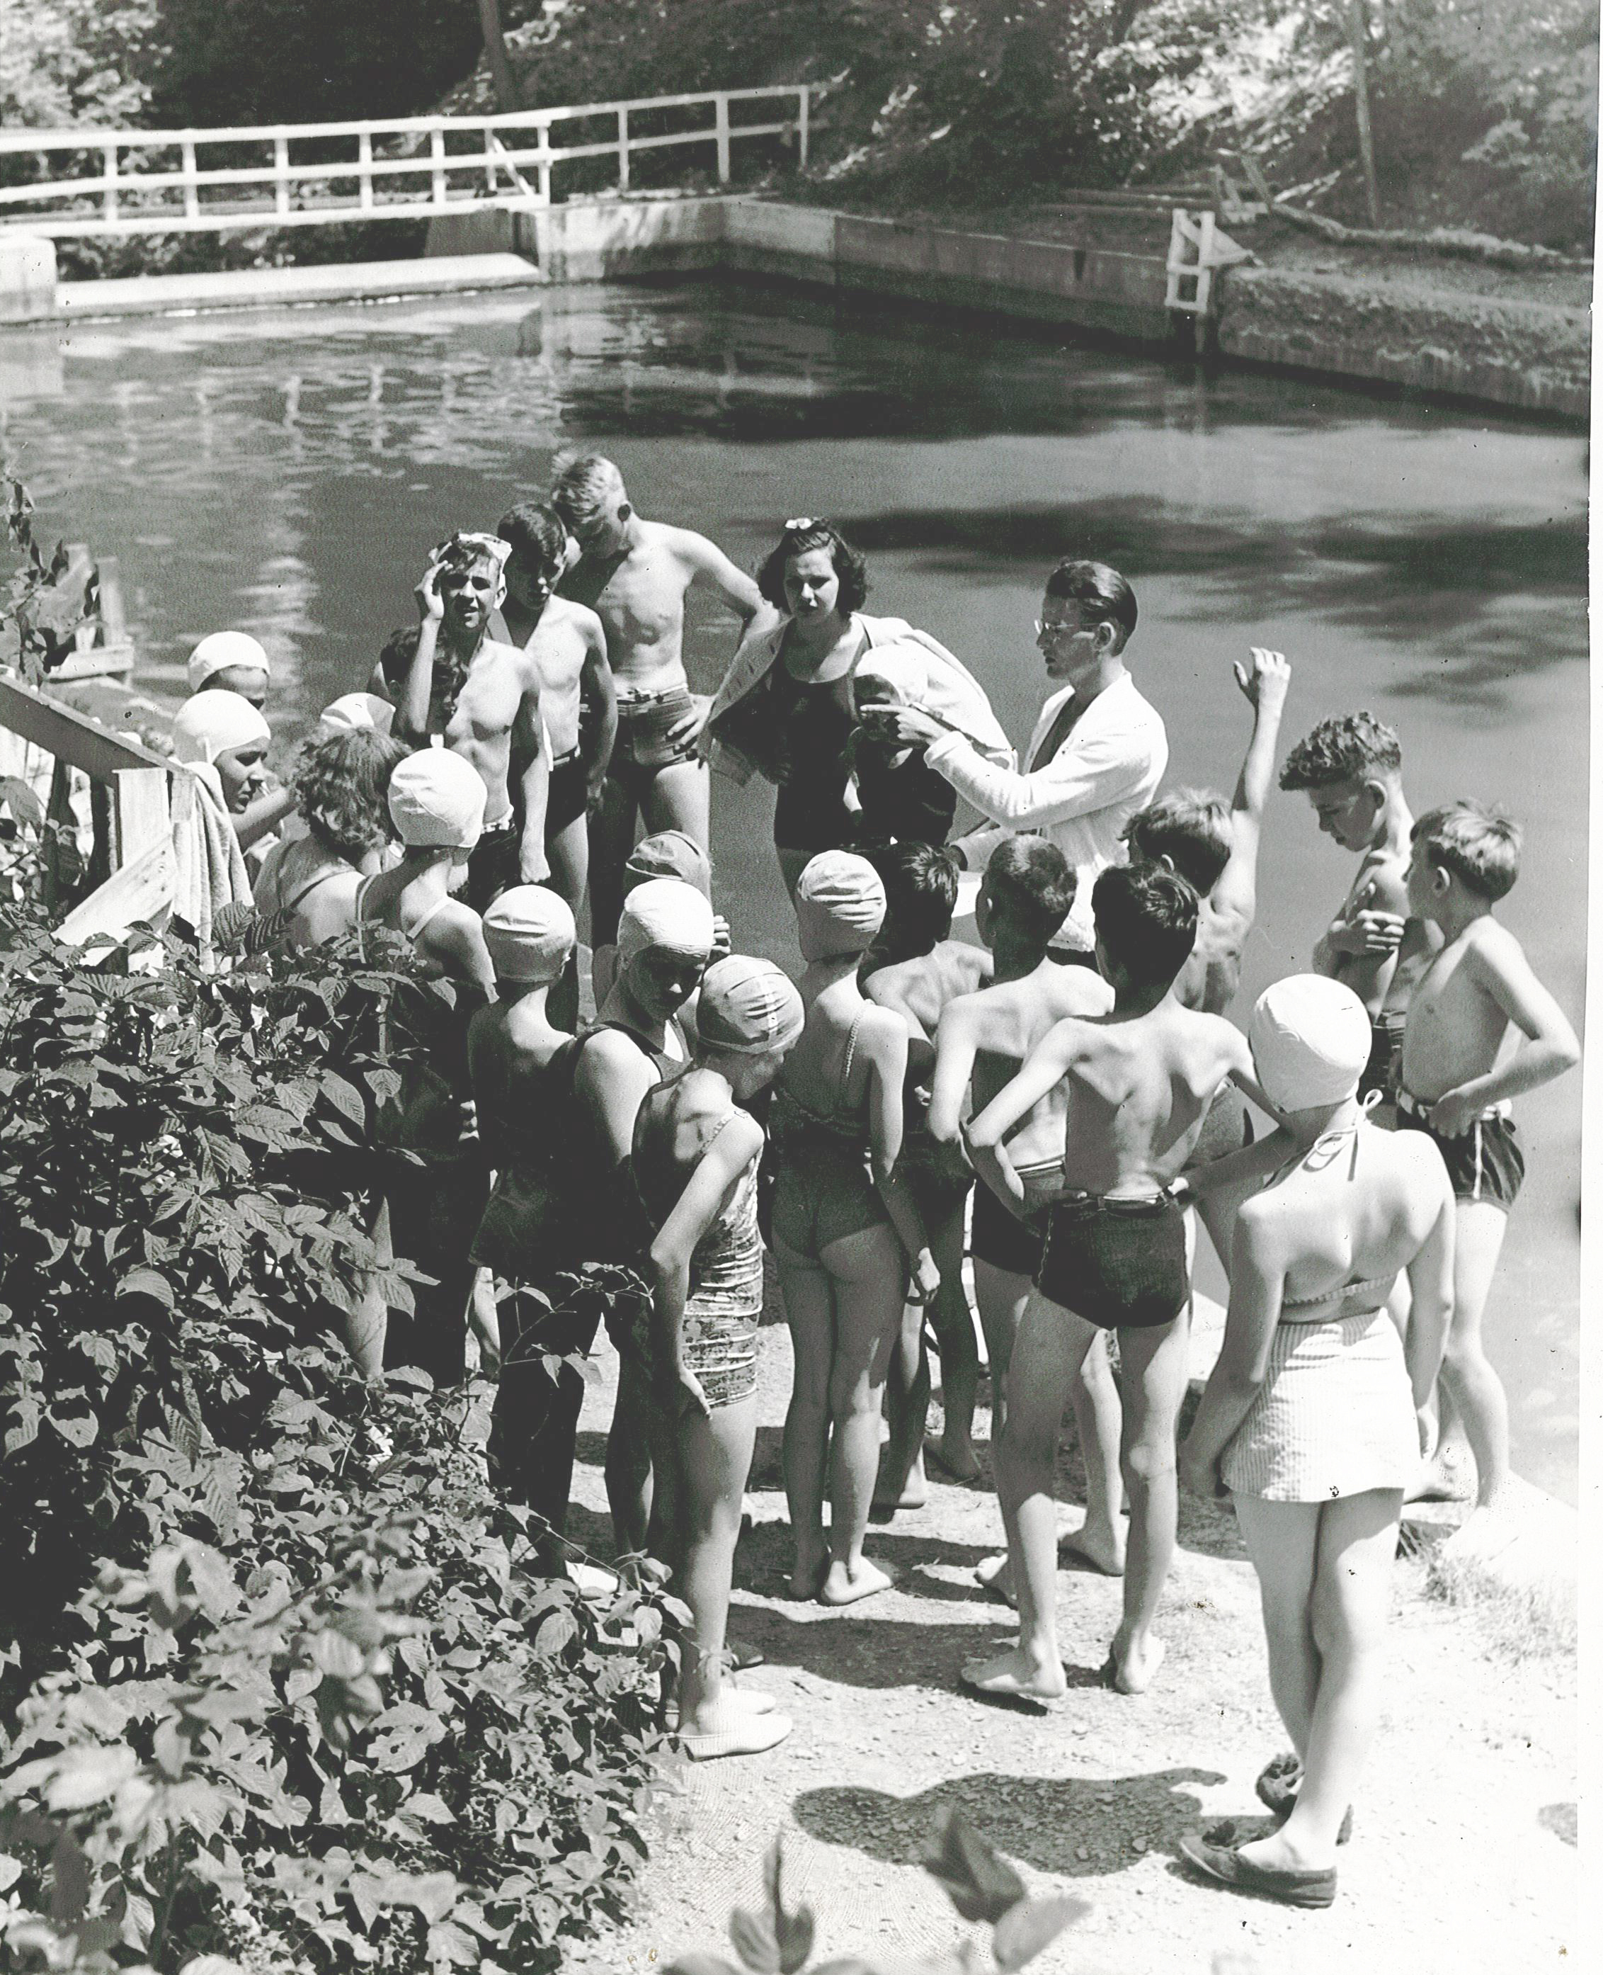
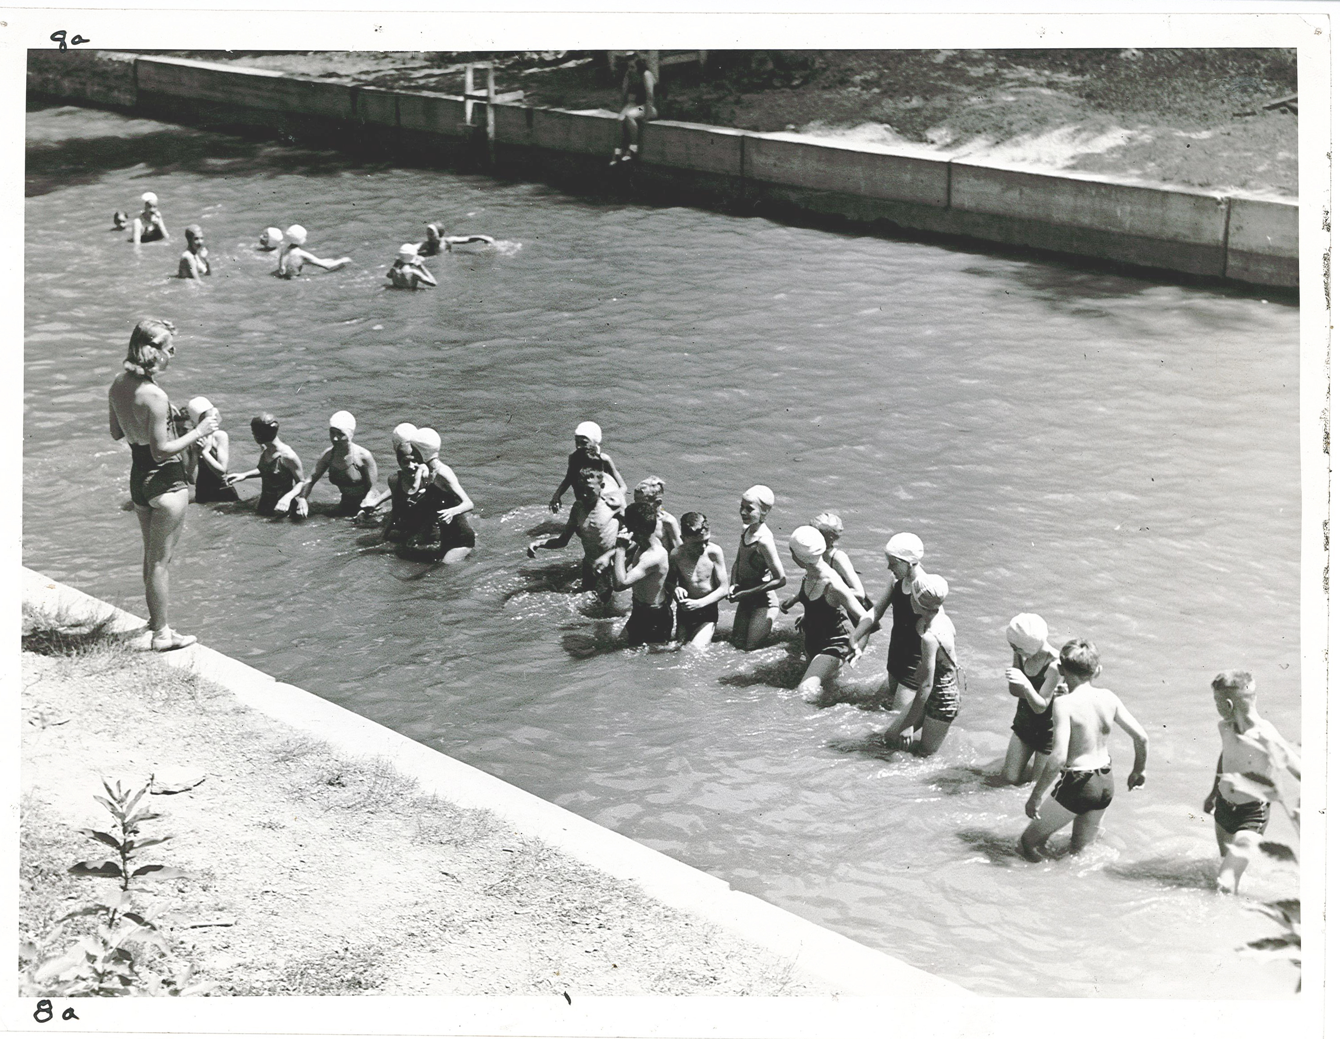
AN URGENT NEED: SWIM LESSONS FOR ALL
First campers swam in Canandaigua Lake.
First pool built in 1936
Drowning is a leading cause of unintentional death in young children; swimming skills, like floating and treading water, can save a life. From 2020- 2022, 4,500 people annually drown, up 500 from 2019.

Slide 12
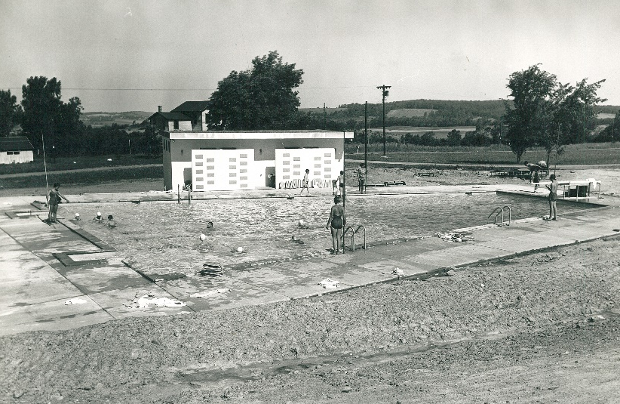
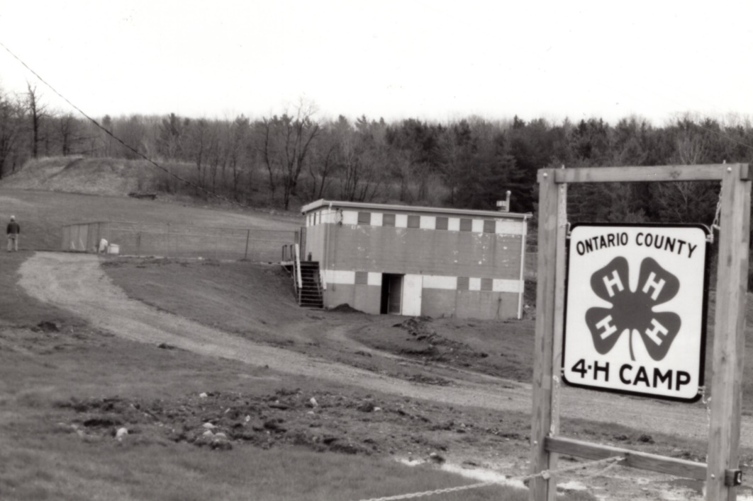
AN URGENT NEED: SWIM LESSONS FOR ALL
Current Pool built in 1960
Full-Body Workout: Swimming improves cardiovascular health, strength, flexibility, and endurance.
Cognitive Development: Swimming supports brain development, improving memory, attention, spatial reasoning, and following instructions.
Motor Skills: Swimming enhances coordination, balance, and gross motor skills.

Slide 13
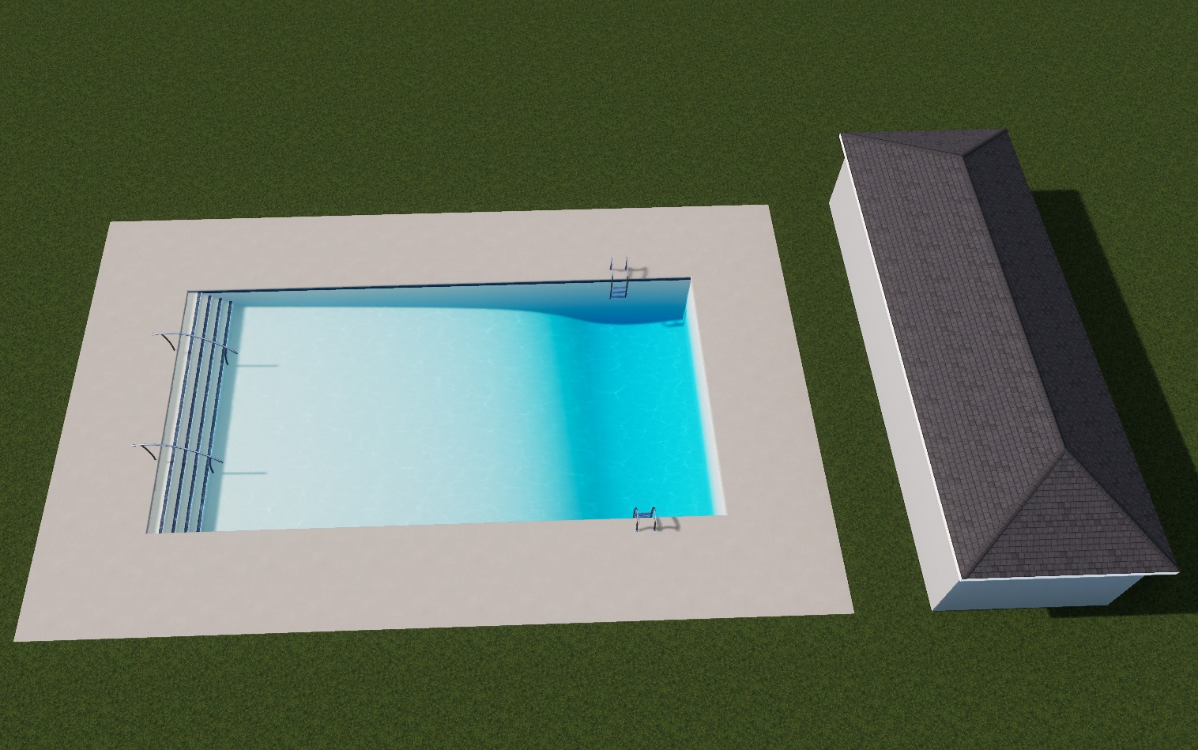
AN URGENT NEED: SWIM LESSONS FOR ALL
New Pool Complex estimated at $1M.
Applied for NY SWIMMS Grant
If awarded, we will need $200k in matching funds
Urgent need for funds to support engineered drawings, permits, surveys and demolition in 2026 Q1/Q2.
New complex will include 1600 sf pool, pool house, concrete deck, bathrooms, outdoor showers, shade pavilion.

Slide 14
AN URGENT NEED: SWIM LESSONS FOR ALL
Over 700 children swim each summer at 4-H Camp. Many receive free swim lessons as part of Camp.
4-H Camp provides Lifeguarding, WSI, CPR and First Aid training courses each spring for young adults throughout the Finger Lakes.
The pool is a significant source of revenue for off-season rental groups at camp as well.

Slide 15
OPPORTUNITIES to get involved

Slide 16
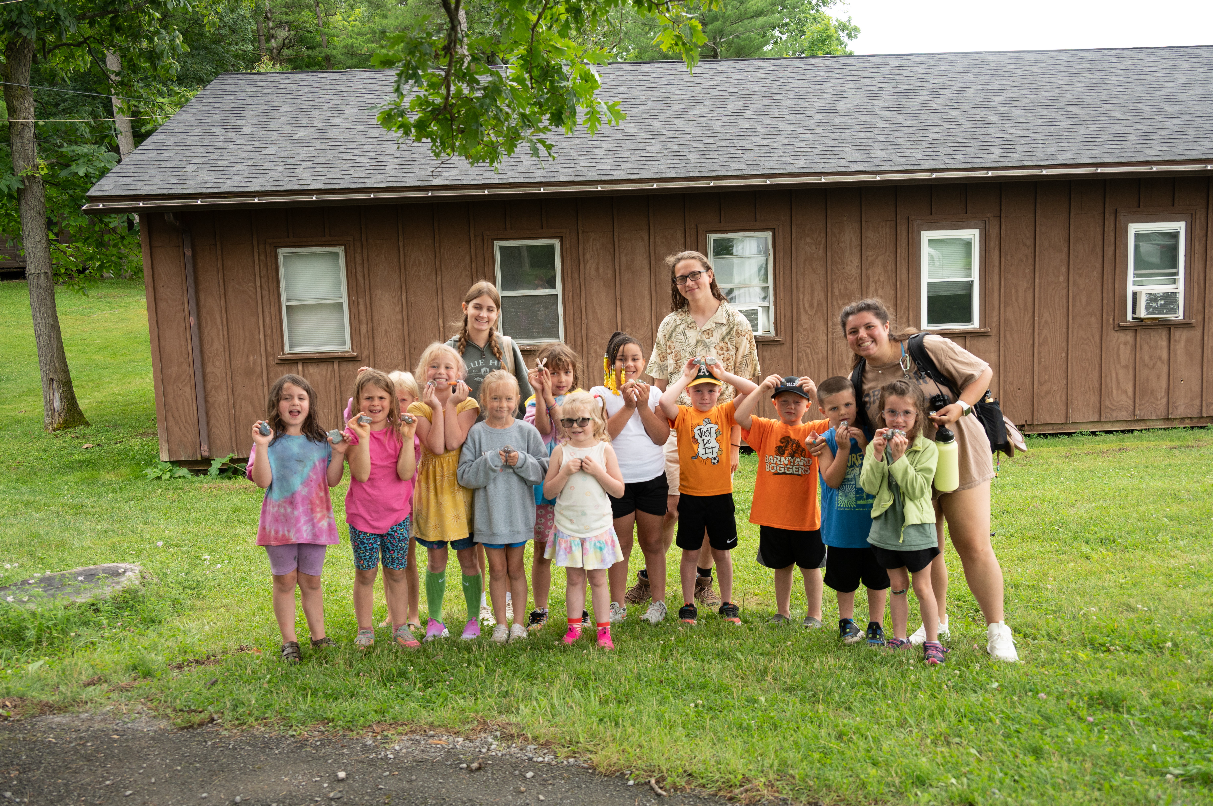
SEND A LOVED ONE TO CAMP
Registration opens January 1!
Affordable fees
Financial Aid deadline is March 1

Slide 17
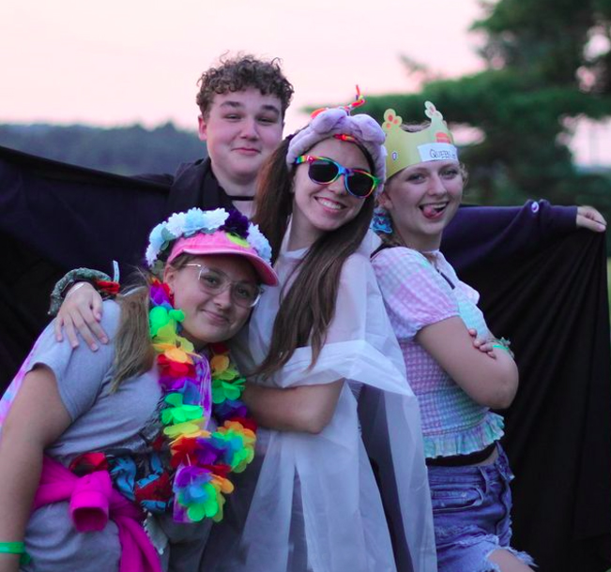
DONATE TO THE HILLTOP FUND
Over 100 children attend annually on scholarship
$375 supports a full scholarship for a week of Day Camp
$570 sends a child for a full week of Resident Camp
$675 provides a full two-week Leadership Development program for a 15-16 year old child

Slide 18
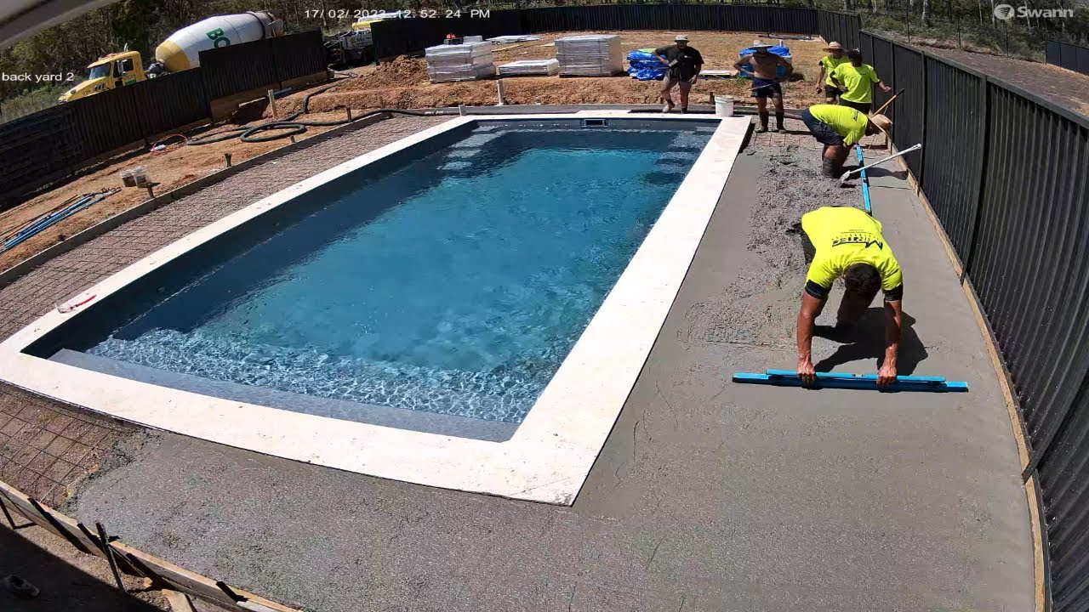
DONATE TO THE POOL COMPLEX
Donations of all sizes, personal and organizational, will directly support construction costs of the new pool complex.
We are a non-profit, so donations are tax deductible.
We have already secured $100K in gifts and fundraisers.
We need your help!
Stock photo of pool construction

Slide 19
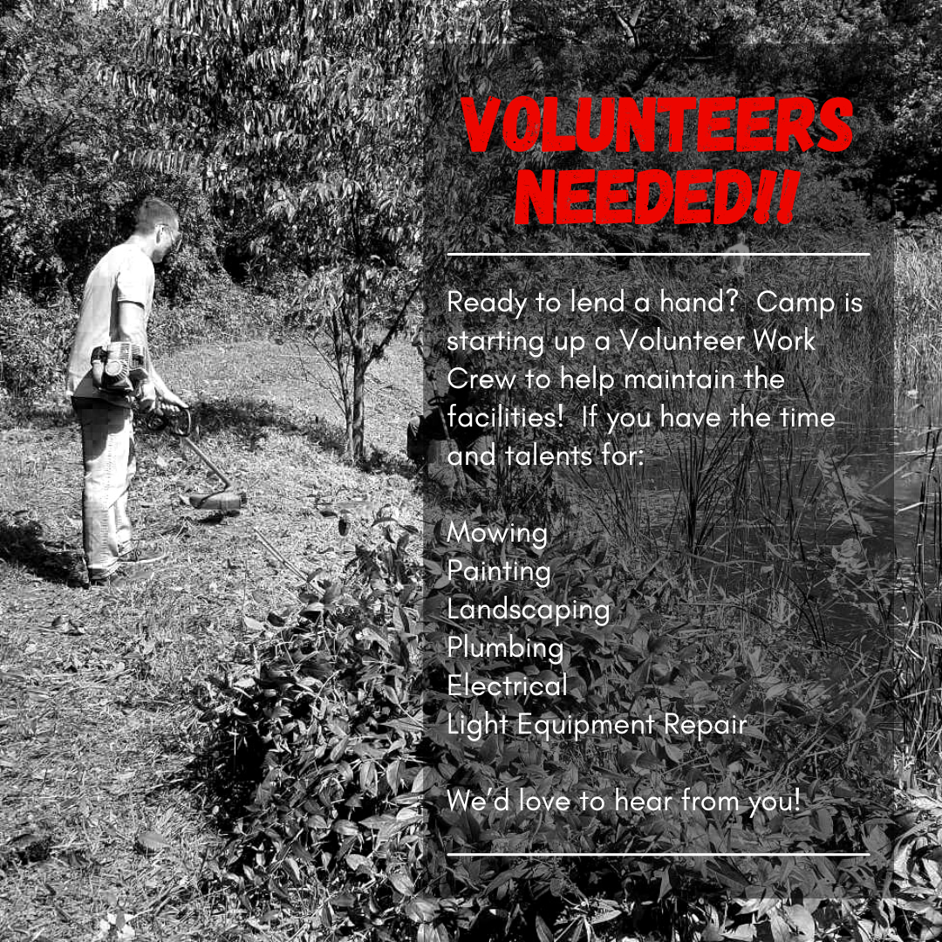
VOLUNTEER AT CAMP
Hosting 100 volunteers through the United Way Day of Caring on May 21.
We can set up a Kiwanis Day at Camp
Join our 4-H Camp Volunteer Corps

Slide 20
THANK YOU!
Jim Hooper
Camp Manager
(585) 394-3977 ext 435
campbristolhills@cornell.edu
www.4-hcampbristolhills.org

