Slide 1
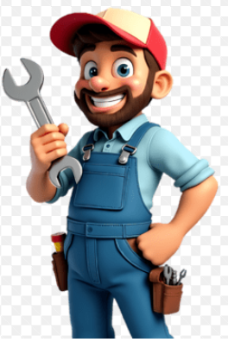
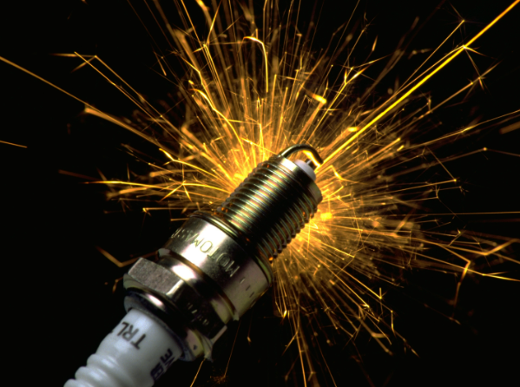
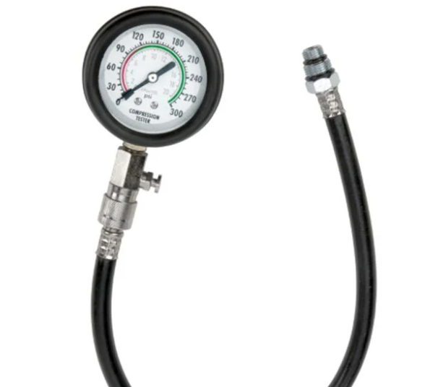
Lesson 5 Diagnostics
Bringing it ALL together!!!

Slide 2
Questions from previous lessons?
Basic engines
Fuel systems
Ignition systems
Oil and cooling systems.

Slide 3
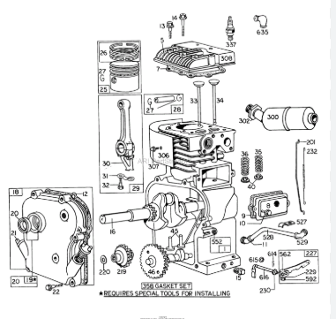
Engine components layout.
Cylinder block
Cylinder head
Connecting Rod
Crankshaft
Camshaft
Piston
Piston rings
Intake valve
Exhaust valve
Tappets/Lifters
Crankcase cover
Governor

Slide 4
Basic needs
All engines 2 cycle or 4 cycle have three basic needs,
Compression
Fuel
Ignition
With these three things there is a very good chance that an engine will run. Now these are going to be the basic first steps in diagnosing any small engine.
See Through Engine - 4K Slow Motion Visible Combustion ( S1 • E1 )
How Engines Work - (See Through Engine in Slow Motion) - Smarter Every Day 166

Slide 5
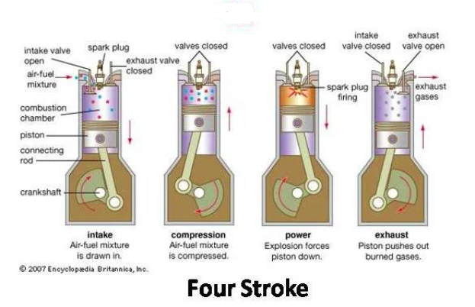






Compression test
Starting with the compression test. This test is a way of showing how strong the pressure is in the engine cylinder from the action of the piston moving up and down the engine cylinder. These readings will have a base line of a minimum specification that is required for an engine to run. Most gas engines have a minimum of around 85 to 100 psi. This goes for both 2 cycle and 4 cycle. But the 2 cycle engines will need to be on the higher end of the minimum.
These readings can be affected by some engines having a compression release to aid in starting.
**85-100 psi minimum**

Slide 6
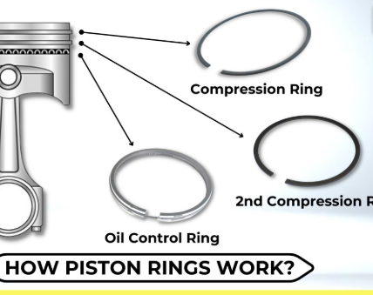
Signs of low compression
Hard starting or not starting at all
Low power
Performing a cylinder compression test to verify the results. Also, a cylinder leak down tester is another great way to test the health of an engine.
Areas to check, Piston Rings, valves, head gasket.

Slide 7
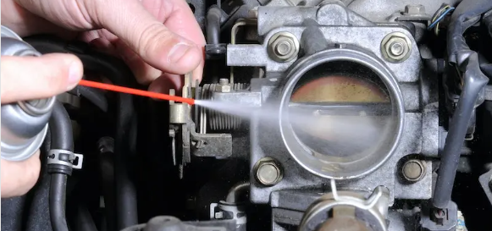
Preliminary Fuel tests.
Checking fuel level
Checking fuel supply, Pump and lines from the tank
Remove air filter check for restrictions
If equipped check fuel shut off solenoid.
Try to aid with starting fluid. If it runs on that you have a carburetor issue. *This can also be a quick check for spark*

Slide 8
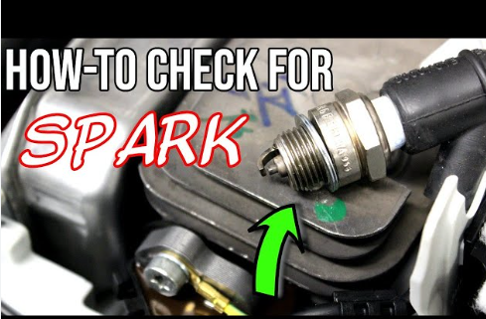
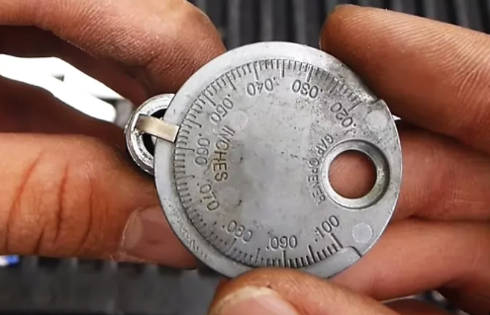
Ignition test
As shown previously checking spark with either a spark plug tester, Or the use of the current spark plug and making sure that it is grounded to the engine block metal surface.
Can be difficult with 2 cycle engines due to most cases being encased with plastic shielding.

Slide 9
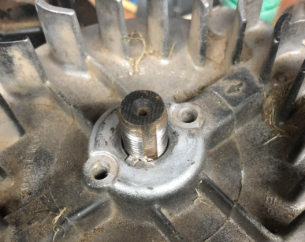
Ignition malfunctions
If you have an engine that has spark but will not fire and has compression. Then the next diagnostic step would be to check the timing. Most small engines the timing is going to be controlled by the flywheel to crankshaft by means of a keyway.
These keyways can shear from shock loads, Example of a pushmower engine when the blade contacts a rock. The rotating mass of the engine can cause the keyway to shear and change the position of the crankshaft to ignition timing.

Slide 10
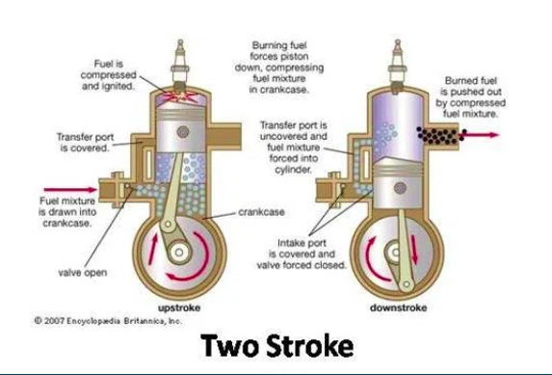
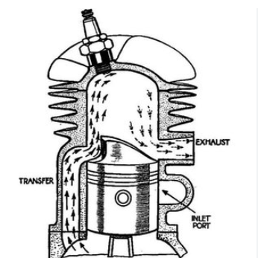
2 cycle engine
These principles are going to be the same for the 2 cycle engine. There are just in combination with only one rotation of the engine.
The piston ports are what is going to deliver the fuel to the combustion, and the exhaust port is going to be the exit for the gases.
Timing will be critical for the ignition, but with less moving parts and the piston essentially controlling any delivery of fuel (no moving valves) There is a simplicity to these engines.
https://www.youtube.com/watch?v=6_wIjvf_3-Y

Slide 11
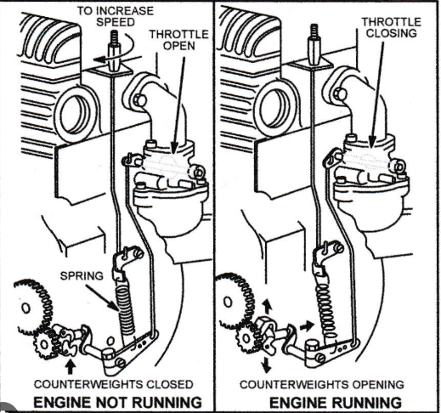
Governor
Using the internal rotating gear with flyweights the tension you add to the throttle linkage will use engine speed to regulate the throttle position and maintain engine speed despite the engine load.
If we had the throttle at a fixed position as the load increased the engine speed would drop due to the load.
Also the governor has the main purpose preventing Overspeed by using the weights to push the throttle position as speed gets greater.
https://www.youtube.com/watch?v=WZNLd7D_7tc&list=PLIypK-LnuAWB6XQYpGHVjaX1AZRAbfW1w&index=2

Slide 12
Quiz time!!!!
Intake, compression, ignition, exhaust
Worn rings, valves, head gasket
Flywheel key
Transfer port
Mark of course!
What are the 4 strokes in order
What can cause low compression
What sets the ignition to crankshaft timing
What delivers the fuel to the top end on a 2 stroke
Who is the best small engines instructor ever

