Slide 1
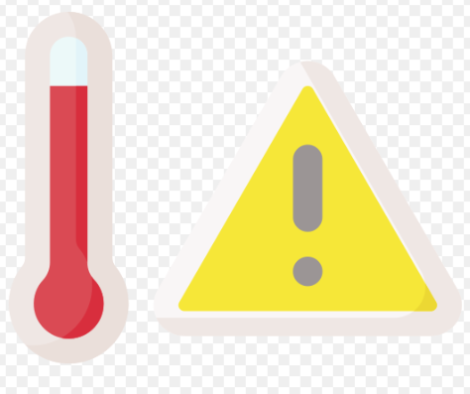
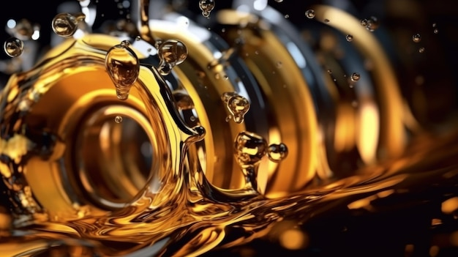
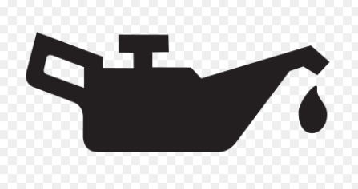
Oil and cooling
Lesson Four

Slide 2
Any Questions from previous lessons?
Types of engines
Carburetion
Ignition systems

Slide 3
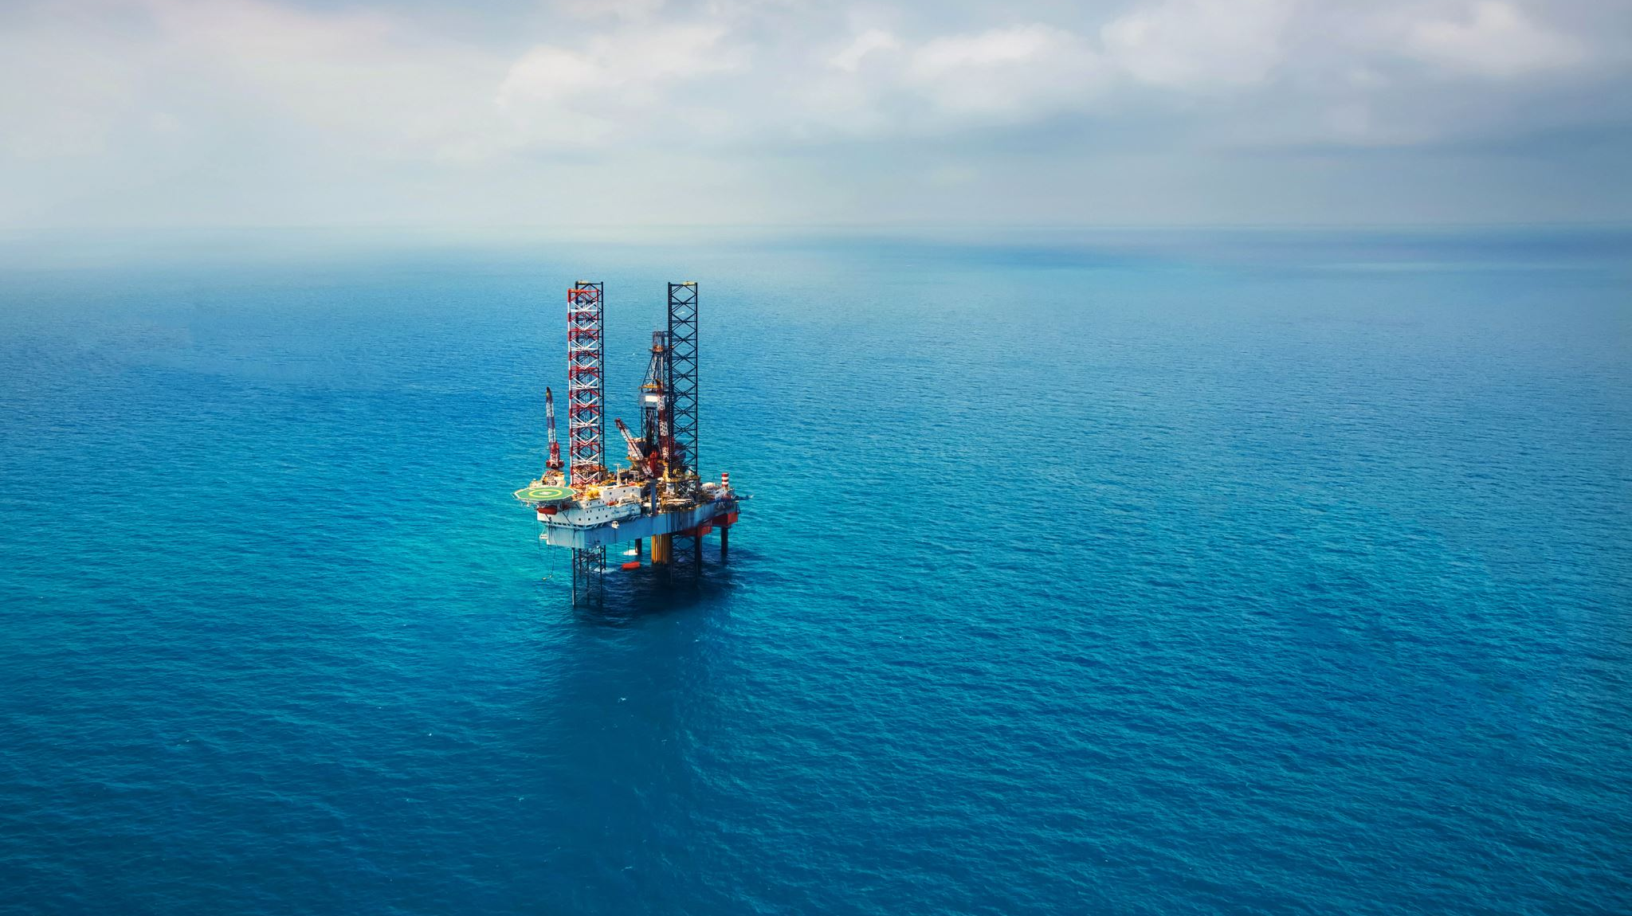
Oil systems
All engines must incorporate some kind of lubrication system. Examples are:
2 Cycle
Oil-gas mixture- Proper ratio
Oil injection- Pump driven oil pump that will deliver the oil to internal rotating group.
4 Cycle
Splash lubrication- The rotating parts internally splash the oil to the areas needing the lubrication.
Pressurized oil system- These systems have a pump to deliver the internal components of engines the proper amount of oil. These systems contain a pump pressure regulator filter and oil pressure galleries.

Slide 4
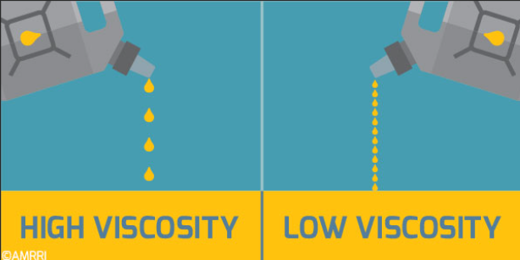
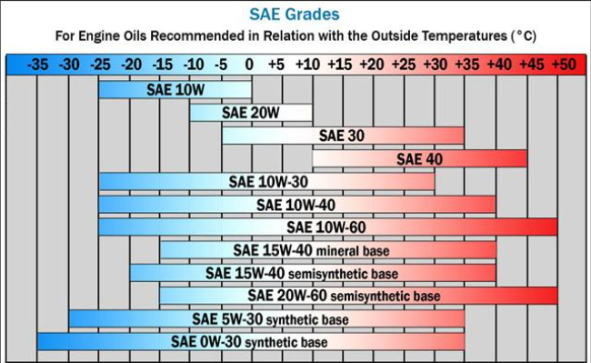
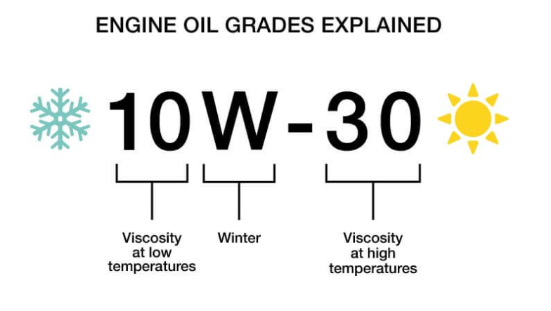
Engine oil
It is important to use the correct oil and viscosity rating based on the air temperature that engines will run in. Operating outside of these recommended air temperature ranges may cause premature engine failures.
Viscosity is the internal friction within an oil that resists its flow. It measures the oil’s resistance to flow.
Temperature can affect the oil viscosity-
Always follow the manufacturer recommendations for which oil to use in their products.

Slide 5
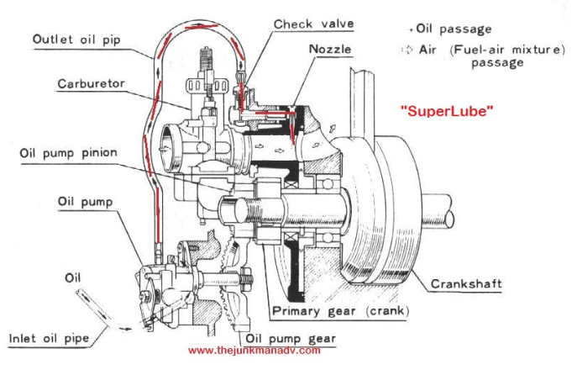
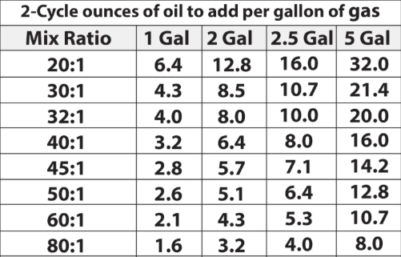
2 cycle
Use of the oil mixture to incorporate all the internal parts and lubricate them.
Oil injection: This has a small driven pump that will draw the oil from the reservoir to then inject it into the intake stream. These can also be attached to the throttle linkage and vary the amount of oil in relation to throttle position.
Correct Mixture will include the proper amount of oil for the lubrication properties and to keep the engine from fouling spark plugs

Slide 6
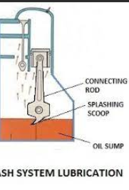
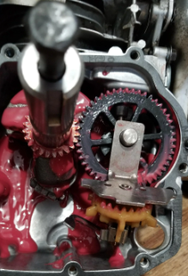
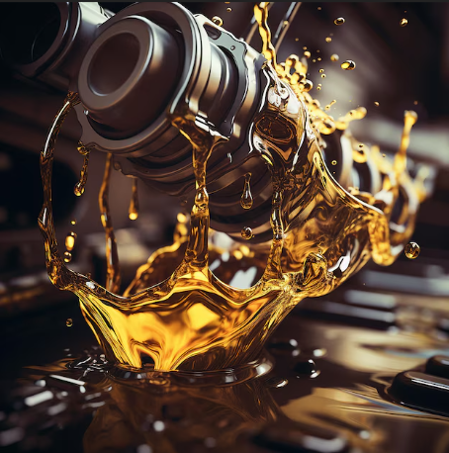
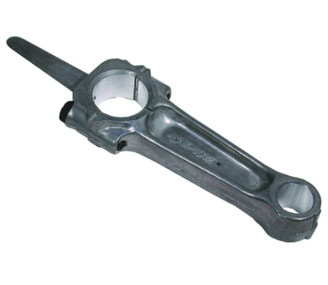
Splash Lubrication
4 cycle
This style system utilizes the rotating mass of engine parts to create a splash of oil delivered to the crucial components of the engine.
Can be a dipper on a connecting rod
Or rotating paddles usually attached to a governor
Briggs & Stratton: How a Single Cylinder Engines Work

Slide 7
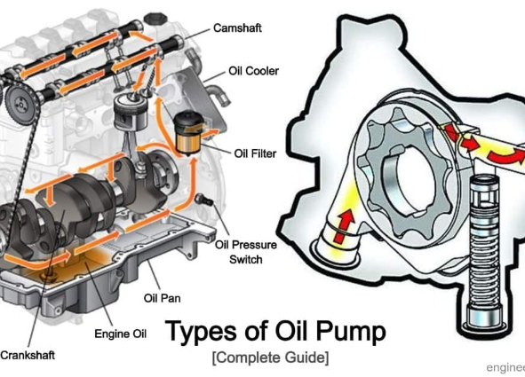
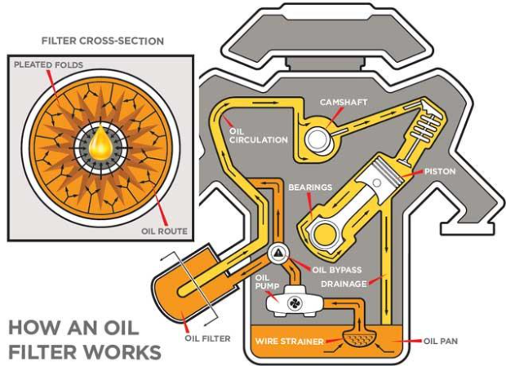
Pressure lubrication.
4 cycle
Pressurized oil, starts with the oil pump that is gear driven off the crankshaft. That oil is drawn up and under pressure fed to a pressure regulator. From there through the oil filter and feeding the oil passageways of the engine. There are internal drain passageways to return to the oil pan or sump.
Oil filters are made up of folded paper like material that fluids need to pass through
https://www.youtube.com/watch?v=IGyuWI5Lga8

Slide 8
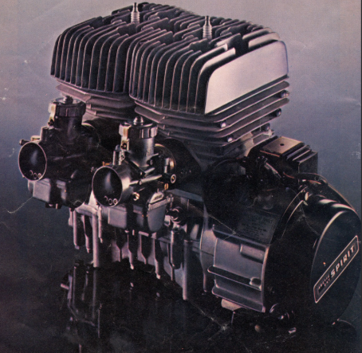
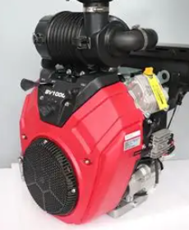
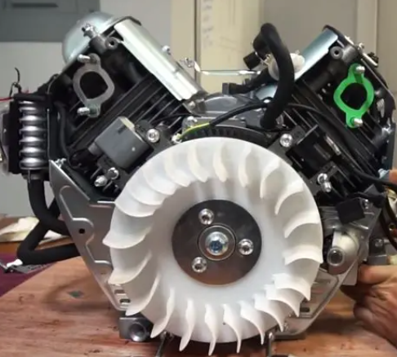
Cooling systems
Air cooled: These air cooled engines use the operation of cooling fins molded to the engine components. These fins help to disperse the heat out away from the combustion heat created.
Can be “Free air” No external fan source. Typical on motorcycles and powersports equipment
Fan cooled: Uses similar fin designed but have external fan to force air across the cylinders.

Slide 9
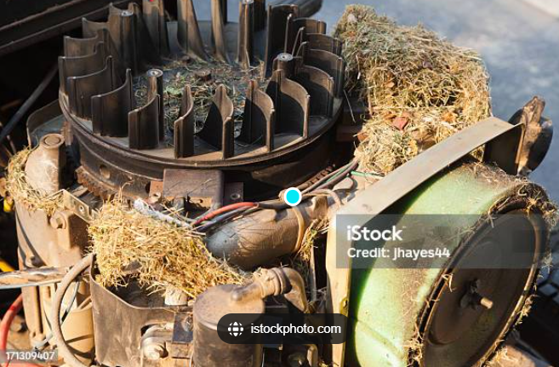
Air cooled engine failures
This picture is a great example of the biggest down fall to air cooled small engines.
The grass buildup is very common from mice building nests in the engine. That nest blocks the airflow across the cylinder and to the cylinder head. This heat buildup will lead to premature engine failure.

Slide 10
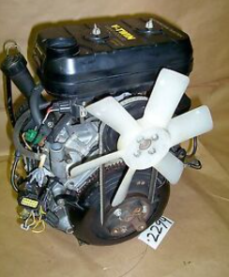
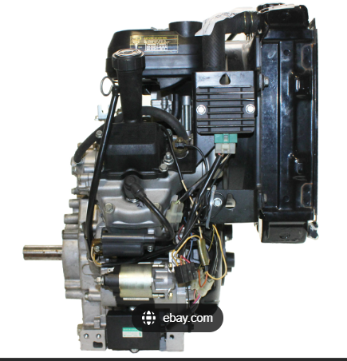
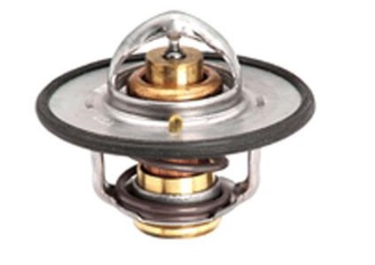
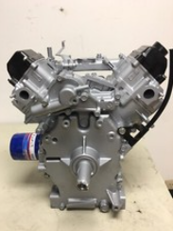
Liquid cooled engines.
Utilizing Jacketing around the heat generating parts cylinder and cylinder head. Fluid is trapped internally and circulated to a radiator to cool.
System is made up of the cooling ports, water pump, thermostat, hoses and radiator. As the heat is generated in an engine and is circulated the radiator will reduce the temperature from air being forced across the radiator.

Slide 11

Pros vs Cons
Benefits of Air cooled:
Lighter
Simpler
Cheaper
Less maintenance
Smaller
Larger oil capacity,(also aids in cooling)
Benefits of Liquid Cooled:
Quieter operation
Better at high temperatures
Maintain a more uniform engine temperature
Longevity
More efficiently running

Slide 12
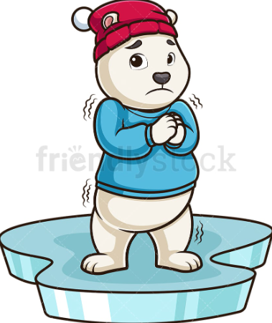
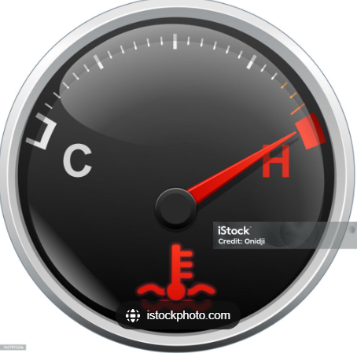
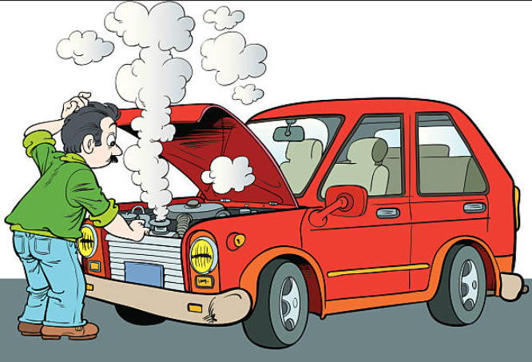
Coolant/ anti-freeze
This is a concentrated chemical solution, typically made from either ethylene glycol or propylene glycol. Its primary function is to lower the freezing point of the liquid in your vehicle’s cooling system. Preventing it from freezing when temperatures go below the freezing point, also raises the boiling point to help regulate the engine temperature effectively.

Slide 13
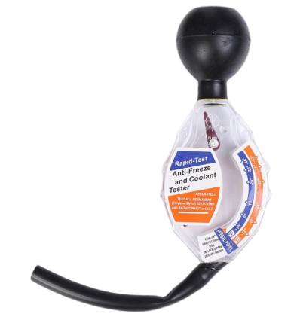
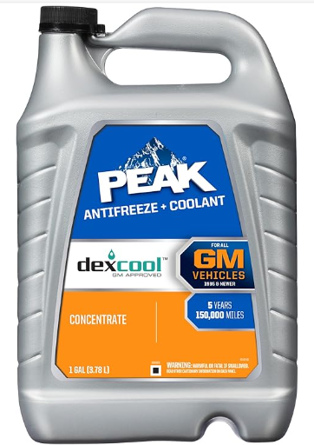
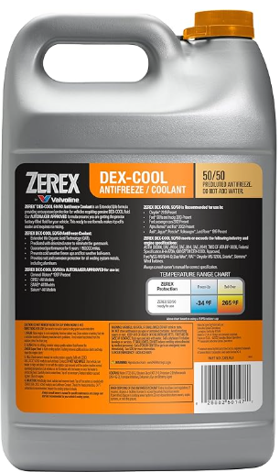
Coolant maintenance
Freeze point. Taking measurements of the point at which anti-freeze will freeze.
Additives. Can be added to prevent deposits of minerals and cavitation.
Leaks. Leaks can be both external and internal.
Thermostat. Failure to open can lead to overheating. Failure to regulate can lead to engines running too cool
Flushing system. Service intervals to remove the deposits.
Proper concentration for optimal cooling.

Slide 14
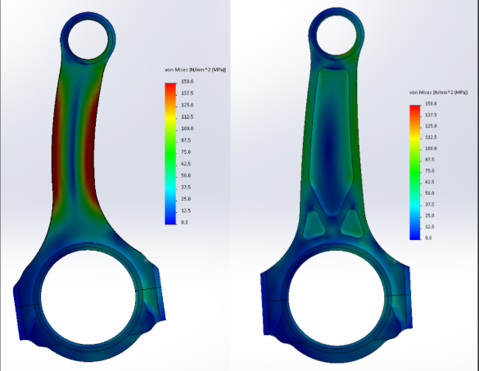
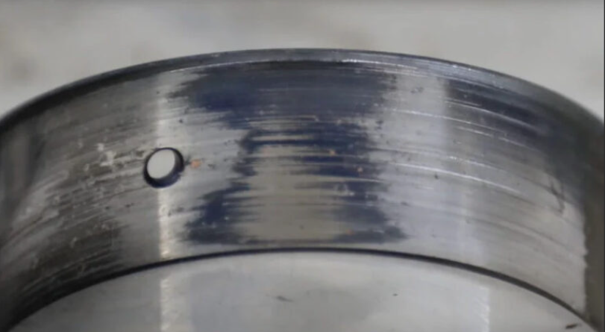
Diagnosing malfunctions
Both cooling and oil play a major role in the longevity of an engine. If there is a lack of either, this will lead to premature failure of components.
Lack of lubrication will lead to that reduction of the protective film of oil that is needed to reduce friction. Combating friction is the single most important role of oil.
Cooling, as the internal parts become close to their melting points that is where the components will start to “weld” themselves together.

Slide 15
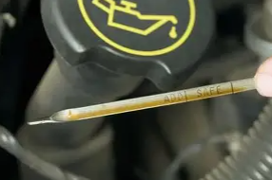
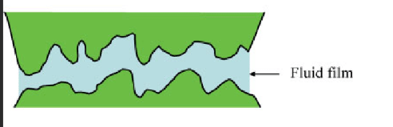
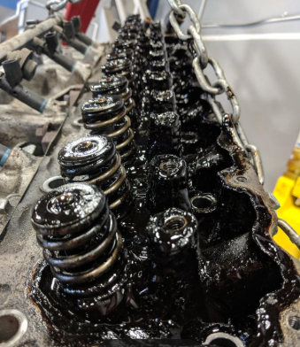
Oil breakdown
**This shows the importance of oil changes**
The lack of regular oil changes can lead to a sludge buildup from carbon and even fuel vapors in the oil. These will break down that viscosity and make the oil thicker. If the oil looses that ability to coat the wear parts of the engine with a fluid film, that is when we have the direct connection of metal against metal. The picture shows how the oil can suspend those parts.

Slide 16
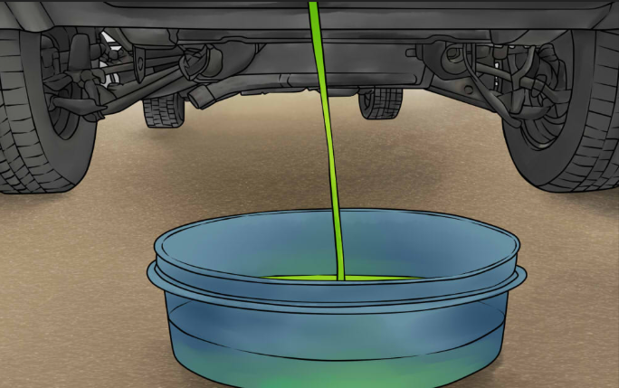
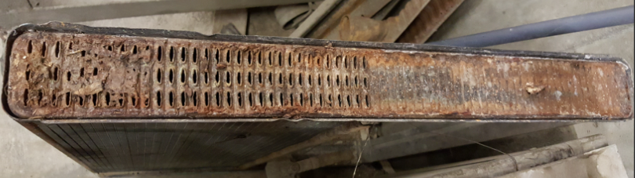
Coolant Breakdown
Over time through heat cycles there is a potential that coolant can break down the chemical structure, In turn making it less effective.
The water that we use to dilute the mixture is important. Using Tap water can introduce minerals into the system that will aid in the creating corrosion and buildup.
Flushing the coolant system and adding new coolant will bring that freeze point back to correct levels. While also removing the sludge or contaminants from the system.
Sign of breakdown, can be a discoloration or overheating.

Slide 17
Quiz time
What is the optimal mixture of coolant
Besides lubrication, what does engine oil do?
Can a fan cooled engine be run without shields?
____air is an air-cooled engine without a fan
What is the name of the protective barrier oil makes?

Slide 18
Quiz time
50/50
Aids in cooling
No air will not be forced across the crucial parts
Free air
Fluid Film
What is the optimal mixture of coolant
Besides lubrication, what does engine oil do?
Can a fan cooled engine be run without shields?
____air is an air-cooled engine without a fan
What is the name of the protective barrier oil makes?

