Slide 1


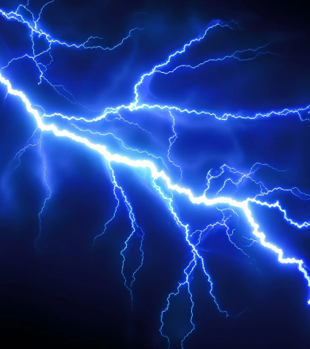

Lesson three ELECTRICAL
Ignition, and electrical components of small engines.

Slide 2
Overview from previous classes
This is your opportunity to ask questions from the previous classes.

Slide 3
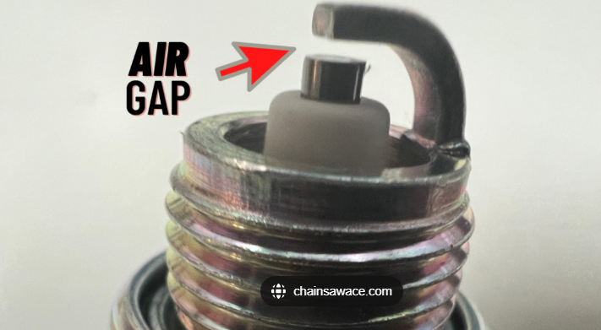
Key terms for today
Ignition coil
Primary windings
Secondary windings
Air gap
Magnet
Magneto
Breaker points
Condensor
Spark plug
Spark plug wires (high tension leads)

Slide 4
Types of ignition systems
Magneto
Power source
Electronic ignition
Breaker-point ignition systems.
Some of these are coupled together to make up the complete ignition systems.

Slide 5
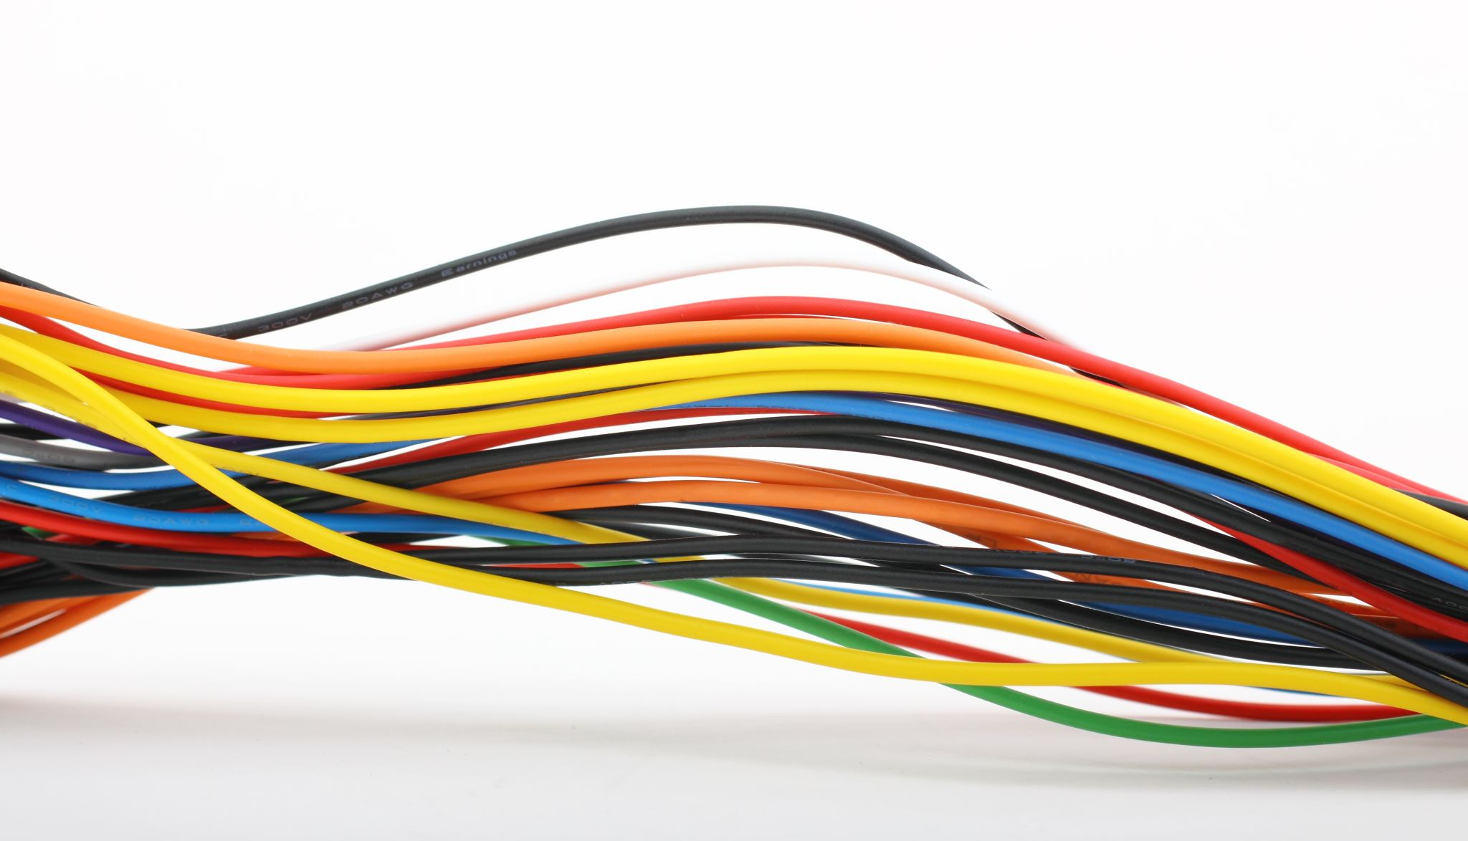
How to create voltage with a magnetic force.
As a coil of wires has magnets pass by it will create a voltage. That is going to be the primary coil of wire. That will work in series with the secondary coil of wire to “Ramp up” the voltage to an even higher number. Some secondary wire coils can be 20-100 times more than the primary to magnify the intensity of the voltage to 20,000 volts!!!!
https://www.youtube.com/watch?v=xyvk76QWQhE

Slide 6
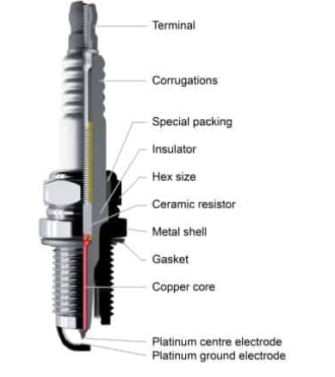
Spark plugs
These are the device that delivers the spark to the combustion cycle of the engine cycle. These will be very similar in both 2 cycle and 4 cycle engines.
Spark plugs can handle the compression pressures and the explosion at the time of the power cycle.
They are made up of different metals and insulators.
They can cause poor running conditions from internal shorts. Incorrect air gaps.
Very common to be replaced at a tune up or service interval.

Slide 7
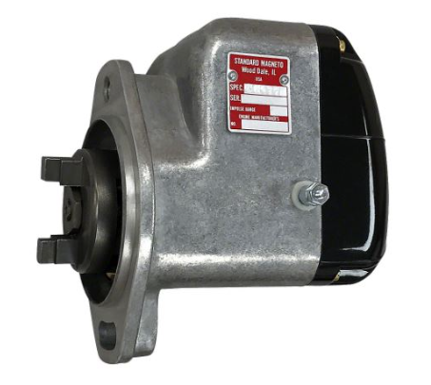
Magneto Ignition
How an Aircraft Magneto Works - Basics Explained
The magneto is a high voltage generator that creates the electrical pulse to deliver to a spark plug. Older machines had a bolt on ignition system. This Magneto contained all of the ignition system parts in one assembly.
This requires no exterior power source EX a battery.
The spark is created and distributed to the correct cylinder with adjustability within the mount.

Slide 8
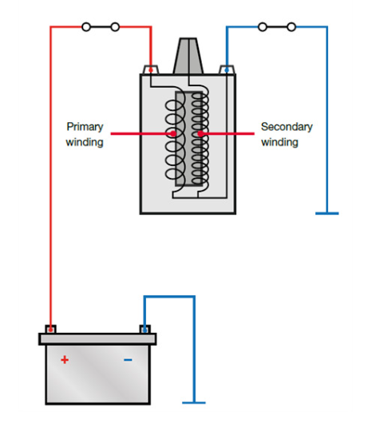
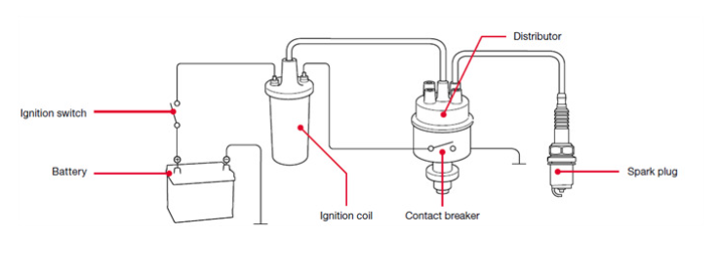
Battery Ignition
This style system is going to be similar in the use of the energy that is created by a winding of wires. The difference is that it is using a battery source of voltage. Now the key ingredient of this style system is the introduction of a set of breaker points to control when that spark is created. Think of the breaker points as a switch to control when the coil makes the high voltage spark.

Slide 9
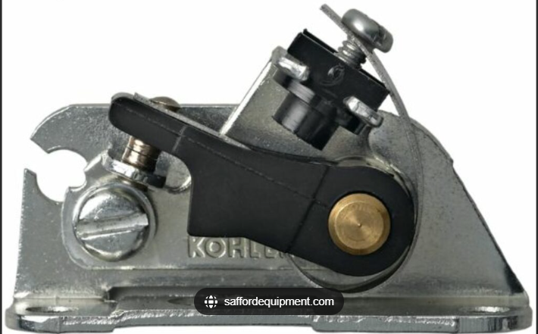
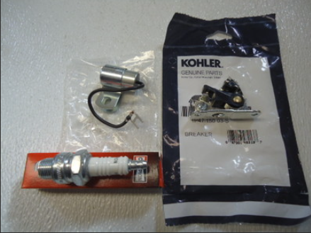
Battery ignition continued
The breaker points control the timing of the spark with the air gap that they are set at. Along with the points there is a condenser, the purpose of the coil is to reduce the chance of the breaker points arcing and burning up and also aids in producing a high-powered spark.
These are adjustable to get the proper timing of the spark at the piston position.
How Ignition Coils Work

Slide 10
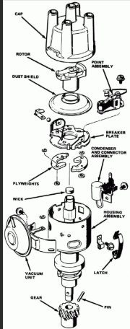
Distributor
On multi cylinder engines there is a possibility of them having a distributor. The job of the distributor is to divert the spark to the correct cylinder. That is sent out using a distributor cap. The rotating group has the rotor that has a contact on the top for the input of the spark from the coil. The rotor will point to the different contact points of the distributor cap.
The distributor internally houses the breaker points and condenser. The rotating shaft has lobes to push the points open and fire at that correct time.

Slide 11
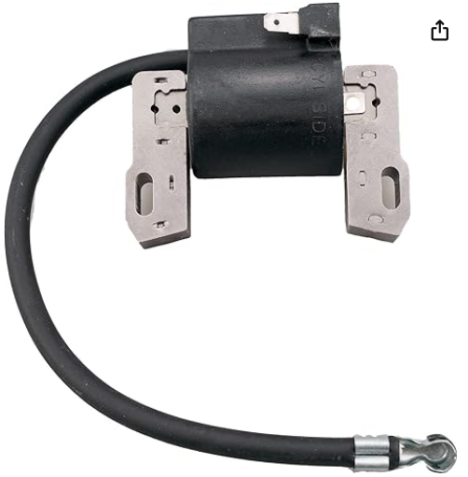
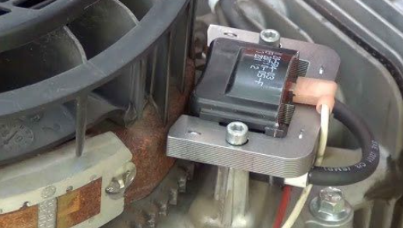
Modern Magneto Coil electronic
The flywheel magnets induce current into the magneto ignition coil, which in turn produces current high enough to jump the spark plug gap. There is one additional wire connected to the ignition coil beside the high tension lead to the spark plug. That smaller wire will ground out that voltage that is created and in turn cause the magneto to not make a spark. Shut down position.
Much simpler than the battery ignition system. Less parts are needed. Can be used on a small engine without a battery.
The timing is controlled by the passing of the magnet of the input of the coil.

Slide 12
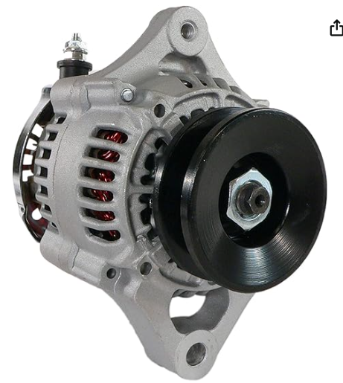
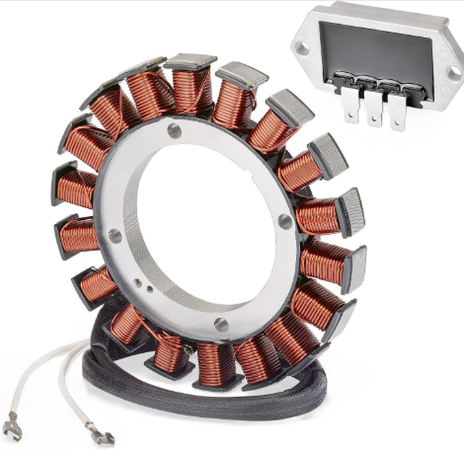
Charging system
Alternator
Uses the same theory just as a removable part. Typically found on larger engines
Uses a regulator to create the same D/C voltage to feed these electrical systems.
Usually Belt driven
Stator/ Regulator setup.
Using the coils of wire and the rotating magnets on the flywheel. An A/C current is created.
The regulator transmits that voltage to D/C Current.

Slide 13
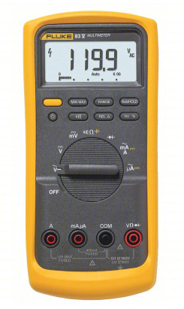
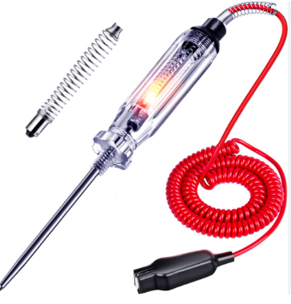
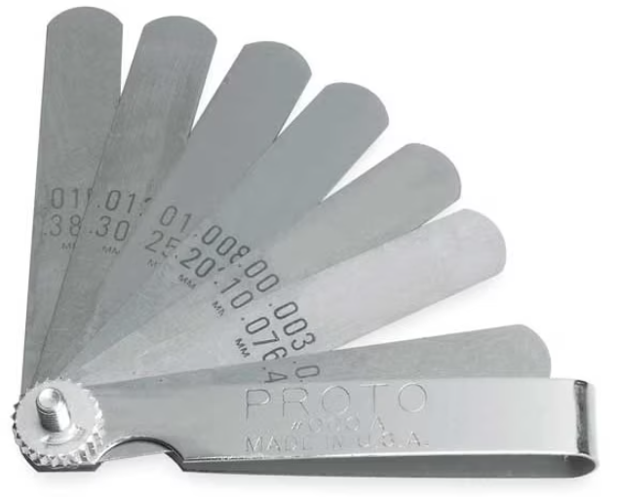
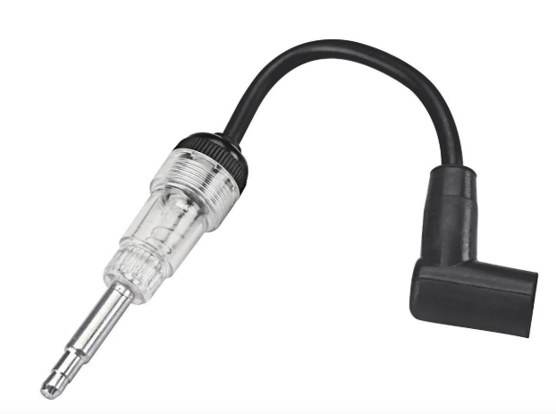
Diagnosing malfunctions
Some tools needed to perform tests
Test light
Multimeter
Feeler gauges
Inline spark tester

Slide 14
Common problems.
Magneto (OLD)
Timing adjustments
Points/condenser
Windings
Rotating group
More moving parts than the other ignition systems.
Battery Ignition
Timing adjustments air gap
Points/condenser
Coil fault
Battery voltage
More overall parts needed to work
Magneto electronic
Timing is less adjustable
Air gap
Shorted shut down wire
Similar problems with windings but replaceable with one part.

Slide 15
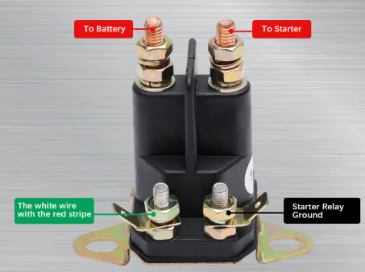
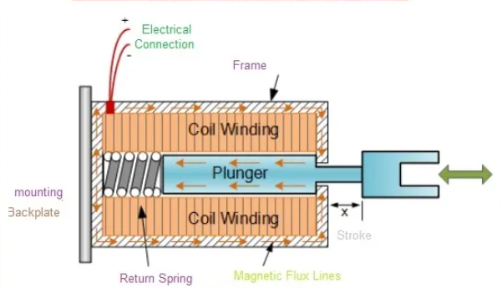
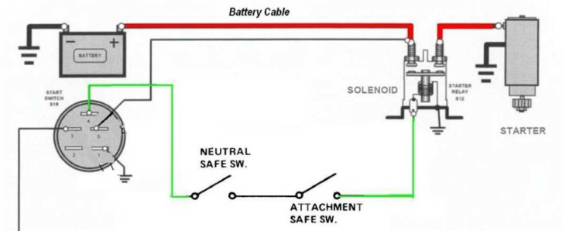
Solenoid operation
Electrical current is supplied to a solenoid for it to perform work.
Examples are a fuel shut off solenoid
Starter solenoid.
These are essentially electrical magnets. When power is given to the coil of wire that causes the magnetic force to then push or pull a plunger to perform work.

Slide 16
Quiz time!!!!!!!!
A ____passing a winding of wires will make a small electric current.
What is at the very end of a spark plug?
What can happen from inproper air gap on breaker points?
What is not needed to make spark with a magneto?

Slide 17
Quiz time!!!!!!!!
A ____passing a winding of wires will make a small electric current.
What is at the very end of a spark plug?
What can happen from inproper air gap on breaker points?
What is not needed to make spark with a magneto?
Magnet
Electrode
Improper Timing
Battery power

