Slide 1
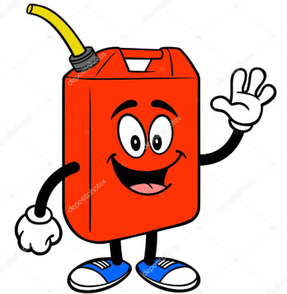
Lesson two: fuel systems.

Slide 2
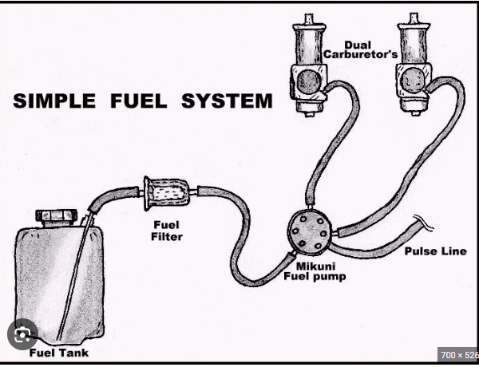
Agenda
Differences between 2 cycle and 4 cycle carburetors
Fuel delivery
Fuel mixtures
Components of a carburetor
What is needed for and engine to run
Governor operation

Slide 3
FUEL SYSTEM COMPONENTS
ALL ENGINES WILL NEED A FUEL TANK. SOME WILL HAVE RESERVE CAPACITY. YOU CAN FIND THAT ON POWERSPORTS EQUIPMENT TYPICALLY.
SOME HAVE A GRAVITY FEED FUEL TANK. SOME HAVE A TANK THAT IS LOWER AND REQUIRE A FUEL PUMP. THOSE CAN BE ELECTRIC, MECHANICAL OR A DIAPHRAGM STYLE PUMP.
ALL FUEL SYSTEMS SHOULD CONTAIN SOME KIND OF FILTER. EXAMPLES CAN BE INLINE OR CANISTER CARTRIDGE STYLE.

Slide 4
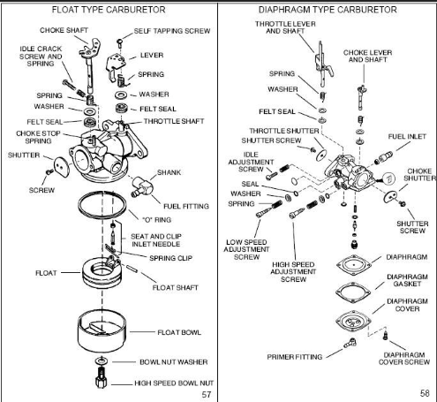
Key Components
Venturi
Needle valve
Jet
Bowl
Float
Float bowl
Needle
Seat
Throttle plate
Choke plate

Slide 5
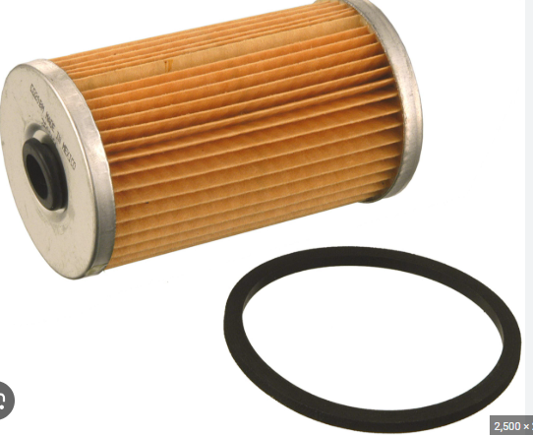
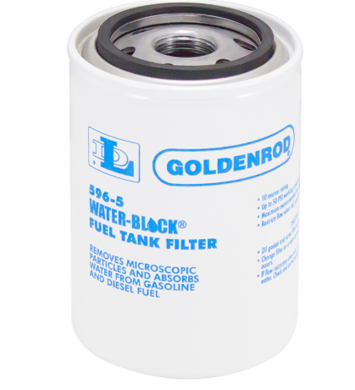
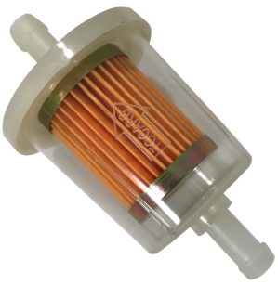
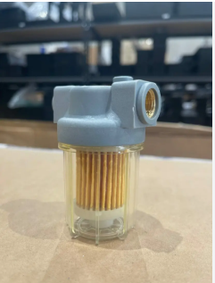
FUEL FILTERS

Slide 6
Updraft = older equipment diaphragm=2 cycle equipment slide=powersport equipment
SIDE DRAFT=most common with small 4 cycle engines
DIFFERENT TYPES OF CARBURETORS
https://www.youtube.com/watch?v=MfTpU6HS4cA

Slide 7
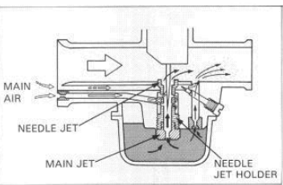
SIDE DRAFT CARBURETOR
MOST COMMONLY FOUND ON 4 STROKE ENGINES, LAWNMOWERS, RIDING TRACTORS. GENERATORS AND PRESSURE WASHERS.
HAS TO HAVE EXTERIOR FUEL PUMP OR GRAVITY FED FUEL SYSTEM.
CONTAINS VENTURE, THROTTLE AIR PLATE AND JETS.
NEEDS A CHOKE FOR STARTUP

Slide 8
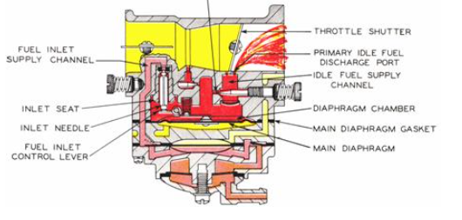
DIAPHRAGM CARBURETOR
MOST COMMONLY FOUND ON 2 STROKE EQUIPMENT
CHAINSAWS WEED WACKERS, COMPACT POWER EQUIPMENT.
FUEL PUMPING ACTION IS FROM WITHIN THE CARBURETOR WITH A PULSE LINE.
CONTAINS A VENTURI, JETS, AND THROTTLE AIR PLATE
NEEDS A CHOKE FOR STARTUP

Slide 9
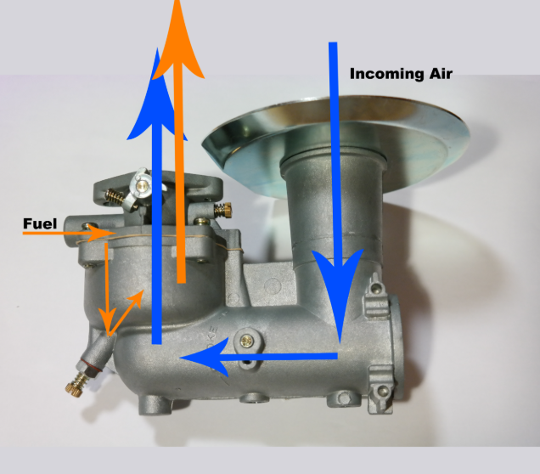
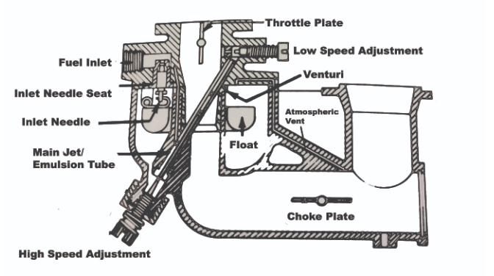
UPDRAFT CARBURETOR

Slide 10
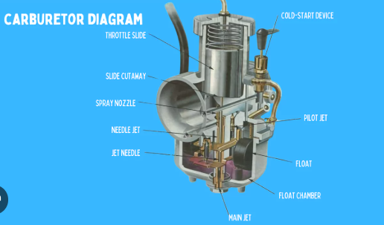
Slide carburetor
MOST COMMONLY FOUND ON POWERSPORTS EQUIPMENT, ATVS, SIDE BY SIDES, AND MOTORCYCLES
CONTAINS A SLIDE FOR AIR THROTTLE MIXTURE AND A MOVING NEEDLE JET. STILL CONTAINS A VENTURI FOR THE VACUUM EFFECT OF THE AIR FUEL MIXTURE.
HAS A COLD START PLUNGER FOR STARTUP. DOES NOT UTILIZE A CHOKE PLATE.

Slide 11
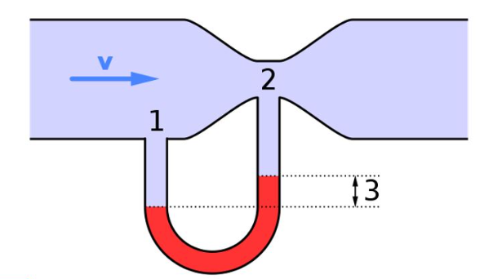
Venturi
As the air passes through that reduction in size of the bore it creates a “vacuum” that will draw the fuel from the lower portion.
This diagram will help to explain that principle.

Slide 12
Questions?

Slide 13
GOVERNOR OPERATION
An engine governor is a device that automatically maintains an engine's speed within a desired range, regardless of changes in load. It works by sensing engine speed and adjusting the fuel or air supply to the engine to counteract load fluctuations. For example, if a lawnmower's engine slows down under a heavy load of grass, the governor will open the throttle to increase fuel flow and bring the engine speed back up.
This is a load sensing component that when your throttle is demanded it will try to maintain that speed. Using a rotating gear assembly with flyweights it will spin with the engine speed. If there is a drop in that speed without and throttle position change, the spring and momentum of the flyweights will increase the throttle position to try to recover from that drop.

Slide 14
DIAGNOSING MALFUNCTIONS
ENGINES WILL REQUIRE SPECIFIC FUEL/AIR MIXTURE FOR RUNNING.
ENGINE SURGING CAN BE CAUSED BY A LACK OF FUEL IN THE MIXTURE. THAT SURGE IS CAUSED BY THE GOVERNOR TRYING TO MAINTAIN A SPEED BUT THE REQUIRED FUEL IS NOT SUFFICIENT. THIS IS KNOWN AS A LEAN FUEL MIXTURE. LEAN IN FUEL AIR MIXTURE.
OVERFUELING CAN LEAD TO A BLACK SMOKE AND MISSFIRE. THAT BLACK SMOKE IS UNBURNED FUEL AND IS ALSO KNOWN AS A RICH FUEL MIXTURE. RICH IN FUEL BUT LACKING THE PROPER AIR MIXTURE. CAN BE SEEN IF YOU TRY TO START AN ENGINE AND LEAVE THE CHOKE LEVER ENGAGED.
MOST MODERN CARBURETORS DO NOT HAVE ADJUSTABLE NEEDLE JETS FOR SETTING THE PROPER MIXTURE. THESE PROBLEMS ARE GENERALLY CAUSED BY PARTIALLY PLUGGED JETS.
https://www.youtube.com/shorts/WykFpaLDUcc

Slide 15
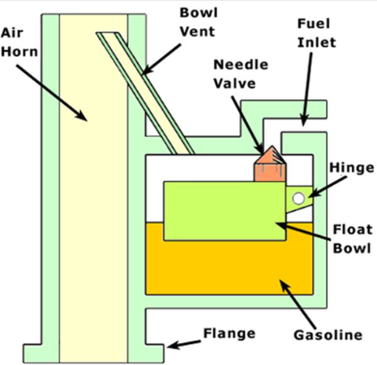
Float and Bowl
The fuel for the carburetor to burn needs to be in a “reservoir” at the ready for the intake stroke.
This is accomplished by the action of the needle and seat. They are attached to the float that controls the fuel capacity of the reservoir.

Slide 16
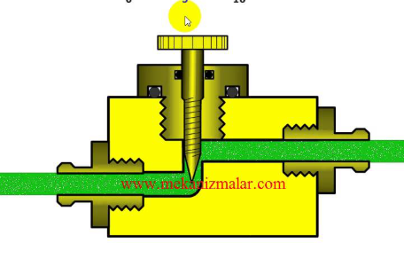
Adjustable needle valve:
This diagram will help to show how the needle valve is able to give a more precise fuel delivery. This is also found on idle air mixture screws.

Slide 17
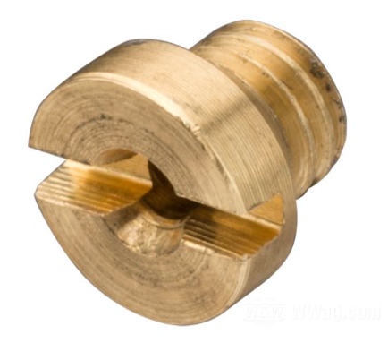
Fixed main Jet:
This is most commonly found on the newer equipment. This small passageway is a fixed port for fuel to go through. The poor running conditions we see most commonly are caused by these ports being partially or completely blocked off.

Slide 18
QUIZ TIME!!!!!!!!!!!
1)What is the purpose of a float?
2)Air mixture being rich means more _____than _____
3)What part of the carburetor causes the “vacuum”?
4)What application mostly uses a diaphragm carburetor?
5)What can cause an engine to surge

Slide 19
QUIZ TIME!!!!!!!!!!!
1)What is the purpose of a float?
2)Air mixture being rich means more _____than _____
3)What part of the carburetor causes the “vacuum”?
4)What application mostly uses a diaphragm carburetor?
5)What can cause an engine to surge
Regulate the fuel in the bowl
Fuel than air
The venturi
2 Cycle engines
Lack of fuel, main jet plugged or not adjusted correctly.

Slide 20
THANK YOU
MARK CHRISTENSEN
MARK.CHRISTENSEN@UATNE.COM

