Slide 1
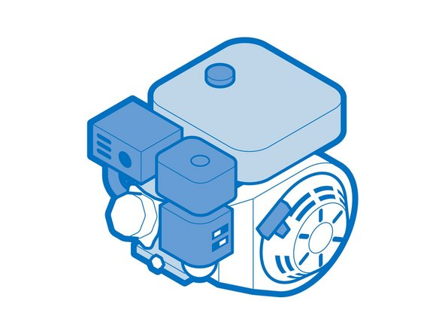

INTRODUCTION TO SMALL ENGINE REPAIR
MARK CHRISTENSEN

Slide 2
About me-
Graduate from Orange Ulster Votech, Heavy equipment program.
Graduate from SUNY Cobleskill 2006
Have worked for the local John Deere Dealer since 2004. Transitioned from a Technician of 18 years, to a service manager. Currently tech support for our 50 locations throughout the northeast.
What are you looking for from this class? I want to base this learning on input from you!
Skill set?
Strengths and or weakness

Slide 3
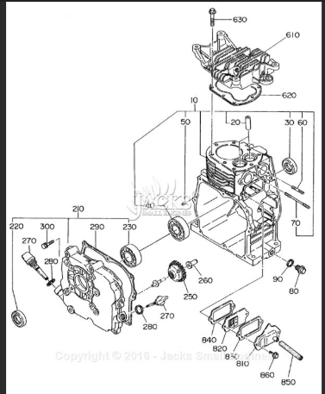
Goals and Objectives to Cover
Engine principles: The fundamental theory behind internal combustion engines. Focusing on two- and four-cycle operations.
Engine systems: A detailed examination of key systems.
Carburetion: How the Carburetor delivers the proper Air-fuel mixture.
Ignition systems: The operation and troubleshooting of the ignition systems and spark plugs
Lubrication: The role of the lubricants in reduction friction and cooling
Cooling systems: Understanding how engines are cooled.

Slide 4
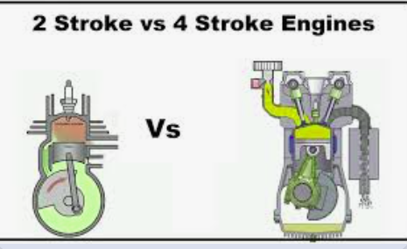
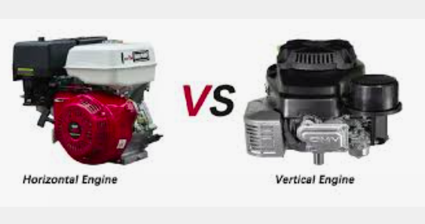
Engine Basics, Material we will cover
Definition of 2 stroke vs 4 stroke.
Engine crankshaft orientation and meaning
Fuel system differences.
Types of equipment and what are their uses.
Failure and prevention.
Maintenance
Pros and Cons of different engines.
https://youtube.com/shorts/kOL-qNyklz8?si=dUKTH7_izARE9qlU

Slide 5
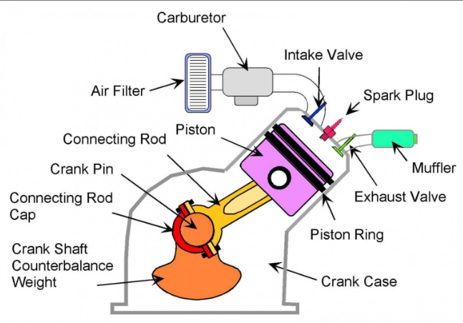
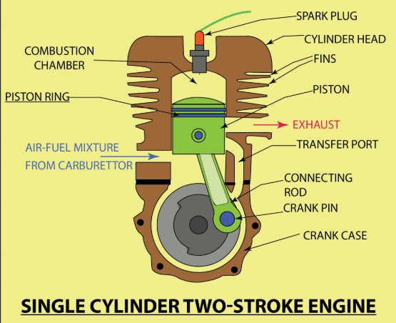
Components

Slide 6
Engine Cycles
For a 2 stroke engine in the rotation will include an intake compression ignition exhaust in 2 strokes of the piston.
For a 4 stroke engine the same.
INTAKE---COMPRESSION---IGNITION---EXHAUST

Slide 7
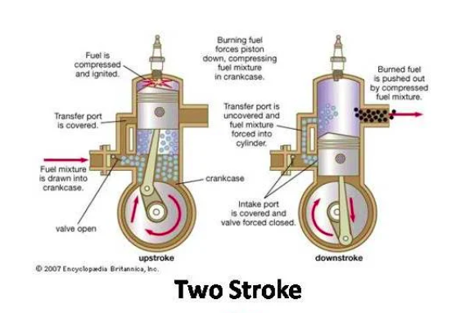
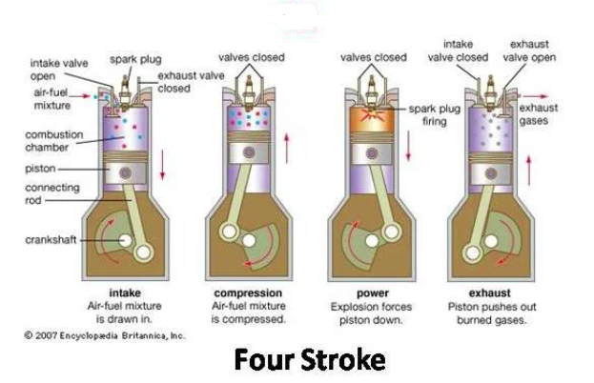
Similarities
https://www.youtube.com/shorts/kOL-qNyklz8
Both engines have similar components. Starting with an Engine block, crankshaft, flywheel, ignition, piston, rings, connecting rod, exhaust and carburetor. Intake and exhaust.

Slide 8
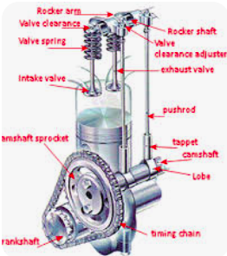
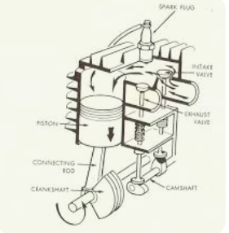
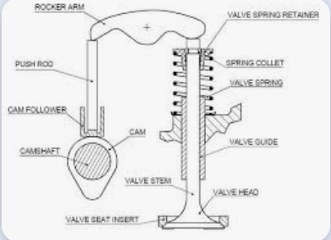
Differences
All of the differences between the engines mostly have to do with the fuel system and the number of cycles.
4 stroke engines utilize a camshaft and valves for the timed cycles of the engine to provide the power.
OHV- Over head valve
L head design

Slide 9
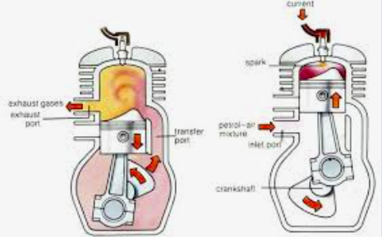
Two stroke
Without valves to direct the flow of the intake air and exhaust gases out. These engines use port to direct the airflow.
That airflow is crucial for the engine performance.
Intake air with fuel mixture is going to enter the crankcase to act as the lubricant and the fuel source for the engine. Then at the point of the ignition is when the exhaust port will be uncovered allowing the point for the exhaust gases to escape the engine. Starting the next phase or (stroke)

Slide 10
Questions

Slide 11
2 Stroke vs 4 Stroke
2 Stroke
Lightweight and high-speed engines, Found in smaller power equipment.
Less moving parts
One rotation per ignition cycle.
Lower maintenance.
Lubrication from oil gas mixture
Compact size
4 Stroke
Higher Torque applications.
Lower noise
Fuel efficient
Lower emissions
More complex, due to additional components
2 rotations per ignition cycle.
Intake, compression, ignition, exhaust.

Slide 12
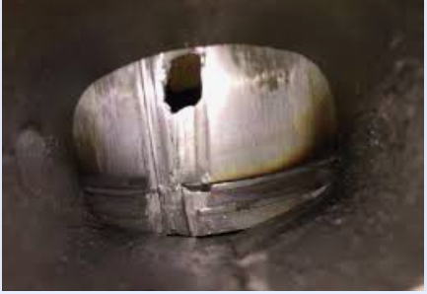
2 stroke engine
Carburetion
Maintenance
The fuel “mixture” is what is used in the combustion cycle of the engine. Its purpose is not only to burn, but also be the lubrication of the internal components.
Improper mixture: Rich or Lean
Symptoms and repair
What causes most failures?
Fuel change- stale fuel
Spark plugs- Fouling
Exhaust- plugging
Air filter fuel filter

Slide 13
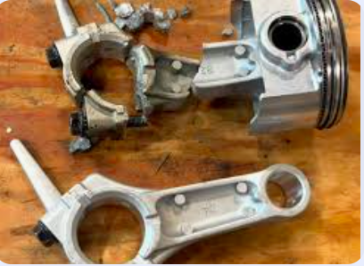
4 stroke
Carburetion
Maintenance
Simply uses gasoline for the fuel source.
Lubrication is achieved through crankcase oil.
Lean/ Rich fuel situations
Camshaft and valves.
What causes most failures?
Fuel change, Stale gas
Spark plug, fouling
Oil change interval.
Air filter, fuel filter

Slide 14
Failures
Both 2 Stroke and 4 Stroke.
Lubrication is the number one cause of failure in small engines.
Overheating.
Poor running, carburetion
Hard starting, carburetion/ timing
Proper storage
How can you prevent these?
Maintaining your equipment!

Slide 15
Questions

Slide 16
Key Terms:
Crankshaft
Camshaft
Connecting Rod
Piston
Rings
Cylinder head
Cylinder block
Fuel system (carburetor)
Ignition System

Slide 17
Thank You!

