Slide 1

ICD Procedural Coding
By Diana Turner

Slide 2


This presentation includes:
12 major body systems
7 pcs code characters
ICD-10-PCS system
Root Operations

Slide 3
Body systems
4. Integumentary System: Is the largest organ system covering up the entire human body, it serves as protection from infections or radiation damage.
What organs make up the Integumentary System?
Skin: Is the largest organ in the body, it serves as a physical protection shield to help fight against UV sunlight and helps regulate body temperature.
– Hair: Is not only there for looks it also protects from UV rays and severs as protection for the skin.
– Nails: protect toes plus fingertips and enhance sensation of sensory enhancement.
1. Circulatory System: The circulatory system is part of the cardiovascular system, the goal
of this system is to move blood throughout the body, at the same time transporting rich
oxygen and nutrients into the body’s cells while also removing waste products.
Which elements make up the circulatory system?
- Heart: is consistently pumping blood throughout the body.
- Veins: Hold the most blood supply.
– Blood: Carries nutrients and antibodies throughout the body.
– Arteries: Transfer blood away from the heart.
5. Endocrine System: Is found in all living organisms, this system helps control reproduction, mood and sends hormones into the blood.
What are some endocrine organs?
-Female ovaries: Play a role in the reproduction part of the endocrine system by producing eggs for fertilization and makes hormones.
Thyroid: Is responsible for speeding up metabolism.
- Pituitary: Another gland that controls and release hormones.
2. Digestive System: Is part of the gastrointestinal tract, which acts as a passageway for
food to travel to be broken down into energy and growth.
What organs help the digestive system work?
- Stomach: Temporarily holds food then breaks food down by releasing acids and
enzymes.
– Mouth: First part of the digestive process prepares the food for the breakdown process. The salvia moistens while the teeth grind food into smaller pieces.
-– Small intestine: Absorbs most of the nutrients then sends the food into the colon.
6. Muscular systems: The muscular system's main function is to allow movement while also
maintaining of posture, locomotion, and control
3. Lymphatic System: Maintains fluid balance by removing all accumulated body fluids from
body tissue.

Slide 4
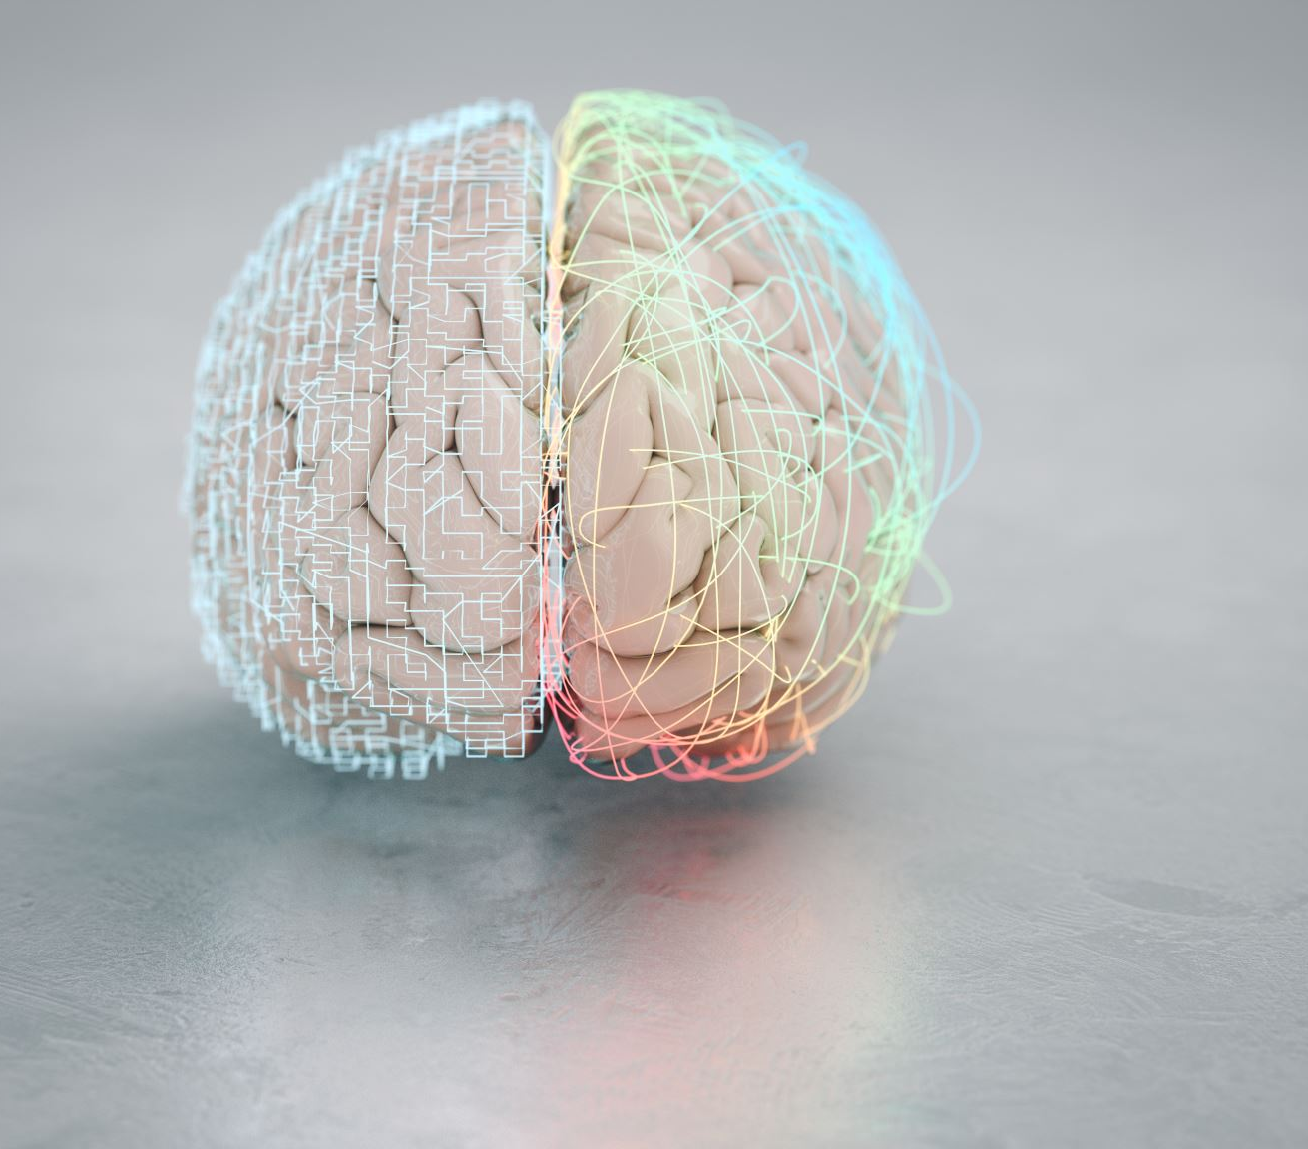
The Nervous System:
The nervous system is the instructor of the body, it sends an indication to all parts of the body including the brain and other organs which result in response such s movement, breathing, and thinking.
What Makes Up The Nervous System ?
Spinal Cord: By using its connection to the brain the spinal cord is able to send signals to the brain allowing the body to feel movement and other sensations.
Brain: The brain is the master of the nervous system, it controls thoughts, feelings, and even reactions.
Nerves/Nerve Cells: The nerve cells are the messenger in the nervous system they carry messages to the brain and other parts of the body allowing communication.

Slide 5
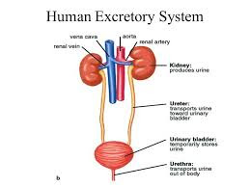
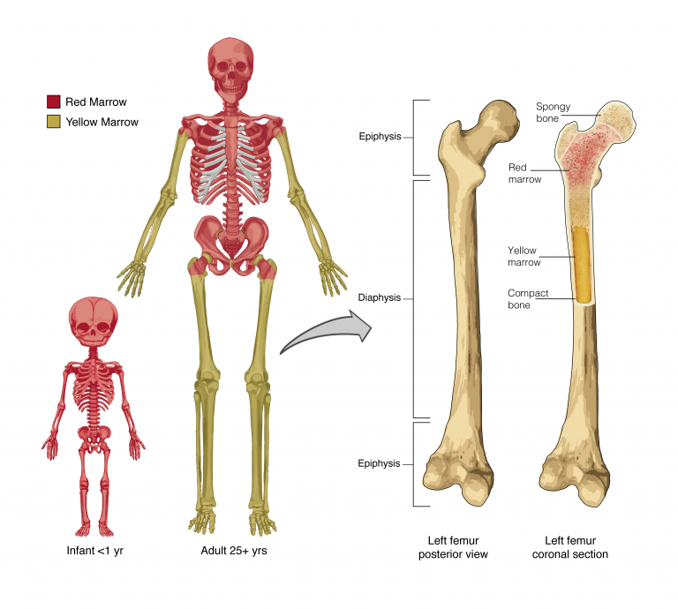
Urinary System:
Skeletal System:
Is the framework of human body, the human body structure is made up of bones, cartilage, connective tissue, tendons, and ligaments. The skeletal system severs as protection to internal organs and supports movement.
What makes up the skeletal system?
Connective tissue: Connects tissues and organs, the cells in connective tissue defend the body from microorganisms that entering the body.
Cartilage: Cartilage has many roles in the skeletal system it provides cushion for joint surface, absorbs impact from movement and covers the ends of the bones where bones meet.
Bones: The body is surrounded by bones which make up the shape or the body, there are approximately 206 bones in the human body that make red blood cells. Ribs are bones that protect the heart and lungs.
The urinary system allows filtration meaning it destroys waste from the body, this system also balances the body’s fluids by removing excess water
What does the urinary system consist of ?
Kidneys: The role of the kidneys is to filtration,, it filter’s out blood and makes urine. One way the kidneys are able to remove waste from the body is by urine, urine contains toxins that need to be filtered out of the body.
Bladder: The purpose of the bladder in the urinary system is to hold urine, it can hold 400 to 500 milliliters. Once the bladder can no longer hold the urine it releases it allowing urination.
Urethra: The Urethra is a passageway from the bladder, this tube empties out all urine from the bladder.
This Photo by Unknown Author is licensed under CC BY-SA

Slide 6
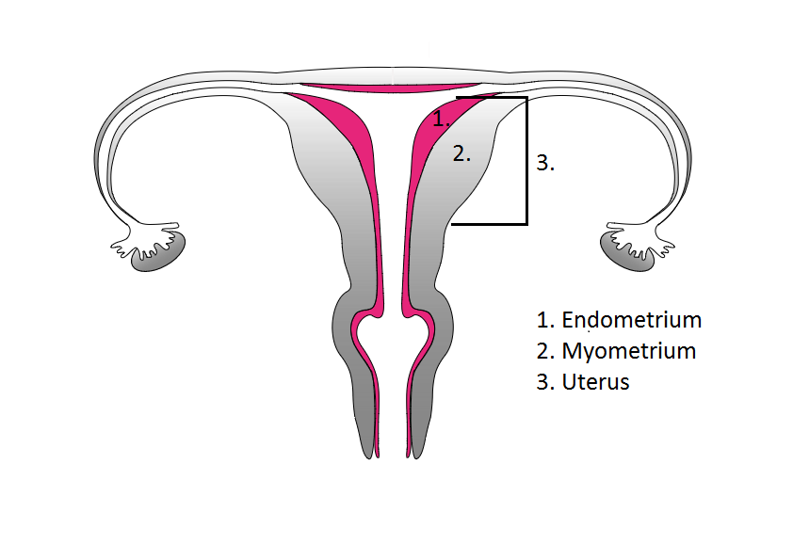
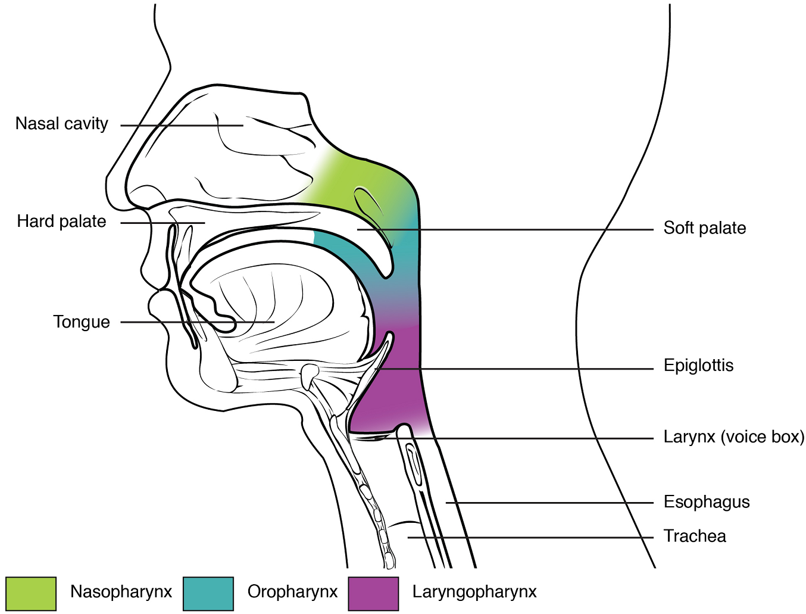
Reproductive System:
The reproductive system is in charge of producing an offspring by enabling a male to impregnant a female.
What is the difference between male and female reproductive system?
  Female Reproductive System: Is designed to ensure fertilizations happens, the ovaries produce oocytes necessary for reproduction once the egg is fertilized comes development.
  Male Reproductive System: Is in charge of producing, storing, and transporting sperm, sperm plays a major role in reproduction process. Testes are responsible for sperm production.
Respiratory System: This system grants the process of movement of air in and out the lungs in exchange for oxygen to help remove carbon dioxide and it also allows sense of smell.
What are 3 organs that are part of the respiratory system?
  Lungs: The lungs are essential in the respiratory process, with their elastic tissue, the lungs fill up with air empowering the air flow, they deliver oxygen to the blood.
  Nose: The breathing process begins in the nose, the nose lets air enter the body, the incoming air is filtered and then warmed.
  Larynx: Not only does it allow humans to talk but it also serves in protecting the lower airways from food or liquids by blocking the passageway in the respiratory tract.
This Photo by Unknown Author is licensed under CC BY

Slide 7

Hypertension
Secondary Hypertension codes:
I115.9 Secondary hypertension unspecified
I115.0 Renovascular hypertension
Coding Guidelines:
Secondary hypertension is due to an underlying condition. Two codes are required: one to identify the underlying etiology and one from category 115 to identify the hypertension. Sequencing of codes is determined by the reason for admission/encounter.
According to the coding guidelines I would code secondary hypertension with two codes, 115.0 renovascular hypertension with underlying condition of I70.1.

Slide 8
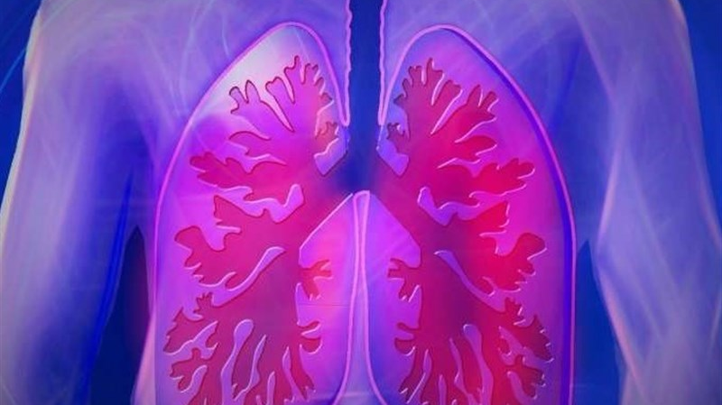
COPD
Codes:
J44.9 Chronic obstructive pulmonary disease, unspecified
J44.0 Chronic obstructive pulmonary disease with (acute) lower respiratory infection
Coding Guidelines:
Codes in categories j44 and j45 distinguish between uncomplicated cases and those in acute exacerbation. An acute exacerbation is a worsening or a decompensation of a chronic condition. An acute exacerbation is not equivalent to an infection superimposed on a chronic condition, though an execration may be triggered by an infection.
I would code J44.0 along with a code also to identify infection, of J06.9 for acute respiratory infection.
This Photo by Unknown Author is licensed under CC BY

Slide 9
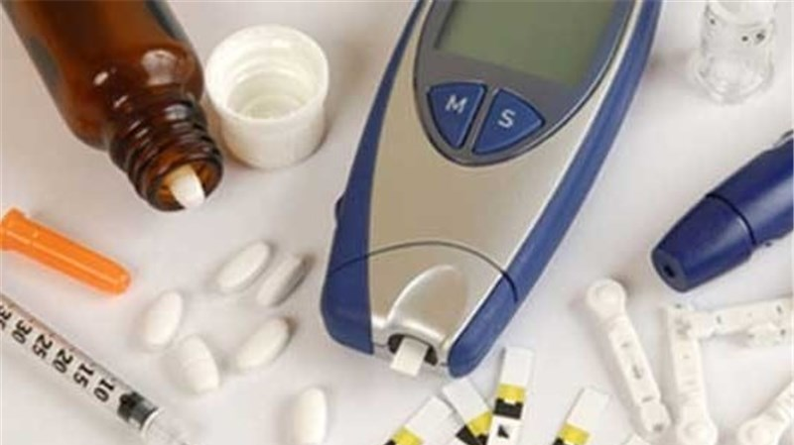
Diabetes Mellitus
Codes:
E11.22 type 2 diabetes mellitus with diabetic chronic kidney disease
E11.29 type 2 diabetes mellitus with other diabetic kidney complications
Coding Guidelines:
The diabetes mellitus codes are combination codes that included they type of diabetes mellitus, the body system affected, and the complications affecting that body system. As many codes within a particular category as are necessary to describe all of the complications of the disease may be used. They should be sequenced based on the reason for a particular encounter. Assign as many codes from categories e08-e13 as needed to identify all of the associated conditions that the patient has.
E11.22 is a diabetes mellitus combination code that includes the type of diabetes mellitus with the kidneys being affect, (use additional code to identify stage of chronic kidney disease) N18.1 chronic kidney disease stage 1.
This Photo by Unknown Author is licensed under CC BY

Slide 10
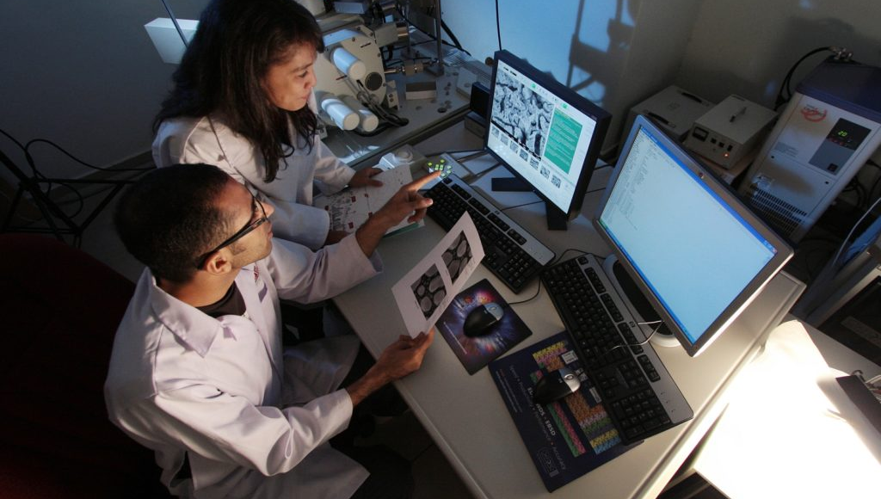

What is the purpose of the Icd-10-pcs coding system?
PCS coding is so much different form any other coding system! There is no diagnostic information included or code elsewhere notes, instead PCS coding is used to code procedures. PCS stands for procedure coding system and was developed by CMS as a replacement of ICD-9-CM, it’s purpose is to report inpatient procedures.
This Photo by Unknown Author is licensed under CC BY-NC

Slide 11
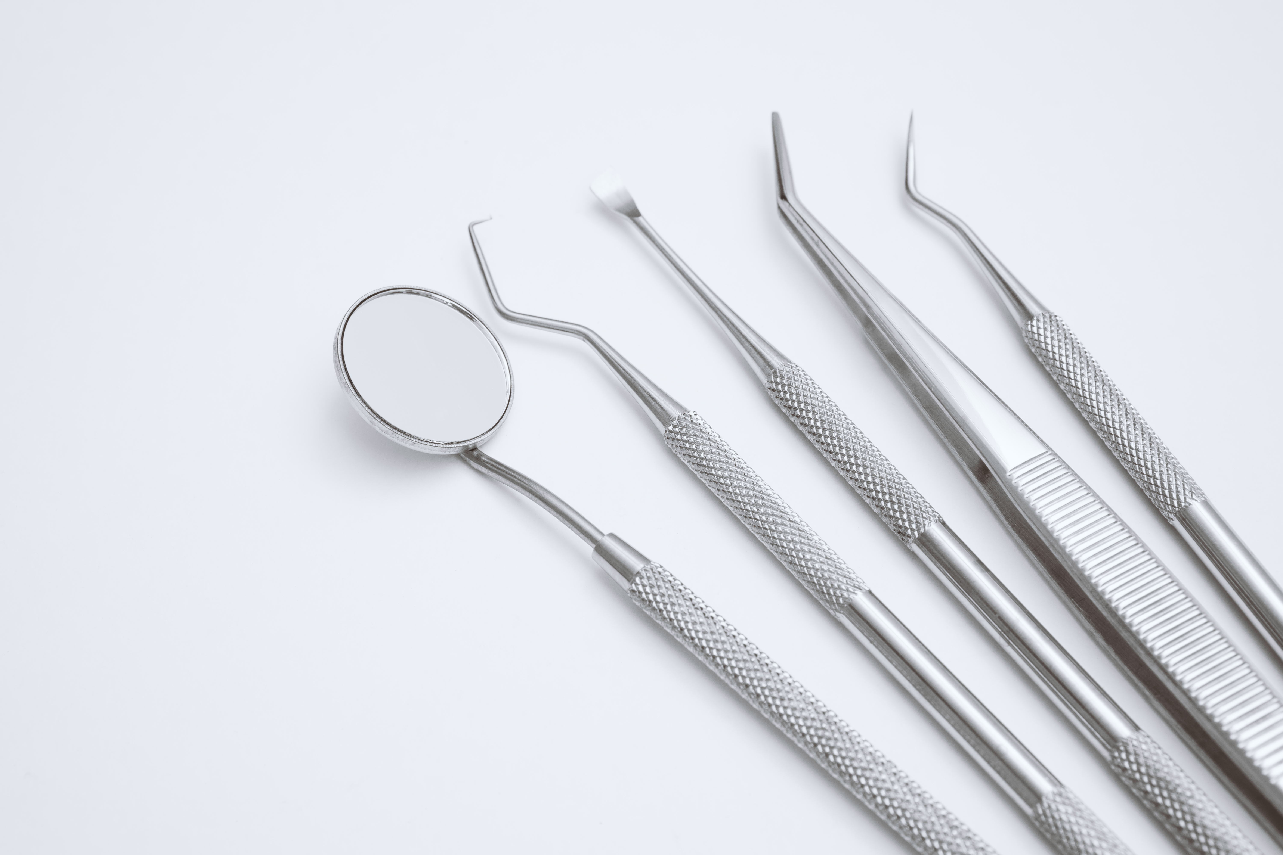

ICD-10-PCS Characters
Character 1: Identifies the general type of procedure.
Character 2: Indicates the general body system where the procedure was preformed.
Character 3: Identifies the objective of the procedure.
Character 4: Indicates the specific anatomical site of the body system where the procedure was preformed.
Character 5: Identifies the technique used to reach the site of the procedure.
Character 6: Used to specify devices that remain after the procedure is complete.
Character 7: Contains unique values for individual procedures.
The procedure coding system contains a code structure of seven alphanumeric characters, each character contains up to 34 possible values. In order to build a code, there are 7 characters needed. Every single individual character has something to do with the procedure and specific section, body part body system, approach or root operation.

Slide 12


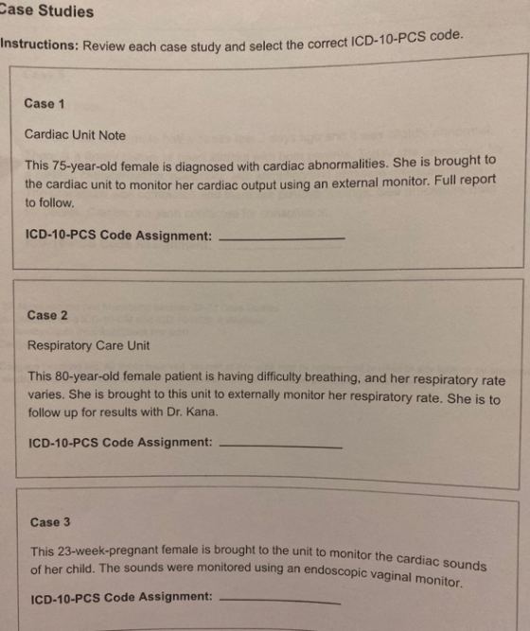
To create a PCS code using the PCS alphabetical index and code tables you must first figure out the root operation. You can look up each root operations and their meanings in “appendix A”. Once you found the correct root operation in the index, which contains a list of 3 to 4 characters, you must proceed to a specific body part and body system. That way you are able to build a pcs code from the table, remember to always have a 7-character code format and to choose the correct characters from the appropriate rows/columns.

Slide 13

PCS Codes
Pcs codes are used in inpatient facilities to code procedures, pcs codes should always have 7 characters to build a code. Section, body system, root operation, body part, approach , device, and qualifier are always included when building a pcs code.
Example: The patient is a 27-year-old female who had a biopsy of the right cornea with open approach.
The root operation for biopsy would be excision.
Look for excision of cornea specifically the right side in the alphabetical index.
Look for the body system, in this case it’s the eye.
Go to the medical and surgical section, eye tables and build code using the table.
Section(0) medical and surgical, Body system (8), Operation: Excision, Body part: cornea-right, Approach (0) open, Device: (Z) No Device, Qualifier (Z) No qualifier
PCS Code = 08B80ZZ

Slide 14
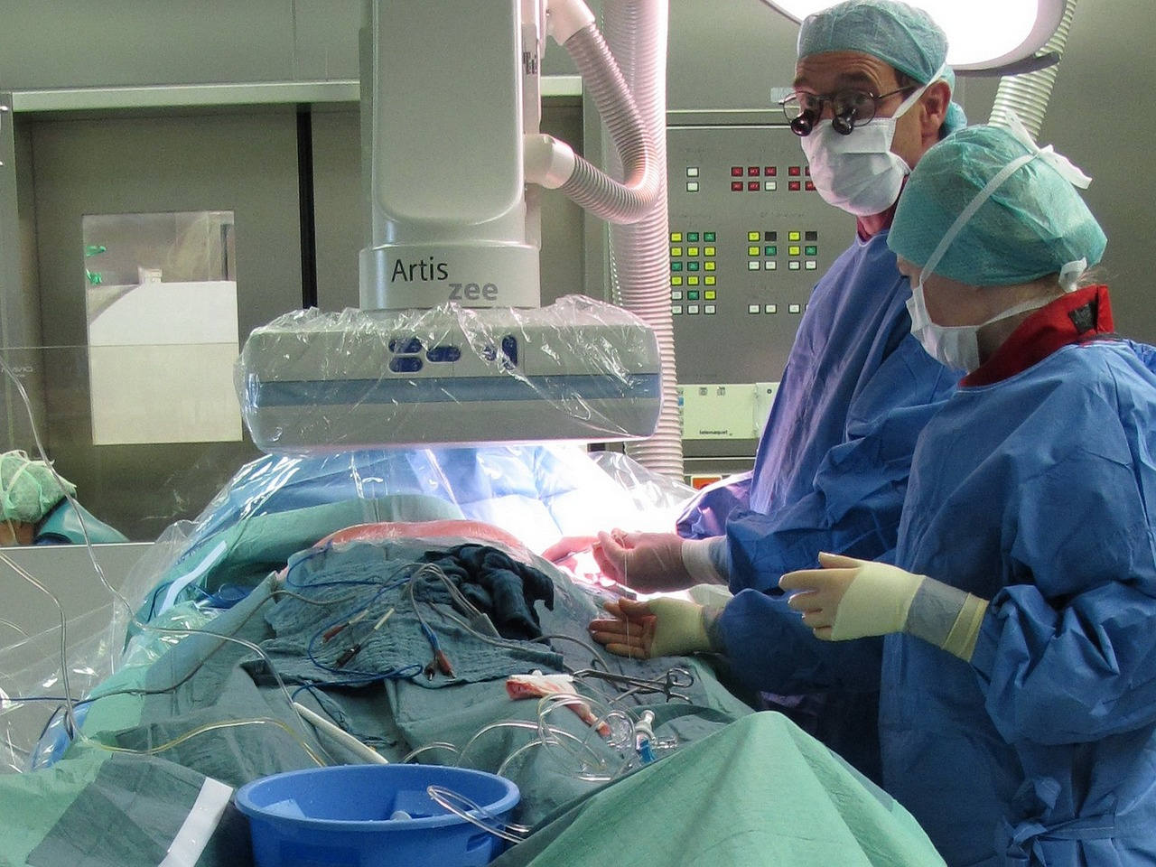
ICD-10-PCS ROOT OPERATIONS
Root Operations: Are based on the objective of the procedure, when trying to determine a root operation ask yourself what is the provider trying to accomplish. Root operations are at the beginning of trying to assign a code for procedure and are always the 3rd character.
Let’s take a look at 4 root operations:
1.) Excision: Cutting out or off, without replacement, a portion of a body part.
2.) Removal: taking out or off a device from a body part.
3.) Resection: Cutting out or of, without replacement.
4.) Replacement: Putting in or on biological or synthetic material that physically takes the place and/or function of all or portion of a body part .

Slide 15


