Slide 1


Portfolio Project
This Photo by Unknown author is licensed under CC BY-SA.
Ashley rhodes
October 1, 2022
Bryant & Stratton College
Sosc102- Principals of Sociology

Slide 2
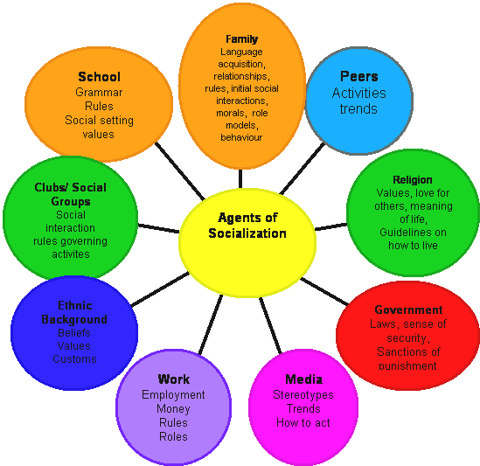
What is Sociology & why is it important?
Sociology is the study of social life, social change, and the social causes and consequences of human behavior
Agents of socialization- Significant individuals, groups, or institutions that influence our behaviors, norms, and values
Examples of social agents:
Family
School
Media
Peer Groups
The workplace
This Photo by Unknown author is licensed under CC BY-SA-NC.

Slide 3

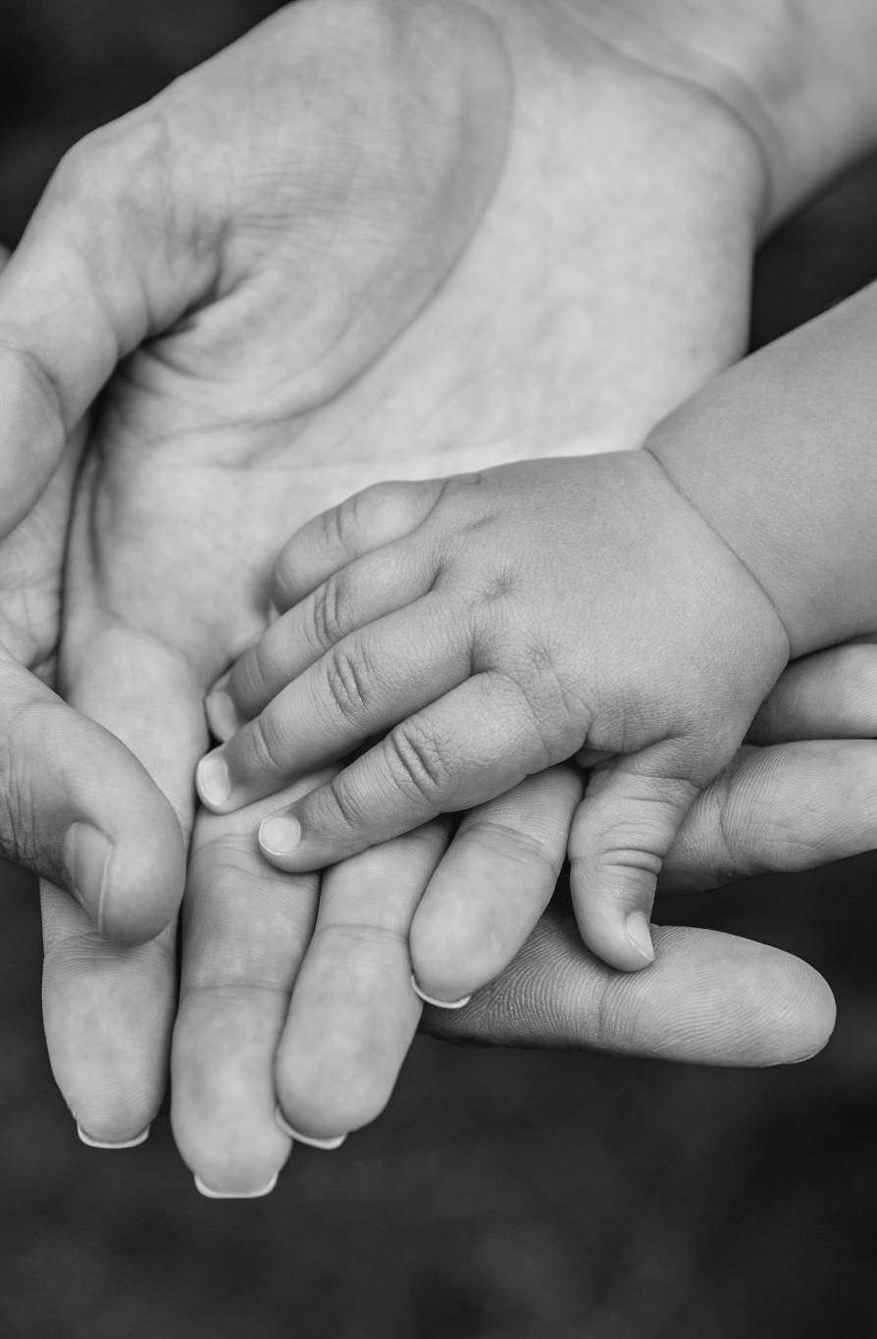




Families are the first and most important agent that we encounter.
Family teaches us what is socially acceptable
What we learn from our parents and siblings usually sets the standard of the norms and values.
Our organization is like a family! We build and grow together!
FAMILY

Slide 4
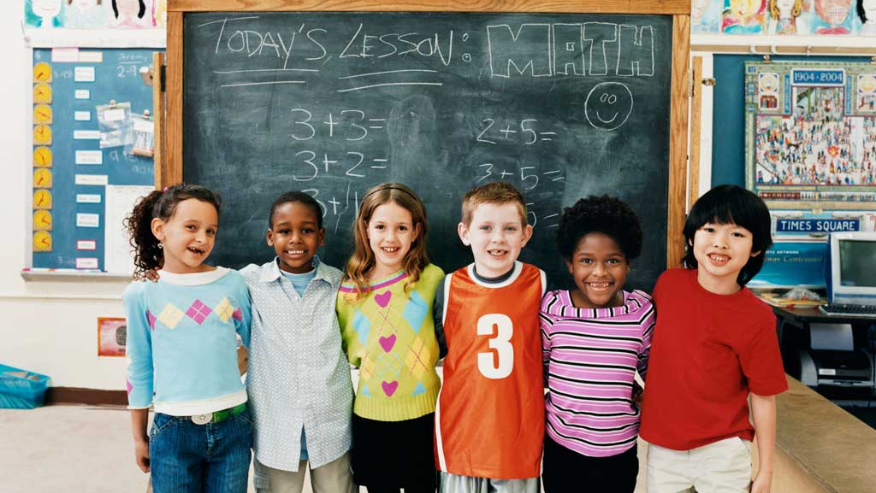
School
School is believed to be the second socialization agent that we encounter.
School prepares a child's mind to become more open of the world.
School teaches us about diversity
School will prepare us to be socially acceptable for a workplace environment.
School will help create social skills needed in the workplace.
This Photo by Unknown author is licensed under CC BY-NC-ND.

Slide 5

MEDIA
The media plays an important role in the workplace.
You can receive and deliver information to anyone anywhere by using media.
In the workplace, we use media as a form of communication
We can effectively communicate with employers and clients.
Media can influence our thoughts and beliefs
Media can assist with marketing and promoting our organization
This Photo by Unknown author is licensed under CC BY.

Slide 6

Peer Groups
Peers play an important role in our social life – positive and negative ways
Peers will help develop your social life
You can socialize with positive or negative influences
Peer groups allows us to socialize with people of our own age and beliefs
Your peer group may change in a diverse work environment
This Photo by Unknown author is licensed under CC BY.

Slide 7

The Workplace
The workplace environment creates a diverse space
We are subjected to socially interact with others that may be different than us
The more diverse the atmosphere is in the work environment, the more likely you are to interact with others
As an adult, we will likely socialize more with the people we work with.
This Photo by Unknown author is licensed under CC BY-SA-NC.

Slide 8

Religion
Religion plays an important role in the workplace
We learn about people's beliefs even if they are unlike our own
Religion allows us to come together with people of similar beliefs
This Photo by Unknown author is licensed under CC BY-NC-ND.

Slide 9
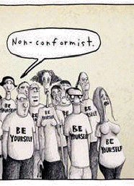
Deviance
Violation of "social norms"
Not conforming to what is socially acceptable as a norm
Deviance in the workplace can be caused by stress and lack of leadership
Deviance is looked at in a negative way
Deviance can result in disciplinary action
This Photo by Unknown author is licensed under CC BY-SA-NC.

Slide 10

Social Inequalities
Social factors and social change equals social inequalities
Some issues related to social inequalities are:
        Racial discrimination
        Gender discrimination
        Age
        Ethnicity
        Education
        Social Class
This Photo by Unknown author is licensed under CC BY-NC-ND.

Slide 11
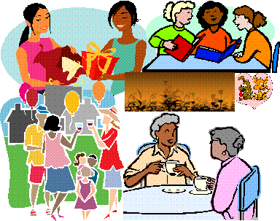
Conclusion
Socialization is a life-long process of an individual or group learning what the expected norms are through social interactions. There are many factors that teach us socializing skills.
This Photo by Unknown author is licensed under CC BY-SA-NC.

Slide 12
References
https://psych.la.psu.edu/research/social-inequality#:~:text=Social%20inequality%20refers%20to%20differential,and%20other%20important%20social%20markers.
population. (2013). In K. Bell (Ed.), Open education sociology dictionary. https://sociologydictionary.org/population/
religion. (2013). In K. Bell (Ed.), Open education sociology dictionary. https://sociologydictionary.org/religion/

