Slide 1
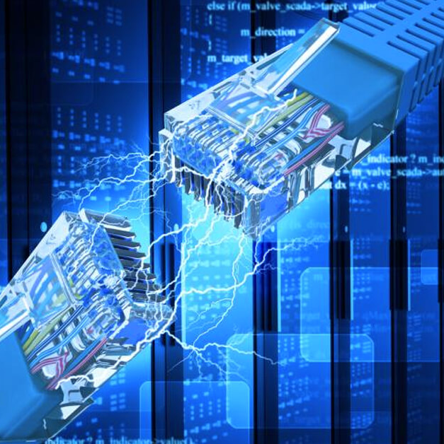

A Tale of Two Subnets
TECH151
Dennis DeWaters
October 9, 2021
N. Luster
Notes:
Hello everyone and welcome to "A Tale of Two Subnets." Throughout this presentation, I will touch on a few subjects involving IP addresses and their classes, subnetting, and routing to give cohesion to setting up IPC's management and floor staff with separate subnets. Hopefully, the talking points should also leave everyone feeling a little wiser about working in a networked environment.

Slide 2
The Situation
Intelligent Product Controllers (IPC) has 80 employees: ~53 main floor production employees and ~27 upper management employees on the first floor
Requesting two subnets to compartmentalize and systematize information between production room employees and management
Notes:
It's clear that the current network implementation doesn't adequately meet IPC's needs. With a 1:2 ratio of managers to employees, dividing the network's IP addresses into 2 smaller subnets will increase network performance and security, while efficiently handling future administration needs and network growth. "But what is an IP address," you ask; "what does a 'subnet' even do," you may wonder? Let's explore these more in-depth.

Slide 3
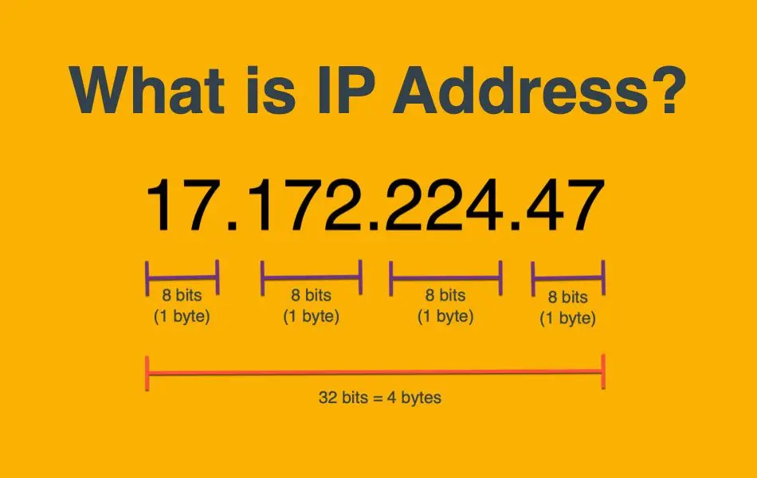
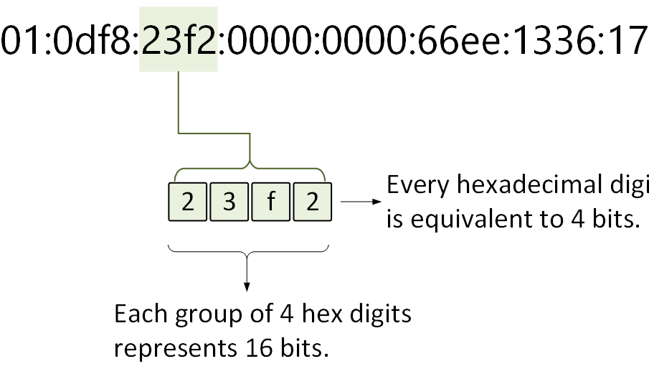
What is an IP address?
IPv4
IPv6
Notes:
Starting with an IP address, this is most commonly a sequence of 4 numbers separated by dots that provides a form of asset management on a network. IP, or "Internet Protocol," determines what kinds of data go out to either the internet or a local network. Try to think of it like a home or business address: a truck full of pillows wouldn't do much good at your home or a call center, so a furniture store's address allows the truck driver to identify where to go and what to deliver. There are two kinds of IP addresses: the most common one, which will be the focus going forward in the presentation, is IPv4. IPv4 addresses contain 32-bits (or 4 bytes) of address space; deferring to the home analogy, an IP address exists for roughly half the population of the planet. There is also an IPv6 address, which functions the same way as an IPv4, though they contain 4 hex digits, and 8 different sections where each number equals 2 bytes; mathematically, the world's population would have enough IPv6 addresses for everyone to have 10 octillion of their own IPv6 addresses. Since we're dealing with 80 people, let's continue with IPv4.

Slide 4

What is a subnet mask?
Notes:
In deference to what an IP address was, a subnet mask is another 32-bit address, with the important difference of distinguishing between a network's IP address and a host's IP address. Moving forward with the more relatable home analogy, an IP address will get you to the house, and the subnet mask will tell you which room you're supposed to go into.

Slide 5
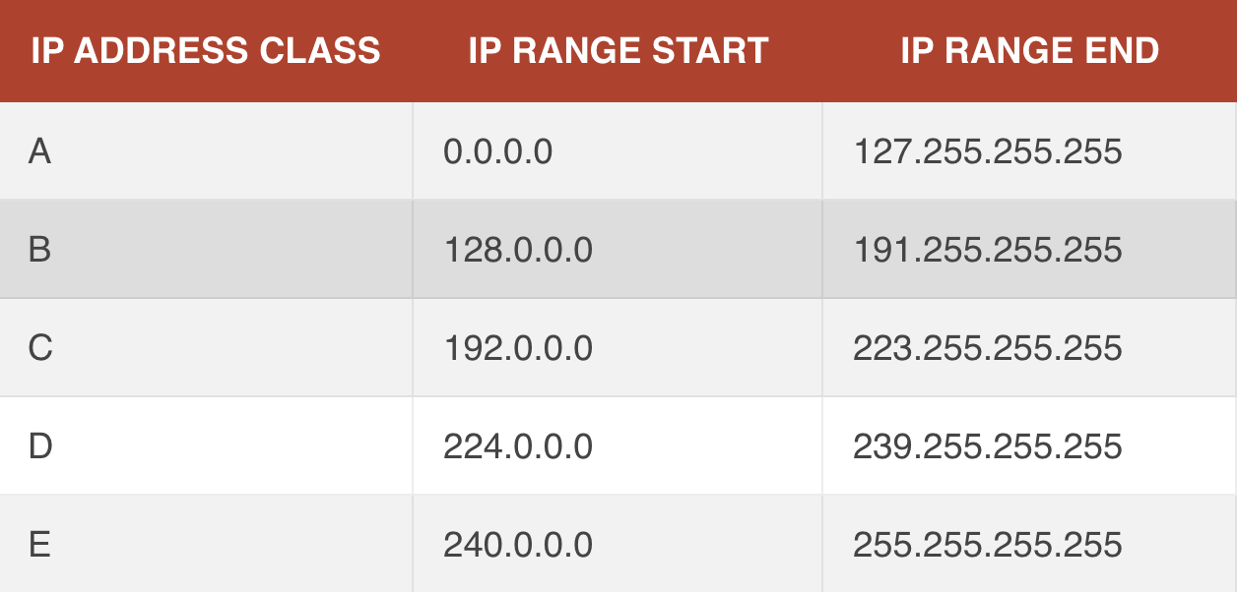
IP Address Classes
Notes:
Since we now know a little about IP (Internet Protocol) addresses and subnets, let us move into IP address classes. With distinct parts of the octet used to show a network, the remaining octets help find hosts within a network. There are 5 IP address classes, each one defined by a letter: A, B, C, D and E and defined by the first octet range. Each successive letter will shift both network and host identification, making finding the differences simple.
For A class IP addresses, the first octet identifies the network, and the other 3 octets identify as hosts. This class of IP addresses’ first octet is between 0 and 127. Larger networks usually use A class, capable of supporting 16 million hosts. Adding an octet to the network identifier and removing one from the host identifier, B class IP addresses have a first octet between 128.0.0.0 and 191.255.255.255. Smaller networks make use of B class networks, which support up to 65,000 hosts. Moving in the same pattern, C class IP addresses consist of a first octet between 192 and 223. Used usually for home networking or basic networking needs, this class supports up to only 254 hosts.
Classes D and E are rarely used, if ever; address classes also do not involve using IPv6.
Another way to classify IP addresses is through a VLSM (variable length subnet mask), which identifies network bits with a number at the end of an IP address. For example, 192.168.1.1 would have a /24 at the end of it, denoting 3 octets for the network, making it a class C IP address.

Slide 6
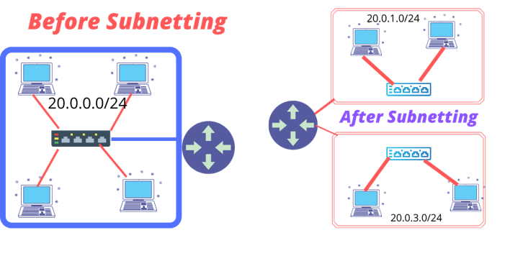
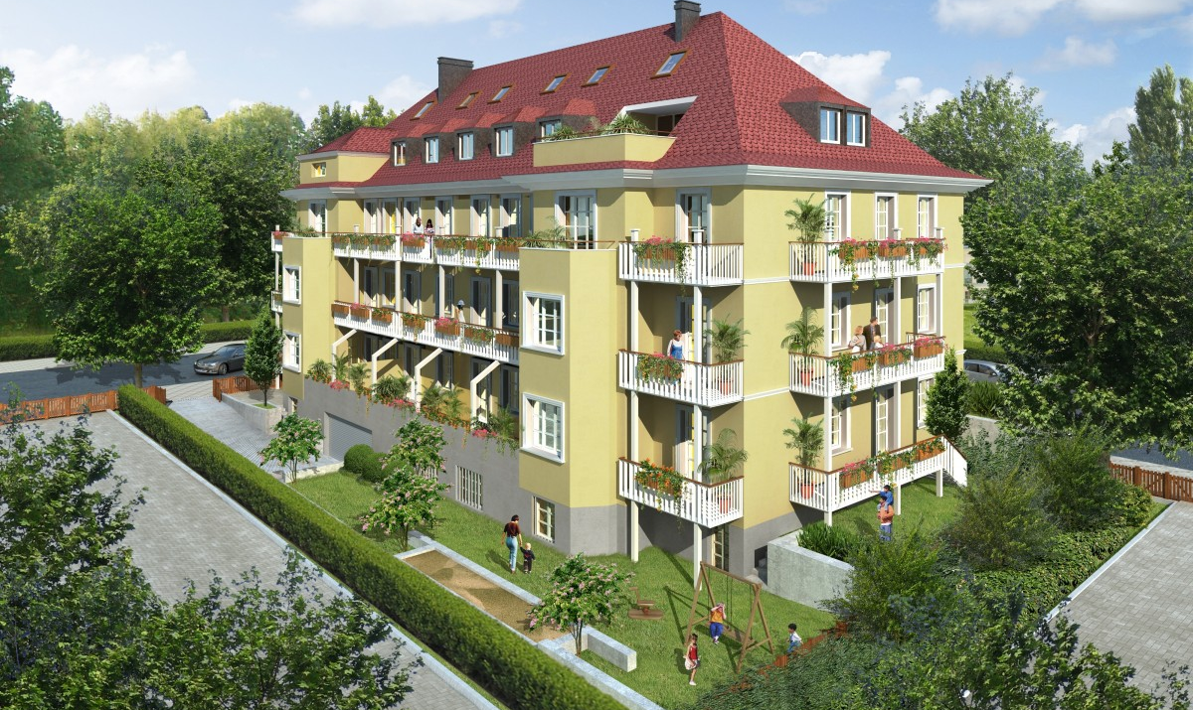
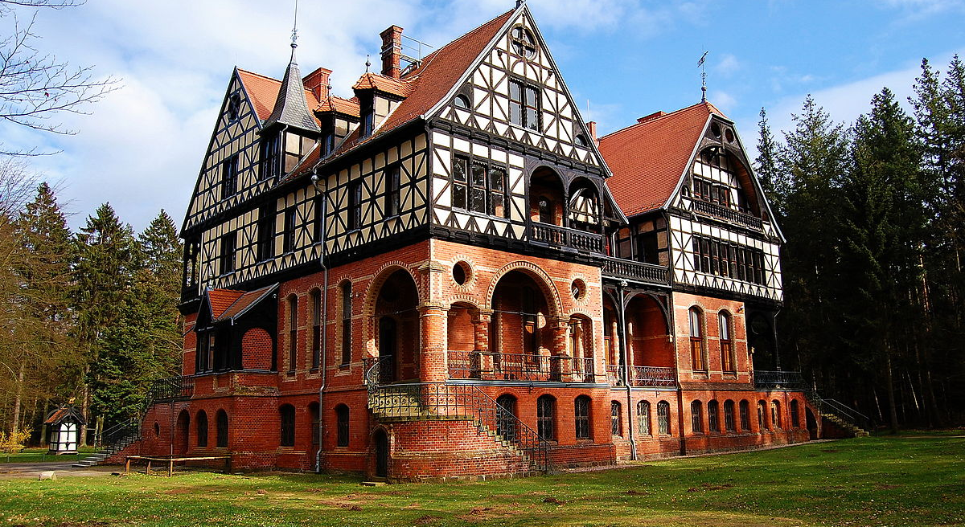
What is subnetting, anyway?
Notes:
A subnet, or subnetwork, is a segmented piece of a larger network. More specifically, subnets logically partition (or separate) IP networks into multiple, smaller network segments. In continuation of the housing analogy, subnetting would be similar to taking something like a mansion, and dividing it into a duplex or multiplex to accommodate more than one family.

Slide 7
Subnet Layout: 192.168.180.1/25
Network Address:192.168.180.0
Subnet Mask: 255.255.255.128
Range of Host addresses:
192.168.180.1 - 192.168.180.126
192.168.180.129 - 192.168.180.254
Each subnet's broadcast address:
192.168.180.127
192.168.180.255
Notes:
The network address is 192.168.180.0 with a subnet mask of 255.255.255.128. This splits IPC's network into 2 usable subnets with 126 hosts (or devices) per subnet. Each subnet's broadcast address is 192.168.180.127 and 192.168.180.255, making the range of available host addresses from 192.168.180.1-192.168.180.126 and 192.168.180.129-192.168.180.254, respectively.

Slide 8
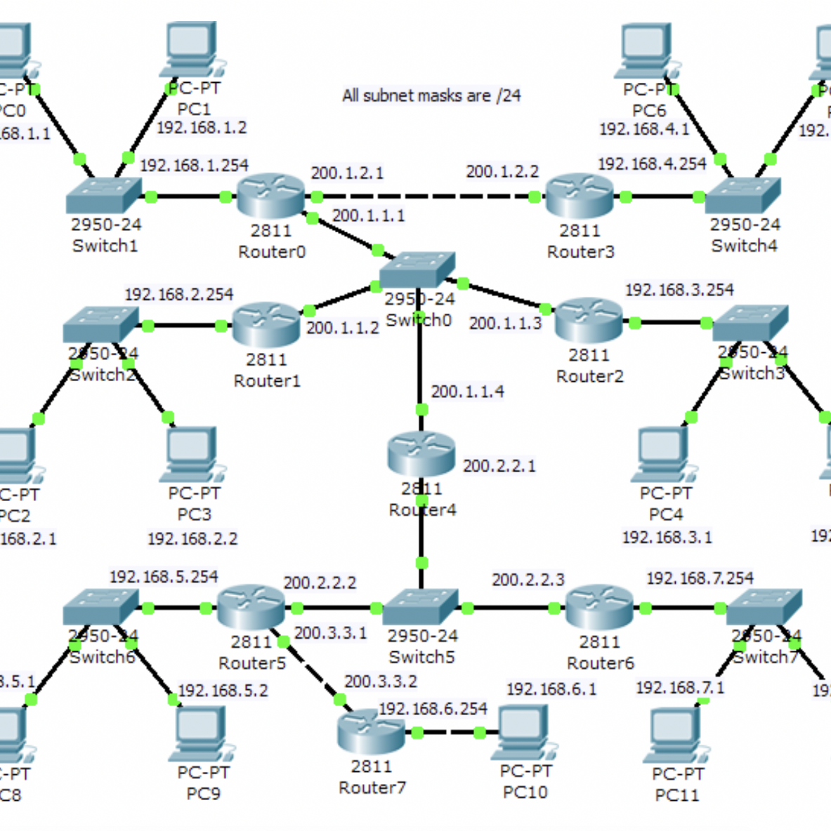
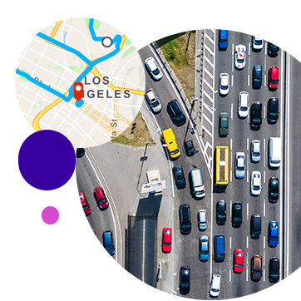
What is routing?
20
Notes:
Routing is the way information travels along a given path between networks. From cell phone networks to traveling to your relatives’ in a neighboring state, finding the best route has multitudinous applications. In an instance like the internet, routing makes paths for packets of information – from start to finish. Just like police officers standing in an intersection route driving traffic, routers direct networking traffic. In deciding how to route information along network paths, routers use routing tables to get the best layout of how information should best traverse a network. In using the traffic analogy, think of a routing table as choosing whether to “avoid highways and tolls” when going on a road trip; while it may not be the “fastest,” it’s generally more scenic, and avoids toll costs.

Slide 9
Routing: Simplified
Routers connect devices within a network by forwarding data packets between them.
This data travels between devices, or from devices to the internet.
Routers assign local IP addresses to each of the devices on the network.
Notes:
Essentially, a router receives information, reads the the destination information (also called headers), then figures out the best way to route the information based on its routing tables. Routers do this millions of times a second with millions of packets. As a packet travels to its destination, it may be routed several times by different routers.

Slide 10
Static vs. Dynamic Routing
Static (nonadaptive)
      No extra bandwidth
      Granular control of router
      Topology changes require manual intervention
      No fault tolerance
      Not ideal for larger networks
Dynamic (adaptive)
      Simpler configuration
      Fault tolerance
      Chooses optimal route in case of toplogy change
      Consumes extra bandwidth
      Chooses from several different protocols; not the same each time
Notes:
Let’s discuss static routing and dynamic routing. Put simply, they decide the best way a packet gets to its destination. As its name implies, static routes manually, before any network communication takes place; whereas dynamic routing learns network pathing through a router-to-router information exchange.
Static routing (also called nonadaptive routing) defines routes in the event of a single, or preferred route for network traffic. By using small routing tables containing one entry for each destination, and because each route is preconfigured, static routes use less bandwidth than dynamic routing. The catch is that administrators must manually configure routes in the event of changes to the network. Ideally, static routes are best implemented for networks where no changes occur, anyway.
Sometimes referred to as “adaptive routing,” dynamic routing’s complexity creates more potential routes than static routing to send information over a network. Instances in which static routing proves challenging in maintaining and reconfiguring, dynamic routing proves invaluable for larger networks. Using algorithms to figure out a multitude of possible routes while determining the best network path, dynamic routing uses two types of routing categories: link state protocols and distance vector protocols. These protocols create routing tables including a designation for each possible network destination, network group, or specific subnet, specifying which network connection is best in the event of any network infrastructure changes. In contrast to static routing, because of the complicated routing paths, dynamic routing uses more bandwidth than static routing.

Slide 11
Routing Protocols
RIP
OSPF
EIGRP
Notes:
As mentioned previously, dynamic routing employs different categories of routing protocols. Three of these are RIP, OSPF, and EIGRP; RIP is a distance vector protocol, OSPF is a link state protocol, and EIGRP is a hybrid of the two.

Slide 12
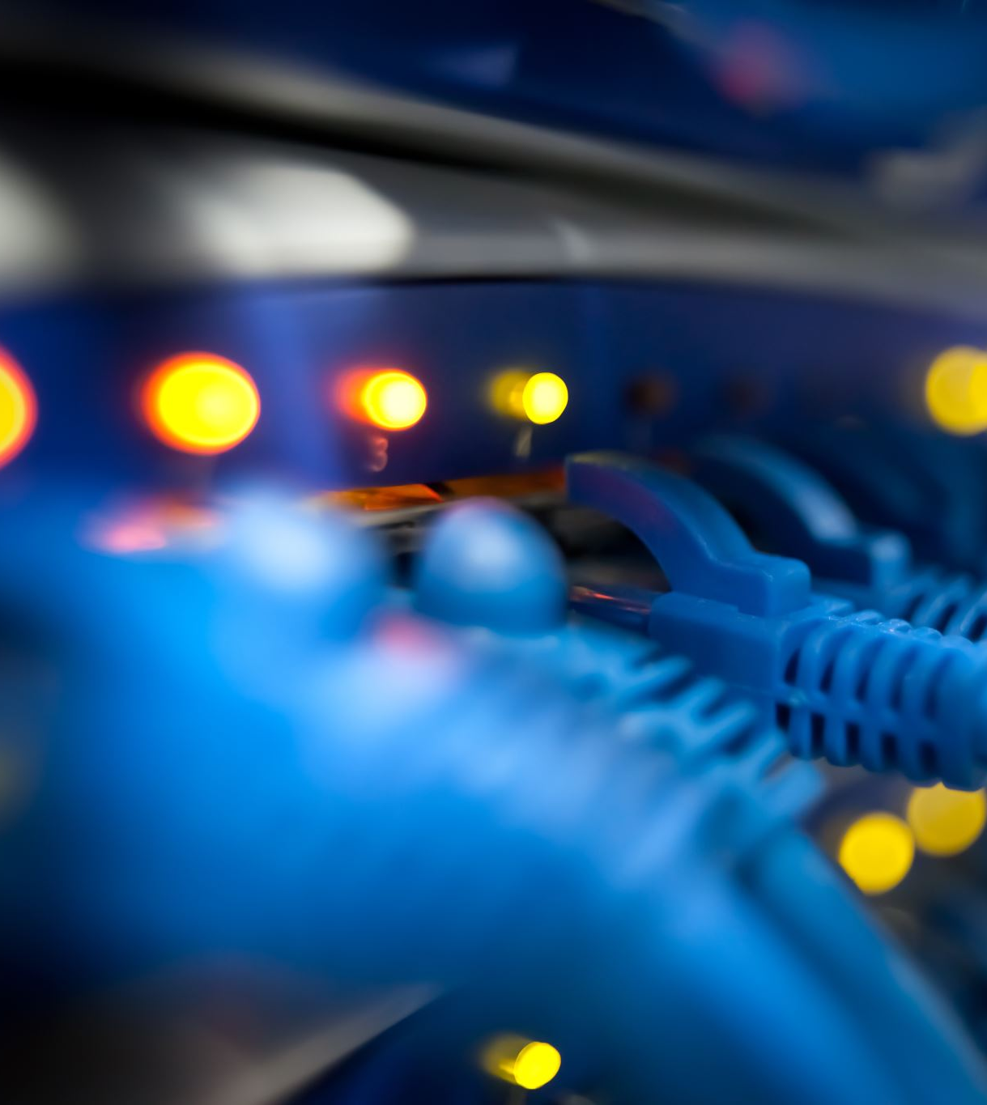
RIP (Routing Information Protocol)
Distance vector protocol
Maintains routing table of nearest routers
Uses hop count as a routing metric (up to 15 hops [or routers])
Broadcasts its entire routing table every thirty seconds
Notes:
Routing Information Protocol (or RIP) uses a distance vector algorithm to decide which path to put a packet on to get to its destination. Each RIP router maintains a routing table, which is a list of all the destinations the router knows how to reach. Each router broadcasts its entire routing table to its closest neighbors every 30 seconds.
Although a relatively simple routing protocol, since RIP uses hop counts to find the best route for a network, there is a good chance it could use a suboptimal route. Supposing two routes exist between two networks, where one route has a single hop, and the other route has two hops, RIP will always pick the route with fewer hops – even if the other route has the faster connection overall.

Slide 13

OSPF (Open Shortest Path First)
Link state protocol
Sends out information updates instead of the entire table
Maintains logical topography
Divides networks into “areas”
Notes:
A link-state protocol, OSPF (or Open Shortest Path First) listens to neighbors and gathers available information to build a virtual map of available paths in a network, then saves the information in its Link-State Database (LSDB).
From the information gathered in the LSDB, it calculates the best shortest path to each network while compiling three tables to store the information. Firstly, a Neighbor Table – as its name implies – generates information about its neighboring connections. Next, a Topology Table, which (also as its name implies) generates a kind of map with the information about all the best, shortest paths to take to which destination. Finally, a Routing Table, which has all the best paths currently working, to send traffic to its neighbors. This manner of “logical topography prevents OSPF from sending out its entire table each time it wants to figure out the most efficient way to transmit data.
OSPF also divides routers in its topology into “areas” made up of a group of connected routers. This helps to ease the load on the network while making the best use of resources like memory and bandwidth. The “main area” – or the backbone area (Area 0) – needs all other areas connected to it to function correctly. A given area’s boundaries keep a network “contained” in that they mitigate the impact a sudden change in topology might have.

Slide 14
EIGRP (Enhanced Interior Gateway Routing Protocol)
Hybrid protocol (link state and distance vector)
Unlike RIP, manual route summarization configured on arbitrary network boundaries to reduce the routing table size.
Requires less processing power and memory than OSPF
Exchanges the full routing table at startup, and then partial routing updates thereafter.
Uses a composite number for the metric, which indicates bandwidth and delay for a link. The higher the bandwidth, the lower the metric.
Notes:
Last, but certainly not least, is EIGRP – or Enhanced Interior Gateway Routing Protocol. Also known as a “hybrid” protocol, it combines features of both link state and distance vector protocols.
EIGRP doesn’t suffer the same issues as RIP or OSPF. It’s still a distance vector protocol, but it comes along with a lot more metrics than just the hop count, which makes it a link state as well.
And since EIGRP only sends an entire routing table once, each subsequent time it only sends information it needs to , making it more robust and efficient than OSPF.
Unlike RIP’s limiting 15 hop count, EIGRP has a hop count of up to 255; though it can be made to whatever metric suits the network’s needs. To reduce the load on the network, the network’s broadcast interval also happens 3 times less than RIP and 2.25 times less than OSPF; the only catch in this instance is an increased convergence time or – as opposed to OSPF – an increased amount of time to find the “best path.”

Slide 15
Summary
IP Addresses and their classes
Subnet and subnet mask
Routing; static and dynamic
Routing protocols
Create two subnets: one for production floor staff and one for management
Notes:
We discussed what an IP address was and the various classes of IP address schemes; we also discussed the distinction between a subnet and a subnet mask relative to IP addresses on a given network; We also discussed Routing – both static and dynamic – and the differences between the two types, including the environments in which they best performed; we also discussed (though not exhaustively) different routing protocols – including Routing Information Protocol or RIP, Open Shortest Path First Protocol or OSPF, and Cisco’s proprietary Enhanced Interior Gateway Routing Protocol or EIGRP. Per IPC's request, dividing the current network from one subnet into two would minimize network congestion, while routing production staff's and management staff's network traffic to their appropriate destinations. I hope you’ve enjoyed this presentation, and I hope IPC can move forward in their growth with networking confidence.

