Slide 1


NETWORKING PORTFOLIO PROJECT
NEWT151
Samantha Beecham
2/6/2022
Daniel Butler

Slide 2
INTRODUCTION
What is an IP Address & Subnet Mask
IP Address Classes
Subnetting Design of IPC Network
Routing
Difference between Static & Dynamic Routing
Routing Protocols
References

Slide 3

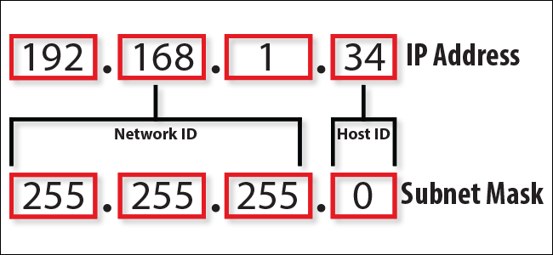
What is an IP Address & Subnet Mask
IP Address means (Internet Protocol) Address. Used for routing traffic.
All IP Addresses contain a subnet mask, and identifies the range of IP's within the subnet.
Utilized at layer 3 of the OSI model.
4 octets, which are each one byte of 8 bits making it 32 bits total

Slide 4
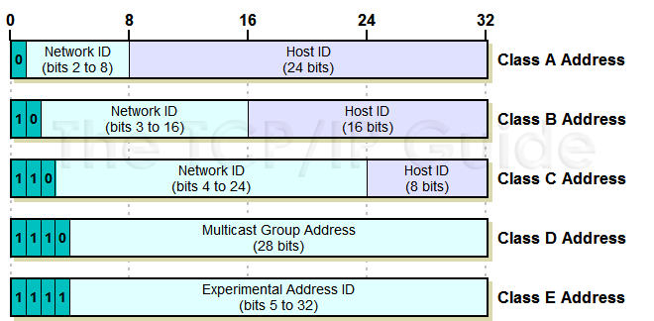
IP Address Classes
NETWORK ID & HOST ID
Class A
Large Number of Hosts
Higher order bit is 0
Range for IP prefix is 1-126
Class B
Medium to large networks
The two High order of bits are 10
Range for IP prefix is 128-191
Class C
For smaller networks
Three High order Bits set to 10
Range for IP prefix is 192-223
Class D
Reserved for IP multicast addresses
Class E
Is experimental reserved for future use
Network ID is the portion of the TCP/IP Address that is used to identify individuals or devices on a network.
Host ID is the portion used to identify Hosts such as a PC, Networked printer, or a network.

Slide 5
Subnetting Design of IPC Network
Static- (3 traits)
Administrator has full control over routing behavior
Easy to configure on a small network
Produces no traffic to other routers
Dynamic- (3 traits)
Straight forward to configure
Uses multiple algorithms and protocols
Enables routers to select paths according to real-time logical network layered changes

Slide 6
Routing Protocols
Routing Information Protocol (RIP)-
Dynamic routing protocol, Uses hop count as a routing metric to find the best path, Sends all or a portion of their routing tables in routing-update messages
Open Shortest Path First (OSPF)-
Uses a link state routing (LSR) algorithm, Used to distribute IP routing information, Used to find the best rout for packets
Interior Gateway Protocol IGP)-
Dynamic route update protocol used between routers that run on TCP/IP hosts, Used to exchange information about IP routes in large networks, Method for administrators to handle computer network traffic routes

Slide 7

Conclusions
What is an IP Address and Subnet Mask
IP Address Classes
Subnetting Design of IPC Network
Routing Protocols
References

Slide 8

References
Multiple Websites in Google
Instructor’s PowerPoint example
TestOut Assignments

