Slide 1

Distracted
Davina Wilson​​
Intro to Counseling and Case Management

Slide 2
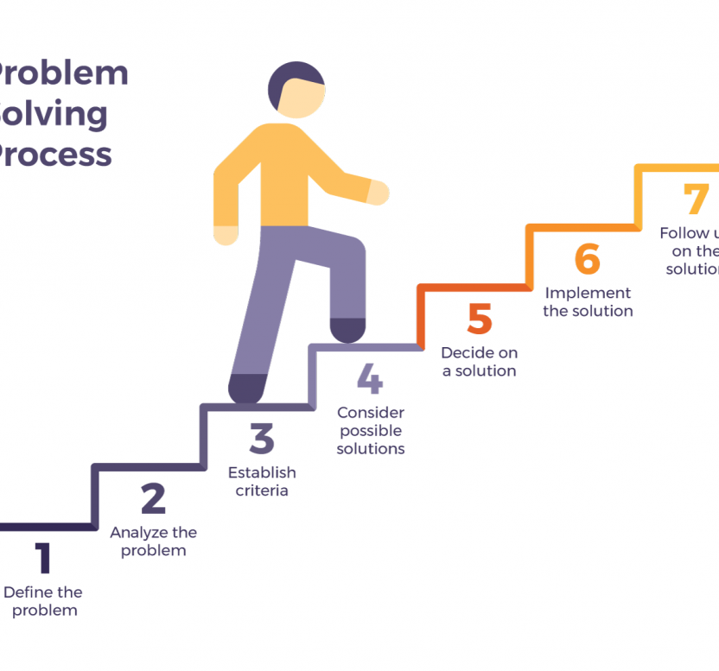
Case OVERVIEW
13-Year-old teen girl; lives with grandmother
Grandmother verbally abusive
Arianna aware she needs to change attitude
No contact with mother or father
Plans to live with grandmother go to school and get job
Does drink alcohol and smoke marijuanna

Slide 3
Goals
Family Counseling
Follow Through
Financials
Provide counseling for grandmother as well as Arianna.​
Get Arianna involved in teenage activities
As well as individual therapy
Provide activities for both grandmother as well as Arianna
Weekly Check-in for progress
Random visits to client's home
Seek financial assistance for grandmother
Look into teenage jobs for Arianna to occupy her mind
Individual plan
Stabilization
Allow Arianna to begin explaining what she needs and wants
Let her feel included in life plans
School/Graduation Plan
Provide aftercare case plan
Continued Check-ins

Slide 4
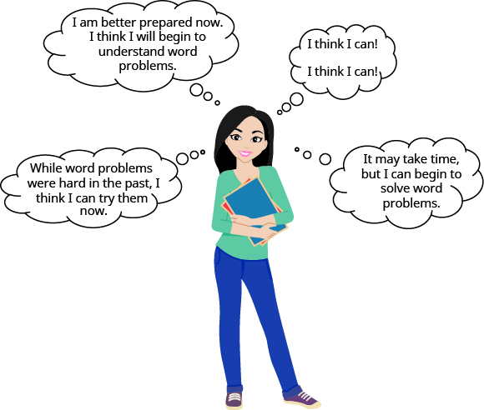
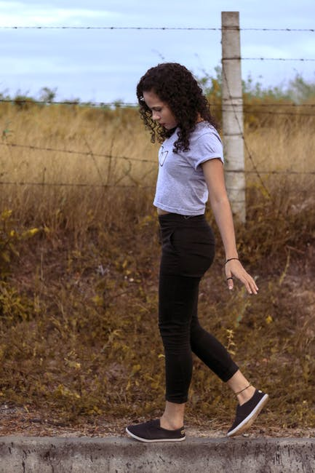


Solutions
Close the gap
Target
There seems to be a disconnect present between grandmother and grand child-
How do I determine what that is.
Arianna
Siblings
grandmother
Income
Progress
Implement a cares fund for grandmother to receive income for having custody of her grandkids.
Check-ins
Advancements
walk throughs
communication

Slide 5

PROGRAMS
TEEN TALK
School Activities
Teen talk groups like teens with solutions and outcomes
Include school guidance counsellor in plan
Daily tutoring
Weekly school work check​
Summer Activities
Job Readiness
By giving Arianna a focus, she will see the value in change and growth
Job leads for teens
Organizations that provide job training skill
This Photo by Unknown Author is licensed under CC BY-NC

Slide 6
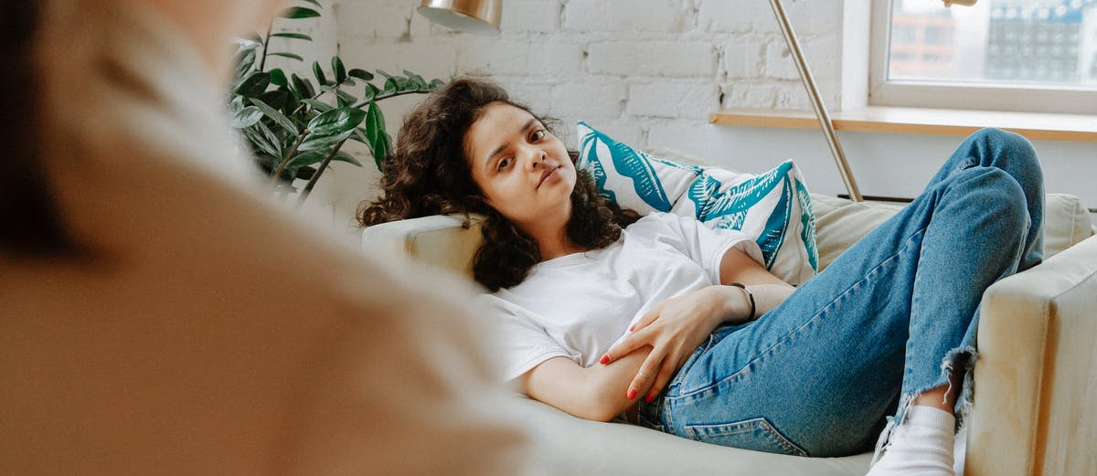
Summary
Established care plan
Ongoing case management
Psych evaluation for Arianna
Intensive therapy
Program selection
Success story

