Slide 1
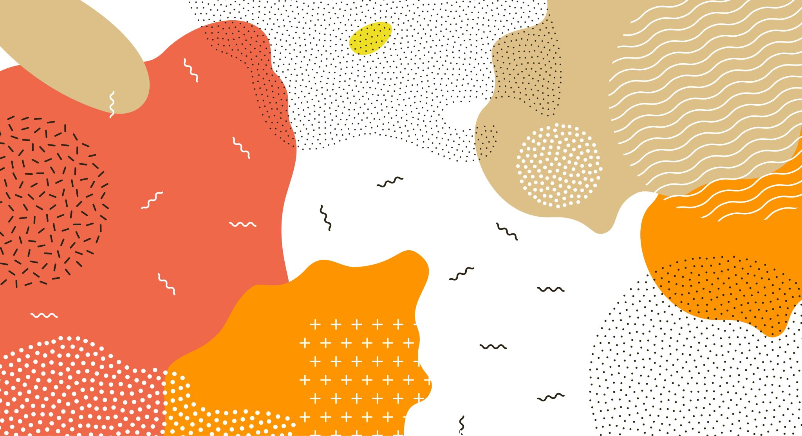
Contemporary Family Patterns, Trends, and Relationships Across Cultures, Class, and Ethnicities
ECED106 Portfolio Project
By Cheyenne Estep

Slide 2
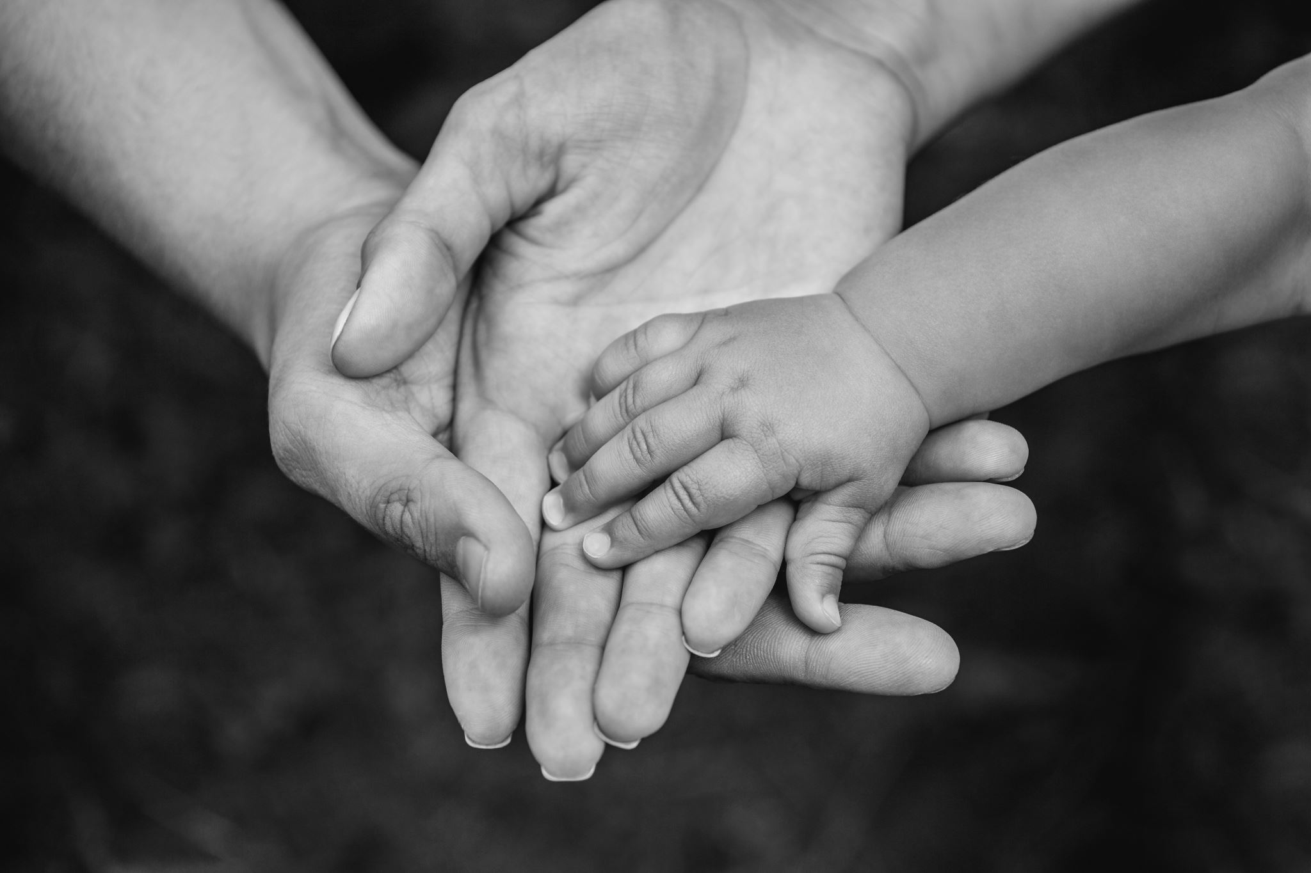
The Family
Families should be supporting and loving, respectful of how the child finds their personality and be there for everything.

Slide 3
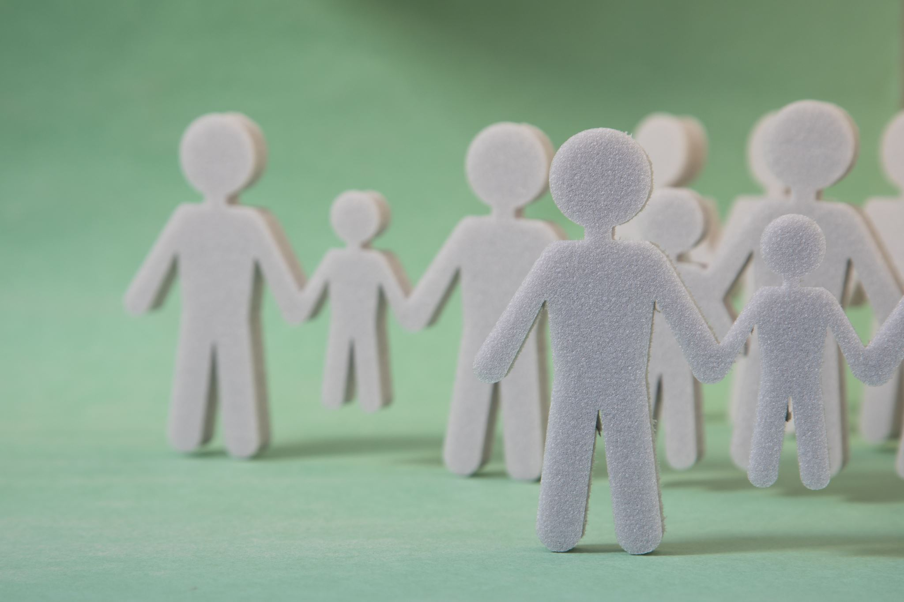
Trends in Family and Family Structure
Every family is different, so that means that every family does things differently, it is important to notice the different types of trends and structure, that way we can learn how the child does in certain situations.
Some children only have one parent, and some may only have grandparents, and some children may have them all and live in the same home as them.

Slide 4
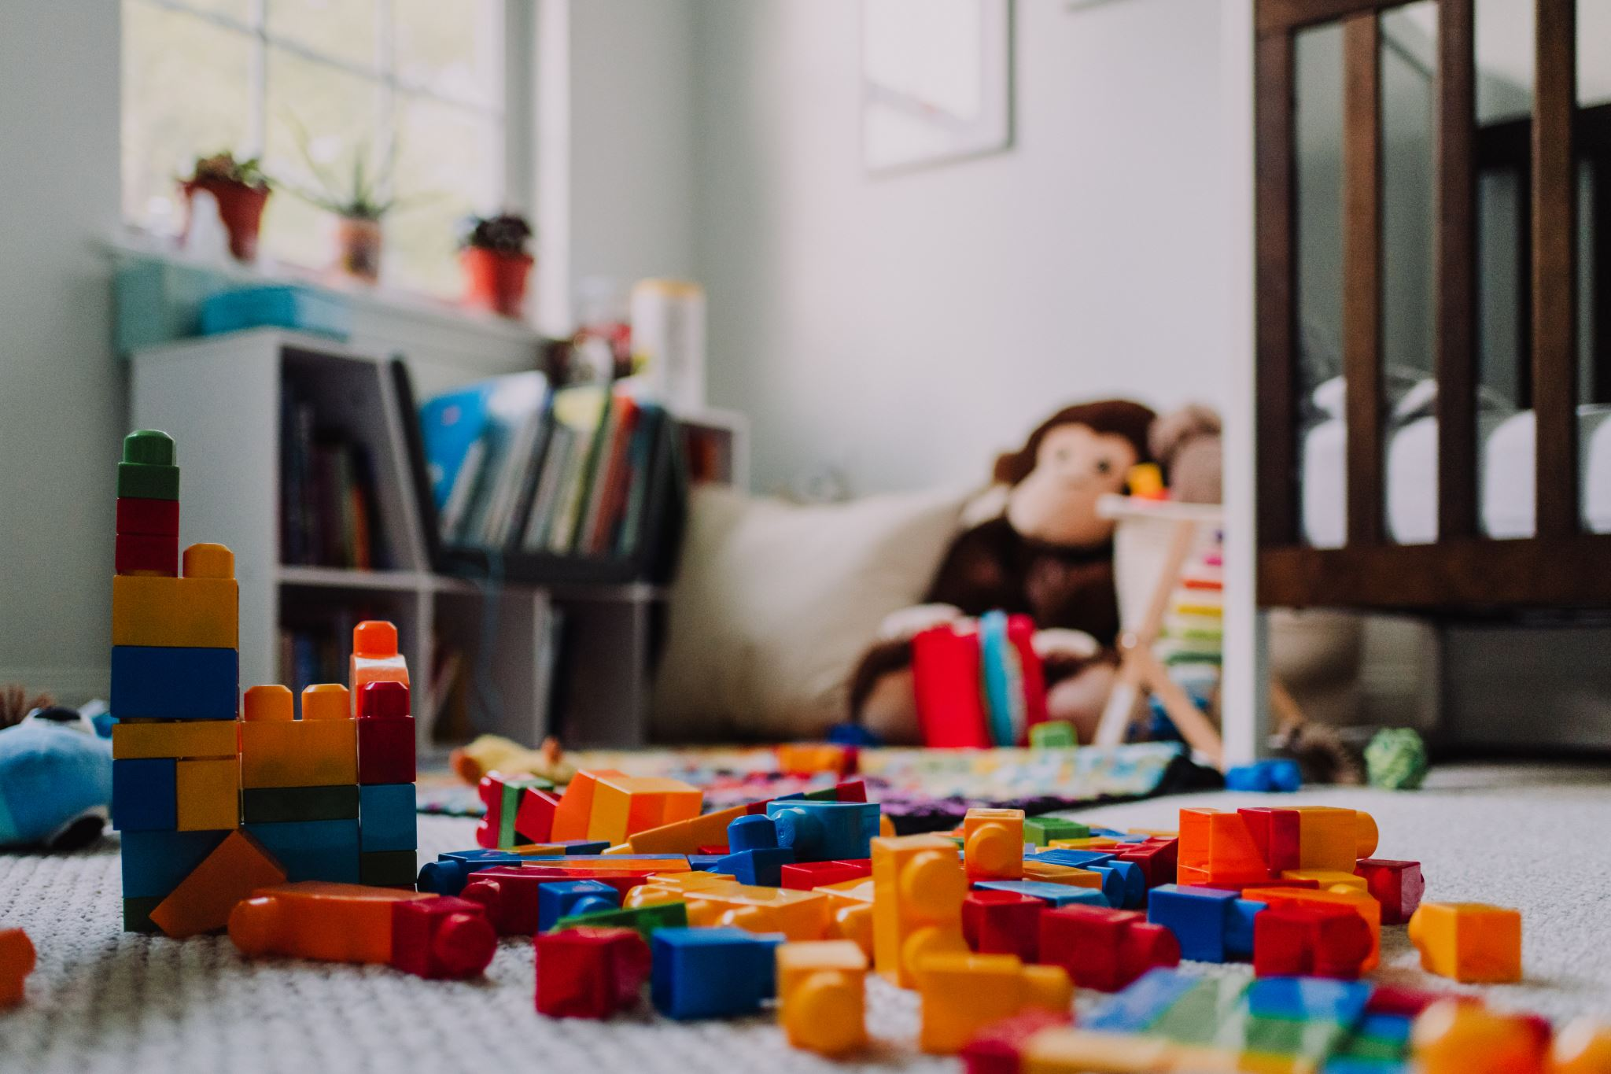
Impact of Family Trends on Student Learning and Teacher-Family Relationships
The impact of family trends defines the child in everything they do like how they think, learn, how they view life, how they interact with others.
It is important that teachers get involved with the family to see how the things are within the family.
Having a relationship with the family and children creates that bonding aspect.

Slide 5

Social class
Social class is based on income and how the family can meet the basic needs of their children
Upper class
Middle class
Lower class

Slide 6
Family and class connections
Family being involved in class is very important for the child's learn and bring them confidence
Family being involved in class sets up a great explain for the children
Family involvement in class helps the family keep the child on track in there learning experience

Slide 7
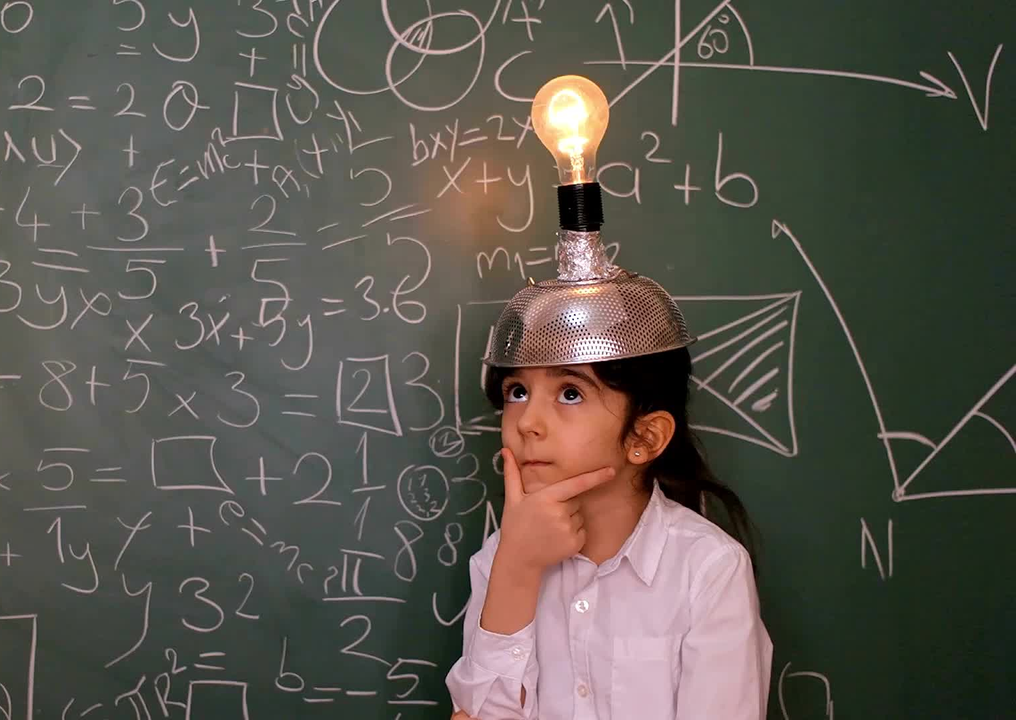
Differences in social classes
Upper class is where most of the child get the best education and are usually set up for great future's
Middle class is hard working family's whose children usually have pretty great set up future's as well
Lower class family's unfortunate must face more troubles than others and must work harder to achieve their goals

Slide 8
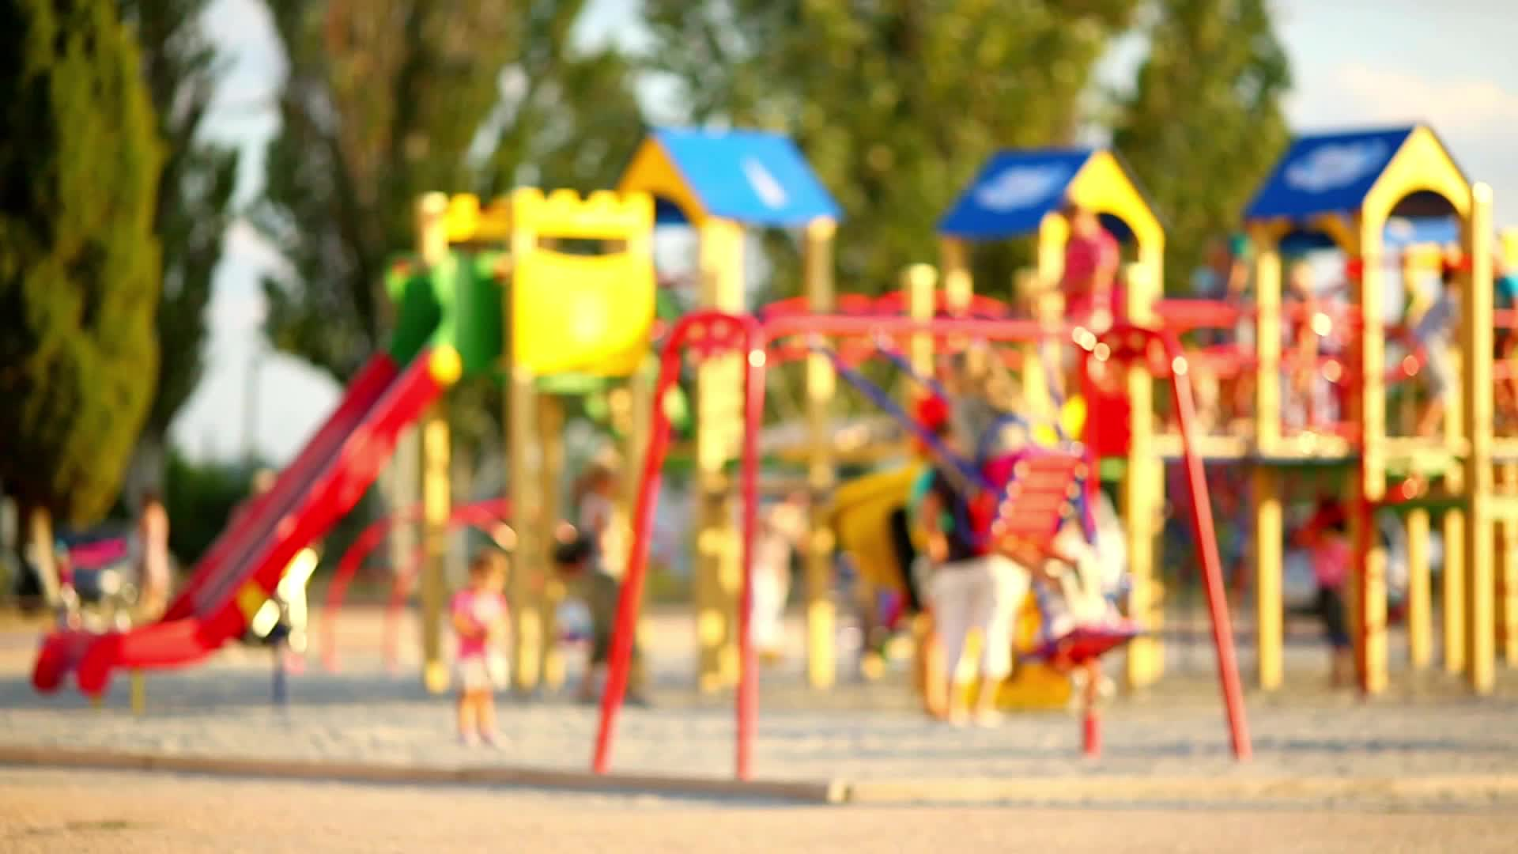
3 ways social class affects a child
The way they learn because some children don’t have support from family or some children's family never got knowledge their selves.
Attendance, some children may not have rides or people that help them with rides to attend school or school events
Social skill, some kids not get to have friends over or go to friend's house and lack more social skills than others

Slide 9

Culture and ethnicity
Ethnicity is the group of people that you are born into
Culture is the art or custom of different people

Slide 10
Different cultures around me
African American
Caucasian
Mexican

