Slide 1
Child growth and development age birth-8
Physical/ motor skills
Language/ communication
Thinking/cognitive
Social/emotional
Atypical development
Asher daycare
7am-10pm

Slide 2
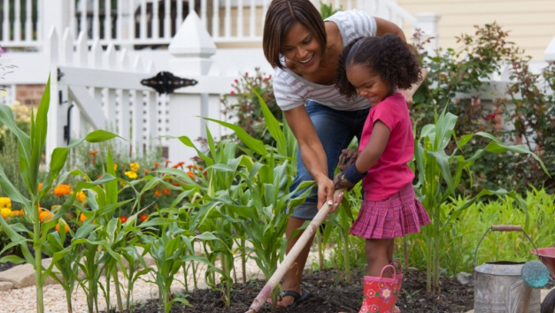
Birth to 1 year
Physical/motor skills
rolling over, crawling, moving around their environment, and walking
The infant begins to use their hands, reaches for and grasps objects, and uses a spoon
Atypical development
If the child is not interested in playing
Language/communication
Crying is the first way that an infant has of communicating. Then they move on to cooing and then add consonants to begin babbling.
infant will combine gestures with sound and play gestural games (like “so big” and “peek-a-boo”)
Atypical development
If the child is not pointing to communicate or not trying to move about
Thinking/cognitive
During the first year of life, infants can learn to imitate others and their facial expressions.
infant might do things like throwing objects off of their highchair to watch them fall and hear the noises the objects make when hitting the ground.
Atypical development
If the child does not make a range of sounds
Social/ emotional
Loving and positive relationships help children develop trust, empathy, com passion, and a sense of right and wrong.
a caregiver should look for ways to add the child’s home culture as part of their daily routine. This can be through reading books, listening to music, or even using some of the child’s home language
Atypical development
If the child does not react to loud noises or turn head towards loud noises
Notes:
NOTE: To change images on this slide, select a picture and delete it. Then click the Insert Picture icon in the placeholder to insert your own image.

Slide 3
1 to 3 Year
Physical/motor skills
All baby teeth are in
Can climb stairs one foot at a time
Can play catch
Can stand on one foot
Can start to peddle on a tricycle
Atypical development
If the child is unable to walk well.
Language/communication
Vocabulary and sentence length increase as children continue to master syntax and grammar.
At around 3 years old children begin to add helping verbs and negatives to their vocabulary. Preschoolers will also show signs of a desire to be independent through their words and actions
Atypical development
If the child does not speak at least 50 words.
If the child is not putting 2 words together to make a short sentence
Thinking/cognitive
• Sort by shape and colors
• Stack blocks on top of each other
• Point to familiar objects like their parents or favorite toy
• Start to play make-believe.
Atypical development
If the child is having trouble imitating actions or words.
Social/emotional
• At this age children are starting to be capable of empathy, which is understanding that others have feelings too.
• At this age, children are starting to develop more advanced social skills such as sharing and turn-taking
Atypical development
If the child cannot follow simple instructions.

Slide 4
3 to 5 Year
Physical/motor skills
Can hop on one foot
Can feed themselves with a spoon or fork
Can make shapes out of play-dough
Atypical development
If the child falls a lot or has difficulty going up and down the stairs.
Language/communication
At around 3 years old children begin to add helping verbs and negatives to their vocabulary. Preschoolers will also show signs of a desire to be independent through their words and actions. As children develop, their sentences become more complex. During the fourth and fifth year, children continue to use nouns and begin to use subject clauses, conjunctions, and prepositions to complete their sentences.
Atypical development
If the child is unable to communicate in short phrases
Thinking/cognitive
Children grow in their ability to use language.
Children are egocentric, meaning children at this age think everyone thinks like they do and act as they do for the same reasons. Children at this age have a hard time being sympathetic and understanding other people’s problems.
Atypical development
If the child is unable to build a tower with 4 or more blocks.
Social/emotional
: During the toddler and preschool years, children develop an understanding of gender
Atypical development
: If the child has little interest in pretend play or playing with others

Slide 5
5 to 8 Year
Physical/motor skills
Hand and foot coordination is still developing
Good balance and coordination
Height and weight increase at a steady rate
Atypical development
No sign of interest in running or kicking a ball
Unable to hold a pencil or draw pictures
Language/communication
Child understands conversations of others and more complex gramma
Atypical development
Child has hard time expressing themselves
Thinking/cognitive
Child understands the passage of time, such as day, date, and time
Can count backwards from 20
Atypical development
The child cannot follow simple 2 step (or more) directions
Social/emotional
Child understands strengths and interests of others
Atypical development
Child prefers playing alone

