Slide 1
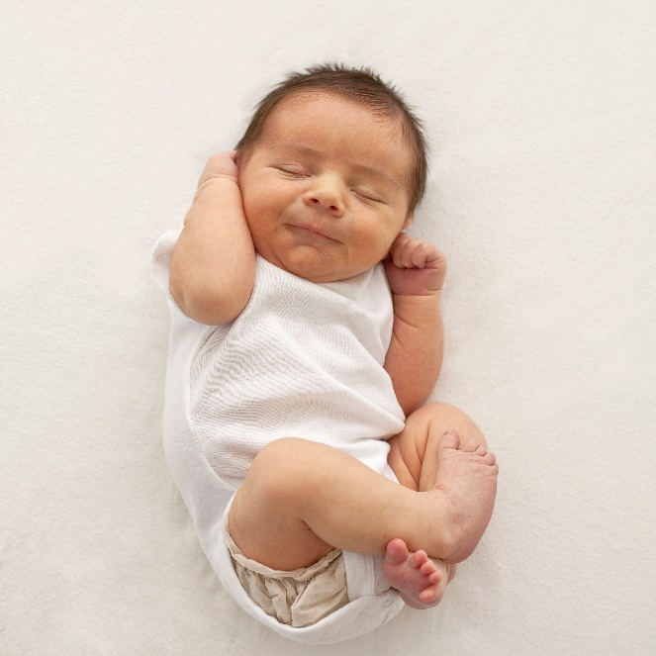

Developmental Stages!
PSYCHOLOGY 111
Evan Hall
8/14/2022

Slide 2

CONTENT
Infancy
Early Childhood
Middle Childhood
Adolescence
Early Adulthood
Middle Adulthood
Old Age

Slide 3
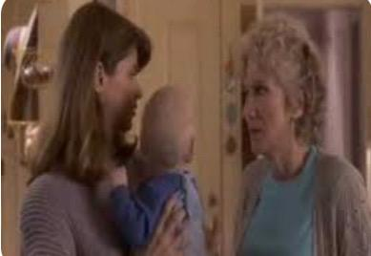
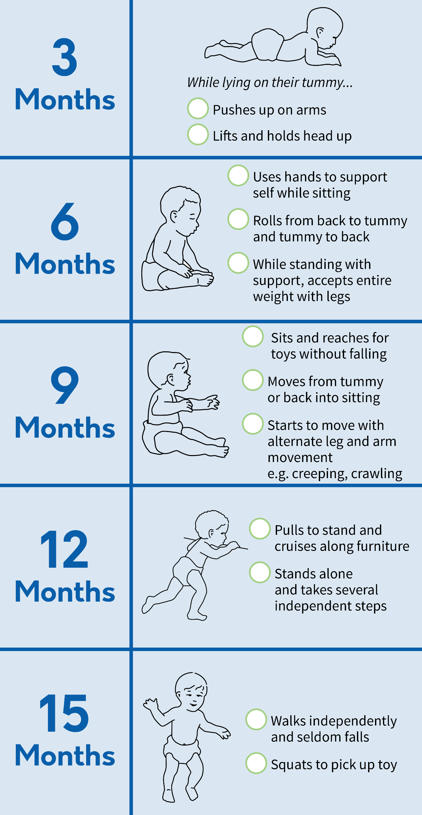
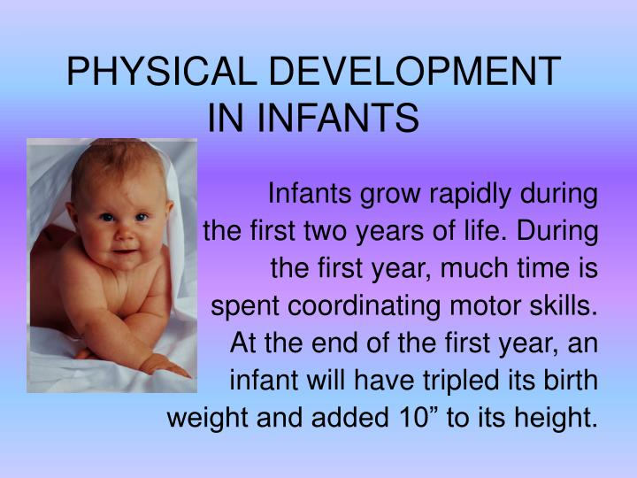
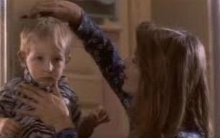
Infancy: Physical Development

Slide 4
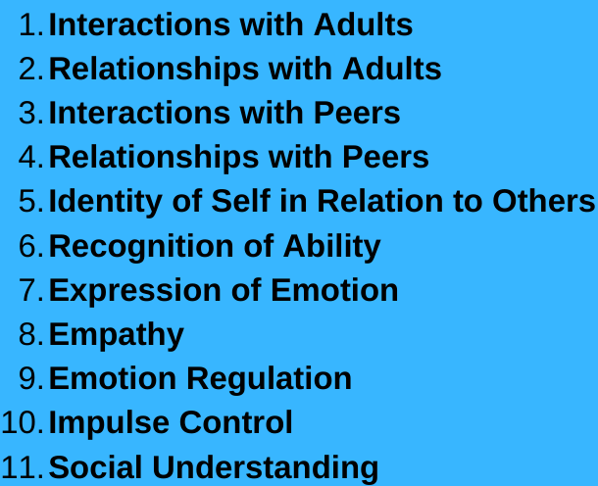
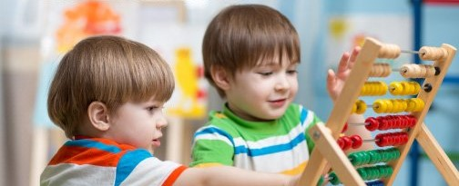
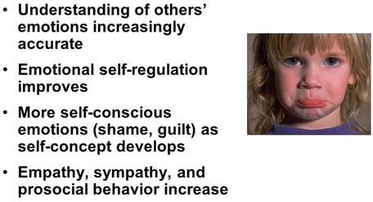
Early Childhood: Emotional Development

Slide 5
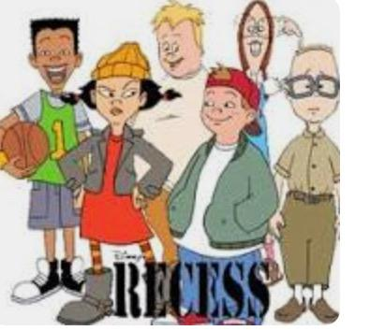

Middle Childhood: Social Development
6-12 Years Old
The overall development of children includes their physical, cognitive, social, and emotional growth.
Children show more independence from parents and family.
Start to think about the future.
Pay more attention to friendships and teamwork.
Want to be liked and accepted by peers.

Slide 6
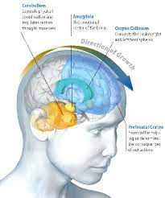
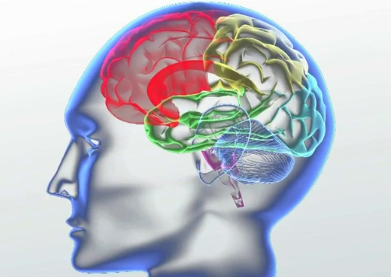
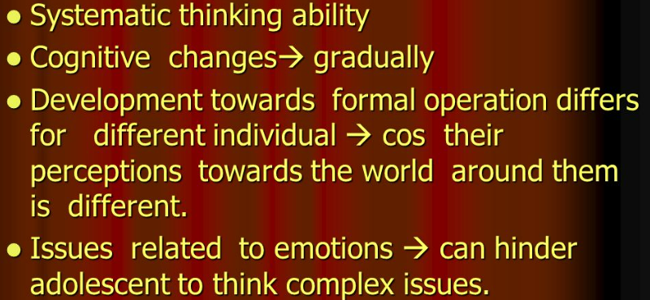
Adolescence: Cognitive Development

Slide 7
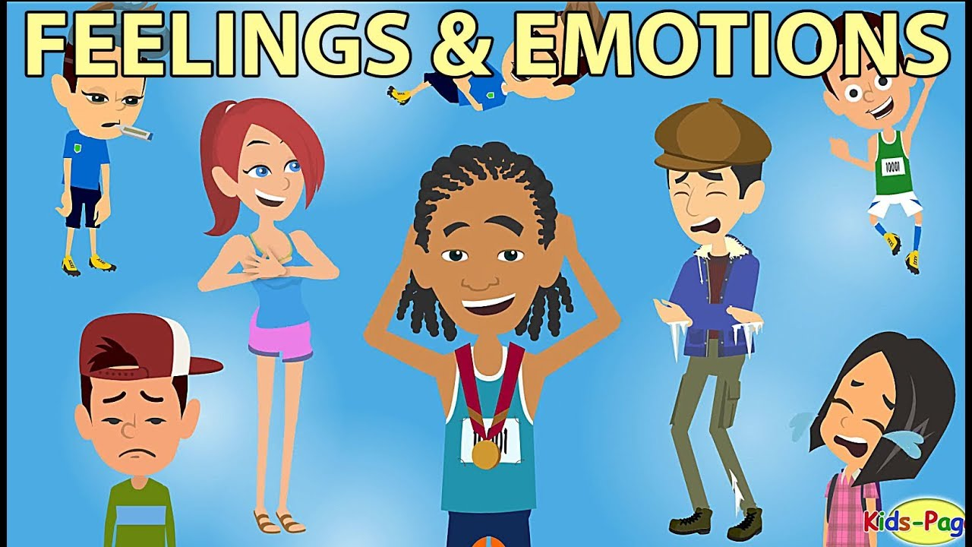
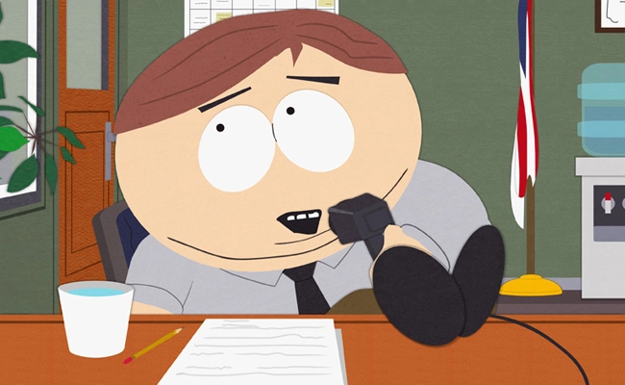
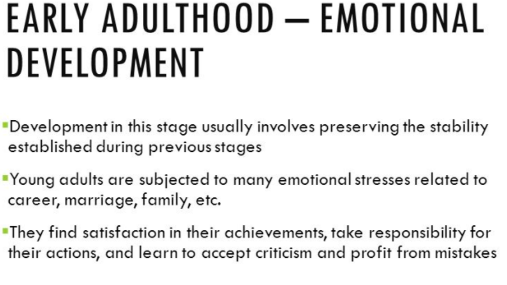

Slide 8
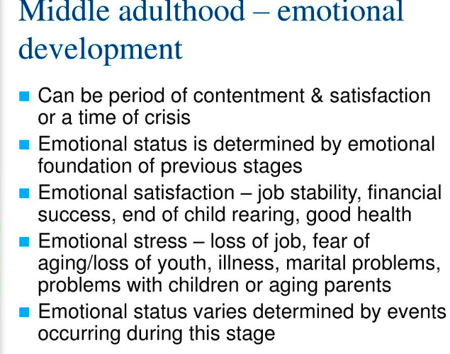
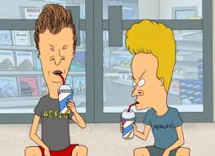

Slide 9
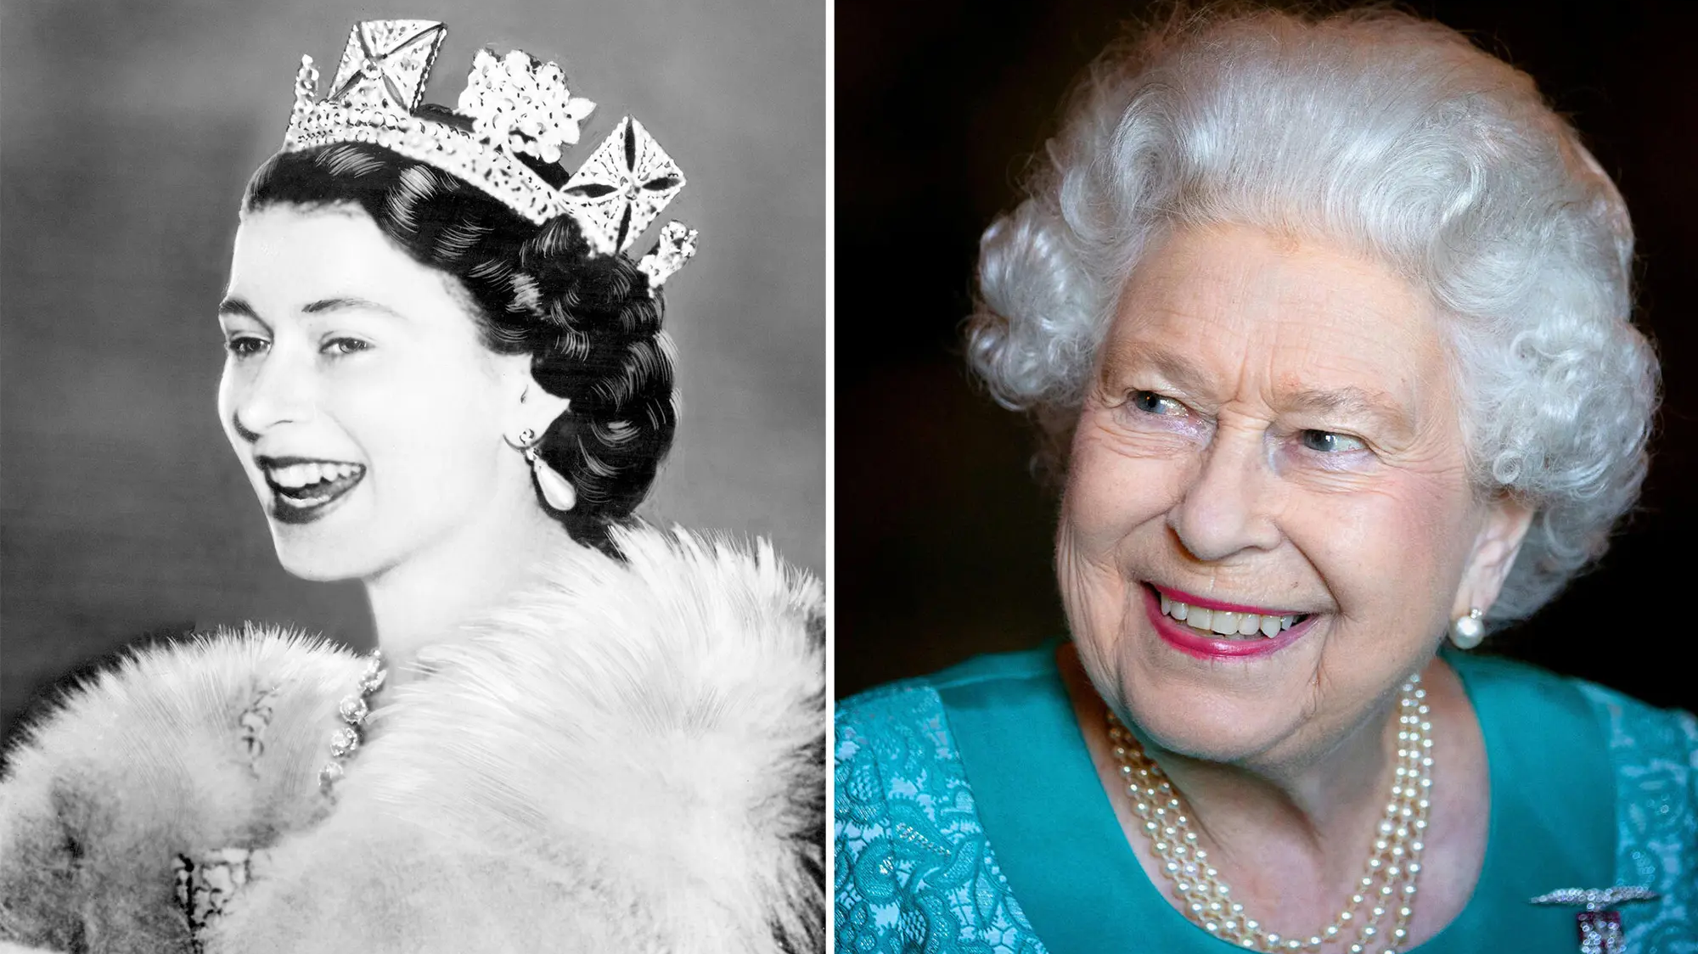
Older Adulthood
Physical Development:
When Queen Elizabeth reached old age, she had more and more health problems. She faced skin changes. She started to shrink and had a loss of eyesight. She didn’t find it hard to work because her health is better than others. However, everybody sees these changes and there’s not much anyone can do about them.

Slide 10
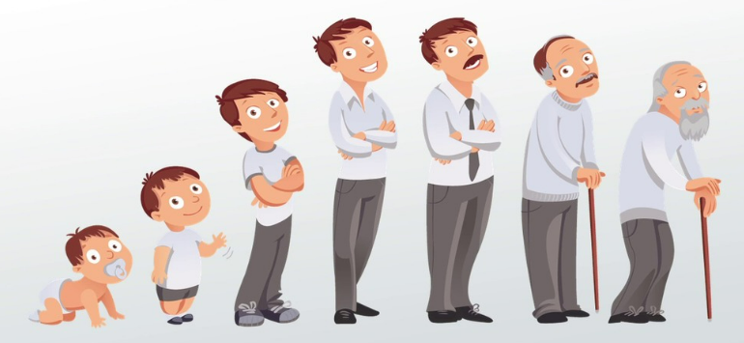
Conclusion: “The Circle Of Life”

