Slide 1

PORTFOLIO PROJECT
ENGLISH 202
AUTHOR: EVAN HALL
4/23/2022
INSTRUCTOR: Dr. Sarah Syrjanen

Slide 2
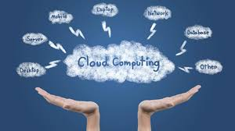

PRESENTATION
1
What is Cloud Computing?
Cloud Computing Structure
Hybrid Cloud
Community Cloud
Software As A Service
Platform As A Service
References
2
3
4
5
6
7

Slide 3
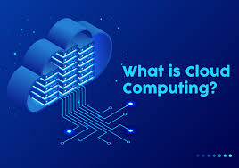

Cloud computing service models are hassle-free. When referred to infrastructure as a service, it is a cloud service model where users get access to basic computing infrastructure, they are commonly used by it administrators. If your organization requires resources like storage or virtual machines it is the model for you. You only have to manage the data runtime middleware applications and the os while the rest is handled by the cloud providers.
Cloud computing is a type of computing that depends on sharing computing resources rather than having local servers or personal device to handle applications.

Slide 4



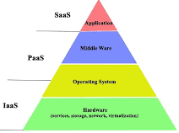


Cloud Computing Structure
2
The cloud computing industry extends far beyond name-brand IaaS cloud providers. Software-as-a-Service (SaaS) and Platform-as-a-Service (PaaS) companies build their products on top of cloud infrastructure and provide solutions across and within certain verticals. These products can range from HR or CRM software to solutions specifically designed for health care providers. Such companies tend to be cloud-natives, developed from the ground up to offer their services to any device with an internet connection.

Slide 5
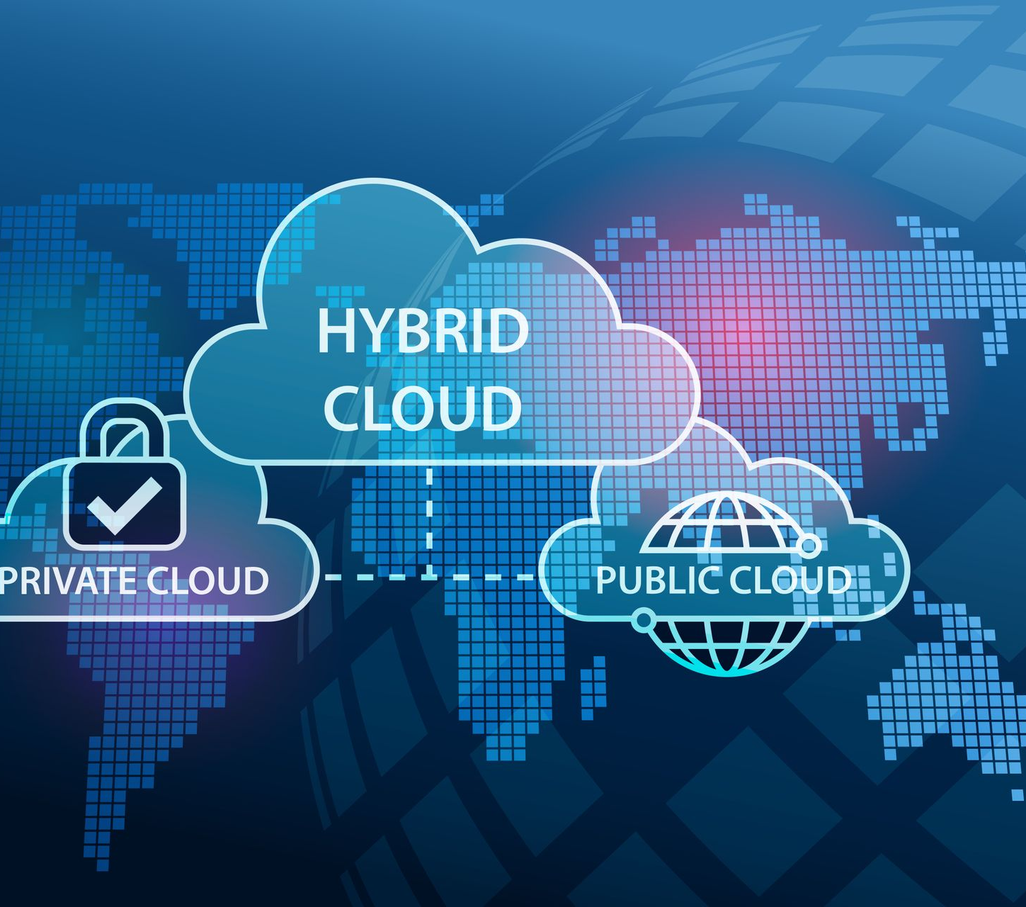
A hybrid cloud is a combination of a public and private cloud that interoperates.
3

Slide 6
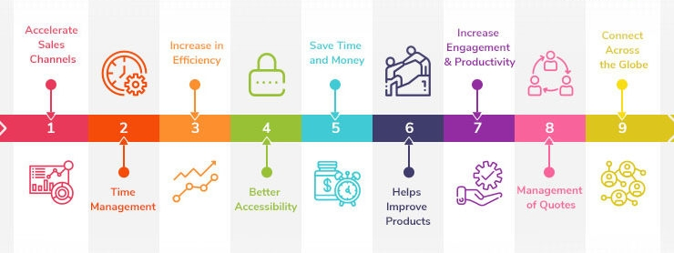
A community cloud is controlled and used by a group of organizations that have shared interests, such as specific security requirements or a common mission.
4

Slide 7

Software-as-a-service:
This is the model in which an application is hosted as a service to customers who access it via the internet. Some examples of this Google docs, salesforce.com, CRM, ERP, email, social networking.
while providing significant efficiencies in cost and delivery in exchange for minimal customization and represents a shift of operational risks from the consumer to the provider.
User of Saas offering usually has neither knowledge nor control about the underlying infrastructure.

Slide 8
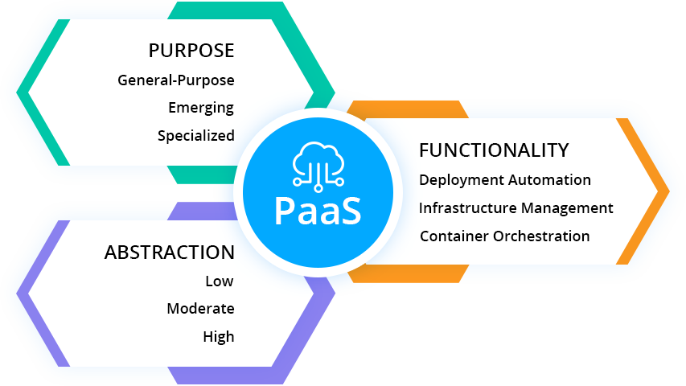
PaaS
Platform-as-a-service
This kind of cloud computing provides development environment as a service.
The consumer can use the middleman’s equipment to develop his own program and deliver it to the users through internet and servers.
It provides a well organized and graceful approach to operate scale-out applications in a predictable and cost-effective manner.

Slide 9
REFERENCES
Google Search
Youtube

