Slide 1


PORTFOLIO PROJECT
NETW 151
AUTHOR: EVAN HALL
2/12/2022
INSTRUCTOR: DANIEL BUTLER

Slide 2
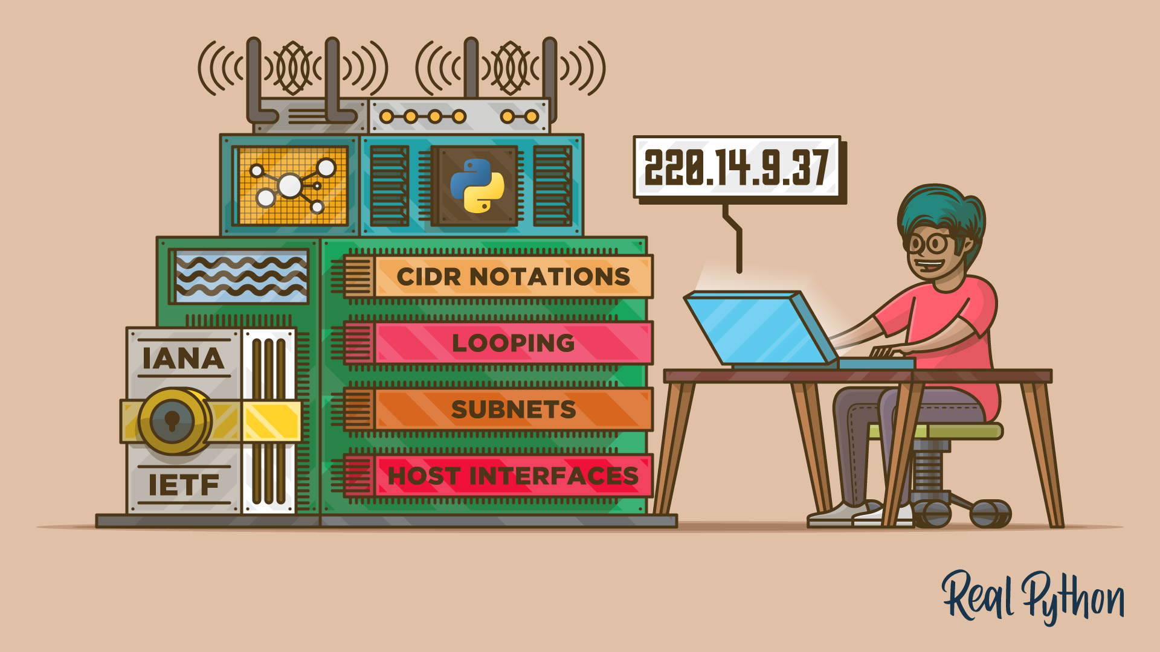
PRESENTATION
What is an IP address and Subnet Mask
IP Address Classes
Subnetting Design of IPC network
Routing
Difference between static and dynamic routing
Routing protocols
References
1
2
3
4
5
6
7

Slide 3
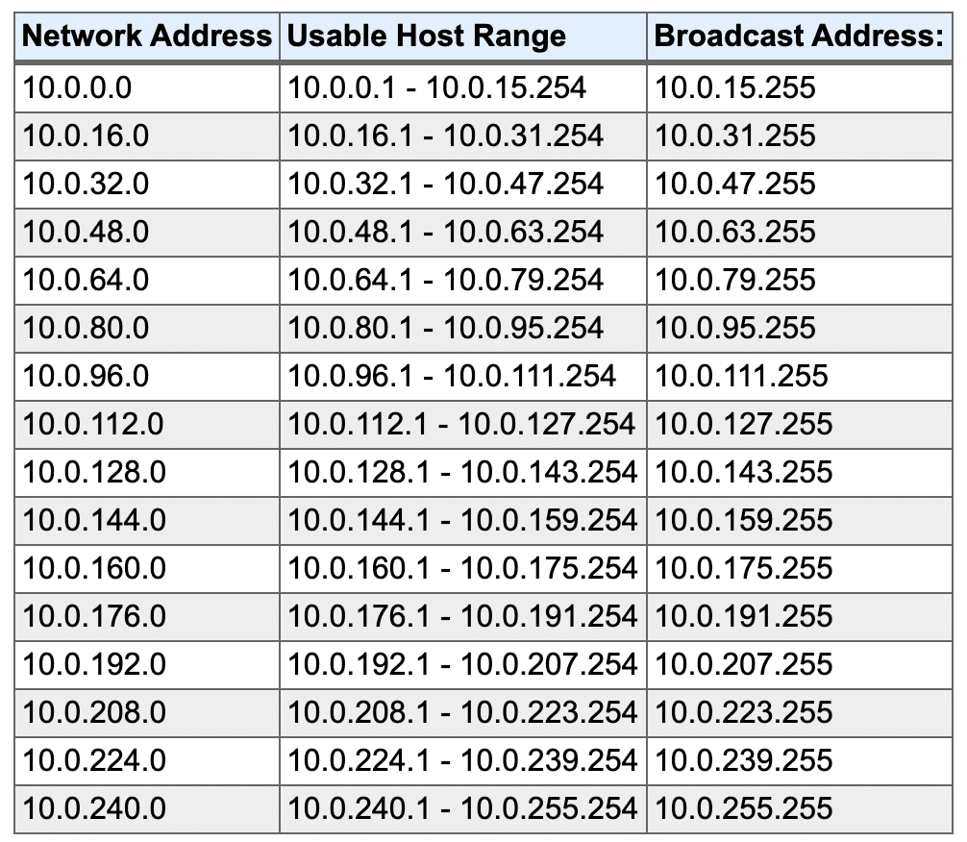
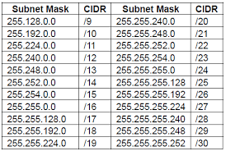
What is an IP Address and Subnet Mask?
A subnet mask is a 32-bit number created by setting host bits to all 0s and setting network bits to all 1s. In this way, the subnet mask separates the IP address into the network and host addresses.
Push chairs in
Lights out
Single file, silent line
Walk toward the high school
Pass the playground on the left
Proceed to new gym
Count off
1
An IP address is a unique address that identifies a device on the internet or a local network. IP stands for "Internet Protocol," which is the set of rules governing the format of data sent via the internet or local network.
2
3
4
5
6
7

Slide 4
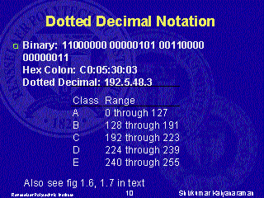
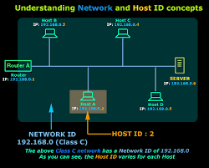
IP Address Classes
Class A
  Large Number of Hosts
  High Order Bit is 0
  Range for IP prefix is 1-126
Class B
  Medium to Large Networks
  The two High Order Bits are 10
  Range for IP prefix is 128-191
Class C
  For small networks
  Three High Order Bits set to 110
  Range for IP prefix is 192-223
Class D
Reserved for IP multicast addresses.
Class E
Is experimental reserved for future use.
Network ID is the portion of the TCP/IP Address that is used to identify individuals or devices on a network.
Host ID is the Portion used to Identify Hosts such as a PC or Networked printer on a network.

Slide 5
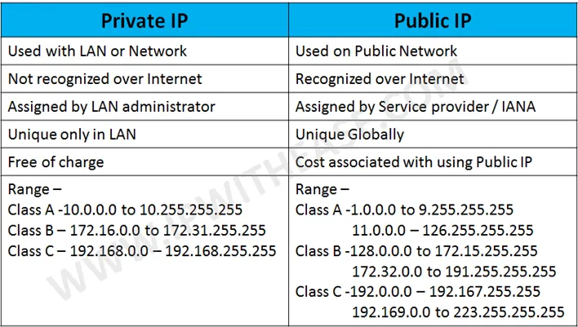
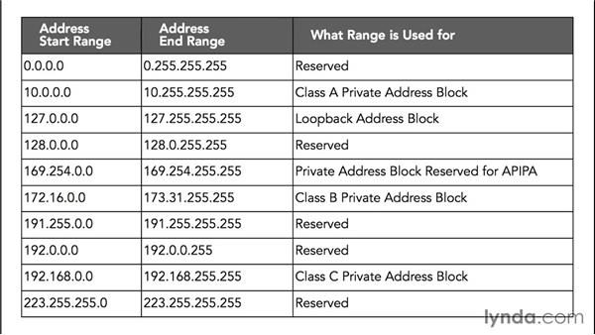
Production Subnet
Management Subnet
Router
Router
Switch
Switch
Switch

Slide 6




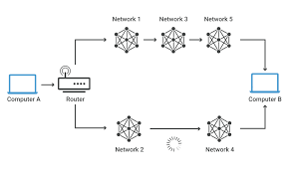

ROUTING
Routers must maintain their routing tables and ensure that other routers know about changes in the network. Routers do this by using a routing protocol to communicate the network information to other routers from a routing table on the router.
Routers use the routing table to determine where to forward packets. Routers forward packets through a network interface toward the destination network identified by the destination IP address in the packet. the routing table to determine where to forward packets. Routers forward packets through a network interface toward the destination network identified by the destination IP address in the packet.
Routers have network adapters to which IP addresses are assigned.
Console port: The router uses a console port for the attachment of a terminal used for management, configuration, and control. A console port might not be found on all routers.
Network port: The router has a number of network ports, including different LAN or WAN media ports.

Slide 7
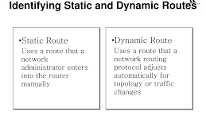
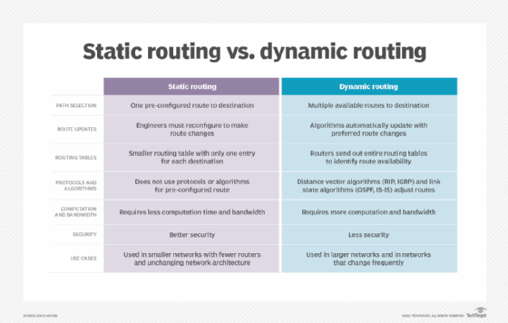
What is static routing?
Network administrators use static routing, or nonadaptive routing, to define a route when there is a single route or a preferred route for traffic to reach a destination. Static routing uses small routing tables with only one entry for each destination. It also requires less computation time than dynamic routing because each route is preconfigured.
Because static routes are preconfigured, administrators must manually reconfigure routes to adapt to changes in the network when they occur. Static routes are generally used in networks where administrators don't expect any changes.
What is dynamic routing?
Dynamic routing, sometimes called adaptive routing is more complex than static routing because it creates more possible routes to send packets across a network. Dynamic routes are typically used in larger; fluid networks where static routes would be cumbersome to maintain and frequently reconfigure. Because dynamic routing is more complicated, it consumes more bandwidth than static routing.

Slide 8
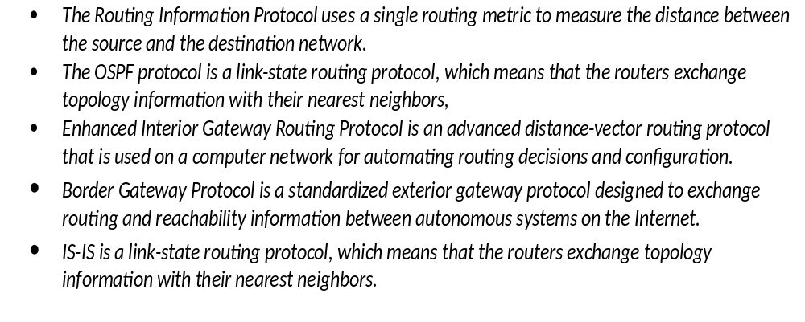
ROUTING PROTOCOLS

Slide 9

Conclusion
What is an IP address and Subnet Mask
IP Address Classes
Subnetting Design of IPC network
Routing
Difference between static and dynamic routing
Routing protocols
References

Slide 10
REFERENCES
Instructor : Daniel Butler
Google Search
Network + Certification Exam Guide

