Slide 1


Math 201 Quantitative Reasoning
Evan hall
Notes:
NOTE:
To change the image on this slide, select the picture and delete it. Then click the Pictures icon in the placeholder to insert your own image.

Slide 2
Student Loan Repayment Strategy
Start making payments after the first of the year.
Once graduated continue to make payments towards the principal.

Slide 3

Is My Repayment Plan Affordable ???
The way that I see it, currently I am a Field Supervisor for MGM Grand Casino. My monthly income is over $3,040 monthly. Besides my rent and small expenses currently I have a great amount of money left over every month. I am a new single parent and lately I have realized that my two daughters require a lot every month. So, after my credit card payments are caught up after the first of the year, I plan on starting my repayment plan.

Slide 4
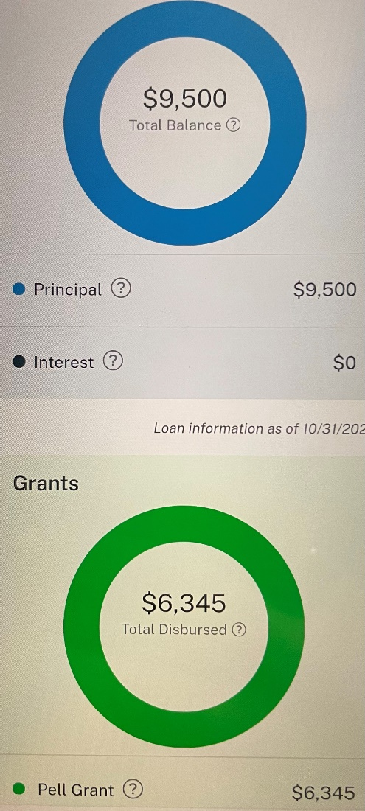
College Loan`s
Loan Serviced By:
Dept Of ED/FEDLOAN SERVICING(PHEAA)
Due Date 09/27/2023
Total Balance: $23,800
If Paid By 09/27/2023 = 0% Interest Rate
After 4.228% Fee Will Be Applied

Slide 5
Net Monthly |  | $3,400
Expenses
Car Payment |  | $400
Insurance |  | $190
Food |  | $500
Cell Phone |  | $100
Rent |  | $1,000
Electric |  | $200
Gas |  | $50
Internet |  | $160
Car Fuel |  | $150
STUDENT LOANS: |  | $96.18
TOTAL EXPENSES: |  | $2,846.19
Disposible Income: |  | $553.81

Slide 6
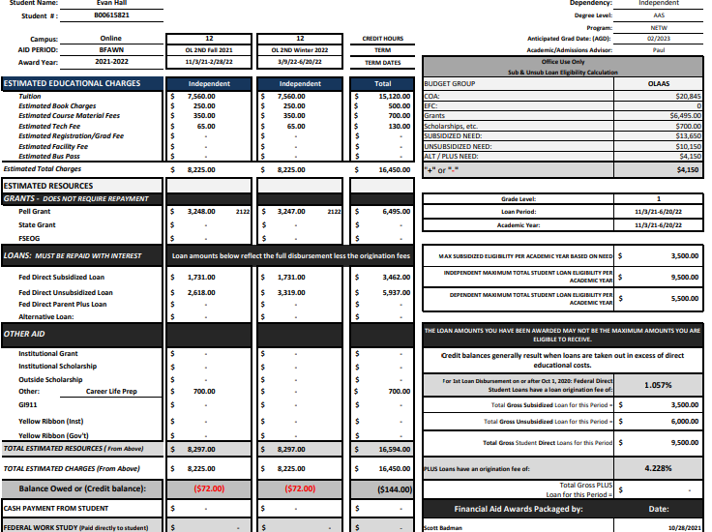

Slide 7
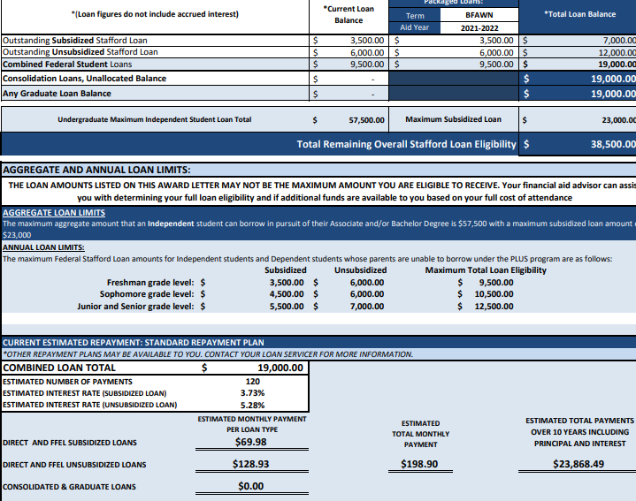

Slide 8
College Repayment Schedule
 | Loan amount |  | $23,800.00 |  | Scheduled payment |  | $243.55
 | Annual interest rate |  | 4.23% |  | Scheduled number of payments |  | 120
 | Loan period in years |  | 10 |  | Actual number of payments |  | 120
 | Number of payments per year |  | 12 |  | Total early payments |  | $0.00
 | Start date of loan |  | 11/26/2021 |  | Total interest |  | $3,533.21
 | Optional extra payments |  | $100.00 |  | LENDER NAME | FASFA

Slide 9
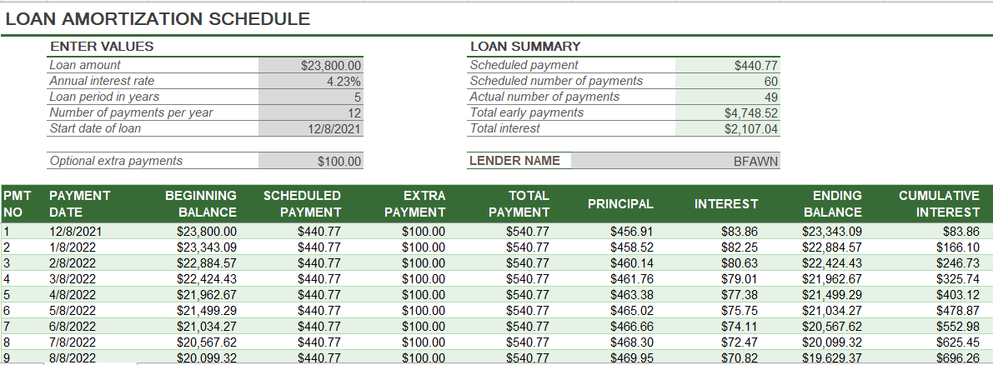
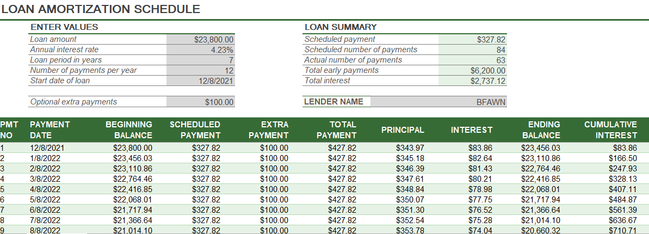
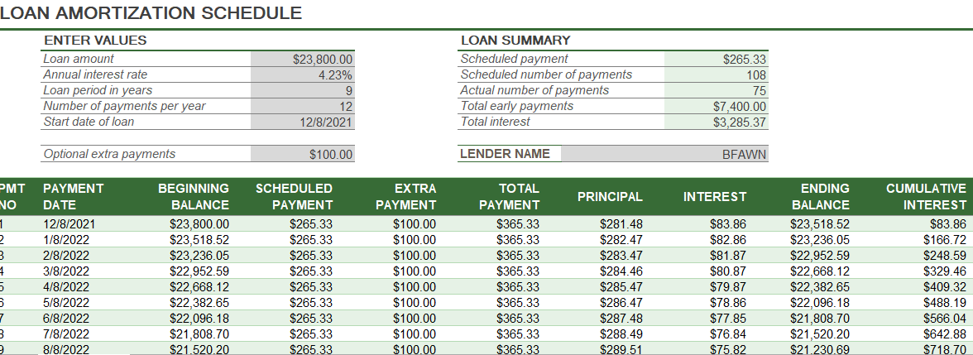

Slide 10
My Conclusion
The Monthly payments increase as well as the number of payments required to pay off the loan amount. but the future value of my account decreases a lot from 10 years as I Decrease the number of years invested and my presentation the amount of interest stays the same as well which is 5%.

