Slide 1



Angelika Romatowska
Bryant & Stratton College
SOSC 102
Instructor: Mr. Vincent
March 20, 2022

Slide 2
Introduction
How does socialization and social control
affect my target customers' internal and external influences?

Slide 3


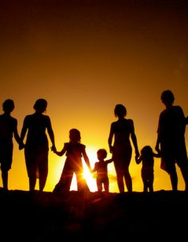
Family
Family has taught us many things throughout life, they taught us strong values from a young age, how we approach a certain situation in life, how to talk, how to feed ourselves etc. Family has a strong impact on where we end up in life.
This Photo by Unknown Author is licensed under CC BY-SA

Slide 4

School
In school, we learn the importance of not only learning the academic curriculum, but also how to obey authority. School introduces children to life beyond home. If you do not do good in school, you can’t move up in life to get a good career.
This Photo by Unknown Author is licensed under CC BY-SA-NC

Slide 5

Media
Media has been around for centuries. It started out with a television. But media has had a negative impact on many. From long-term implications for behavior, for example violence, prosocial behavior, eating disorders, sexual experiences; cultivation of worldview and values. (Lemish, 2015).
This Photo by Unknown Author is licensed under CC BY-SA-NC

Slide 6

Peer Groups
Peer groups allow kids to explore different types of relationships on the outside. “Peers, or a group of people who have similar interests, age, background, or social status, serve as an important source of information, feedback, and support to individuals as they develop a sense of self.” (Little B. 2020)
This Photo by Unknown Author is licensed under CC BY-NC-ND

Slide 7
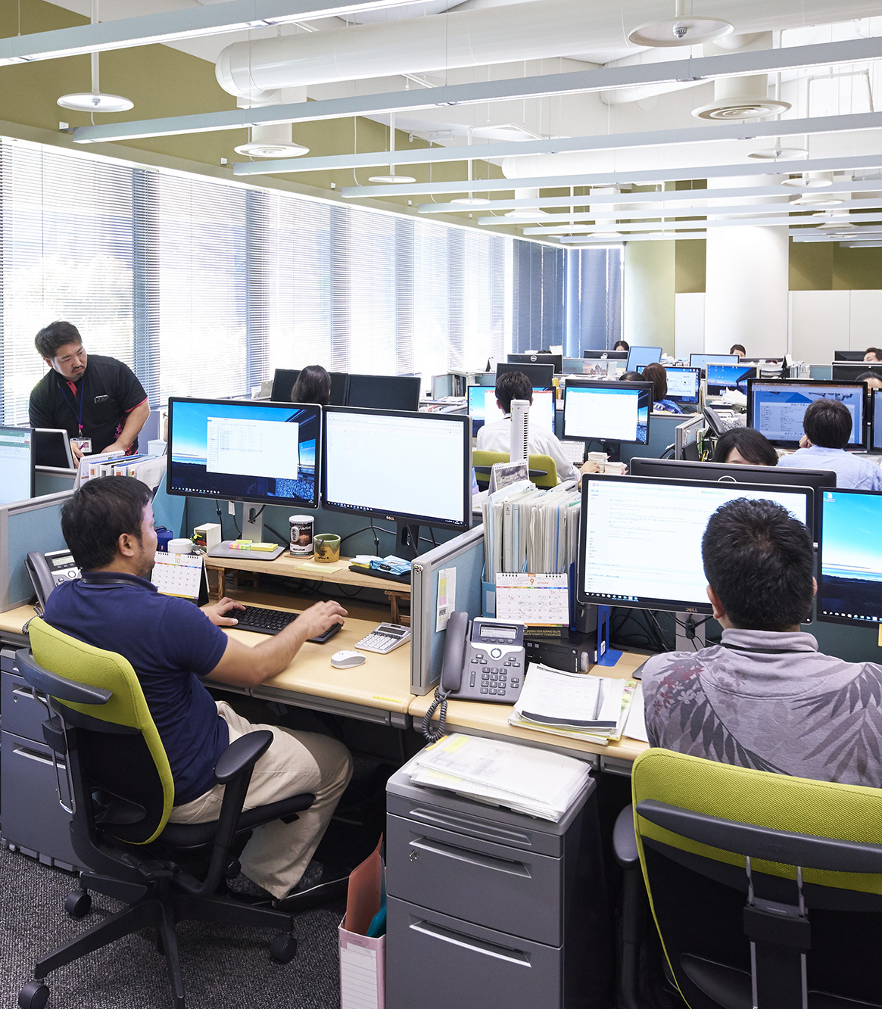

The Workplace
By socializing at work, you build a trusting relationship with the people you work with. It may be hard for some people to socialize at work because they are shy or simply not good communicators. By communicating well with co-workers, you corroborate better on projects, group discussions etc.
This Photo by Unknown Author is licensed under CC BY-ND

Slide 8

Religion
Religion is not a subject most people feel comfortable talking about. But fortunately, there are different types of religions practiced all over the world. There is not just one religion for every person. Many go to synagogues, temples, churches, or mosques to socialize with people who have the same religion in common.

Slide 9
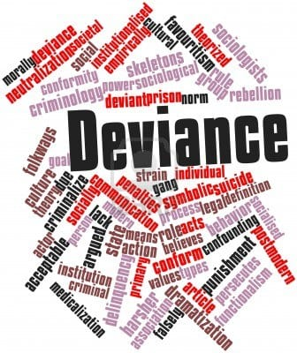
Deviance
Personal- Deviance helps us in our personal lives because it sets rules that we must follow. If there is no deviance, there is no rules. However, some peoples' versions of deviance can be different from others because of cultural differences. It might seem like a normal thing to do for you, but to a different culture its not okay.
Workplace- In the workplace, there are rules put into place that we must follow. There is no room for bad behavior because that job pays for our bills.

Slide 10
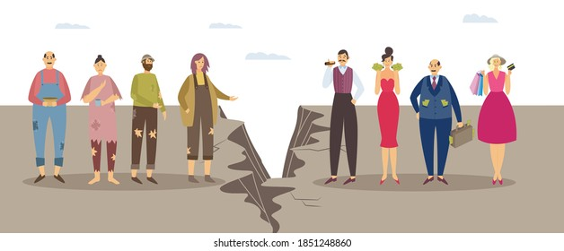
Social Inequalities
Social inequalities happen from people from different race, class, or gender because of rights they think they have. In this society now, race is a big issue because people of color get treated one way while white people think they are privileged because of their skin color. Or because you are poor you get treated differently than the rich. When you are rich you get more perks of life while the poor struggle by putting food on the table for their families. We can create social change by having the government take some examples from other countries and what they do right. For example, in this pandemic, the Canadian government helped everyone by giving them financial help until the pandemic has calmed down. In New York, we only got financial help a few times and people spent it on new TV’s, clothes etc.

Slide 11

Conclusion
Which social interaction has framed you to be the person you are today? Why did you choose these social interactions?
This Photo by Unknown Author is licensed under CC BY

Slide 12
References
Crossman, A. (2021, February 16). The Sociology of Social Inequality. Retrieved from https://www.thoughtco.com/sociology-of-social-inequality-3026287
Deviance. (2013). In K. Bell (Ed.), Open education sociology dictionary. Retrieved from https://sociologydictionary.org/deviance/
Schaeffer, K. (2020, February 7). 6 facts about economic inequality in the U.S. Retrieved from https://www.pewresearch.org/fact-tank/2020/02/07/6-facts-about-economic-inequality-in-the-u-s/
Blakemore, Erin. “Race and Ethnicity Facts and Information.” Culture, National Geographic, 3 May 2021, https://www.nationalgeographic.com/culture/article/race-ethnicity.
“Race and Ethnicity in the Workplace.” VERCIDA, https://www.vercida.com/uk/articles/race-ethnicity-workplace.

