Slide 1

Compensation & Benefits Plan
Joe Harwood
October 19th, 2021

Slide 2
Management Responsibility
Responsibilities of Director of Accounting:
  Oversee employees to ensure proper conduct
  Foster a safe and hospitable work environment
Notes:
"Responsibilities for management include:"
These are most likely responsibilities for management of any profession, not just Accounting.

Slide 3
Components of Compensation
Compensation: cash payments to employees
Mismanaged compensation components:
  Wages
  Meal break
Notes:
"Wages: employees not clocking in/out at proper times or having other employees clock them in entirely. Results in unnecessary overtime and employees getting paid for work not done"
Meal Break: similarly to wages, employees not clocking out when they leave on breaks results in an abuse of sick leave/vacation time. Policy-abiding employees are forced to use their time off, whereas those who are abusing this are essentially getting extra paid time off in the form of extra breaks"

Slide 4
Components of benefits
Benefits: non-cash payments given to employees
Mismanaged compensation components:
  FMLA
  Sick leave/vacation time
Notes:
Today, compensation and benefits has evolved to a more comprehensive package including stock purchase plans, and variable pay plans.
"Fmla: employees on FMLA are not properly inputting their intermittent FMLA hours in the timekeeping system. Therefore, some employees are getting 12 weeks of FMLA annually, while others are taking off as much as 15 weeks per year."
"Sick leave and vacation time: similarly to wages, employees getting clocked in by others when they aren't even at work results in an abuse of sick leave/vacation time. Policy-abiding employees are forced to use their time off when they can't come into work, whereas those who are abusing this are essentially getting extra paid time off"

Slide 5
Ethical implications
Pay fairness is an ethical issue
Ethical Issues of Sam Smith:
  Not properly track the time records of the employees
    Results in employees clocking each other in/out
Notes:
Ethically, when two employees are performing drastically different levels of work, but are being paid the same wages, it is definitely unethical.
When Sam is approving the employee’s time cards, if they fail to clock in or out correctly for shift start, meal breaks or end of shift, he will enter time without verifying – results in incorrect hours, unnecessary overtime.

Slide 6
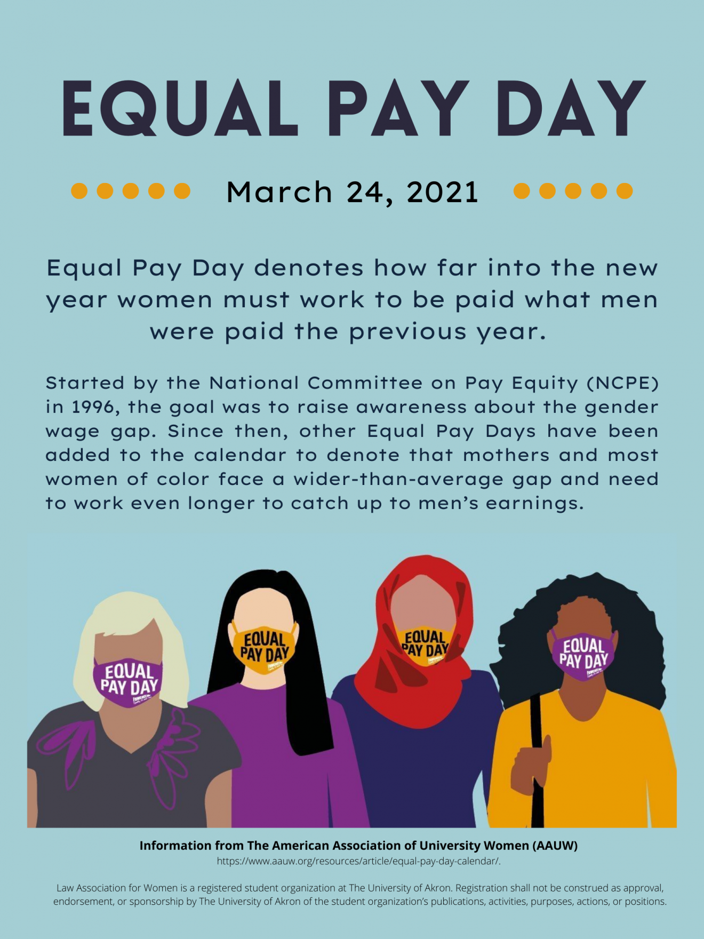
Legislation requirements
EEOC and Equal Pay Act of 1963
  "Compensation discrimination occurs when an employee doing similar work does not receive similar pay"
FMLA
Notes:
1) EEOC and Equal Pay Act of 1963
It is clear that Sam Smith did not provide equal pay for all employees, and it is unclear whether this was random or based upon discrimination: "Compensation discrimination occurs when an employee doing similar work does not receive similar pay"
Additionally, abusing FMLA is illegal because this is an act put into place that is supposed to help provide for employees in need of it. Abusing it puts an emphasis on not caring about other people whom may actually need FMLA and is against the law.

Slide 7
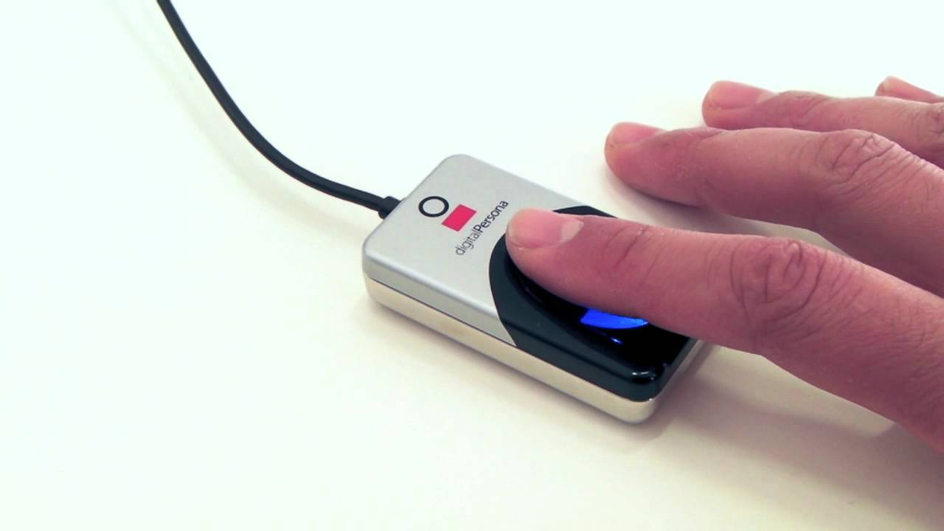
Technology
Technological solutions to FMLA
  Mobile apps and reminders
Technological solutions to timekeeping
  Biometric scanning
Thumbprint scanner used at McDonald's
Notes:
A technological solution the abuse of FMLA is to use reminders to ensure proper FMLA input by the employees. This can be done by sending text message alerts, and can be easily inputted by the employee by use of a mobile app. If a company makes something like this very easy for employees to use, then there will be no excuses as to why it doesn't get completed. If problems continue, then punishments may be in order.
A relatively easy solution to the issue of employees abusing the timekeeping system is to introduce biometric scanning. I have personally seen this used even at minimum wage jobs like mcdonalds, and it is virtually impossible to abuse. The system uses an employee's thumbprint, and when an employee does not clock out for a lunch break, the system sends an alert to the manager to confirm that this was authorized. The only person with the authority to override someone's time clock is the person in charge of payroll, and in this instance that would be Sam Smith.

Slide 8
References
United State Department of Labor. Wages. Retrieved from https://www.dol.gov/general/topic/wages
https://www.investopedia.com/terms/e/equal-employment-opportunity-commission-eeoc.asp

