Slide 1


Graduation: The reality Of Student Loans
Kelly Inskip
Math 201
Mrs. Hines

Slide 2
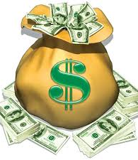
Most students do not plan how to repay the financial cost to go to college. In this presentation I will demonstrate how I plan to repay my student loans.

Slide 3
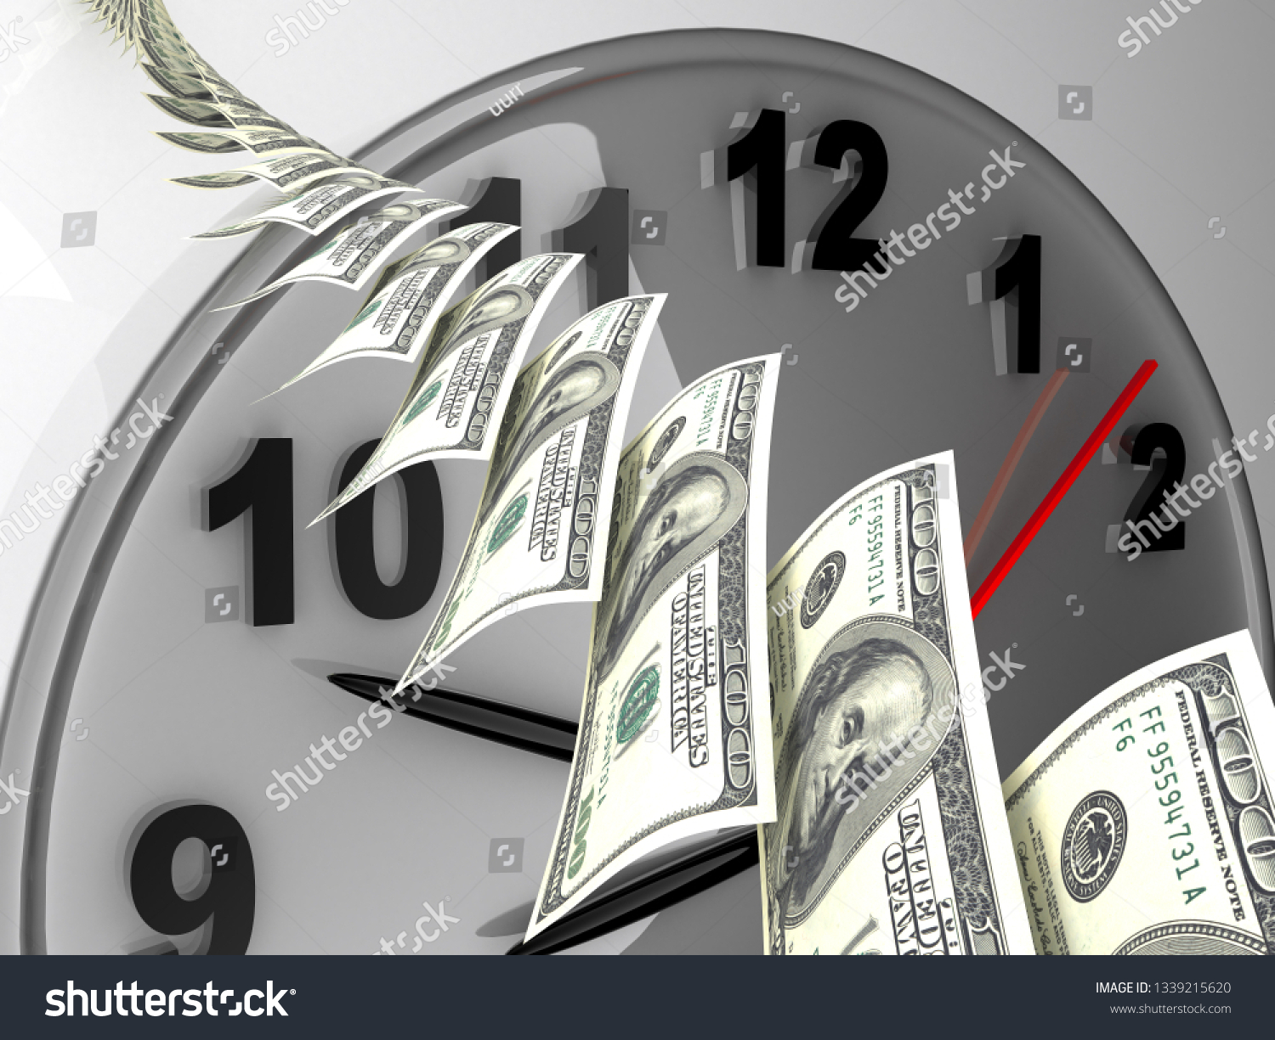
One of the questions that I have to ask myself is: Will I be able to make my payment every month?

Slide 4
Hospital In Newport News, VA
$ 44,769.00
Hospital In Norfolk, VA
$ 42,630.00
Projected Monthly Net Income:
$ 2,798.06
Projected Monthly Net Income:
$ 2,664.38

Slide 5
$ 2,798.06
$ 2,798.06
115 Water
100 fuel
80 Phone
422 Student loan
650 Car Payment
150 Insurance
300 Food
750 Rent
231.06 total after expenses

Slide 6
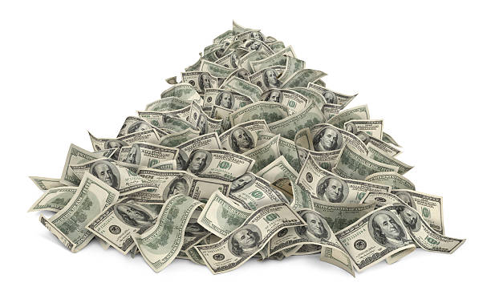
Total amount of loans due after graduation: $ 33,423 with a 4.236%
Payments per month for a 10-year time frame = $342.15

Slide 7
Using the Excel Amortization Schedule my monthly payment will be $342.15 for the standard 10 year student loan. This loan payment is smaller than I had originally projected.
I will use 12.23% of my monthly net salary to repay my student loans.
This seems like a manageable number based on my monthly budget.

Slide 8

If I make the monthly payment of $ 342.15 for the ten -year term I will pay a total of $ 7, 635.36 in interest over the life of the loan. That would make my future value of the loan $ 41, 058.36

Slide 9
Number of years | Payment Amount | Interest Paid | Future value
10 | $ 342.15 | $ 7,635.36 | $ 41, 058.36
8 | $ 411.08 | $ 6,040.84 | $ 39, 463.84
6 | $ 526.51 | $ 4,485.76 | $ 39, 463.84
5 | $ 619.10 | $ 3,723.08 | $ 37,146.08

Slide 10
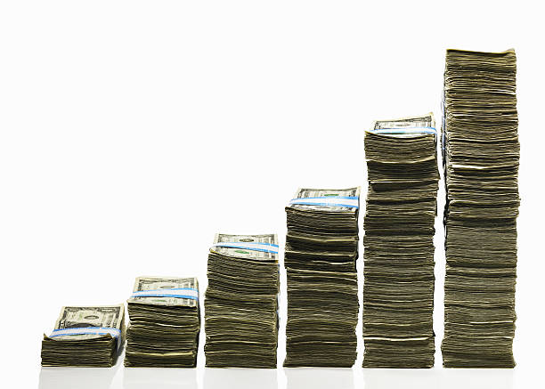
My optimum monthly payment is $ 411.08 each month. I have an eight-year plan to pay off my student loans. I know that I will be able to make this payment even though it is a little higher. While I am in school, I plan to pay off as much debt as I can. This will in turn allow me to focus on paying my student loans a larger payment and cutting my interest paid. I actually estimated a higher payment that would have been unrealistic for me.
This payment is an amount that I feel confident that I can make.

