Slide 1

The Importance of Personal Responsibility and Financial Literacy
By Paloma Vachon

Slide 2


The things I am going to discuss in this PowerPoint are:
Financial Literacy
Personal Responsibility
What are Pre-Employment Background Checks
What results would make an employer more or less likely to hire someone
This Photo by Unknown author is licensed under CC BY-SA.

Slide 3


Financial Literacy is:
Notes:
WHAT IS FINANCIAL LITERACY AND WHY IS IT IMPORTANT
FINANCIAL LITERACY IS THE ABILITY TO UNDERSTAND AND EFFECTIVELY USE VARIOUS FINANCIAL SKILLS INCLUDING BUDGETING, INVESTING, BORROWING, TAXATION.
It is important because a lack of financial understanding may underscore why many Americans struggle with saving and investing.

Slide 4

Personal Responsibility is:
Notes:
When you have a sense of personal responsibility, it means you are willing to accept and live by society’s established standards of individual behavior. When these expected standards aren’t met, someone with personal responsibility doesn’t seek others to blame, rather they’re able to maturely respond to the presented challenges themselves and take any blame for their actions. your life is full of choices, and what you do with them governs your whole reality. Being able to see that your decisions have a direct impact on your life’s events is what being able to accept personal responsibility is all about.

Slide 5
What is a pre-employment Background Check?
Criminal History
Employment History
Credit Check
Driving Record
Drug and Alcohol Screening
Notes:
CRIMINAL HISTORY – Looks into your criminal record. LAWS VARY BY STATE ON WHETHER CRIMINAL HISTORY CAN BE USED AS A FACTOR FOR HIRING SOMEONE.
EMPLOYMENT HISTORY – HUMAN RESOURCES WILL GIVE YOUR JOB TITLE AND TASKS YOU PERFORMED.
CREDIT CHECK – A NEGATIVE FINDING CAN PREVENT AN EMPLOYER FROM HIRING YOU. YOU SHOULD GET A COPY OF THIS FINDING AS WELL. THIS CHECK IS DONE WHEN APPLYING FOR A JOB WHERE YOU WORK WITH MONEY, FINANCES, OR BUDGETING.
DRIVING RECORD – IF APPLYING FOR A DRIVING JOB, THE COMPANY WILL WANT TO SEE A SAFE DRIVING RECORD. THEY COULD BE HELD LIABLE IF YOU ARE INVOLVED IN AN ACCIDENT DURING WORK.
DRUG AND ALCOHOL SCREENING – SOME COMPANYS MAKE THE JOB OFFER DEPENDENT ON A CLEAN DRUG TEST RESULT, OTHERS TEST YOU BEFORE AS WELL AS PERIODICALLY DURING YOUR EMPLOYMENT HISTORY.

Slide 6


What makes an employer more or less likely to hire someone?
Notes:
If you have a criminal record, it will probably be more difficult to find a job. Someone without a criminal record will find it less difficult. If you have unexplained gaps in your work history, it could be a factor in securing a job. Otherwise, if you hold your position in a business for a long time, you show you are responsible and dependable. This could make you appear to be a better candidate. Human resources is generally limited to informing an inquirer that you held a position at that company, the title and the length of your employment. I have never heard of a credit check as a pre-employment background check but apparently it is. If you get a negative response on your credit check, it could cause the employer not to hire you. You should get a copy of this negative response so that you can address it and fix it before the next application for employment is submitted. Accidents or tickets on your driving record could cause a company to not hire you. If your record is clean, this should be a plus on your side. If a drug test comes back positive, do not expect a job offer. It can test positive for food items like a poppyseed bagel. Use your best judgment before you get a drug test done.

Slide 7
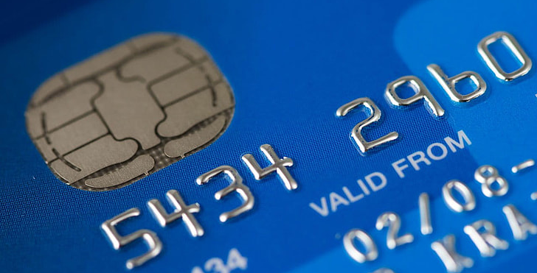

How are Personal Responsibility and Financial Literacy Skills Related to Promotional Opportunities and Growth in The Workplace?
This Photo by Unknown author is licensed under CC BY-SA-NC.
Notes:
PERSONAL RESPONSIBILITY AND FINANCIAL LITERACY ARE RELATED TO PROMOTIONAL OPPORTUNITIES AND GROWTH WITHIN THE WORKPLACE. WITHOUT PERSONAL RESPONSIBILITY YOU MIGHT NOT BE SOMEONE WHO ACCEPTS RESPONSIBILITIES FOR THINGS THAT HAVE NOT GONE AS EXPECTED. THIS COULD MEAN THAT YOU ARE NOT SOUGHT OUT FOR MORE RESPONSIBILTIES. WITHOUT FINANCIAL RESPONSIBILITIES YOU MIGHT BE THE KIND OF PERSON WHO IS TOTALLY CONSUMED WITH FINANCIAL WORRIES AND CAN’T HANDLE ANYTHING ELSE.

Slide 8

Steps I would take to ensure a positive result…
Notes:
CHECK YOUR CREDIT BEFOREHAND BY GETTING A CREDIT REPORT. REVIEW YOUR DRIVING RECORD SO IF THERE IS AN ERROR, YOU CAN CORRECT IT OR ATLEAST HAVE AN EXPLANATION. BEFORE A DRUG TEST, MAKE SURE YOU KNOW WHAT PERSCRIPTION MEDICATION YOU ARE TAKING SO YOU CAN PROVIDE THE NAMES TO THE TESTER. KNOW WHICH DRUGS ARE ILLEGAL IN THE STATE YOU ARE APPLYING IN. GET EMPLOYMENT RECORDS FROM PREVIOUS EMPLOYERS SO YOU ARE FAMILIAR WITH WHAT IS BEING SHARED. LASTLY IF YOU KNOW OF SOMETHING THAT YOUR FUTURE EMPLOYER IS GOING TO FIND OUT ABOUT, LET THEM KNOW ABOUT IT IN ADVANCE.

Slide 9

In conclusion:
Financial Literacy
Personal responsibility pre-employment background check positive results on background checks

Slide 10

References
Mathers, Connie March 15, 2022,What is Personal Responsibility? What is Personal Responsibility? 8 Key Ingredients (developgoodhabits.com)
Zucchi, Kristina Updated April 6, 2022, Why Financial Literacy Is So Important Why Financial Literacy Is So Important (investopedia.com)
This Photo by Unknown author is licensed under CC BY-ND.

