Slide 1


Store Theft
CRJU201 – Criminology: Exploring Criminal Behavior
Dominic Locklear
February 22, 2022
Mr. Amo
This Photo by Unknown Author is licensed under CC BY-NC

Slide 2
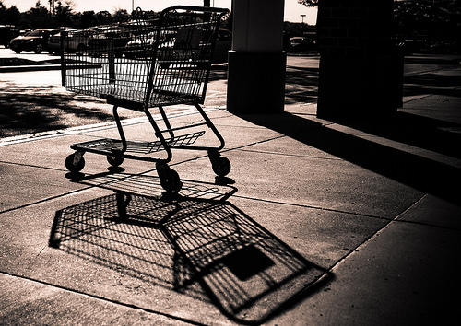
Store Theft - Introduction
• Define Shoplifting
• Define Employee Theft
• Statistics on Shoplifting & Employee Theft
• Shoplifting Statistics & Facts
• Social Disorganization Theory & Criminology
• Psychological Theory & Criminology
• Why They Do It
• Methods Used By Shoplifters
• Evaluation of Loss Prevention Efforts – Loss Prevention for the Holidays
• References
This Photo by Unknown Author is licensed under CC BY-SA

Slide 3

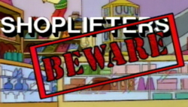
Store Theft
Shoplifting & Employee Theft
Shoplifting
• Willingly taking merchandise from a store without knowledge or consent of owner.
Employee Theft
• Employee steals from their employers, can be merchandise or money.
This Photo by Unknown Author is licensed under CC BY-SA-NC
This Photo by Unknown Author is licensed under CC BY-SA

Slide 4
Store Theft
Shoplifting & Employee Theft Statistics
Employee Theft Statistics
• 75% of employees have stolen at least once from their employer (calrest.org).
• More than 30 percent of business bankruptcies are due to employee theft (Service Management Group).
• 90% of all significant theft losses come from employees (Willis North America).
• Cash theft is the top cause for over 20% of businesses (Balance Innovations).
• 40% of employees who steal from their work have experienced HR red flags prior (SHRM).
• 60% of employees would steal if they knew they wouldn’t get caught (FBI).
Shoplifting Statistics
• Not a new phenomenon
• Those arrested for shoplifting come from neighborhoods with high levels of poverty (Shoplifting Statistics and Facts (2021) and 35 Shoplifting Statistics).
• More likely to shoplift from dollar stores, liquor stores, and convenience stores (Loftin, 2020).
• little differences among shoplifting between genders.
• shoplifting that was done at Walmart was mostly for non-essential items.

Slide 5
Store Theft
Shoplifting & Employee Theft Trends
• It is estimated that there are 550,000 shoplifting incidents per day (National Association for Shoplifting Prevention, 2019).
• Shoplifting has become a socially significant issue and retailers are experiencing thinning revenues because of it.
• Shoplifting, specifically shrinkage that is caused by theft, is a problem for retailers, consumers, and society.
• The larger the store, the higher the shrinkage (National Retail Security survey, 2018).
• Despite anti-theft measures, billions of potential profits are lost each year due to shoplifting (Shoplifting Statistics & Facts, 2021).

Slide 6

Store Theft
Theories & Criminology
Social Disorganization Theory
• Social Disorganization Theory - individuals that live in disadvantaged communities are more likely to engage in delinquency and criminality (Loftin, 2020).
• Failure of community to fully understand and acknowledge the common goals or solve any issues that they may be experiencing (Pham, 2020).
• Three elements - family disruption, evidence of disorder, and crime/delinquency.
Psychological Theory
• Find a link between crime and low intelligence.
• Psychological research - difference of 8 points in IQ scores between delinquents and non-delinquents (http://crime-study.blogspot.com/2011).
• Psychology Theory - criminals with personality disorders such as, pychopaths, sociopaths and antisocial personalities.
This Photo by Unknown Author is licensed under CC BY-SA

Slide 7

Store Theft
Why They Do It
• Personal & Social Pressures.
• Anger
• Loss
• Disempowerment
• Entitlement
• Become Addicted.
This Photo by Unknown Author is licensed under CC BY-ND

Slide 8
Store Theft
Methods Used By Shoplifters
• Concealing Items – Within clothes, burses, bags, etc.
• Walking Out – Taking the item and walking right out so that they don’t look suspicious.
• Switching Tags – Shoplifters will switch tags with lower priced item tags.
• Distraction – If there is more than one shoplifter, one may cause a distraction, so others can shoplift without getting noticed.
• Fake Returns – After stealing an item, they return for cash or store credit.

Slide 9
Store Theft
Evaluation of Loss Prevention Efforts – Creation of a Storewide Loss Prevention Plan for the Holidays
• Organization – Stores should organize their stores so that it is easier and more visible for employees to see shoplifters.
• Employees engagement – Have employees greet customers, ask if they can help them, and just be overall more involved with them on the sales floor.
• Employee Training – Train employees with loss prevention specialists on what to look for in shoplifters behavior.
• Security Cameras – Have security cameras throughout the store.
• Advertise – Advertise with signs letting customers know they are on camera.
• Inventory – Have a good inventory system.
• Payments – Use more credit and less cash.
• Returns – Require receipts for cash or store credit.
• Check Receipts – have an employee check receipts as customers leave the store.

Slide 10
Conclusion
Shoplifting, stealing, theft, whatever we want to call it, is not a new phenomenon. This issue has been going on forever. The main issue is that there is limited scholarly research done on this topic, even though the numbers are very high for this occurring problem. This limits the ability of really understanding shoplifting and why they do it (Loftin, 2020). A survey administered regarding 2018 fiscal year included 63 retailers that included apparel companies, department stores, supermarkets, pharmacies, and toy stores. The results showed that the larger the store, the higher the shrinkage (National Retail Security survey, 2018).
For these reasons mentioned above and throughout the presentation, I hope I was able to provide you with valuable and useful information. It is imperative to have a loss prevention specialist that is willing to listen to your ideas, but at the same time, provide you with the best loss prevention strategies possible to benefit your company.
I hope to be working with you all very soon to ensure that your store has the adequate loss prevention strategies and equipment that will decrease your stores attempts of theft.

Slide 11
References
https://comparecamp.com/shoplifting-statistics/
http://crime-study.blogspot.com/2011/04/three-theoretical-explanations-of-crime.html
Loftin, C. (2020). Thou shall not steal: Assessing demographic and neighborhood predictors of shoplifting through the lens of social disorganization theory. Proquest
Pham, Tiffanie, "Exploring Experiences with Social Disorganization in Denver Communities" (2020). Master's Theses. 172.
https://digscholarship.unco.edu/theses/172
https://recfaces.com/articles/shoplifting-statistics
https://www.psychotherapynetworker.org/blog/details/1236/shoplifting-an-important-and-neglected-clinical-issue
https://www.mlive.com/news/2019/12/how-technology-and-retail-trends-have-changed-shoplifting-for-better-and-worse

