Slide 1

Sociology
Josea sanjurjo, 09/18/2021 Medical assisting

Slide 2

Sociology
Is the study of the way groups communicate with each other
How communication and society come together
Study of social life and social change
Study of human behavior of its causes and consequences
The way sociologist view groups and communication
Study of patterns of social relationships

Slide 3
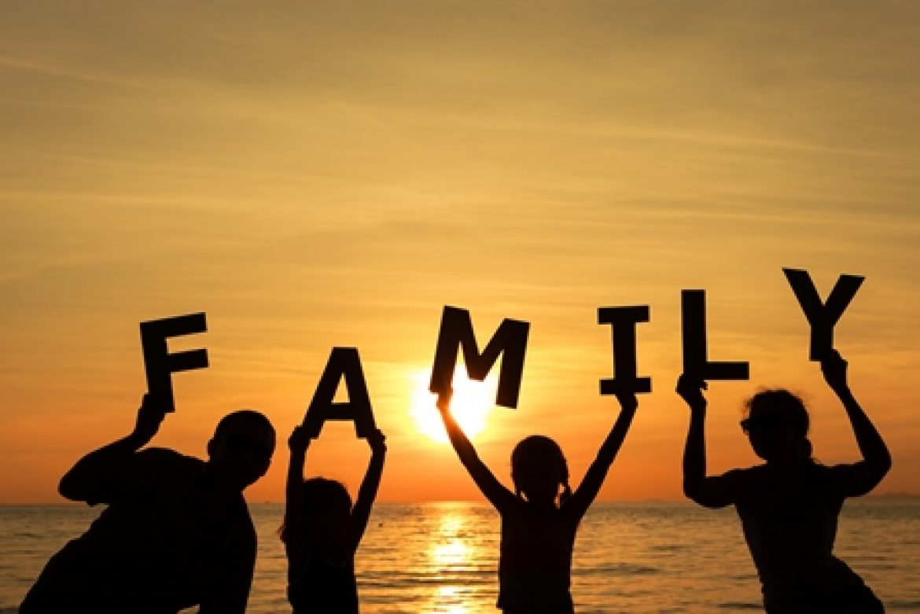
Sociology in family
Family teaches us how to behave
Family teach us how to care for ourselves, look after ourselves
Family contributes to value, norms and beliefs,
Family gives us the sense of belonging
Gives us our identity, social roles, traditions and cultures
Sociology provides structure in my family because our elders have big expectations

Slide 4
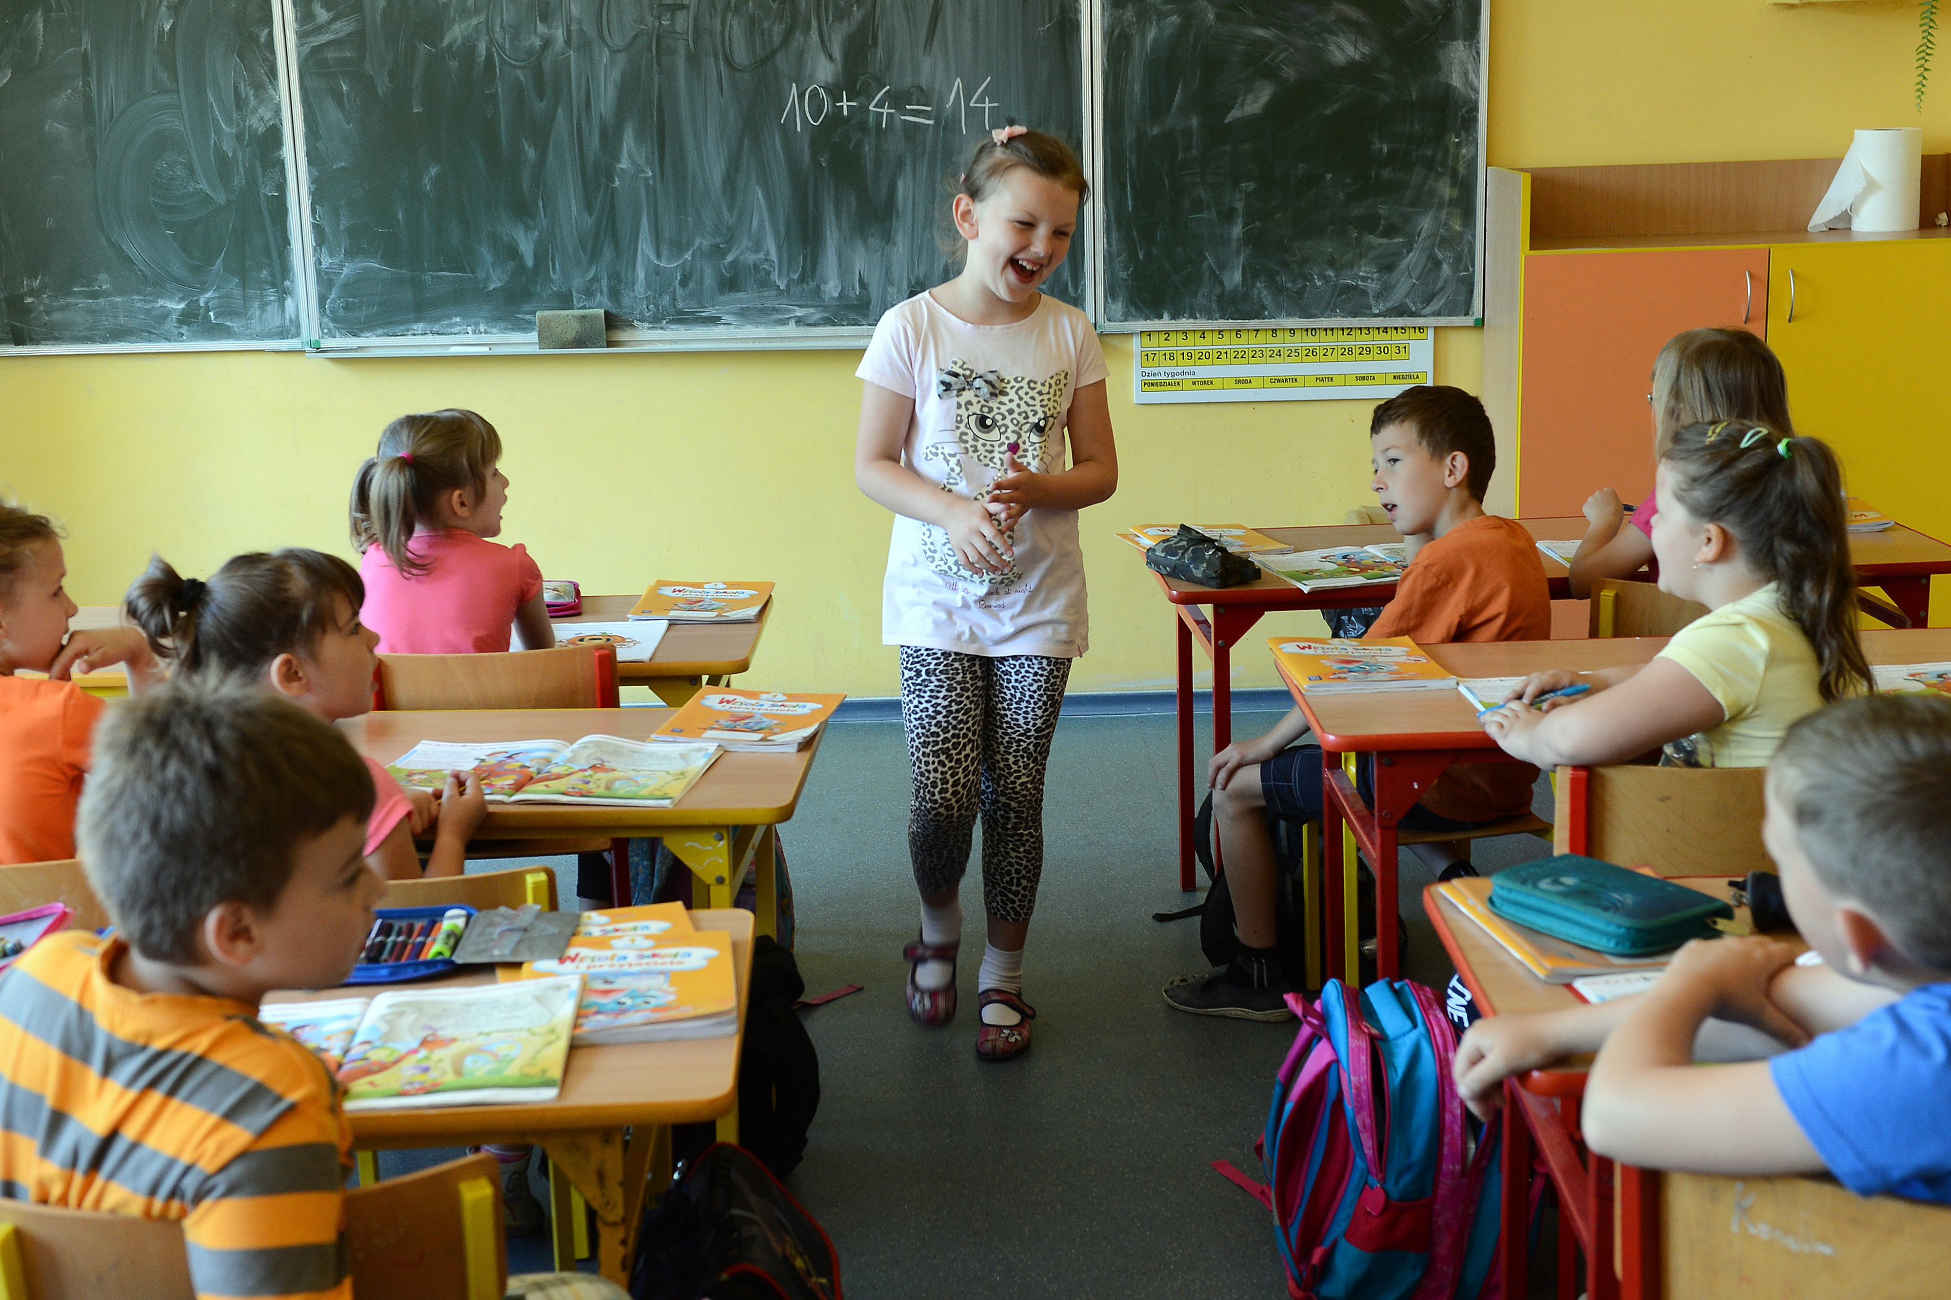
Sociology in school
School helps us develop in personal relationships
We react with teachers and students
School provides structure because we come to learn and pass grades
School provides culture because there are many different types of students with many different types of backgrounds
We have different ethic backgrounds
Schools have different races and social economic classes

Slide 5

Sociology in the media
Social media is powerful because people aren’t living up to the social media “standards”
The media provides different political groups and news
Different ethnic backgrounds
People believe in different things like Christianity
Various types of support like BLm
Influences the people negativity like violence and bullying
Influences people positively like having a voice, networking
This Photo by Unknown Author is licensed under CC BY

Slide 6
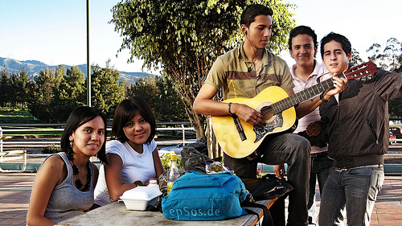
Sociology in peer groups
We all fall into certain groups based off of our personality
Peer groups are in influence because when you have your peers motivating you and doing the exact as you it’ll provide structure
Explain what methods of socialization and social control have affected your organization. (Include political and legal aspects)
Some people fit in together because they have the same beliefs
Dress the same, grew together, might be family
We fall into the same peer group because of some hobbies and activities we participate in
This Photo by Unknown Author is licensed under CC BY-NC-ND

Slide 7

Sociology in workspace
Social relations
Provides structure in how to act with customers, co workers and managers
Brings experience
There are different positions like managers, crew members, staff
There are different salaries for women and men
Build character, networking
Different positions and task

Slide 8
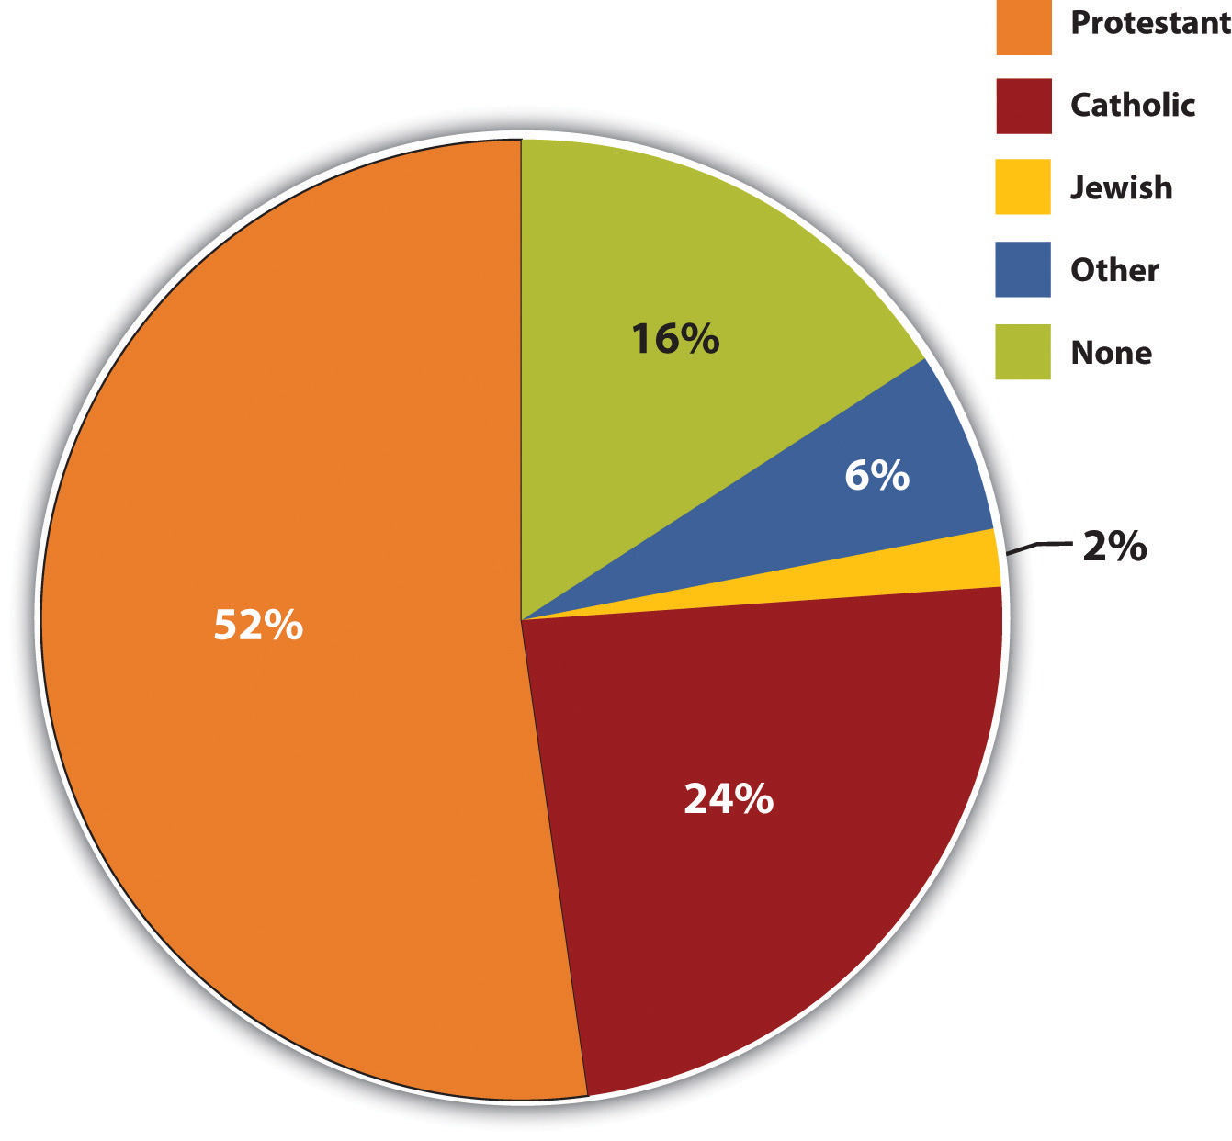
Sociology in relgion
Religion shapes people think a certain way
Religion contributes to structure because you have to behave a certain way
Religion contributes to viewing the world differently
Bring peoples with the same thoughts together
Religion puts people with the same thinking together
Religion effects people in all social classes, there are many types of religion

Slide 9
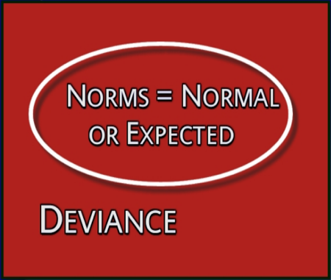
deviance
It plays a part in who we actually want to be and how people perceive us
It breaks you down into groups just like yourself
It plays a part in being accepted
Contributes to social and sexual behavior
Violation of social rules
Being rebellious

Slide 10
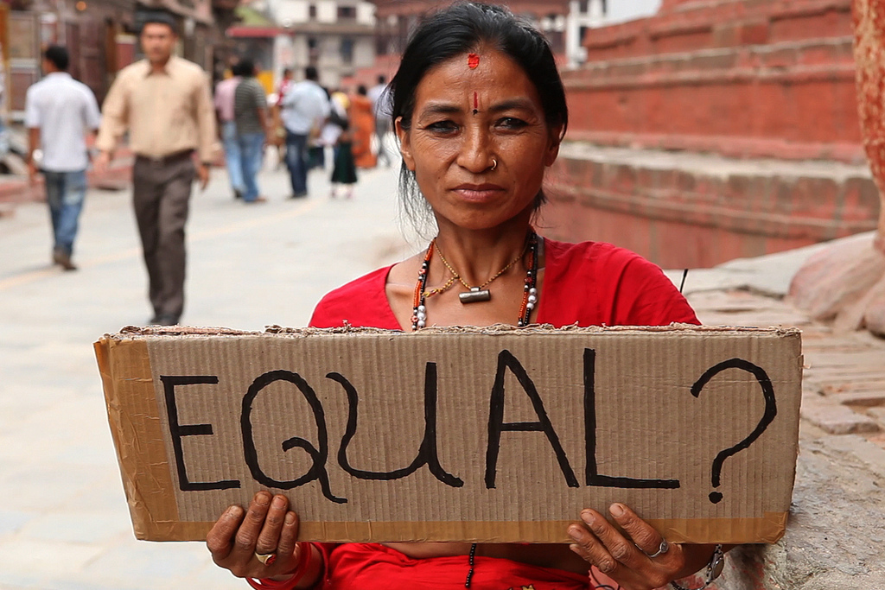
Social inequalities
Race
Gender
Sexual orientation
Religion
Culture
Social economic status

Slide 11

Wrap up
You should not judge a book by its cover
Be nice to everyone
Respect everyone
Be open minded
Be patient and calm
be willing to learn

