Slide 1



MCCG136 ICD Diagnostic Coding
Inpatient vs. Outpatient Training PowerPoint
Adrain Rouse
6/3/2021

Slide 2
Coding Steps:
Locate the main term in the ABC index
Scan the main term entry for any instructional notations
In the diagnostic phrase being coded, identify any terms that modify the main term
Follow any cross-reference notes
Always verify the code in the tabular list
Follow any instructional terms
Select the code

Slide 3

Documentation Differences in Coding:
Outpatient
Inpatient
Patient who is being treated but not admitted under the care of the hospital for an extended stay and released within 24 hours
The (OPPS) Outpatient Prospective Payment System is a prospect payment system that provides reimbursement for hospital outpatient services.
Patient who is admitted to a hospital upon the orders of the physician who then admits the patient for an extended stay.
The (IPPS) Inpatient Prospective payment System is the reimbursement methodology to provide reimbursement for hospital inpatient services.

Slide 4
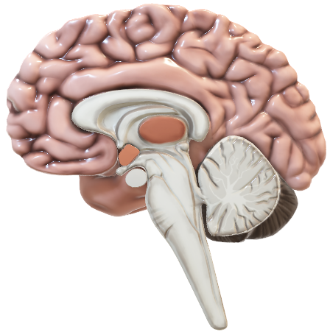
Continued:
Outpatient
Inpatients
Uses CPT or HCPCS coding system to report procedures
The diagnosis are often not established at the time of the first visit.
Detailed diagnosis report in which the patient is generally treated in one visit
The ICD-10-PCS is the inpatient procedural coding system.
The principal diagnosis is the key in determining the resources required by a patient.
Used to report a patients diagnosis and services based on patients extended stay

Slide 5


Coding guidelines: Inpatient
Use of Both Alphabetic Index and Tabular List
Use both the Alphabetic Index and the Tabular List when locating and assigning a code. ...
Locate each term in the Alphabetic Index and verify the code selected in the Tabular List. ...
Level of Specificity in Coding
Always assign all the five-digit ICD codes if they are available and use four and three- digit codes only when no other information is available.

Slide 6

Coding guideline: Outpatient
In the outpatient setting, the term first-listed diagnosis is used for principal diagnosis. ...
The appropriate code (s) from A00.0 through T88.9, Z00-Z99 must be used to identify diagnoses, symptoms, conditions, problems, complaints, or other reason (s) for ...
For accurate reporting of ICD-10-CM diagnosis codes, the documentation should describe the patient’s condition, using terminology which includes specific diagnoses as well as symptoms
Codes that describe symptoms and signs, as opposed to diagnoses, are acceptable for reporting purposes when a diagnosis has not been established (confirmed) by a healthcare provider.
ICD-10-CM provides codes to deal with encounters for circumstances other than a disease or injury.

Slide 7

Coding guidelines: Uncertain Diagnosis
Outpatient:
Inpatient
outpatient coding of uncertain disease do not need coding
Coder should not attempt to add a code based on how their judgement
Coder may code up to the absolute degree of certainty
admissions to short term, long-term, acute care, and psychiatric hospitals, uncertain diagnoses at the time of discharge should be coded as if they existed.
Do not include abnormal findings unless the physician identifies clinical significance of the symptoms

Slide 8

Coding Guidelines: Complications
Outpatient
Inpatient
If patient is admitted to the hospital cause of complication during or after outpatient surgery or other outpatient procedures, complication should be listed as the principle, diagnosis for inpatient admission
If inpatient admission after surgery, no complication the first-listed reason for outpatient surgery should be listed
If reason or admission is not related to the first-listed reason for surgery, the unrelated condition should be listed as the primary diagnosis in a, inpatient setting
If patient has to stay in the hospital longer due to complication, complication should be listed as principle, diagnosis
If complications lack specify to a diagnosis, additional code maybe assigned

Slide 9

Coding guideline: Sign & Symptoms
Inpatient
Outpatient
If sign and symptoms are a given part of a primary diagnosis, they should NOT be coded
Additional signs and symptoms may be coded if no definitive diagnosis is not included
Lacks definitive diagnosis
Signs & symptoms acceptable for coding
Coders should check for any new results and information from the provider before entering the code for sign and symptoms

Slide 10

Resources:
https://www.m-scribe.com/blog/inpatient-coding-vs-outpatient-coding-medical-coding-explained
https://www.differencebetween.net
https://www.pdnseek.com/general

