Slide 1

Stop The Attack
Recovery and prevention
Elizabeth Knox June 5, 2021
Notes:
Name/ stop and prevent cyber attack on PII

Slide 2
OVERLOOK
According to the department of defense (dod), a breach of personal information IS defined as, “the act of accessing or disclosing information to unauthorizing individuals or compromising in a way where the subjects of the information are negatively affected” (DOD privacy program, 2014).
Notes:
Define breach of personal information as given by the Department of Defense

Slide 3
ASSESS THE SITUATION
WHAT HAPPENED
WHY DID IT HAPPEN
WHAT CAN WE DO
Hackers got into software
Hacked clients / investors PII
Company had no cyber security
Did not want to pay the $1,000,000
Pay what we must for protection
Try to retrieve all information stolen
Notes:
Explain the issue, make them understand why it happened then let them know what we can do to make it right

Slide 4


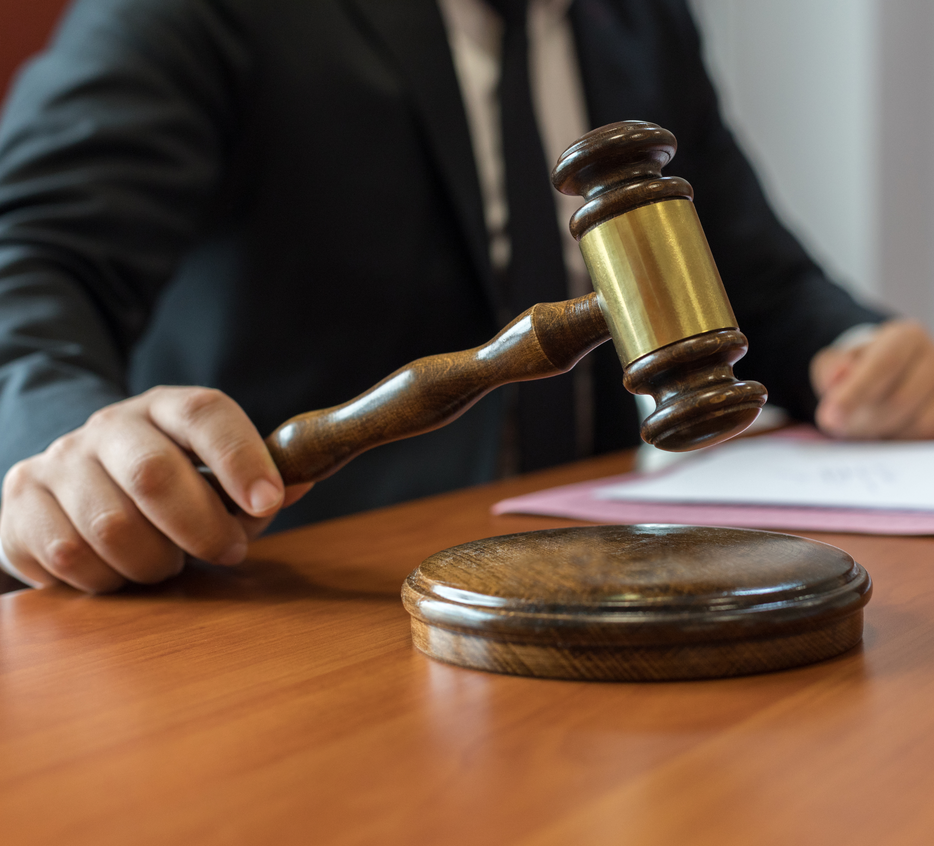
POSSIBILITY OF LAWSUITS
Failed to protect clients/investors
Tort liability (negligence)
Possible misrepresentation
We refused cyber security protection
Knew risks of refusal
Notes:
Explain how this can affect their company and let them know the different ways legal action can be taken, and why this could happen

Slide 5

POSSIBLE STATUTORY LIABILITIES
NEW YORK
Must disclose breach of the data
Must notify Division of Consumer Protection
Must notify NYS Attorney General
Must notify NYS Division of State Police
Notes:
New York requires protection for PII and if beached those affected must be notified as well as CP, AG and State of Police

Slide 6
New York SHIELD (Stop Hacks and Improve Electronic Data) ACT
"This regulation helps guarantee the financial services industry upholds its obligation to protect consumers and ensure that its systems are sufficiently constructed to prevent cyber attacks to the fullest extent possible.“ (Gov. Como, Feb.16, 2017)

Slide 7

POSSIBLE STATUTORY LIABILITIES
CALIFORNIA
Requires businesses to safeguard PII information
Must take reasonable steps to dispose of customer records
Provide written notice of breach of security
Notes:
California laws require protection for clients/investors PII and businesses must protect it and when breached the business must inform client/investor

Slide 8
HOW TO LESSEN THE BLOW
Contact every client / investor individually
ASSURE them we are to be trusted
Notes:
Let them know we can fix this and how we can, and it is imperative that we show them we can be trusted

Slide 9
A brighter future
Admit we were wrong
Offer customers/investors affected guarantee of security going forward
Always put clients/investors first
Purchase security protection
Have extra security in the form of your own team
Notes:
Know we were wrong and admit it, offer security and know clients are the reason we are in business. Always have a back up security plan.

Slide 10
REFERENCES
Eisenhofer, Jay W.; Barry, Michael J. (Nov/Dec2005). Giving Substance to the Right to Vote: The Need for a Majority Vote Standard. Corporate Governance Advisor., Vol. 13 Issue 6, p20-27.
Peter Kontes.(2010). The CEO, Strategy, and Shareholder Value : Making the Choices That Maximize Company Performance. eBook. Wiley Corporate F & A. Hoboken, N.J.
Poyraz, Omer Ilker; Bouazzaoui, Sarah; Keskin, Omer; McShane, Michael; Pinto, C. Ariel. (2020) Cyber-assets at Risk (CAR): The Cost of Personally Identifiable Information Data Breaches. Proceedings of the International Conference on Cyber Warfare & Security, P402-410.

