Slide 1
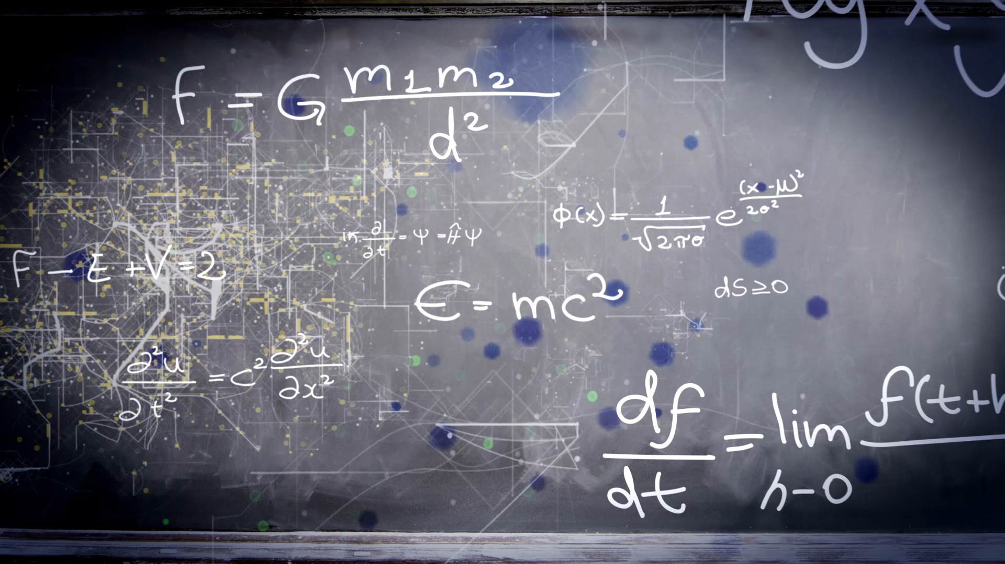

Portfolio Project – College Mathematics
Hope Custer
Notes:
Hello Everyone! – My name is Hope Custer & this is my student loan project for this session.

Slide 2
Introduction
This project is designed to help us start our mindset on how we will repay our student loans once we have graduated from our program.
Notes:
Student loans always seem to give everyone a fright when they think about it, it’s a high stress topic. This project was intended for us to really see what goes into paying back our student loans.

Slide 3

Hypothesis
Will I be able to pay my student loan payments every month?
Notes:
My hypothesis for this project; will I be able to pay back my student loans every month? It’s very important that we prepare for our student loans now, instead of later down the road.

Slide 4
Expected Salary After Graduation
Job: Healthcare Administration
State: New York
Sources:
https://www.glassdoor.com/Salaries/new-york-city-healthcare-administration-salary-SRCH_IL.0,13_IM615_KO14,39.htm
  Estimated Starting Salary - $24/hour
https://www.salary.com/research/salary/posting/hospital-administrator-salary/rochester-ny
  Estimated Starting Salary – about $26/hour
Notes:
After going through a few different websites, I wanted to chose a starting job from around me (which is the one located in Rochester) as well as New York City.

Slide 5
Budget based on your estimated salary
My Monthly bills include
Phone: $274
Car payment: $311
Truck payment: $400
Car/truck insurance: $121
Netflix: $17
Cable: $250
Internet: 150
Food: $300
Rent: $1,000
Student loan (to be added later)
Gas: $150
Total Expense: 2,973
Disposable income: 3,027
Expected Annual Salary - $74,000
Expected Monthly Salary - $6,000
Net pay at 25% tax rate – 6,000 – 664 = 5,336 Monthly take home after taxes
Notes:
Based on my expected monthly salary of a little over 5,000 after taxes are taken out, my total amount of bills can be seen above leaving me with a little under 3,000 each month to add to my savings.

Slide 6
Estimate the total amount of your student loans at graduation
I only have 1 student loan total they are as followed
1,816.01 – 0% interest
2,304.24 – 0% Interest
$2791.78 – 0% Interest
$1981.96 – 0% Interest
$3,500 – 0% Interest
$3,500 – 0% Interest
$2,123.21 – 0% Interest
$4,452.00 – 0% Interest
$2,068.66 – 0% Interest
$7,700 – 0% Interest
Total Principal: $31,704.55
Accrued Interest: 1,033.31
Total Balance at the end of 2021: $32,737.86
Notes:
After graduation at the end of 2021, this will leave my student loan balance at 32,737.86.

Slide 7
Minimum Monthly Payments
Before hand I did check on my loan service website, my loans have 0% interest until I graduate, after it is 6%, so I used 6% for my annual interest rate here.
Loan Amount = $32,737.86
Annual Interest Rate = 6%
Loan period in years = 10 years
Number of payments per year = 12
Start date loan = 5/26/2021
Optional Extra Payments = 100$
Scheduled payment = $363.46
Scheduled number of payments = 120
Actual number of payments =88
Total early payments = $8,700
Total interest = $7,749.46
Notes:
If we set out my loan payment to be paid within 10 years, this will leave me with a 363.46 monthly payment for about 120 months.

Slide 8
Total Cost (Future Value) / Amount of Interest Paid
First, the amount of interest I will have paid through my 10-year payment plan would be = $ 7,749.46
In order to calculate the future value of this loan, I take my original loan amount of $32,737.86 and add the amount of interest through the 10 years
Total amount for future value is = $40,487.32
Notes:
As we saw on the last slide, with my 10-year payment, I would pay a total of interest of 7,749.49. In order to calculate the future of my loan, I simply take the total amount of interest, and add it onto my loan. In the end it will total 40,487.32

Slide 9
Ways that might reduce the amount of interest I pay – Changed 9,7,6 years
ENTER VALUES |  |  |  | LOAN SUMMARY
Loan amount |  | $32,737.86 |  | Scheduled payment |  | $393.04
Annual interest rate |  | 6.00% |  | Scheduled number of payments |  | 108
Loan period in years |  | 9 |  | Actual number of payments |  | 82
Number of payments per year |  | 12 |  | Total early payments |  | $8,045.90
Start date of loan |  | 5/26/2021 |  | Total interest |  | $7,146.69
Optional extra payments |  | $100.00 |  | LENDER NAME | Greatlakes Loan Service
ENTER VALUES |  |  |  | LOAN SUMMARY
Loan amount |  | $32,737.86 |  | Scheduled payment |  | $478.25
Annual interest rate |  | 6.00% |  | Scheduled number of payments |  | 84
Loan period in years |  | 7 |  | Actual number of payments |  | 67
Number of payments per year |  | 12 |  | Total early payments |  | $6,600.00
Start date of loan |  | 5/26/2021 |  | Total interest |  | $5,845.34
Optional extra payments |  | $100.00 |  | LENDER NAME | Greatlakes Loan Service
ENTER VALUES |  |  |  | LOAN SUMMARY
Loan amount |  | $32,737.86 |  | Scheduled payment |  | $542.56
Annual interest rate |  | 6.00% |  | Scheduled number of payments |  | 72
Loan period in years |  | 6 |  | Actual number of payments |  | 60
Number of payments per year |  | 12 |  | Total early payments |  | $5,866.64
Start date of loan |  | 5/26/2021 |  | Total interest |  | $5,142.93
Optional extra payments |  | $100.00 |  | LENDER NAME | Greatlakes Loan Service
Notes:
As we see above, I changed the number of years I would be paying back this loan. Originally, I have it set up for a 10-year payback method. Here I changed it from 9 years, to 7, and finally to 6. If you look, yes, my monthly payments increase but in the end, I will be paying a lot less in interest.

Slide 10
What would be the optimal monthly payment?
The loan I have chosen would be; the 7-year loan.
  After going through what I would receive monthly, after going through a detailed list of monthly bills as well, the 7 year pay back for the loan fits the best.
  With choosing the 7-year loan I save almost $700 in the end from paying interest on my loans.
  With choosing the 7-year loan, it is a comfortable time frame (I always can choose to change it if it becomes too much, or if I want to start paying more each month.)
  If we go back to slide 1, my hypothesis is “would I be able to pay my student loans each month” – I believe with the loan I have chosen, and what I bring in monthly, I will be able to pay my student loans every month.
Notes:
What would my optimal monthly payment be? I know that thinking of spending more money each month on a loan is scary, but in the end you save more money on interest. I chose a 7 year loan payback, for this project. At the end I save almost $700, If we go back to my hypothesis where I was wondering if I would be able to pay back my loan every month. I believe with this payback method I will be able to pay it back on time each month.

Slide 11
Thank you for watching, I hope you enjoyed my Student Loan Presentation!
Notes:
Thank you everyone, I hope you enjoyed my student loan presentation, stay safe and take care!

