Slide 1


Social Structures and Interactions
By: Shelby Patterson

Slide 2

Introduction
Socialization is strongly associated with inclusion; as a result, to feel included in a community, one must believe in, organize, and practice the culture of the society in which they find themselves.
In this PowerPoint, we will talk about how socialization can affect our organization in different aspects and how it plays a factor in our personal and professional lives.

Slide 3

How does family affect your organization?
Family can be considered the basic socialization unit. It greatly influences one's organization since it nurtures one from birth. Those living together share social and cultural practices and often get aligned to a particular political position.

Slide 4

How does school affect our organization?
School brings together different people from different places for learning. With different interactions from different people. In schools, people learn new forms of organization and political ideologies, which has a significant influence on a person.

Slide 5

How does media affect our organization?
The media is mass communication means. Through media, socialization is achieved through communication of various information, including organization politics and legal information that would impact a person.

Slide 6

How do our peer groups affect our organization?
Peer groups are normally people of the same age range. In most instances tend to interact with one another. This will lead to them sharing different beliefs, cultural practices, and habits that would influence their organization's political ideology.

Slide 7
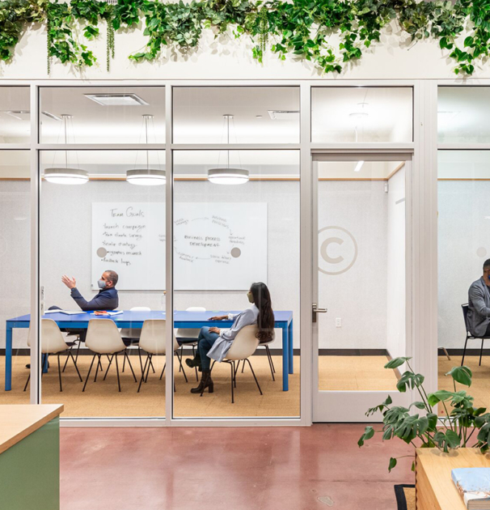
How does the workplace affect our organization?
The workplace is another place where people from different backgrounds come together to work. Socialization in the workplace is inevitable and usually encouraged, leading to people mostly sharing different ideologies and perceptions, which would legally influence their organization's initial view.

Slide 8
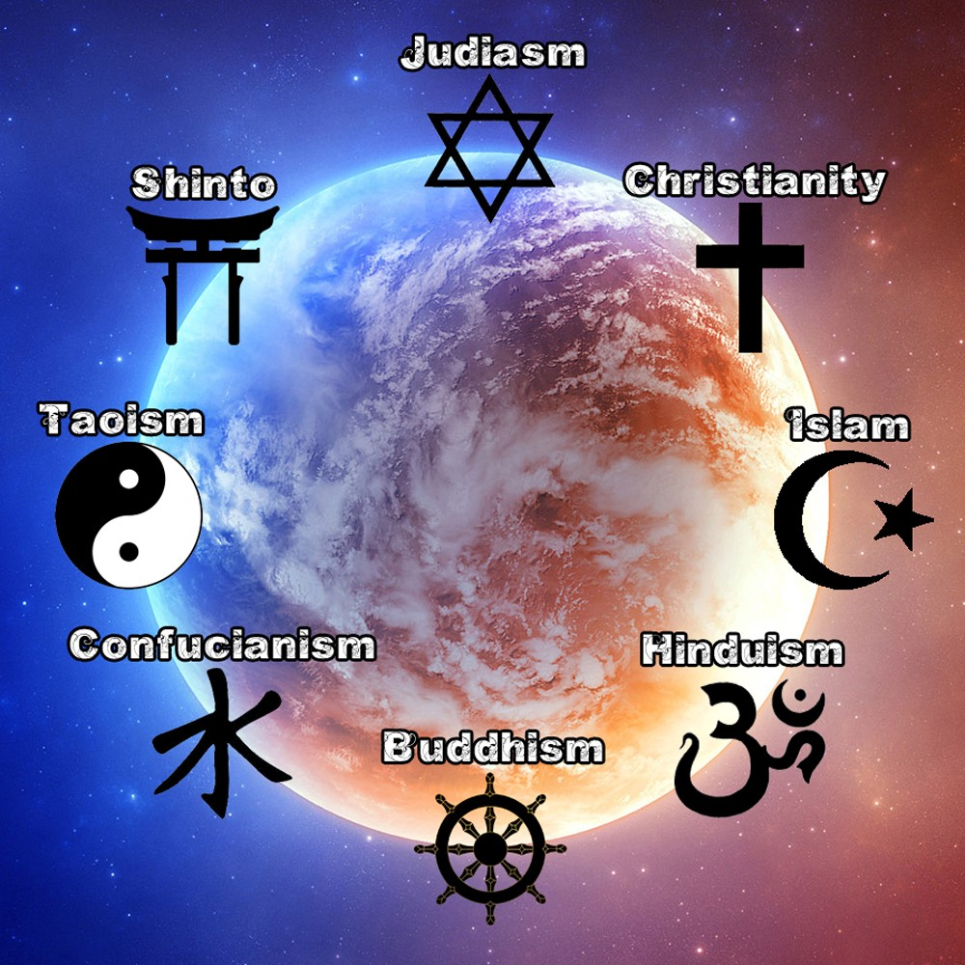
How does religion affect our organization?
Religion is a movement of a group of people with a particular belief. Religion is one of the most influential movements on people as people tend to organize themselves, practice culture, and have political perspectives that are only supported by their religion.

Slide 9
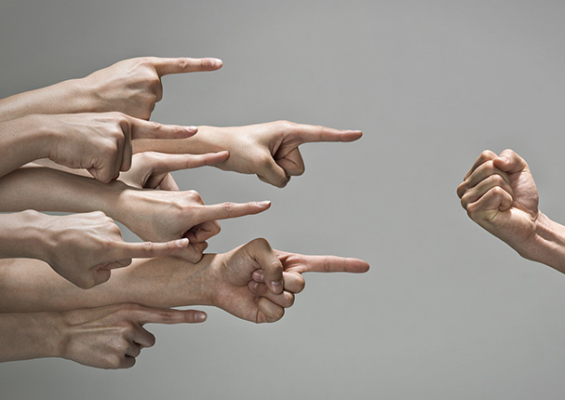
How does deviance play a part in our personal/professional lives?
Deviance is when one rejects or violates the social norms that have been placed or are required to be followed. Deviance plays a major role in personal life as it helps a person stand up against measures that can be considered discriminative or unfair.

Slide 10
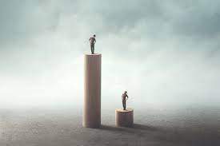
What social factors contribute to the current social inequalities? How can we create social change within our own company/community?
Social factors contributing to current social inequalities include educational attainment and power occupations. There are various ways to create social change within the business and company. People can decide to work towards a common cause. Businesses should implement and promote ethical practices by collaborating with non-profit organizations to help community development.

Slide 11

Conclusion
Socialization can greatly affect several factors in one's personal life, including their organization's political ideology and legal.

Slide 12

References
Boundless. (n.d.). Boundless sociology. Lumen. Retrieved April 2, 2022, from https://courses.lumenlearning.com/boundless-sociology/chapter/agents-of-socialization/
Griffiths, H., Keirns, N., Strayer, E., Sadler, T., Cody-Rydzewski, S., Scaramuzzo, G., Vyain, S., Bry, J., & Jones, F. (2012, February 1). Agents of Socialization. Introduction to Sociology 2e. Retrieved April 2, 2022, from https://opentextbc.ca/introsociology2eopenstax/chapter/agents-of-socialization/
Take online courses. earn college credit. Research Schools, Degrees & Careers. Study.com | Take Online Courses. Earn College Credit. Research Schools, Degrees & Careers. (n.d.). Retrieved April 2, 2022, from https://study.com/academy/lesson/agents-of-socialization-family-schools-peers-and-media.html

