Slide 1

Security Administration
Tisani Anderson
Security Administration CRJU225
William Verna
October 18th, 2022
This Photo by Unknown Author is licensed under CC BY-ND

Slide 2


What will I be learning?
In this PowerPoint you will be learning about a variety of different things such as:
Data breaches
Two real life examples of data breaches
How to handle data breach situations
Cashapp data breach
Red cress data breach

Slide 3
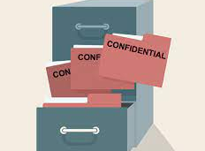

What is a data breach?
A data breach is an incident where information is stolen or taken from a system without the knowledge or authorization of the system’s owner.
A small company or large organization may suffer a data breach.
Stolen data may involve sensitive, proprietary, or confidential information such as credit card numbers, customer data, trade secrets, or matters of national security.

Slide 4

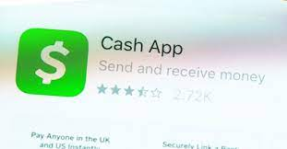
Cashapp data breach vs ABC Bank
Cash App allows individuals to quickly receive and send money from their mobile devices. In addition to mobile banking, Cash App also offers the option to purchase stock and Bitcoin through its platform. Cash also allows individuals to file taxes.
In April 2022, Cashapp experienced a data breach where a former employee had breached its servers.
During the hack, the hackers had access to customer names, stock trading information, account numbers and other sensitive financial information.
The cashapp data breach is similar r to the ABC Bank situation because , in both situations hackers had access to customer personal information like addresses, social security numbers and bank account numbers.
Although the cashapp and ABC Bank situation were similar, there are differences as well. When the cashapp data breach happened, cashapp reached out to all effected customers and informed them on what happened. On the other hand, when the data breach happened at ABC Bank customers were not informed.

Slide 5


Red cross data breach vs ABC Bank
The Red Cross brings assistance to wounded individuals without discrimination to the wounded on the battlefield, to prevent and alleviate human suffering wherever it may be found. Its purpose is to protect life and health and to ensure respect for the human being.
The January 2022, hackers carried out an attack on red cross servers , gaining access to personal information of more than 500,00 people receiving service from the red cross and red crescent movement.
This is similar to ABC Bank because, The company is not aware of who committed the data breach, this is also similar because hackers gained access to important personal information.

Slide 6

Recovering from a data breach
In order to prevent data breaches from happening there is many step companies like cashapp, red cross and ABC Bank can take, such as
Monitoring network access- the more corporate network traffic is monitored the higher the chances of identifying suspicious activity is.
Securing and identifying all sensitive data- companies like the ones we spoke about today need to correctly classify sensitive data and apply strict security policies in order to access.

Slide 7

Recommendation for ABC Bank
My recommendation for ABC Bank would be to add more security measures to their system in order to really protect their customers. Things like two step verifications for employees and more employees monitoring, catching any suspicious activity.

Slide 8

Reference
https://www.upguard.com/blog/prevent-data-breaches
https://ermprotect.com/blog/top-10-data-breaches-so-far-in-2022/
https://www.trendmicro.com/vinfo/us/security/definition/data-breach
https://www.forbes.com/advisor/money-transfer/what-is-cash-app/

