Slide 1



Quantitative Reasoning Presentation
Juliette DeLaVergne-Nichols
Bryant and Stratton College; College Mathematics

Slide 2


Introduction
This quantitative reasoning project is designed to help start thinking about how to pay back my student loans once I have graduated.

Slide 3

Hypothesis
According to my budget, it will take me approximately 30 years to pay off my student loans, which is longer than the standard 10-year repayment plan.

Slide 4
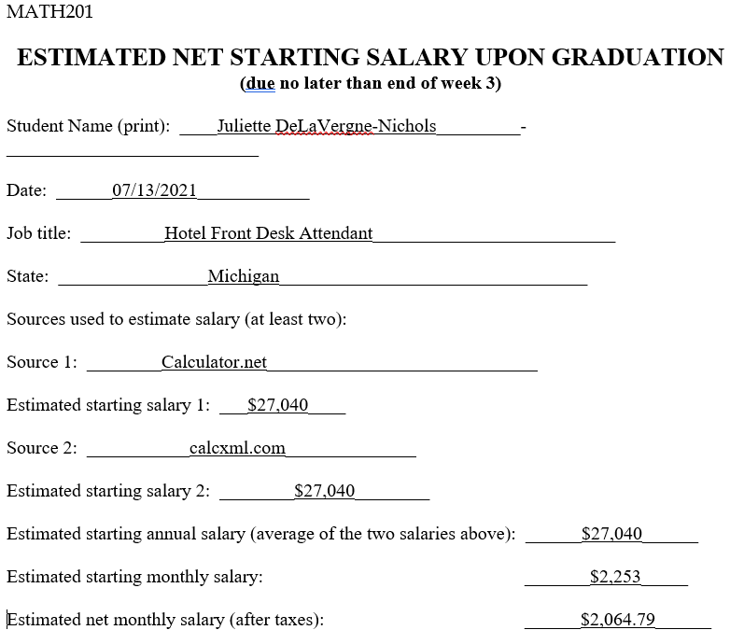
Expected Annual and Monthly Salary
According to two different sources, my annual salary would estimate to approximately $27,040.
According to the second source, my estimated monthly salary before taxes would be $2,253 and after taxes, it would be $2,064.79.
Starting Net Salary

Slide 5
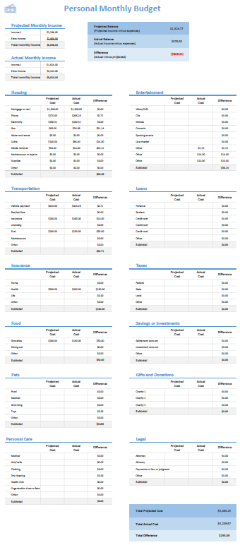
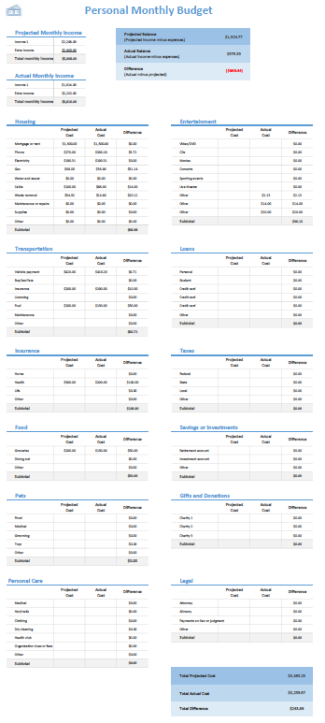
Monthly Budgets
After making two Excel budget spreadsheets, these are the monthly conclusions made before and after my monthly student loan payment is added.
Before my student loan payment calculates:
Total monthly income: $3,816
Total monthly cost: $3,239.67
Total ending balance: $576.33
After my student loan payment calculates:
Total monthly income: $3,816
Total monthly cost: $3,313.15
Total ending balance: $502.85
Monthly Budget Without Student Loans
Monthly Budget With Student Loans

Slide 6
Student Loan Estimate
Student loan cost ≈ $18,000 APR= 2.75% or 0.0275 30-year payments
360 Months total.
$73.48 = Monthly payment
$26,452.80 = Estimated Student Loan Cost After Interest.
68.05% Paid Toward Principal
31.95% Paid Toward Interest
To clarify, the beginning student loan cost is $18,000 with an annual percentage rate (APR) of 2.75% over a 30-year time frame. The total monthly cost is $73.48, the estimated student loan cost over 30 years is $26,452.80 with a total interest rate of 31.95% and 68.05% paid towards the principal.

Slide 7
10 Year Student Loan Monthly Payment
Loan Amount: $18,000 2.75% APR 10-Year payments
120 Months total
$171.73 - Total monthly cost

Slide 8
10 Year Student Loan Estimate
Loan Amount - $18,000 2.75% APR 10-Year Payments $171.73-Monthly
$20,607.60 – Total Estimated Cost
87.35% - Paid toward principal
12.65% - Paid towards interest
$2,607.60 – Amount of interest

Slide 9
Student Loan Payment Examples
$18,000 Student Loan | 2.75% APR | 7 Years
Monthly Cost: | $235.82
Future Value: | $19,808.88
Total Interest: | $1,808.88
$18,000 Student Loan | 2.75% APR | 5 Years
Monthly Cost: | $321.44
Future Value: | $19,286.40
Total Interest: | $1,286.40
$18,000 Student Loan | 2.75% APR | 3 Years
Monthly Cost: | $521.48
Future Value: | $18,773.28
Total Interest: | $773.28

Slide 10
Conclusion
In conclusion, with the information that I had found and the estimated monthly costs during different periods, the monthly payment for my student loans that would best fit my budget would be $73.48 over a 30-year payment plan. This makes the cost of interest higher, however, my budget is very tight, and I would not be able to make higher payments. With what I found from the project, the conclusion of paying $73.48 over 30-years is relatable to the hypothesis in the beginning of the project.

Slide 11
References
https://www.calculator.net/salary-calculator.html
https://www.calcxml.com/calculators/convert-hourly-to-salary
https://d.docs.live.net/da777d7c31f613de/Documents/School/MATH201%20PowerPoint%20Script.docx

