Slide 1


Hospitality management portfolio project
Juliette DeLaVergne-Nichols
Fundamentals of Hospitality Management

Slide 2
Introduction
My name is Juliette DeLaVergne-Nichols, I have worked in the hotel industry for over four years, and I am currently attending Bryant and Stratton College to receive my degree in Hotel Management.
Being a great motivator
Always striving to improve
Being Decisive
Management Philosophy:

Slide 3

Management Skills
Good coaching skills
Great communication skills
Team Player
And Many more!

Slide 4

Current Trends in the Hospitality Industry
Social Media is a major trend within the hospitality industry.
Mobile check-ins and mobile pay is also a major trend within the hospitality industry.
Mobile chatting/texting hotel staff.

Slide 5

Customer Satisfaction Strategies
Seeking feedback from customers and improving based upon that feedback.
Analyze online comments and reviews to also learn what needs to be improved.
Seeking out competitors to see what helps them strive.
Maintain customer service etiquette.
Understand your customers and why they are staying there.

Slide 6


Critiquing Success
When critiquing the success of a full-service luxury hotel, always consider these factors:
The Location of the hotel
The Reviews from guests
Giving guests an innovative experience
Keeping guests safe and comfortable
Communication
Observation from staff

Slide 7

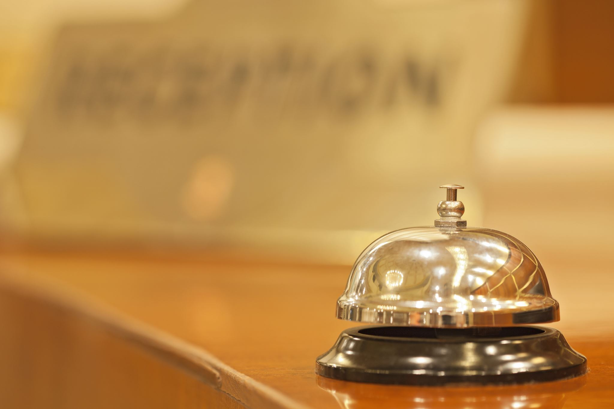
Advertising Strategies
Using the location
Using enhanced and graphic photos
Showcasing the property
Answer all questions and inquiries efficiently
Control rates, availability, and reservations
Real time updates on major platforms

Slide 8

Importance of Interactions
Interactions are always important when it comes to the guests. Whether it is from the manager or any employee, the guests expect to be noticed and communicated with any time contact is made with a member of the staff.

Slide 9
Selecting Job Applicants
Assess the Candidates, do not solely rely on resumes, interview the person to see if they are fit for the job.
Map previous work history and contact previous jobs about performance.
Consider their job skills, as well as their social, personal, communication, and other skills necessary to perform above and beyond.

Slide 10
Staff Empowerment
Identify your employees' strengths, praise their efforts, and forgive their mistakes.
Listening and having good communication with employees can always empower them to strive within the business.

Slide 11


How to Deal with Employee Conflict
Be aware of your employees triggers and what can cause a conflict with other staff.
1
Maintain a positive attitude when handling the conflict between employees.
2
Support, train, and empower all employees, so no employee feels left out or under appreciated.
3

Slide 12

Employment Training
Employment training within the hospitality industry is important because all staff need to know all aspects of the business, and how each department is run, in order for them to gain more knowledge and experience within the business and can strive throughout the time they are employed there. Training correctly and effectively can cause an employee to become more successful for themselves and the business.

Slide 13
Effective Training and Educating
Helping staff build on skills such as communication, smiling and greeting, using positive language, and more!
Use a training program that is renewed often (every six months for example) to help staff learn and grow within the business.
Putting employees in certain scenarios to help improve knowledge and skills needed to assess the situation.

Slide 14

Enhancing Employee Productivity
There are several ways to help improve employee productivity. One way that I have experience was using a point system, to gain rewards. My workplace called it “Pickle Points”, you would receive a pickle point for things such as enrolling a guest in our rewards system, a guest positively mentioning you in a review, and much more! For 9 pickle points, you would receive a $25 gift card to a place of your choosing, 15 pickle points was a $50 gift card, and so on! It has made a difference in my workplace and increases the productivity in all employees!

Slide 15

Assessing and Improving Employee Morale
Increasing Employee Morale plays a major role in the hospitality industry, as you do not want your employees or business to have an overall low morale. A few ways you can increase employee morale include showing employees a sense of ownership and to acknowledge employees’ value as team members in your organization. Showing respect, value, and appreciation towards all employees gives the employees confidence and makes them feel admired. Lastly, having an optimal work environment can create more enjoyment at work and offers the chance for both personal and professional development.

Slide 16

References:
https://www.hcareers.com/article/employer-articles/improving-workplace-morale
https://blog.sfceurope.com/how-to-train-staff-on-good-customer-service-tips-for-managers
https://www.hospitalitynet.org/opinion/4070802.html
https://harver.com/blog/hiring-hotel-staff/#Assessing
https://join.bnberry.com/?gclid=Cj0KCQjwub-HBhCyARIsAPctr7wJgMRpCrJWc1fq-RcgOrp_ghzgzAf9USPEF6gASyekQoBof-gPUXq8aAjhMEALw_wcB
https://www.socialtables.com/blog/hotel-sales/hotel-industry-success/

