Slide 1

Operations Management Responsibilities
By: Juliette De La Vergne-Nichols

Slide 2

Provides inspired leadership for the organization
Make important policy, planning, and strategy decisions.
Develop, implement, and review operational policies and procedures.
Identify and address problems and opportunities for the company.
Support worker communication with the management team.

Slide 3

Skills Required for Operations Managers.
Leadership
Strong communication skills
Good motivational skills
Exceptional organizational skills

Slide 4
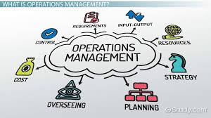
How Operations Managers Help the Company
Help promote a company culture that encourages top performance and high morale
Work with senior stakeholders
Build alliances and partnerships with other organizations
Oversee budgeting, reporting, planning, and auditing.

Slide 5

Customer service
Responsibility for producing the services of an organization
Provides the services directly to the customers
Service as a customer's experience
Service as a package of facilitating goods and services

Slide 6

Technology and Operations Management
Focuses on value creation on a global scale
Capture value through effective supply chain management
Creating value for their customers
Reduce cost, improve delivery process, standardize and improve quality and focus

Slide 7

Future Hospitality Technology
Cloud Migration
Location-based services
Service Automation through AI
Wireless Mobile Devices for staff

Slide 8

Current Hospitality Technology
Self-service meeting spaces
Technology Lounges for relaxation and work purposes
Social Listening through reviews and social media
Predictive Analytics with a company app

Slide 9
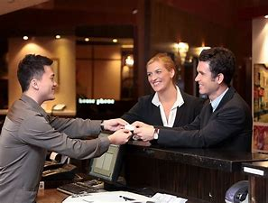
How Guests use Technology in Hotels
Wi-Fi and internet
Smart TV’s and entertainment streaming services
Online booking
Guest computer services

Slide 10
References
https://www.mitel.com/blog/top-10-communication-tech-trends-hospitality
https://www.instead.edu/faculty-research/academic-areas/technology-operations-management
https://www.betterteam.com/operations-manager-job-description

